Slide 1
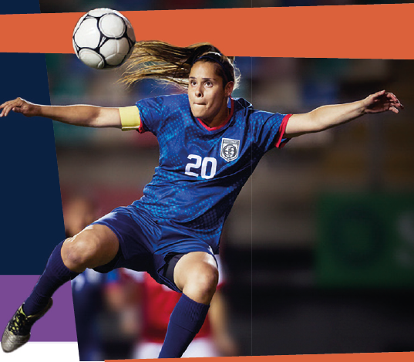
Chapter 1
LEARNING NEW SKILLS

Slide 2



p.2
In this chapter you will learn about:
Skill and Ability
Understanding the difference between skill and ability
Nature versus nurture in sport
Stages of Skill Learning
Cognitive, associative, and autonomous stages
Characteristics of each stage
Factors Influencing Skill Learning
Types of feedback
Practice types and methods

Slide 3
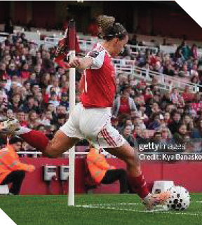
What Are Skills?
p.3
Definition: A skill is something you learn through practice. It's a movement or action that you get better at over time.
Key Points:
Skills are learned - anyone can develop them
Improve with practice and coaching
Can be lost without practice
Examples:
Striking a sliotar in hurling/camogie
Taking a free kick in soccer
Serving in tennis
Dribbling in basketball

Slide 4
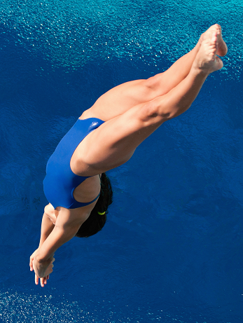
Types of Skills
p.3
1. Psychomotor Skills
Body movements done on purpose to achieve a goal
Examples: kicking a ball, striking a sliotar, diving into a pool
2. Perceptual Skills
Reading the game using your senses
Understanding what's happening and what might happen next
Examples: watching opponent's body position, reading ball flight
3. Cognitive Skills
Problem-solving and decision-making during play
"Game intelligence" or "tactical awareness"
Examples: deciding to pass rather than shoot, forcing opponent onto weaker foot

Slide 5
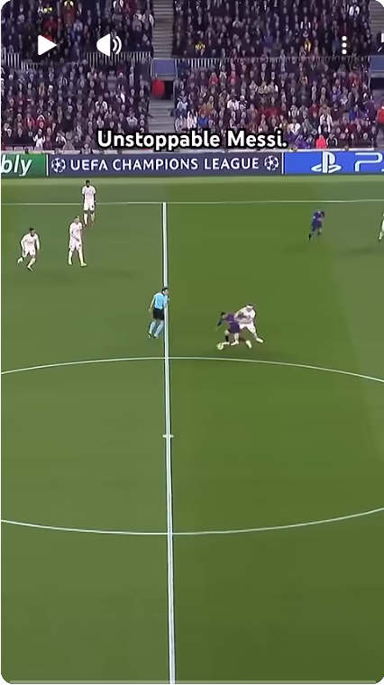

Types of Skills
Watch this video of Lionel Messi.
What types of skills do you observe?
https://www.youtube.com/shorts/2niejSI1zRU

Slide 6
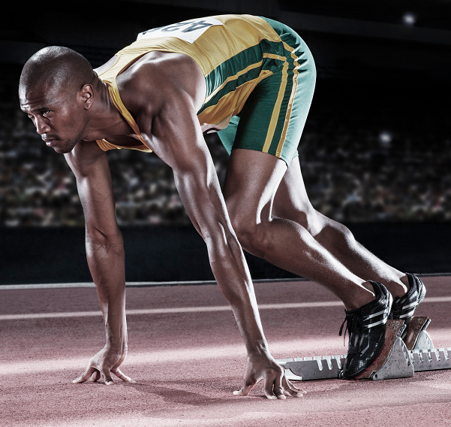
What Is Ability?
p.4
Definition: An ability is something you're born with. It's part of your genetic makeup and refers to characteristics you have from birth.
Key Points:
Abilities are genetic - you're born with them
Form the foundation for building skills
Very difficult to change
Remain relatively stable throughout life
Examples:
Height (helps in basketball, volleyball, rowing)
Natural flexibility (range of motion in joints)
Speed (fast-twitch muscle fibres)
Power (ability to produce force quickly)
Sprinters have lots of fast-twitch muscle fibres

Slide 7
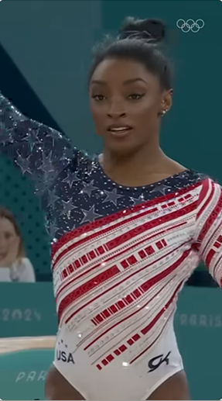
What Is Ability?
Simone Biles: Key Abilities
Small height (4’8’’) – increased rotational speed
Extreme muscular power – allowing her to achieve extreme height in tumbling and vaulting
Elite Air Awareness – capable of maintaining her orientation while performing multiple flips and twists
Hyperfocus" Under Pressure: – can enter a state of intense concentration during competition
Watch the video to observe Simone Biles’ key abilities.
https://www.youtube.com/shorts/FK6DbGzlQks

Slide 8
Skill vs Ability: Key Differences
p.5
Skill
Ability
Learned through practice
Can improve with training
Can be lost without practice
Examples: Free-taking, tackling
Born with (genetic)
Very limited improvement
Stays relatively stable
Examples: height, speed, flexibility
REMEMBER: Skills = LEARNED | Abilities = BORN WITH

Slide 9
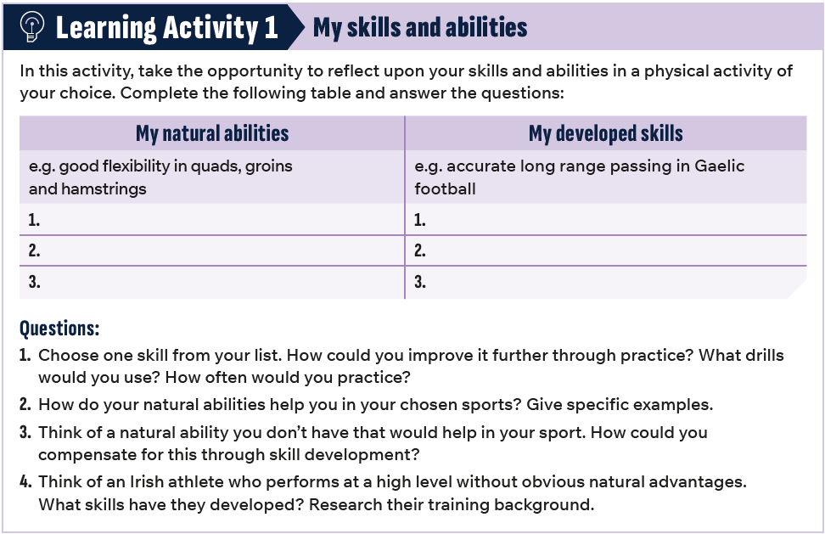
p.5

Slide 10
Nature vs Nurture
p.6
Big Question: Are athletes born or made?
Nature = Your natural abilities (what you're born with)
Nurture = Your skill development (learnt through practice and coaching)
Both matter!
Natural abilities (nature)
Thousands of hours of skill practice (nurture)
SUCCESS!
+ =

Slide 11
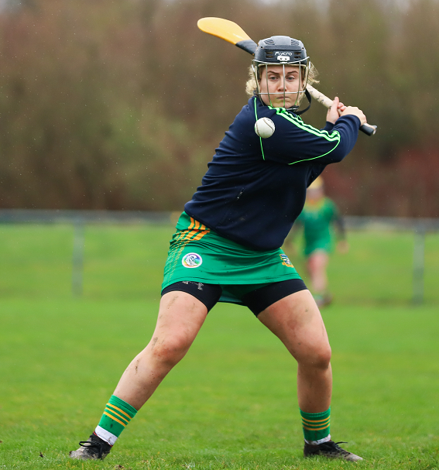
Nature vs Nurture
p.6
Big Question: Are athletes born or made?
Irish Sporting Example - Hurling and Camogie
Some players have natural hand-eye coordination and quick reactions (abilities)
But they practice striking techniques for thousands of hours (skills)
The best players combine natural coordination with technically excellent striking and tactical awareness

Slide 12
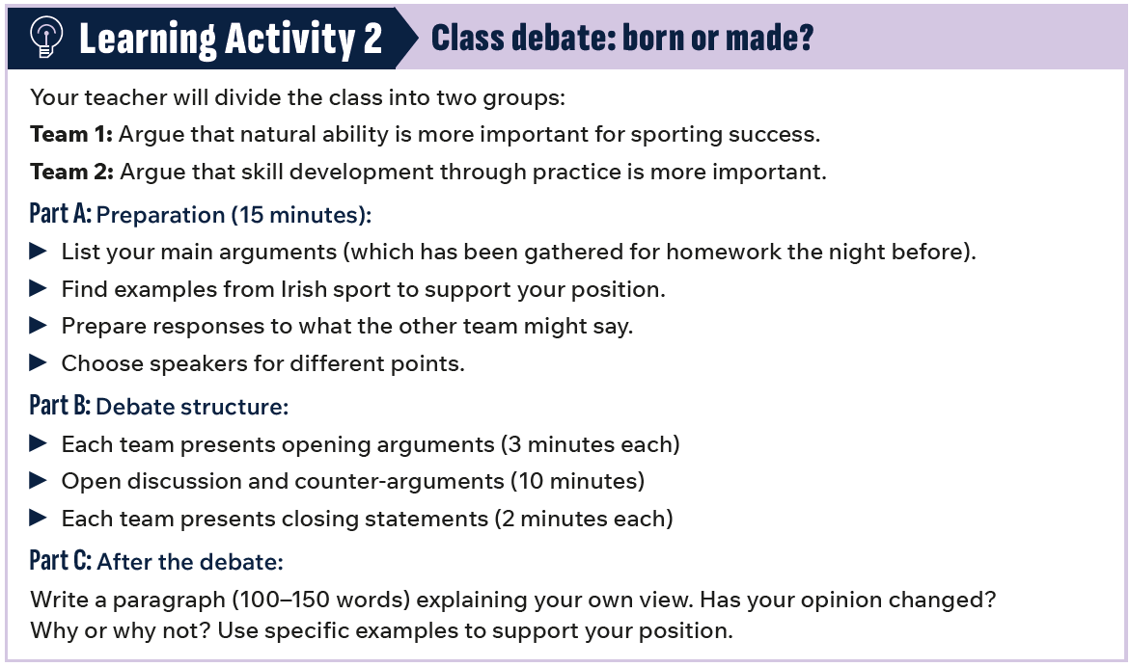
p.6

Slide 13
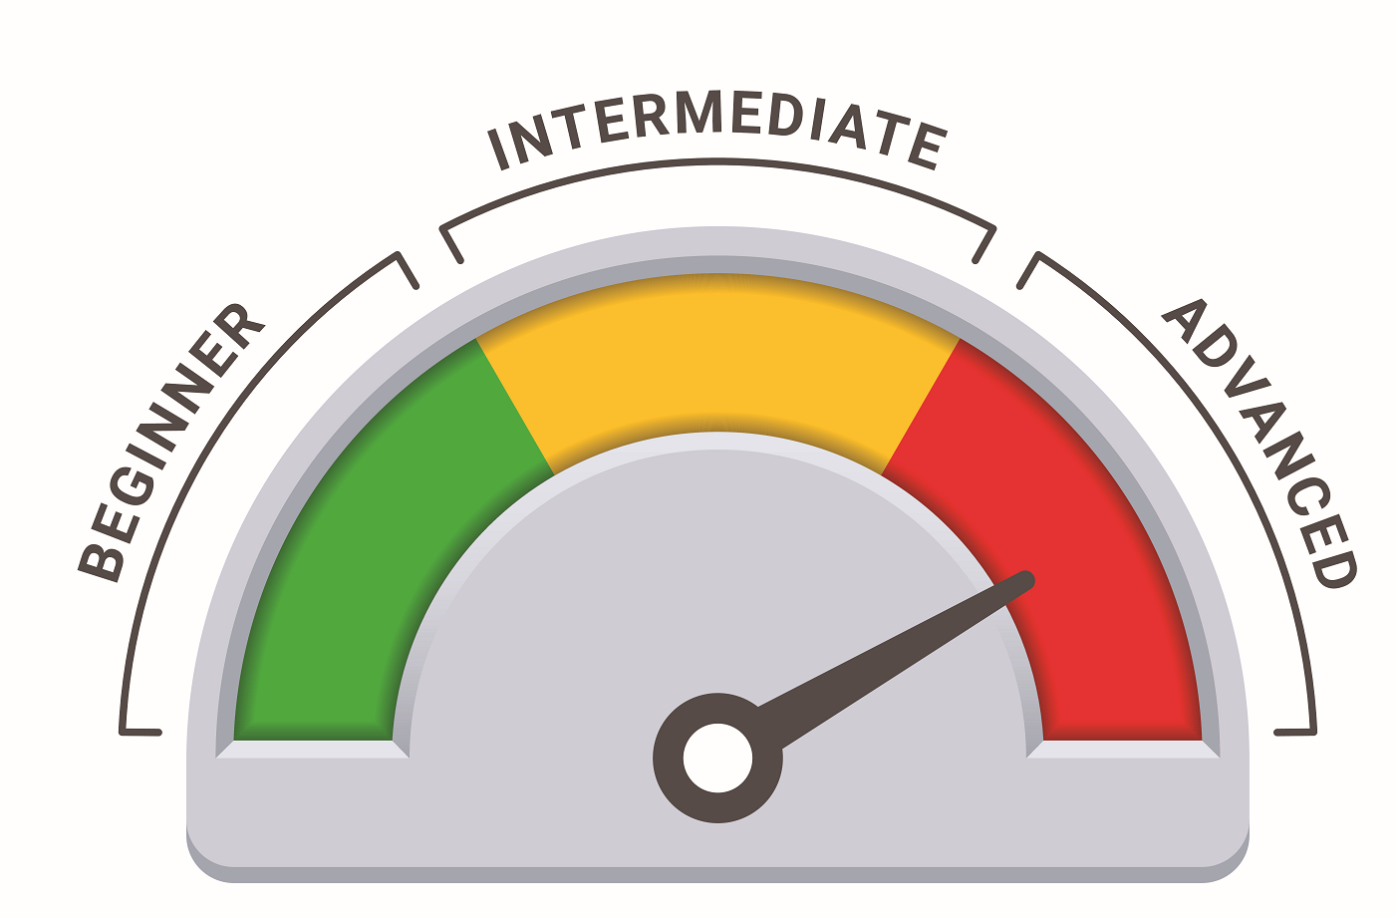
Stages of Skill Learning
p.7
Refining technique.
Becoming consistent.
Learning the skill.
Awkward stage.
Skill is automatic.
Natural, consistent.

Slide 14
Stages of Skill Learning
p.7
Fitts and Posner Model (1967)
Cognitive Stage (Beginner level)
Associative Stage (Intermediate level)
Autonomous Stage (Advanced level)
Key Point: Athletes can be at different stages for different skills.
Example: A golfer might be autonomous at putting but associative when driving

Slide 15
Stages of Skill Learning
p.8
Stage 1: The Cognitive Stage (Beginner)
Movement Characteristics
Mental Characteristics
Awkward and jerky movements
Poor coordination between body parts
Inconsistent performance
Low success rate
Slow execution
Must think about every movement
Can only focus on one thing at a time
Cannot focus on tactics
Can become frustrated easily
What beginners need:
Positive feedback and encouragement
Simple, clear instructions
Demonstrations
Short practice sessions

Slide 16
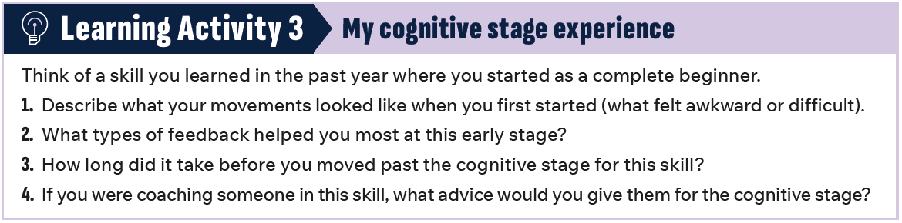
p.8

Slide 17
Stages of Skill Learning
p.9
Stage 2: The Associative Stage (Intermediate)
Movement Characteristics
Mental Characteristics
Smoother, more coordinated movements
More consistent performance
Fewer errors than beginners
Can perform at reasonable speed
Improved success rate
Don't need to think about every single movement
Developing a "feel" for the correct movement
Can start thinking about tactics
Can identify some of their own errors
Better body awareness
What Intermediates need:
Mix of positive and constructive feedback
Video analysis
Variety in practice
Focus on specific technical details

Slide 18
Stages of Skill Learning
p.10
Stage 3: The Autonomous Stage (Advanced)
Movement Characteristics
Mental Characteristics
Smoother, coordinated, flowing movements
Highly efficient (no wasted energy)
Extremely consistent performance
Very high success rate
Can perform at high speed
Movements look effortless
Perform movements automatically without conscious thought
Can focus fully on tactics and opponents
Excellent body awareness (kinaesthetic awareness)
Can detect their own errors immediately
Can self-correct during performance
What Advanced Performers need:
Detailed technical feedback
Video and data analysis
Mental skills training
Pressure practice

Slide 19
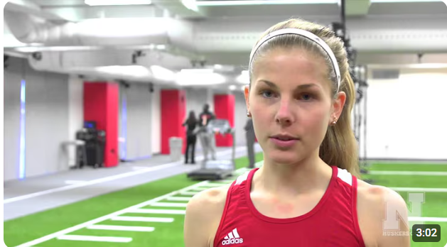
Type of Skill
p.10
Watch the video to see how 3D Motion Capture Analysis supports the training of
Nebraksa and field athletes.
https://www.youtube.com/watch?v=XmGPjIHJfps

Slide 20
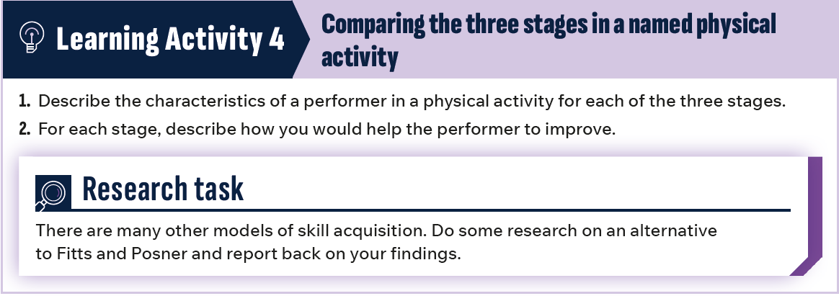
p.10

Slide 21
Factors Influencing Skill Learning
p.11
Two Main Factors:
Feedback
Practice
Information an athlete receives about their performance
Helps identify mistakes and improve technique
Can be intrinsic (from within) or extrinsic (from external sources)
How athletes develop and refine skills
Different types suit different skills and learning stages
Includes practice types and practice methods
Key Principle: Match feedback type and practice method to the athlete's stage of learning

Slide 22
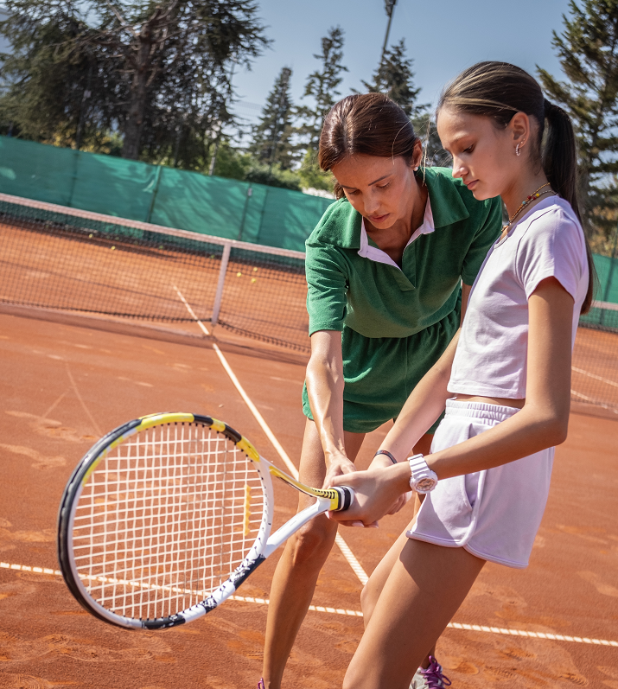
Feedback
p.11
Feedback is information an athlete receives about their
performance. It helps athletes understand what they’re
doing well and what needs improvement.
Effective feedback helps athletes:
Identify mistakes in their technique
Understand what they're doing incorrectly
Develop better movement patterns
Recognize and reinforce good habits
Build confidence in their technique

Slide 23
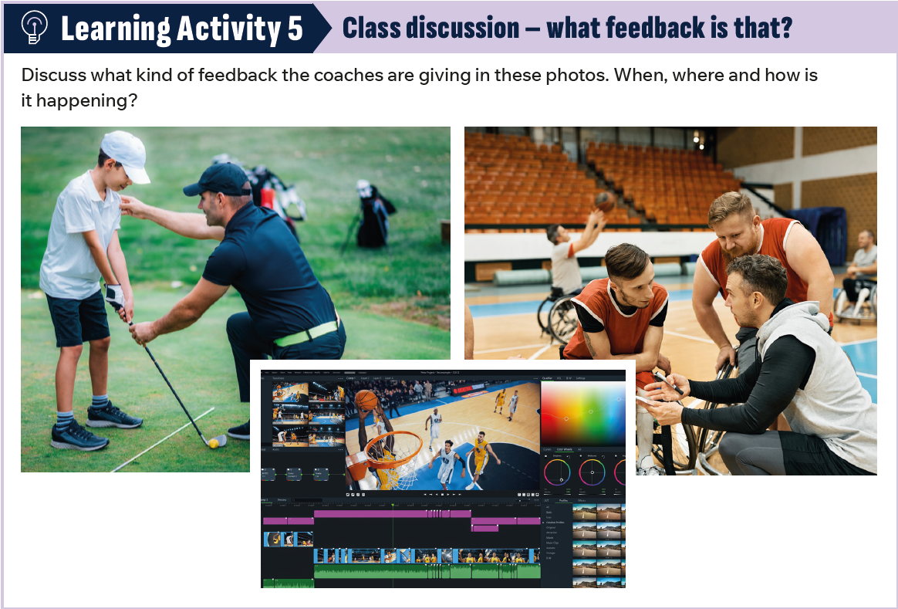
p.11

Slide 24
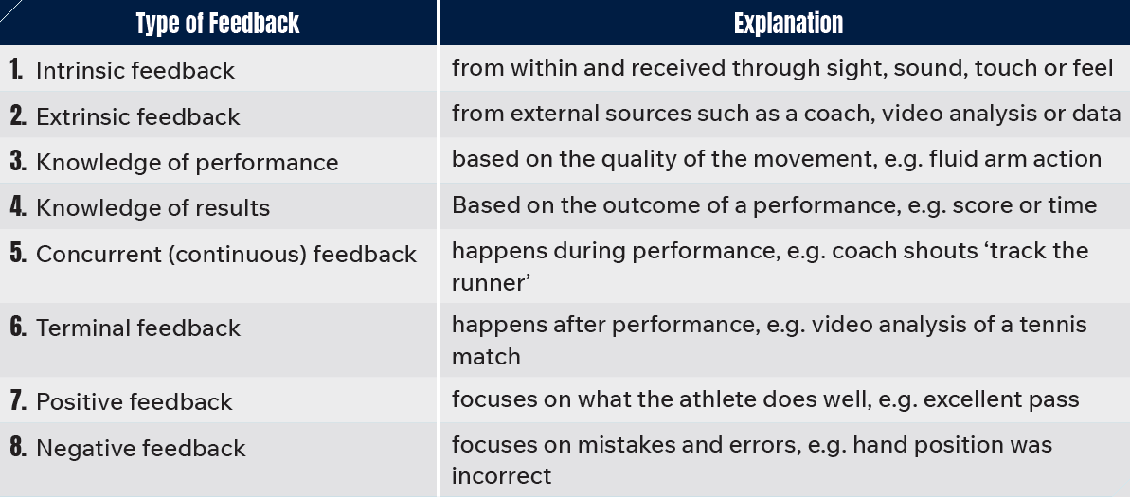
Types of Feedback
p.12

Slide 25
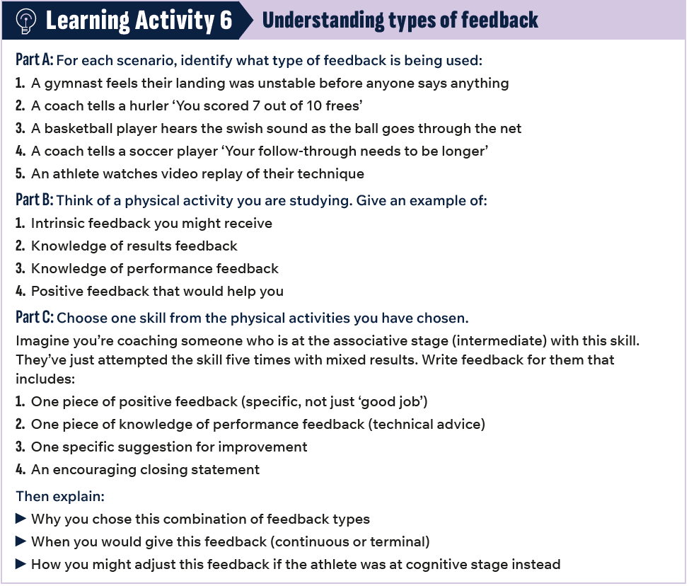
p.12

Slide 26
Types of Practice
p.13-14
Practice Type | Definition | When to Use | Example
Fixed | Same skill, same way, same environment | Beginners, closed skills, muscle memory | Basketball player shooting 100 free throws from exact same spot
Variable | Same skill, changing conditions | Intermediate/advanced, open skills, competition prep | Soccer player practising penalties from different angles and distances
Random | Multiple different skills in unpredictable order | Advanced performers, competition prep, decision-making | Badminton player returning shuttles in different areas at random heights and speeds
Massed | Continuous practice with little/no rest | Simple skills, time-limited, high repetition needed | 50 consecutive jump shots in basketball with no break
Distributed | Practice with rest periods between | Beginners, complex skills, physically demanding | 10 free throws, rest 2 minutes to review video, repeat

Slide 27
Types of Practice…
p.16
Practice Type | Definition | When to Use | Example
Whole Practice | Practise the entire skill from start to finish each time. | Best for associative/ autonomous performers practising continuous skills in a realistic game setting. | Performing a complete golf swing; swimming a full length using front crawl
Part Practice | Learning a skill by practising its parts separately, then combining them | Beginners learning new skill; when one part of skill needs specific attention; complex skills with many components | Learning triple jump by practising hop separately; practising individual tumbles in gymnastics routine; using float to focus on leg action of front crawl
Whole-part-whole approach to practice: Combines both approaches.
Example: Attempt a full tennis serve and notice the ball toss is inconsistent.
Practice 50 ball tosses in isolation. Return to full serve with improved ball toss technique.

Slide 28
Conditioned Games
p.17
Conditioned games = practice games with modified rules
Also called ‘modified games’ or ‘small-sided games’
Rules are changed to focus on specific skills or tactics
Special conditions force players to practise target skills
Can be used to apply variable, random, or whole practice

Slide 29
Conditioned Games…
p.17
Example: Gaelic Football Kicking Game
Setup: 5v5 in a 40m x 40m grid
Conditions:
Five consecutive kick passes (over 10 meters) = 1 point
No hand passes allowed
Ball must be kicked within 3 seconds of catching it
If ball hits ground, other team gets possession
Focus: Kick passing accuracy & movement off the ball
Type of Practice included: random practice and whole practice

Slide 30
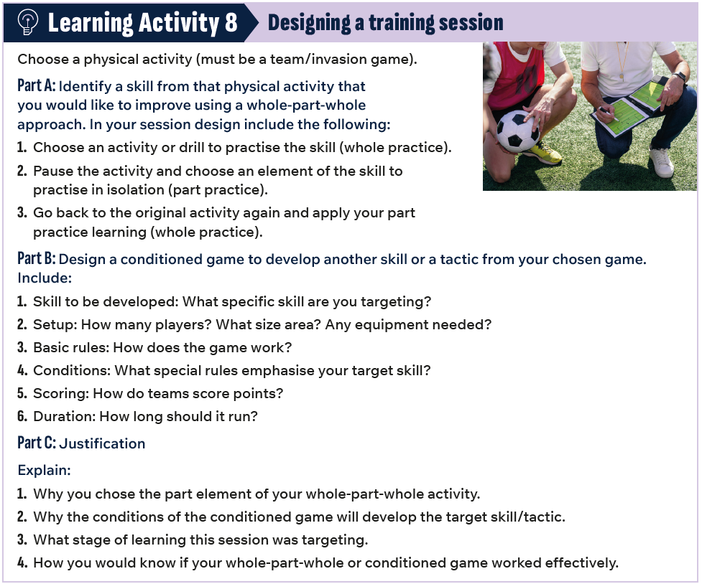
p.17

Slide 31
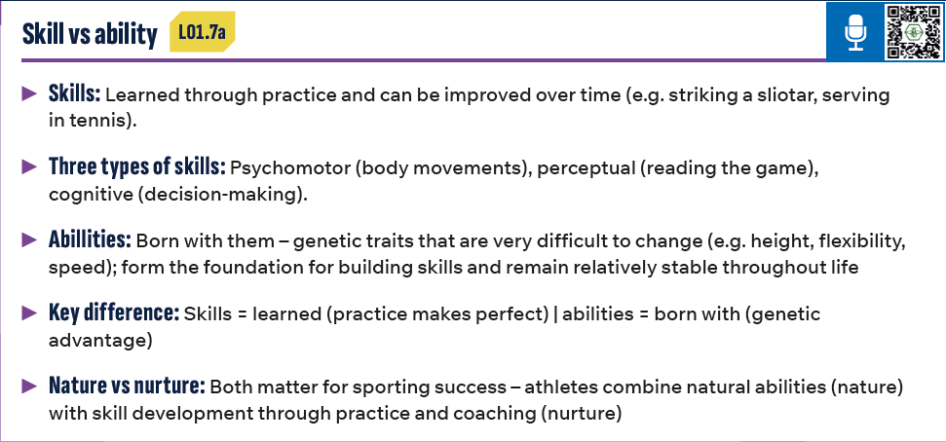
p.18

Slide 32
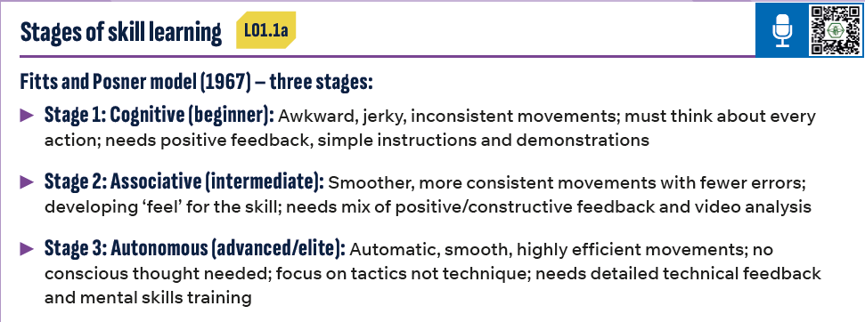
p.18

Slide 33
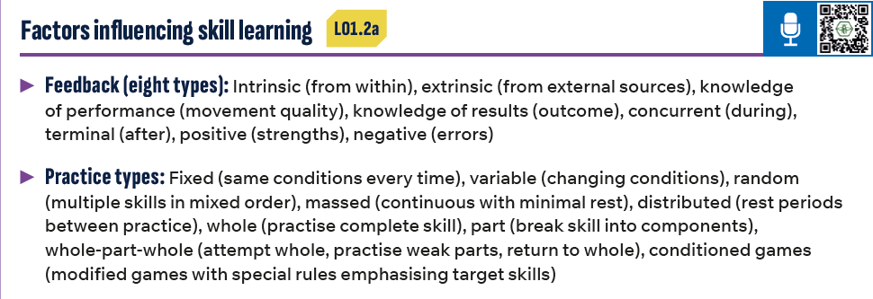
p.18

