Slide 1

Exploring Key Changes
to the
New Junior Cycle

Slide 2
Welcome!
Running order for this evening's webinar:
1. Presentation with Stephanie
2. Q&A session

Slide 3

Our new SPHE for Wellbeing series
Check out the books, planning and other digital resources on Folens.ie

Slide 4
Topics covered this evening
1. Introduction
2. New course overview
3. Assessment
4. Key Features of the SPHE for Wellbeing Series
5. My Advice on Teaching the New Course
6. Q&A

Slide 5
1. Introduction

Slide 6



About Me
Teaching for almost 20 years
Wrote the first SPHE book in Ireland in 2007
Parent

Slide 7
2. Course Overview

Slide 8
New SPHE Specification
Students starting first year in September 2023 should be studying the 2023 specification.
Tool kit and additional guidance for teachers on specific learning outcomes published in November- more to come
Resources for teaching and learning in SPHE | Curriculum Online
Oide- 'Coming Soon'.

Slide 9
Course Overview
Designed for 100 hours of student engagement
Learning outcomes do not have to be covered in sequential order
All learning outcomes do not have to be covered in full each year

Slide 10
The Four Strands of the new SPHE Specification
Strand 1: Understanding Myself and Others
Strand 2: Making Healthy Choices
Strand 3: Strand 3: Relationships and Sexuality
Strand 4: Emotional Wellbeing
Full List of Learning Outcomes

Slide 11
Strand 1: Understanding Myself and Others
Self-awareness
Self-esteem
Healthy relationships
Self-management

Slide 12
Strand 2: Making Healthy Choices
Making healthy choices to support their wellbeing.
Accessing reliable information
Decision making and influences
Notes:
such as family, peer, media and social pressures, that influence decisions.

Slide 13
Strand 3: Relationships and Sexuality
Relationships- family relationships, friendships, romantic
Sexuality
Potential sexual relationships in the future

Slide 14
Strand 4: Emotional Wellbeing
Nurturing emotional wellbeing
Positive mental health
Problem solving and coping skills
How they can support themselves and others
Where/how to find support, if needed.

Slide 15
3. Assessment

Slide 16
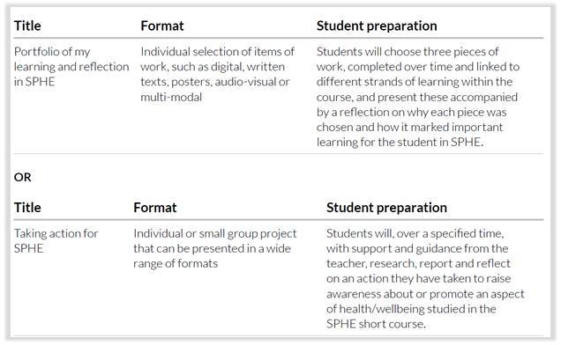
Assessment
Notes:
Takes place in 2nd or 3rd year

Slide 17
Assessment
The focus of assessment is on allowing students to demonstrate the knowledge, skills and dispositions they have gained through their engagement in learning in SPHE.
Should take place in 2nd or 3rd year
Notes:
Takes place in 2nd or 3rd year

Slide 18
4. Key Features
of SPHE for Wellbeing Series

Slide 19


Lesson features
Book is divided into 4 strands
Relevant learning intentions, learning outcome numbers, key words & wellbeing indicators listed at the start of each lesson
Book 1 and 2

Slide 20
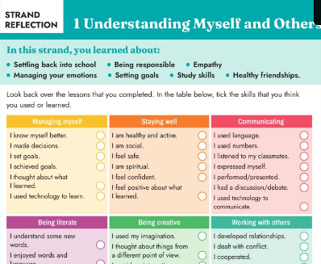
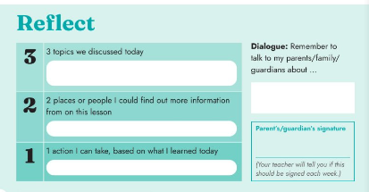
Layout
Short reflection at the end of each lesson and strand reflection at the end of each strand

Slide 21
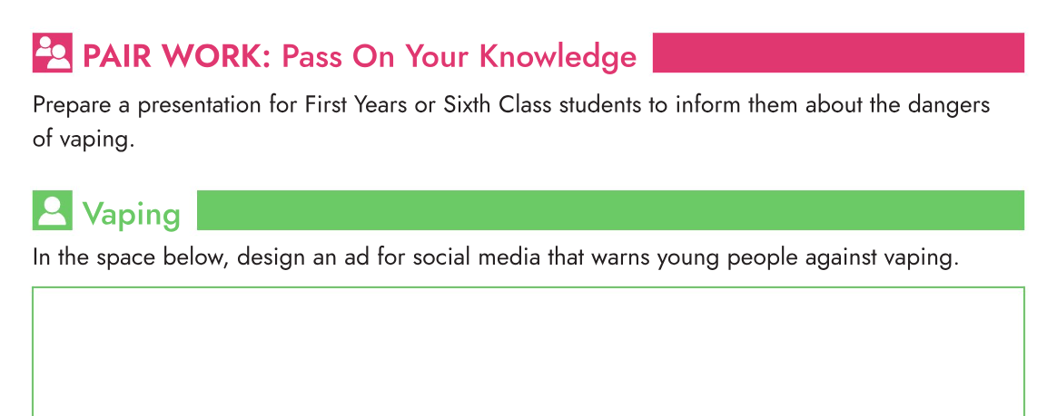
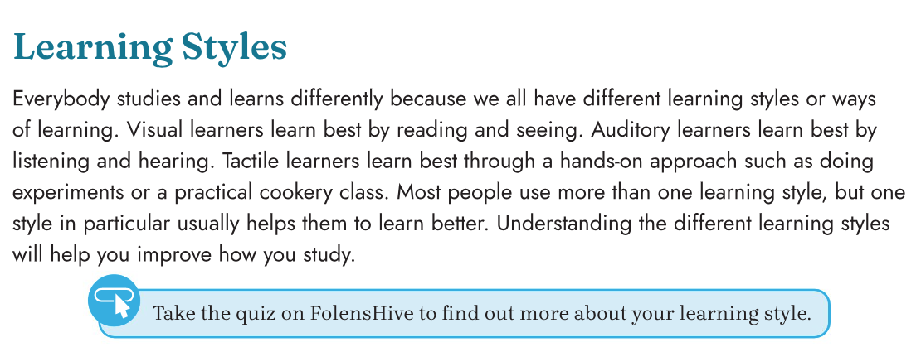
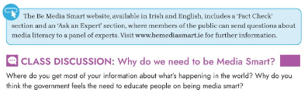
Student Activities
A variety of individual, pair, group and class activities
Additional resources, videos and activities on Folens Hive

Slide 22


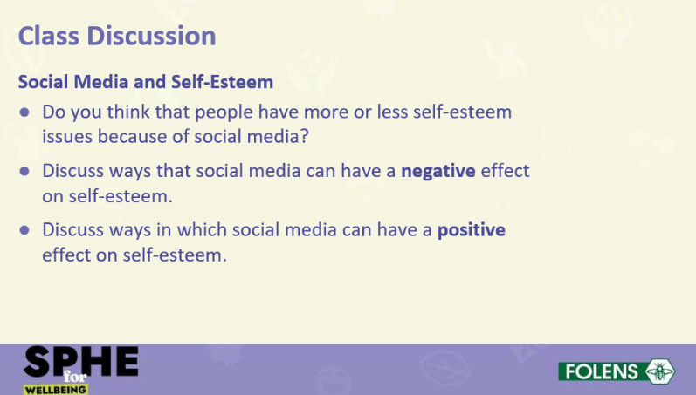
Powerpoints
Lesson summary/highlights
Useful for students with AEN
Additional resources, links and information

Slide 23
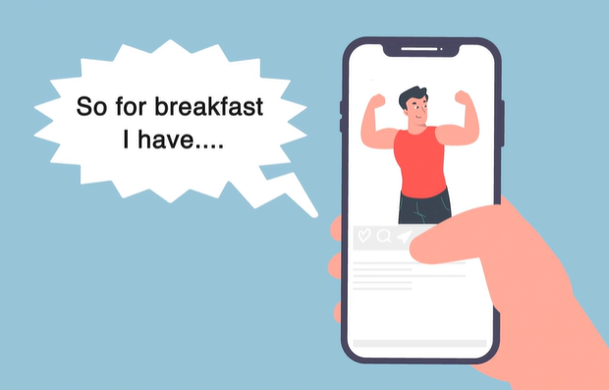
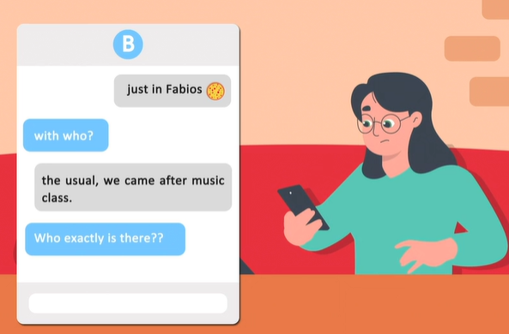
Animations
Additional animations available on FolensHive to support learning and enhance lessons
Useful to look back on in 2nd and 3rd year and for stimulating class discussion

Slide 24
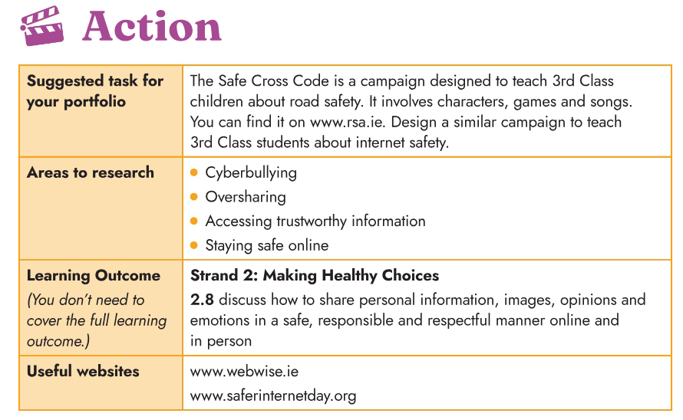
Assessment
More detailed text and links to information with suggestions for CBA /Assessment at the end of each strand

Slide 25
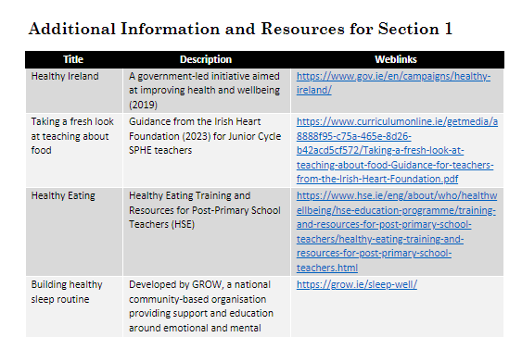
Teachers’ Guide
Concise
Word version can be downloaded and edited to suit your school
Hyperlinks to relevant documents and resources
Links to additional resources

Slide 26
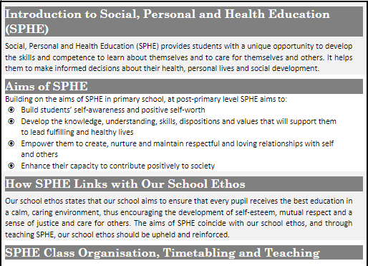
Teachers’ Guide
Download the Sample SPHE Policy Word document and edit to suit your school

Slide 27
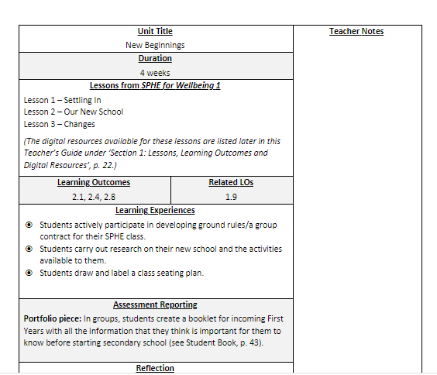
Teachers’ Guide
Download the Units of Learning which are aligned with the book and edit to suit your school
Al online and can be downloaded and edited

Slide 28
Approach to Teaching RSE
Information is presented in a non-judgemental, age appropriate way
(LO 3.9 and 3.5 are not covered in First Year but are covered in Second and Third Year at an age-appropriate level.)
Emphasis on the importance of giving and receiving consent
Gender identity - acknowledges that while most people’s gender identity matches their sex registered at birth, this is not the case for everyone and gender identity is just one part of sexuality

Slide 29
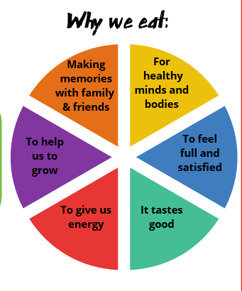
Approach to Teaching about Food
Taking a fresh look . at teaching about food
Image- Irish Heart Foundation

Slide 30
5. My Advice on Teaching the New Course

Slide 31
My perception of main changes compared to 2016 Specification
More Focus on
Consent | Online Safety (Coco's Law, pornography)
Accessing Reliable Information | Resilience
Emotional & Social aspects of sex | Overall mental health & wellbeing
Vaping
All aspects of sexuality
Seeking help
Notes:
Sexuality – values, socialisation, communication, gender expression, as well as sexual orientation

Slide 32
My perception of main changes compared to 2016 Specification
Less Focus on
Pregnancy | Specific Mental Health Illnesses
Birth
Reproduction
Grief
Separation
Repetition
Notes:
Sexuality – values, socialisation, communication, gender expression, as well as sexual orientation

Slide 33
Before Teaching
Prepare well for more sensitive topics (see teachers’ guide & Toolkit)
Be familiar with the glossary and stick to it (e.g. intersex)
Videos on PDST (2016)
Avail of any available training asap
Be aware of school policies (see teachers guide)
Be involved in updating the school SPHE policy (se teachers guide)
If in doubt – defer
Use anonymous questioning in advance
Notes:
Schools are required to teach RSE as part of SPHE in each year of the Junior Cycle SPHE programme.

Slide 34
Parents & SPHE
Advice on communicating with parents about SPHE and RSE
In the event of not reaching a shared understanding of the value of SPHE, parents/guardians have a right to request that their child opt out of SPHE (or parts of it), as is their right with any aspect of the curriculum.
Notes:
Schools are required to teach RSE as part of SPHE in each year of the Junior Cycle SPHE programme.

Slide 35

Your local Folens educational consultant
Available for meetings at a time that suits you
Support you and your classroom needs
Support for the upcoming book scheme

Slide 36
6. Questions

