Slide 1

Notes:
CQ to start

Slide 2
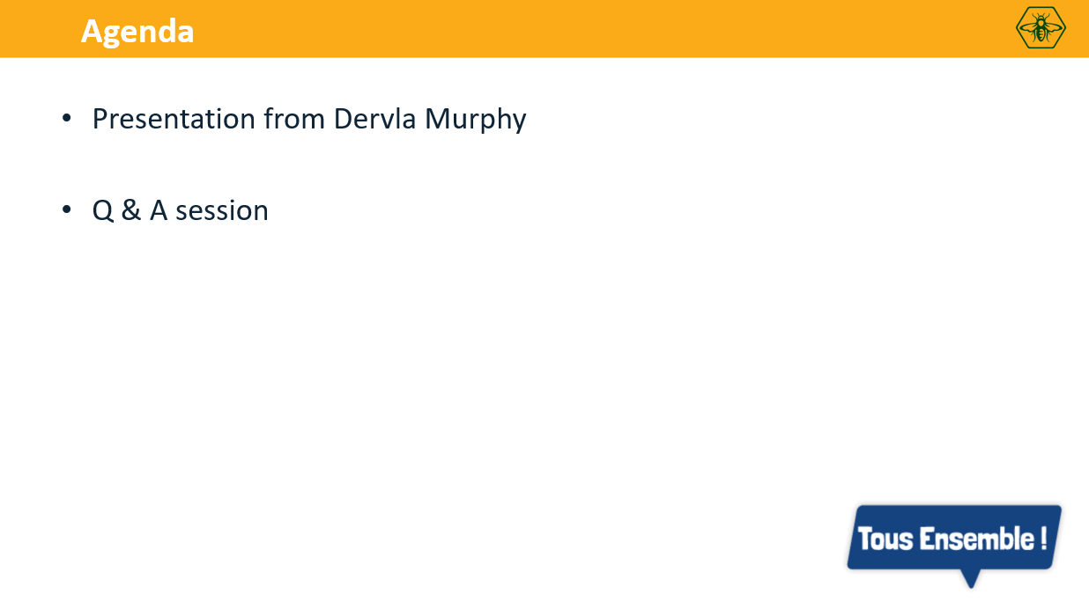

Slide 3
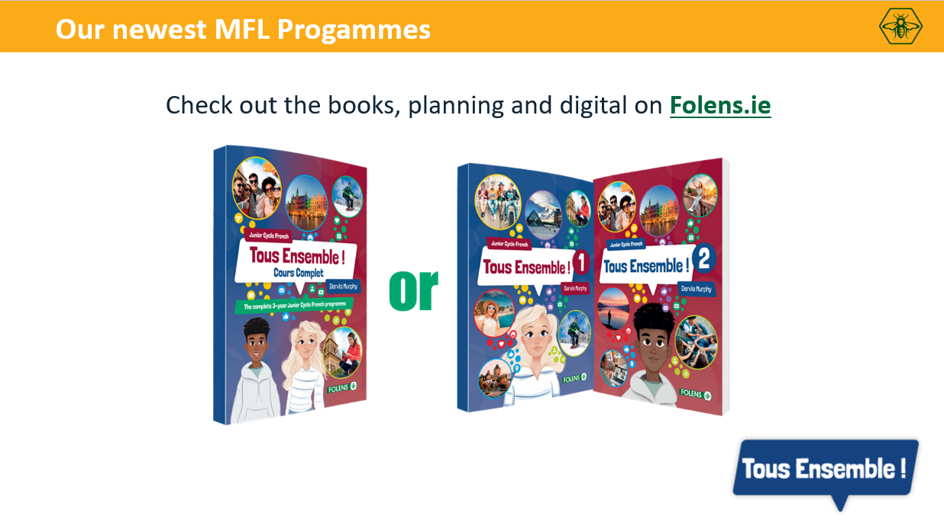

Slide 4

The main challenges of teaching vocabulary
Trying to motivate 28+ learners of varying abilities to continually learn and revise vocabulary.
Keeping learners engaged and on task.
Teaching the ‘tik-tok’ generation.
Encouraging students to work independently and self reflect .

Slide 5

Strategies to Help Students Learn Vocabulary
activating prior knowledge
receptive and productive vocabulary learning
digital tools
sentence builders
recycling and revisiting vocabulary

Slide 6

1. Activating prior knowledge
Activating prior knowledge is a technique where students are encouraged to revisit what they already know about a topic before they are taught new information.
Brainstorming
Mind maps
KWL Charts
Anticipation Guides

Slide 7
Benefits of using activities to activate prior knowledge
It helps learners use their own personal, educational and cultural knowledge to connect new material to familiar concepts.
Learners can use what they already know as the foundation for new ideas and learning.
By revisiting prior knowledge, learners improve their recalled learning.
Students start to see connections between past, current and future learning.

Slide 8
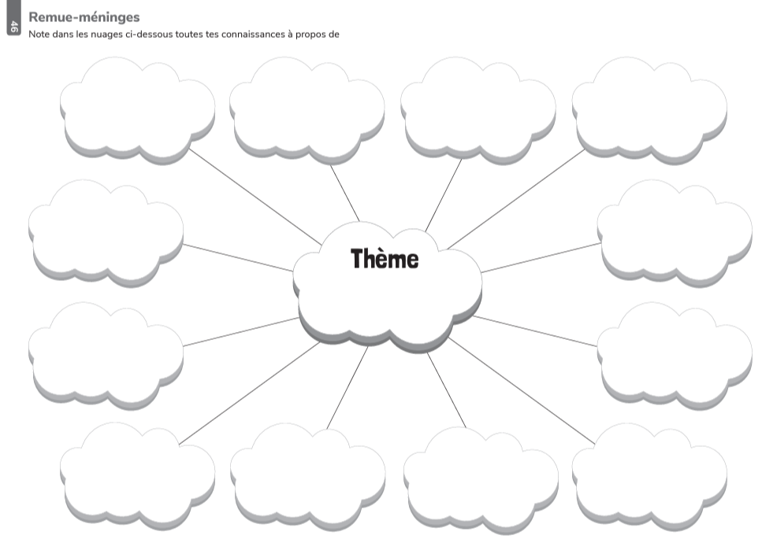
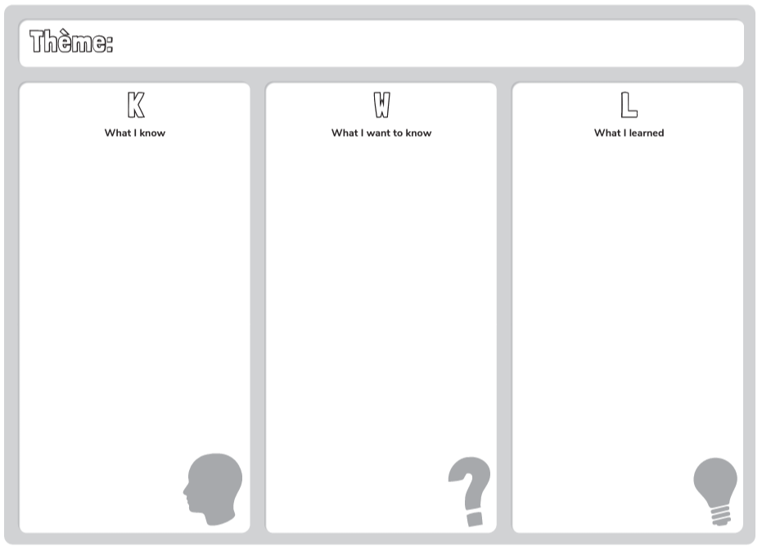

Slide 9
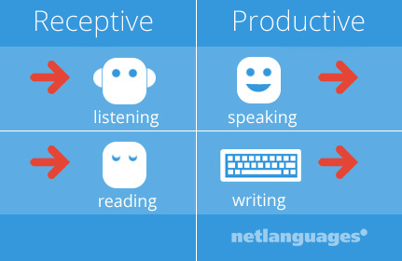
2. Receptive and productive vocabulary learning
Differentiation: categorising vocabulary to help students cope with learning overload
Receptive vocabulary
words that you understand when you read or hear them.
Productive vocabulary
words that you use when writing or talking.

Slide 10
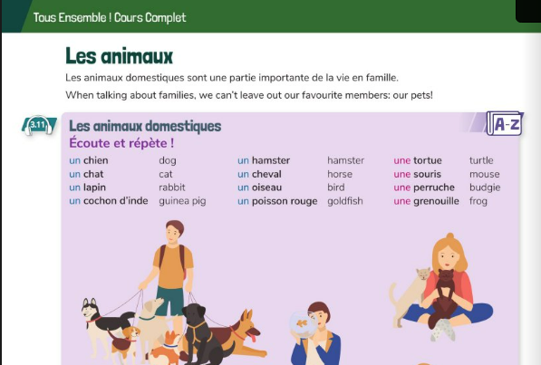
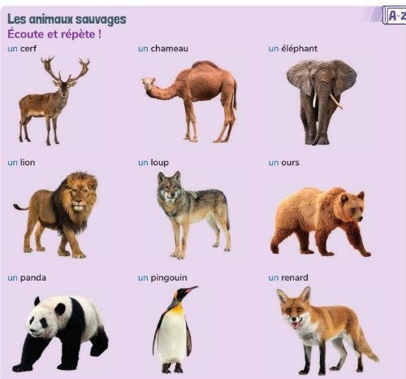
Making it manageable!

Slide 11
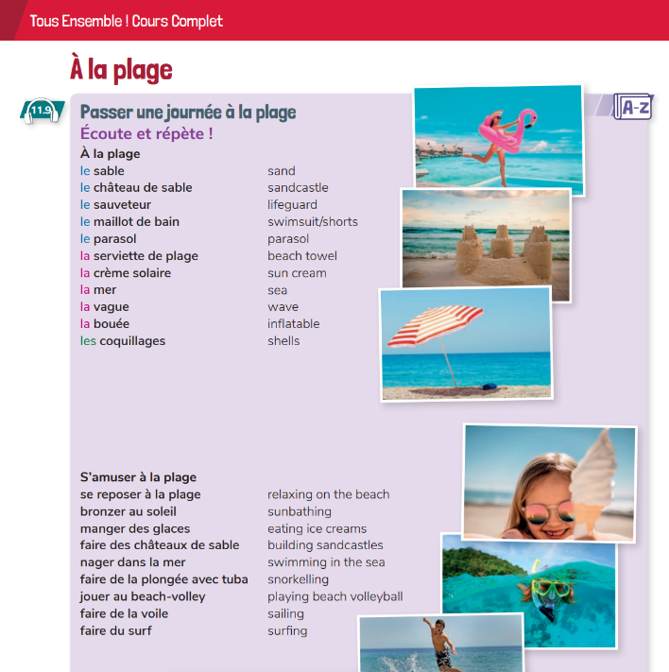

Get the students involved!
Colour coding
Ticking
Highlighting
Grouping words

Slide 12


3. Digital tools
Digital tools help make vocabulary learning
fun and tap into our learners love of apps!
Quizlet
Wordwall
Study Stack
Blooket
Kahoot

Slide 13

Digital tools
FOMO
Whichever one you use, use it consistently!

Slide 14

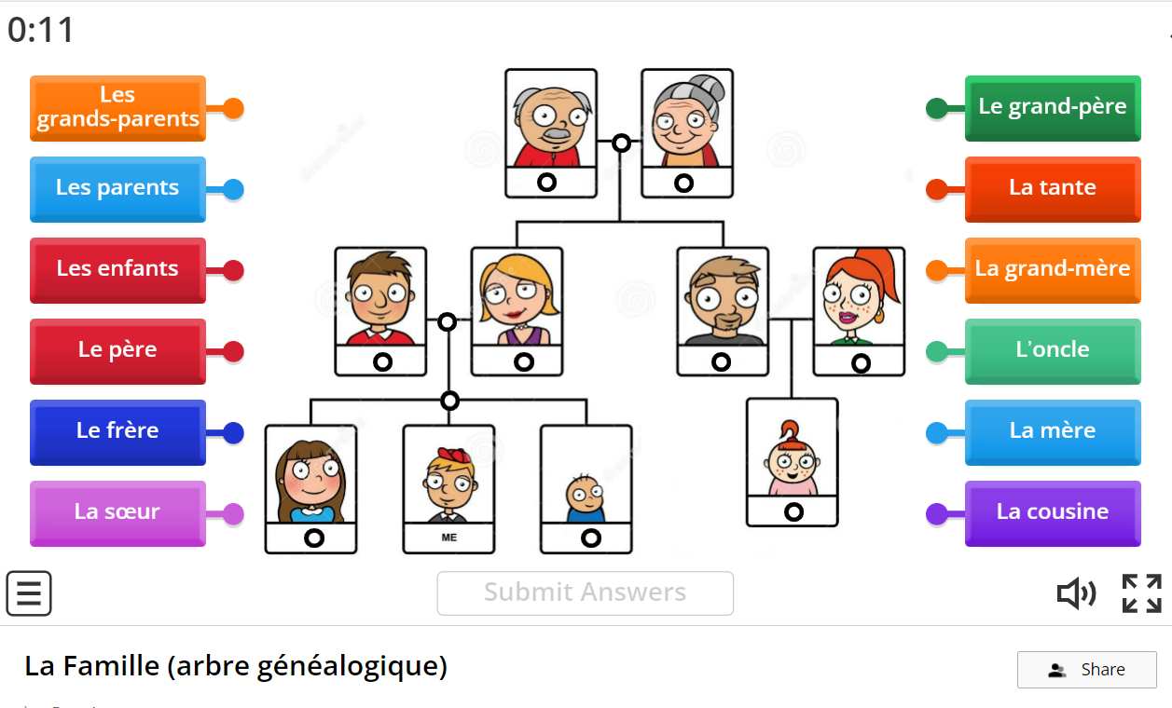
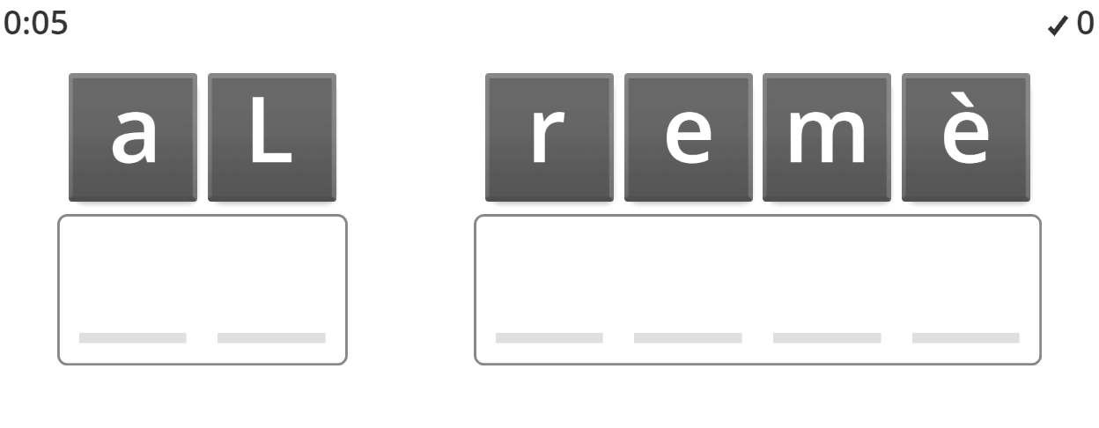
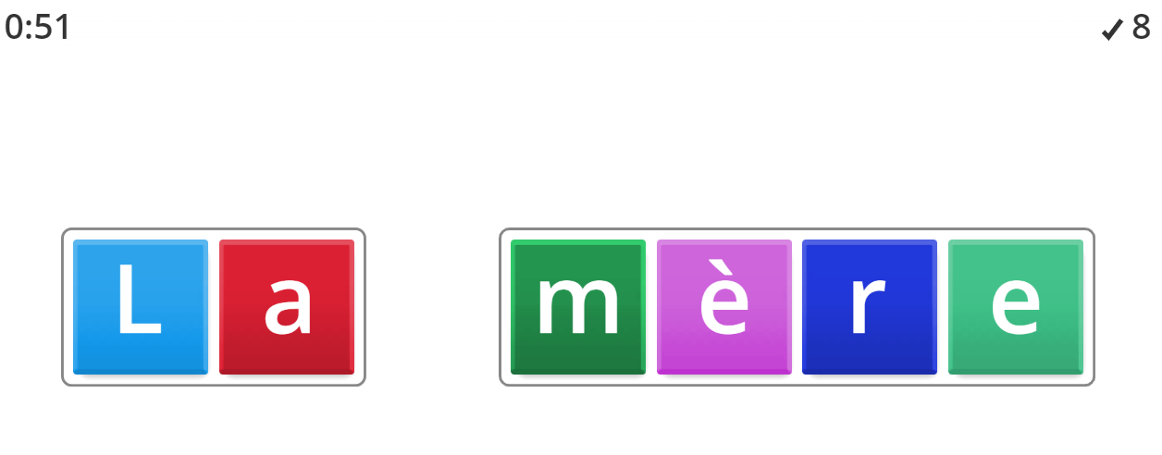

Slide 15

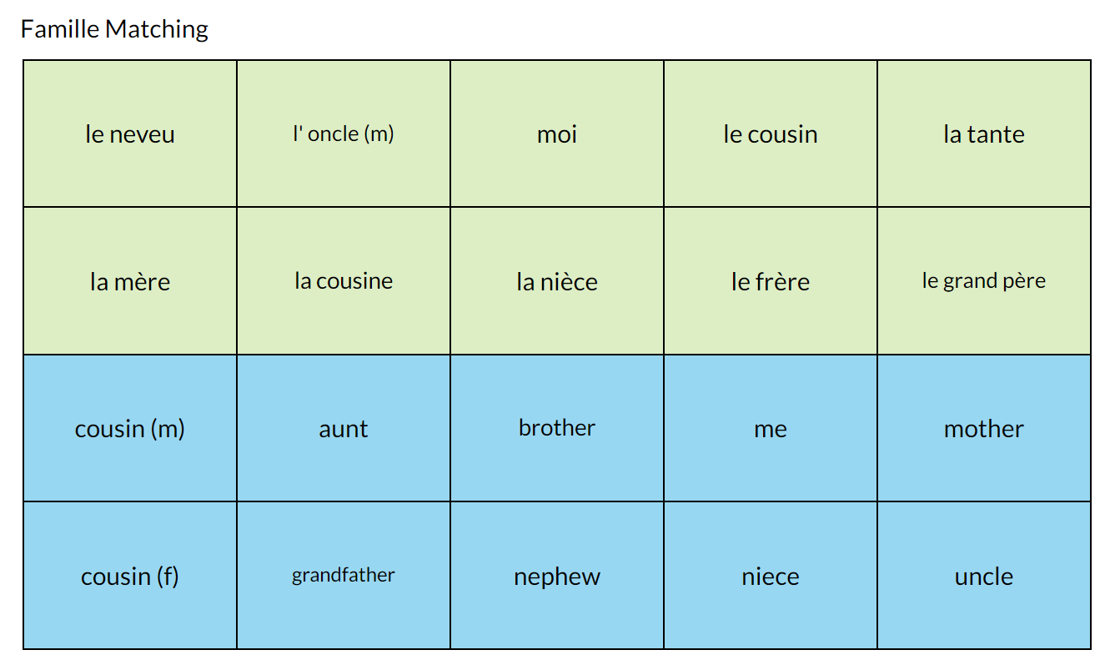
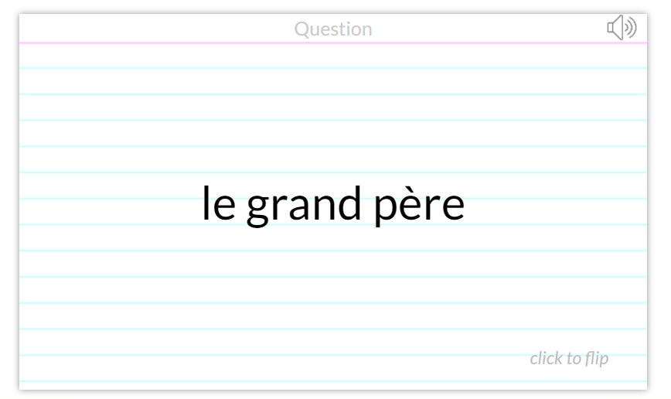
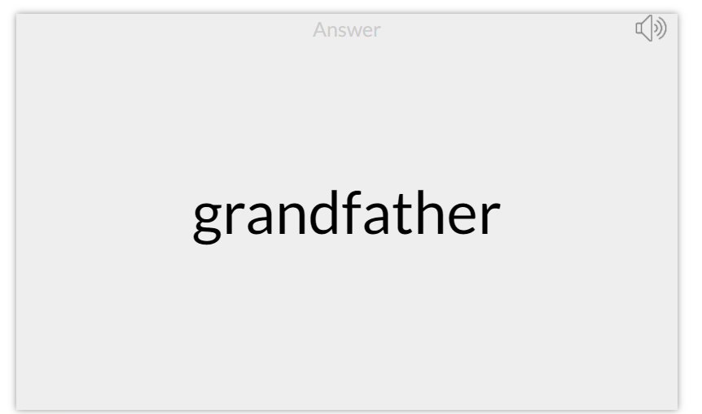

Slide 16

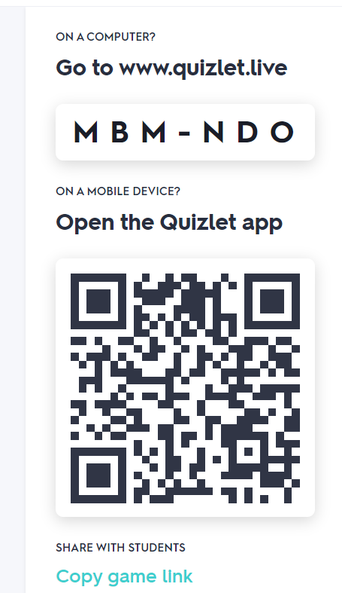
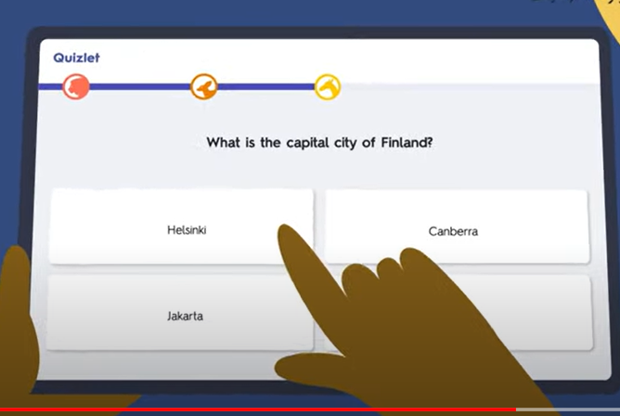
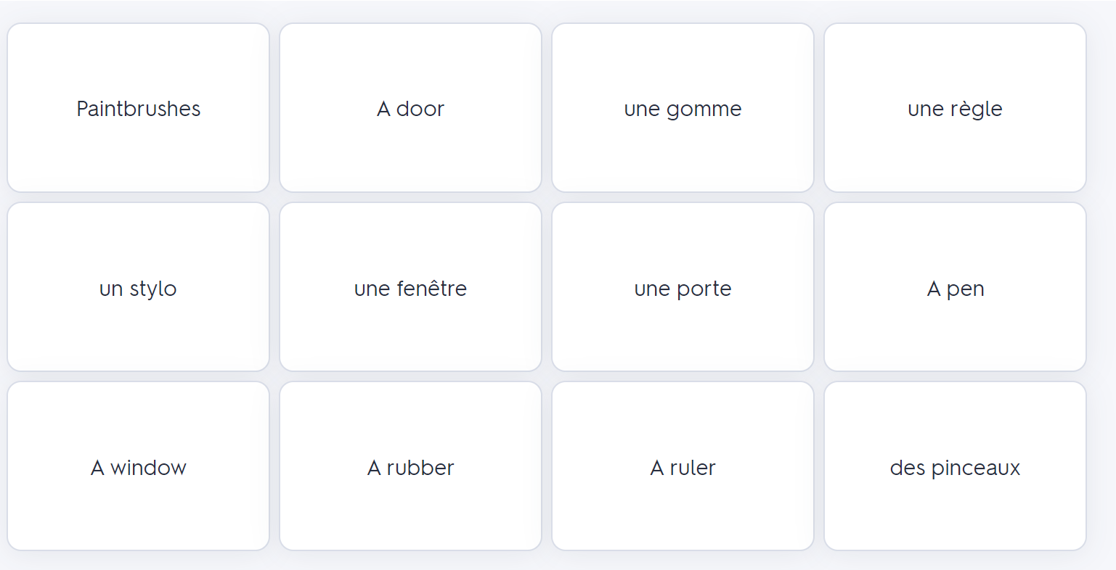
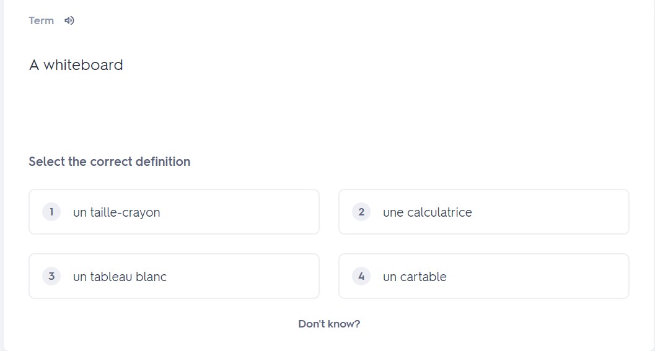
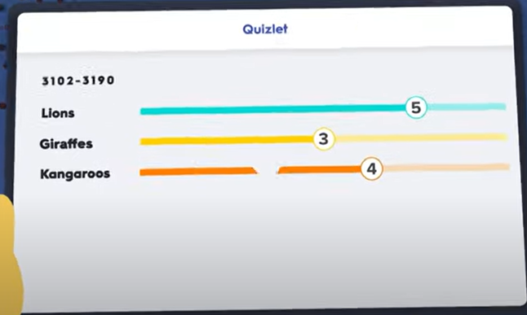

Slide 17
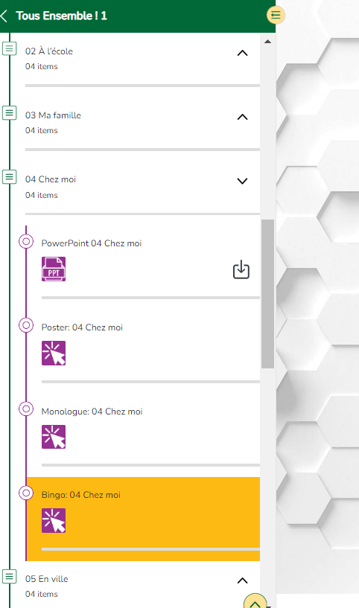
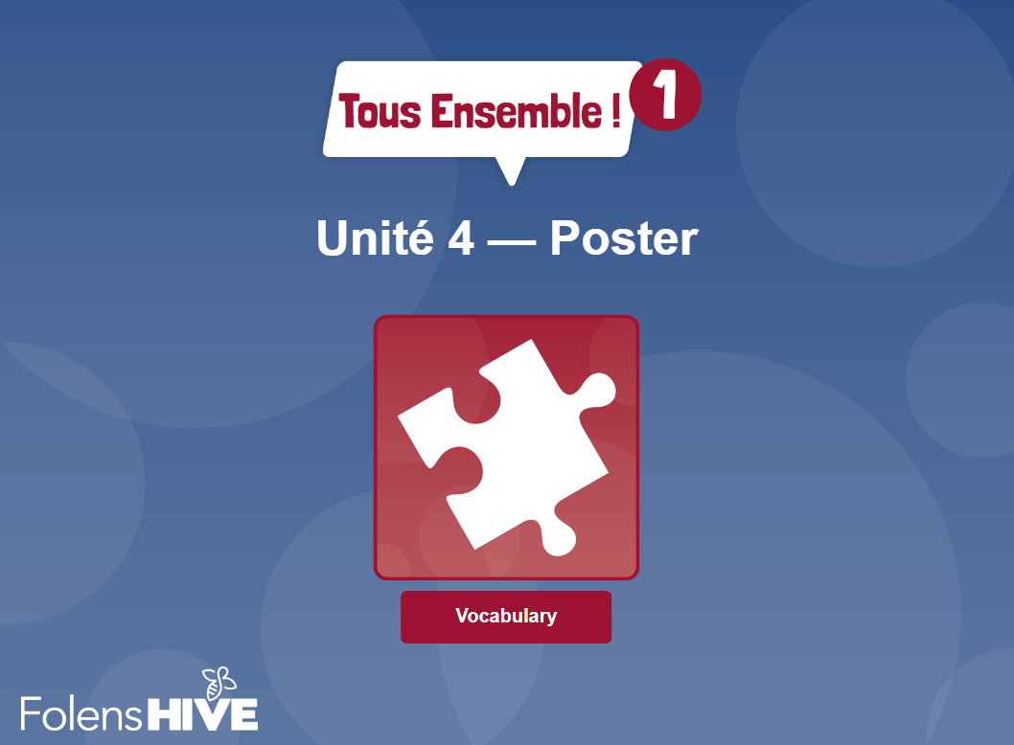

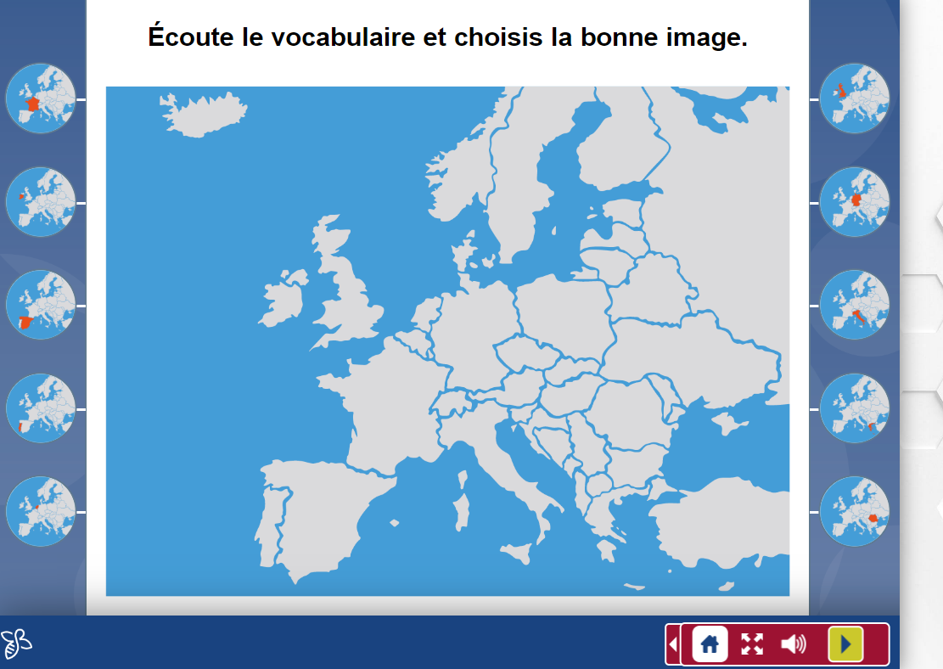



Slide 18
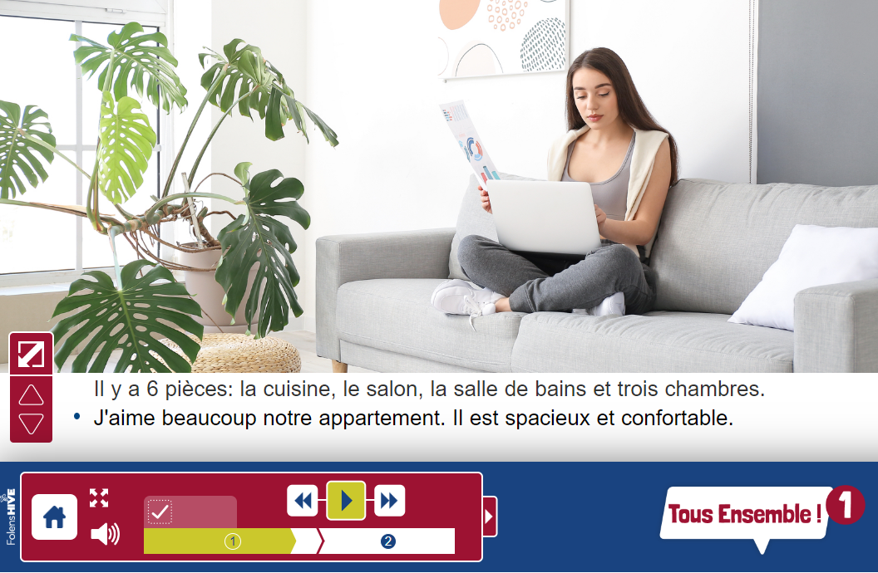
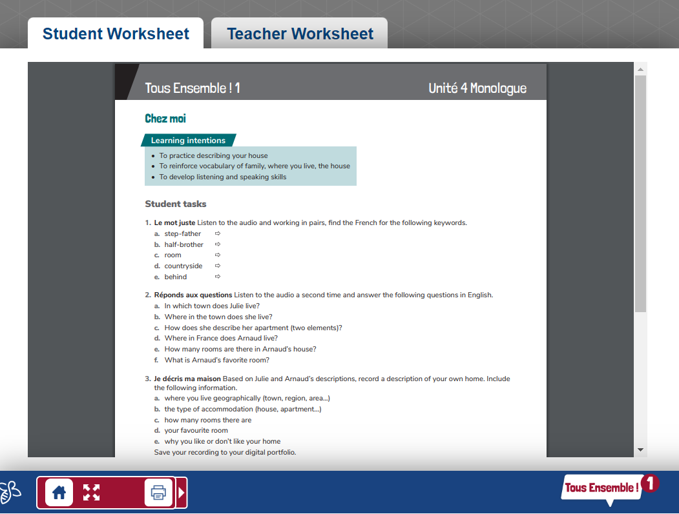
Monologues
Spoken production
Portfolio tasks
CBA prep

Slide 19
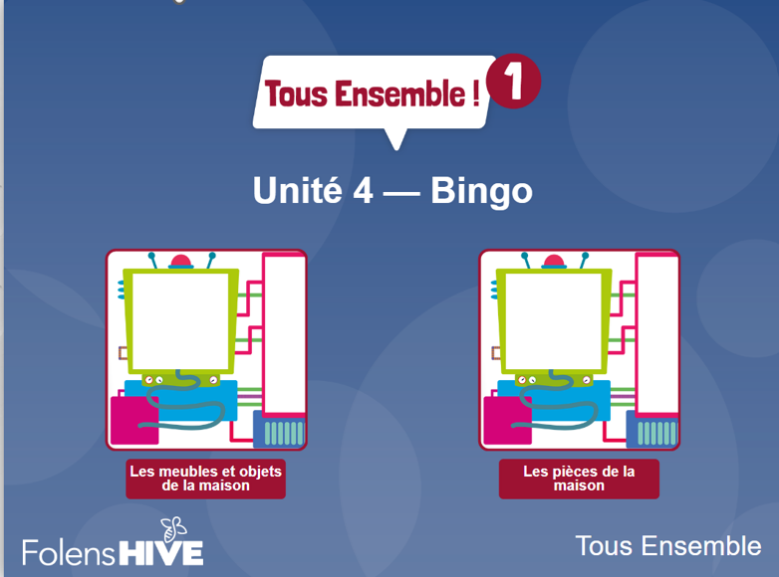
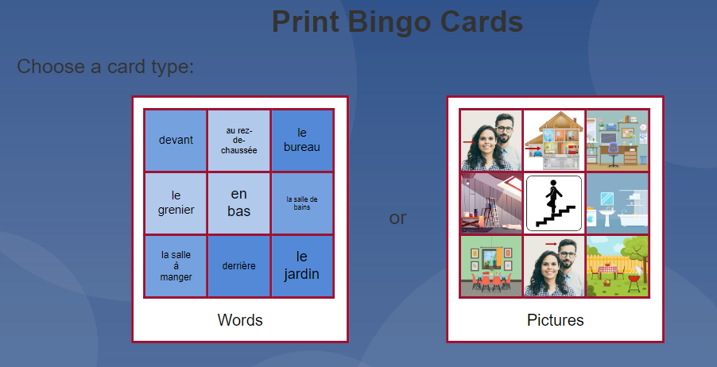
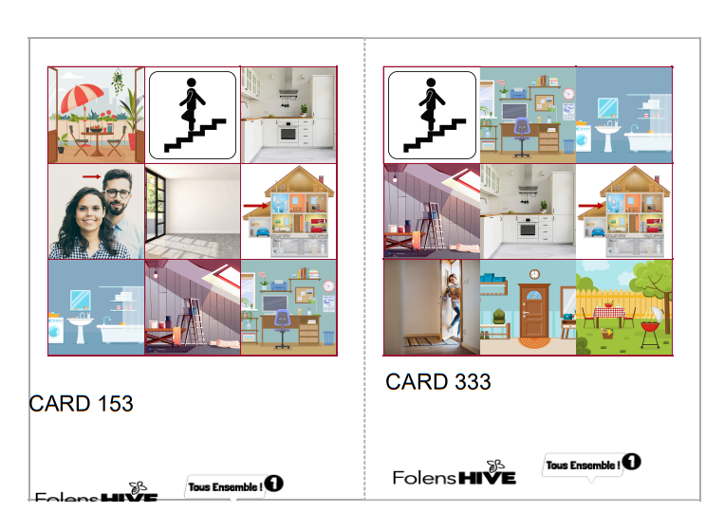
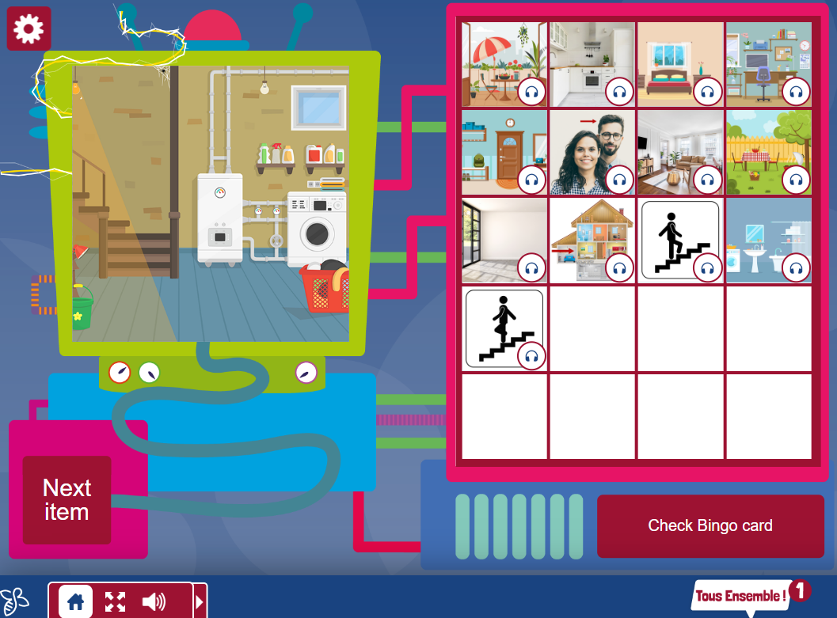
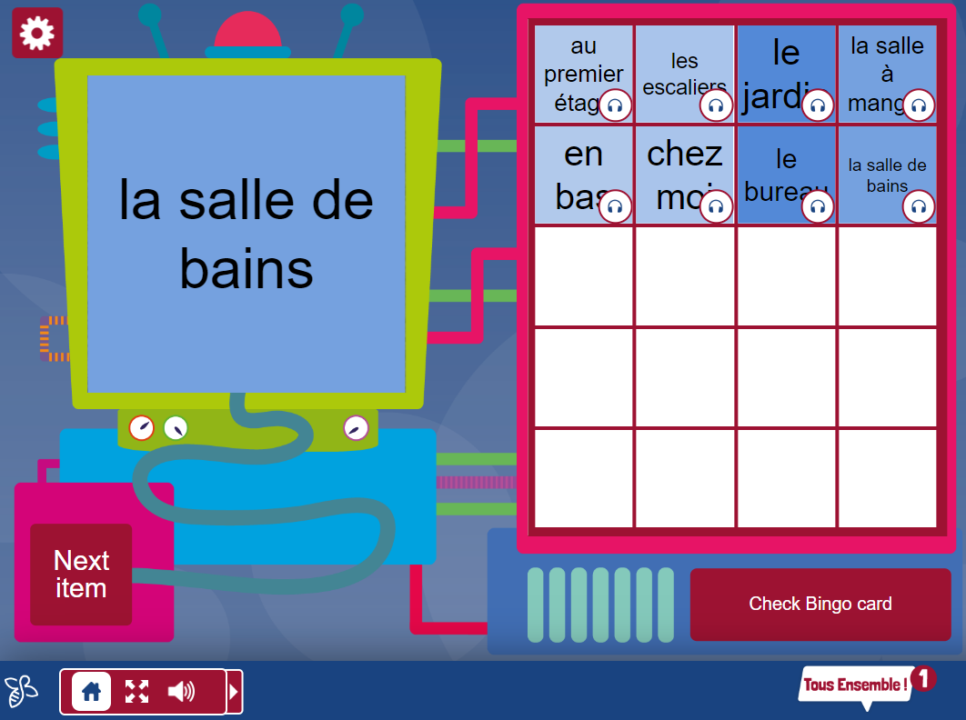

Slide 20
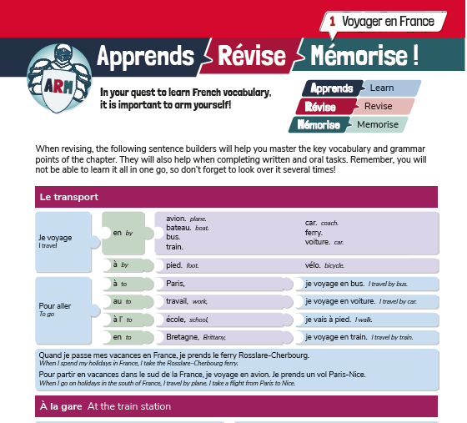
4. Sentence builders
Detailed sentence builders, allow learners to work independently.
They are especially useful in providing all learners with the tools to successfully complete written and oral tasks (the most difficult productive tasks).

Slide 21





A flexible resource
Sentence builders are a low prep but highly adaptable resource
which allow learners to practice the 5 key skills.
They are a great way to build differentiation into lessons in the language classroom.

Slide 22

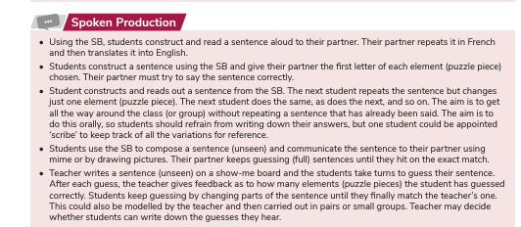

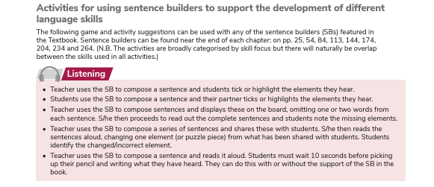
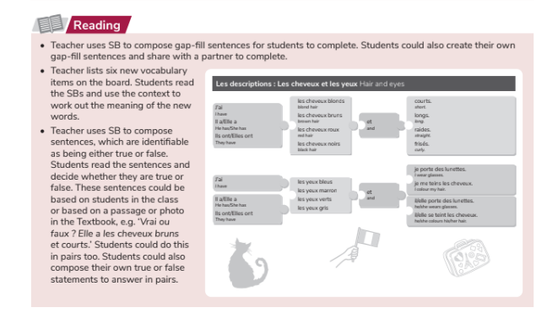

Slide 23
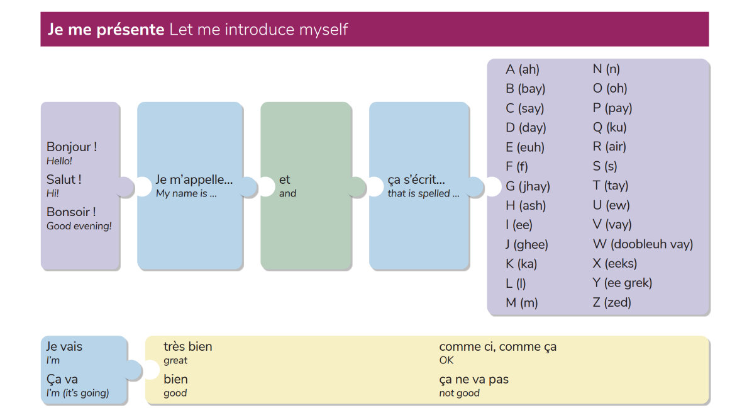
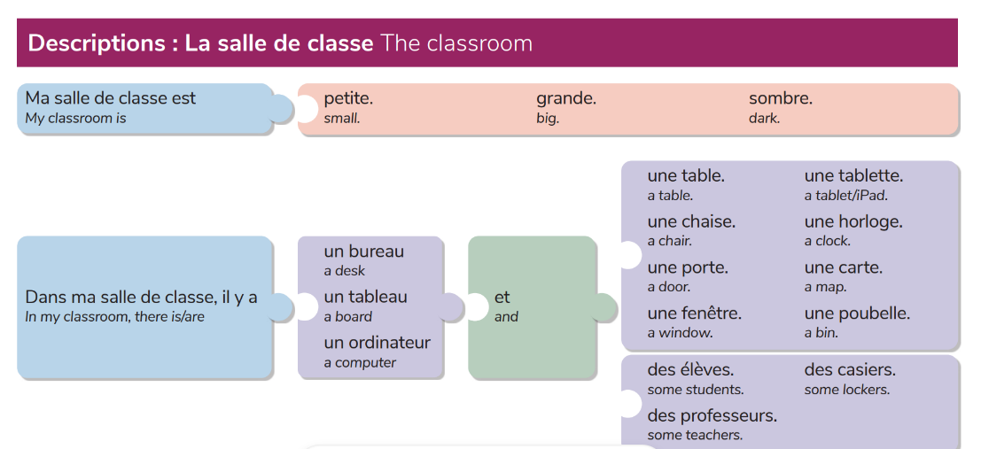
Classwork
Pair/Group work
Homework
Revision
Alternative assessment –
open book tests

Slide 24
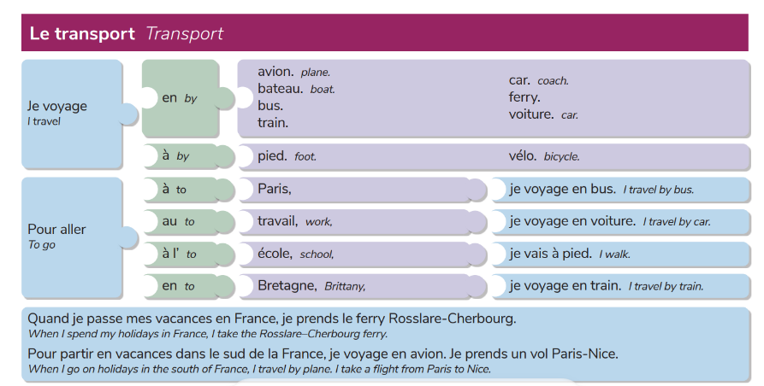
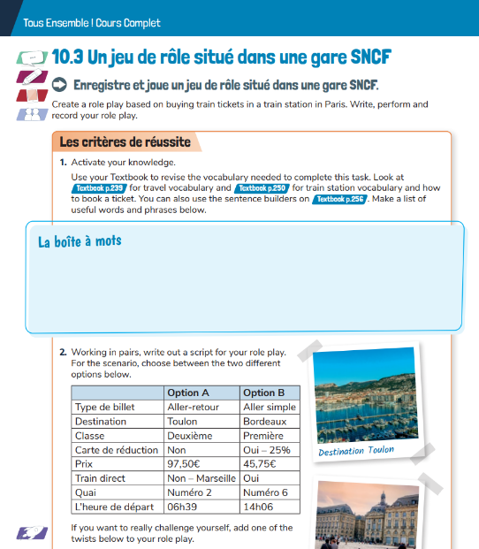
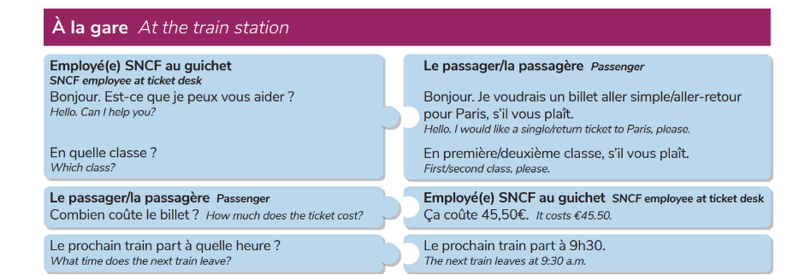
Portfolio pieces
Tâches clés

Slide 25
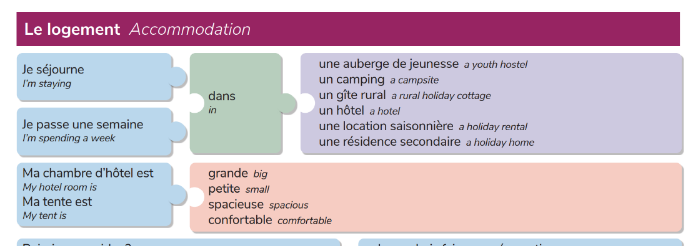
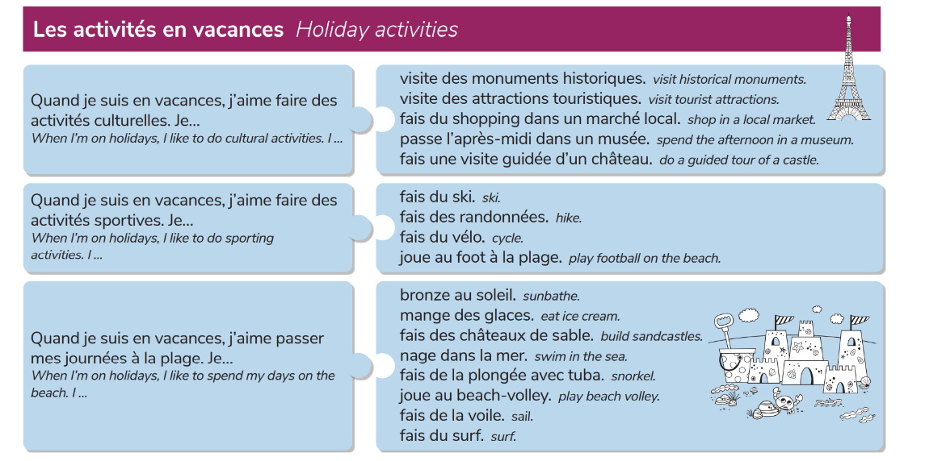

CBA Prep
Blog
Email

Slide 26

5. Recycling and revisiting vocabulary
In order to really internalise vocabulary, we must present our leaners with opportunities to recycle and revisit previous learned words on a regular basis.

Slide 27




Recycling: Provide learners with opportunities to use/see the vocabulary in different contexts and settings.
Accessible News Websites

Slide 28


Revisiting: Helps learner’s brains to form long-term memories of vocabulary and structures.
Creating flash cards
Duolingo
AFL – Mini-quiz

Slide 30


Slide 31
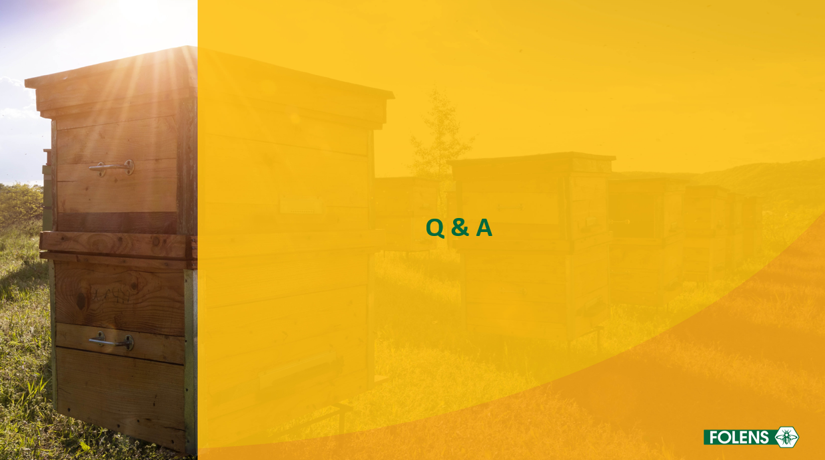

Slide 32


