Slide 1
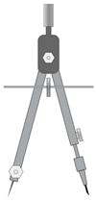
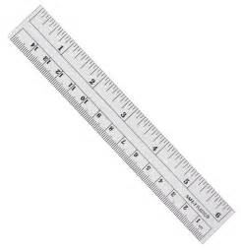
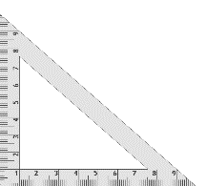
5
Construction 6
Division of a Line Segment into Three Equal Segments, Without Measuring
From point A (or B), draw a ray at an acute angle to the given line segment.
Place the compass needle point on A. Using the same compass width, mark off three equal arcs along the ray. (Use a small compass width.)
Label the points of intersection R, S and T.
Use a straight edge to draw a line segment from T to B.
Using a set square and straight edge, line the set square up with [TB].
Slide the set square along the straight edge.
Using the set square, draw a line segment from S and R to [AB].
The line segment [AB] has now been divided into three equal segments.
A
B
R
S
T

