Slide 1
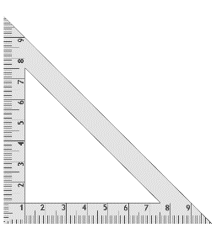
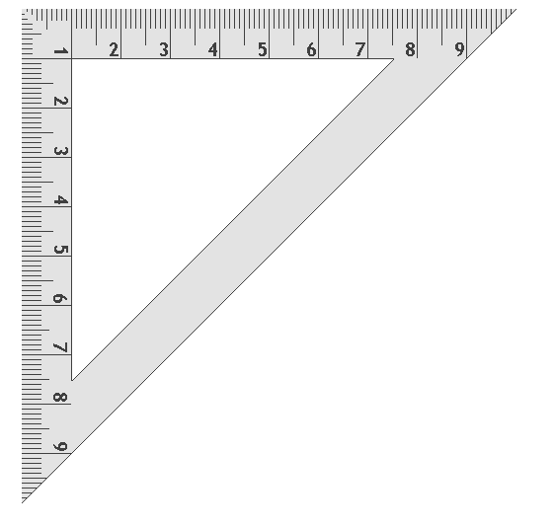
5
Construction 5
Line Parallel to a Given Line, Through a Given Point
Method 1: Solution Using a Set Square
Using a set square, draw a line perpendicular to the line m and through the point C.
Line up one of the two shorter sides of the set square at point C and the other shorter side on the perpendicular line.
Now draw a line through the point C.
This line is parallel to the line m and passes through the point C. Indicate the lines that are perpendicular on your construction.
Use a protractor or set square to check that the constructed line is parallel to the line m.
C
90º
90º
m

Slide 2
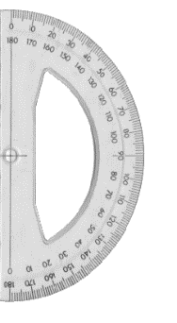
5
Construction 5
Line Parallel to a Given Line, Through a Given Point
Method 2: Using a Protractor and Set Square
Using a set square, draw a line perpendicular to the line m and through the point C.
Line up the protractor with this perpendicular line and place the centre of the protractor at the point C. At the 90° mark on the protractor mark the point D.
Now draw a line passing through both C and D.
This line is parallel to the line m and passes through the point C. Indicate the lines that are perpendicular on your construction.
Use a protractor or set square to check that the constructed line is parallel to the line m.
C
D
90º
90º
m

