Slide 1
Chapter 5: Constructions I
5
Bisect a given angle, using only compass and straight edge
Construct the perpendicular bisector of a segment, using only compass and straight edge
Construct a line perpendicular to a given line l, passing through a given point on l
Construct a line parallel to a given line, through a given point
Divide of a line segment into two or three equal segments, without measuring it
Construct a line segment of a given length on a given ray.

Slide 2
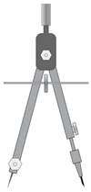
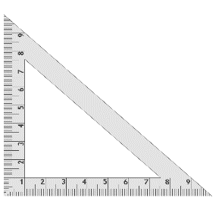

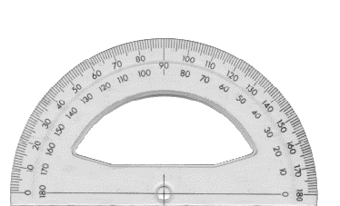
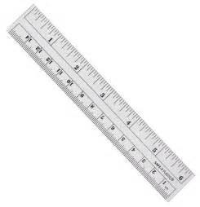
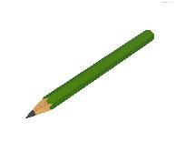
Construction Equipment
Compass
45º Set Square
Protractor
30º or 60º Set Square
Straight Edge
Pencil

Slide 3
Construction List
Make sure you understand what equipment can or cannot be used for your construction.
Lines, rays, and line segments must be drawn using a straight-edge or ruler.
Circles and arcs must be drawn using a compass
Remember NEVER to rub out any lines, arcs, etc. that you have used in your constructions. These construction lines are very important, as they show that you have followed the correct method.
Make sure when your construction is finished that:
All points, lines, rays etc. that were used in your construction have been labelled.
You have checked the accuracy of your construction. Depending on the construction, this can be done using a ruler and/or a protractor.

Slide 4
Construction 1
Bisector of A Given Angle, Using Only Compass and Straight Edge
Place the compass needle point on the point B. Draw an arc of the same width across each arm of the angle.
Label the points of intersection of the arcs and the arms of the angle as X and Y.
Place the compass needle point on the point X and draw an arc. Make sure the compass width is more than half the length from X to Y.
Without changing the compass width, place the compass needle point on the point Y and draw an overlapping arc.
Mark the point where the arcs meet.
Using a straight edge, draw a ray from the vertex B through this point. This ray is the bisector of the ∠ABC.
A
Y
Ѵ
B
Ѵ
X
C

Slide 5
Construction 2
Perpendicular Bisector of a Segment, Using Only Compass and Straight Edge
Draw a line segment [CD].
Place the compass needle point on C.
Set the compass width to more than half the length of [CD] and draw an arc.
Without changing the compass width, place the compass needle point on D and draw an overlapping arc.
Mark the two points of intersection where the arcs intersect.
Using a straight edge, draw a line through these two points.
This line is the perpendicular bisector of [CD].
90º
C
D

Slide 6

Construction 4
Line Perpendicular to a Given Line l, Passing Through a Given Point on l
Method 1: solution Using a Set Square
Line up one side of er side on the line l.
Draw a ray from B using the edge of the set square. Then extend this ray beyond B so it is below the line l.
This line is perpendicular to the line l and passes through the point B.
Mark in the 90º angle.
Use a protractor or set square to check that the constructed line is perpendicular to the line l.
90º
B
l

Slide 7

Construction 4
Line Perpendicular to a Given Line l, Passing Through a Given Point on l
Method 2: Solution Using a Protractor
Place the centre of the protractor on the point B.
At the 90º mark on the protractor, mark a point C.
Using a straight edge draw a ray from B to the point C. Extend the ray beyond B, so it is below the line l.
Mark in the 90º angle.
This line is perpendicular to the line l and passes through the point B.
Use a protractor or set square to check that the constructed line is perpendicular to the line l.
C
90º
l
B

Slide 8
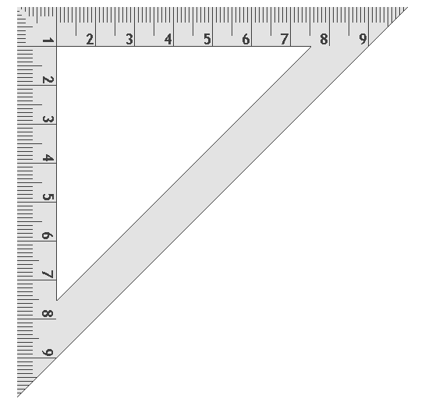
Construction 5
Line Parallel to a Given Line, Through a Given Point
Method 1: Solution Using a Set Square
Using a set square, draw a line perpendicular to the line m and through the point C.
Line up one of the two shorter sides of the set square at point C and the other shorter side on the perpendicular line.
Now draw a line through the point C.
This line is parallel to the line m and passes through the point C.
Indicate the lines that are perpendicular on your construction.
Use a protractor or set square to check that the constructed line is parallel to the line m.
C
90º
90º
m

Slide 9
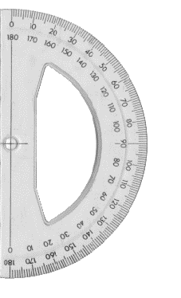
Construction 5
Line Parallel to a Given Line, Through a Given Point
Method 2: Using a Protractor and Set Square
Using a set square, draw a line perpendicular to the line m and through the point C.
Line up the protractor with this perpendicular line and place the centre of the protractor at the point C. At the 90° mark on the protractor mark the point D.
Now draw a line passing through both C and D.
This line is parallel to the line m and passes through the point C.
Indicate the lines that are perpendicular on your construction.
Use a protractor or set square to check that the constructed line is parallel to the line m.
C
D
90º
90º
m

Slide 10
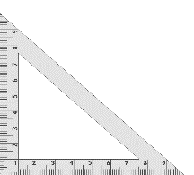
Construction 6
Division of a Line Segment into Three Equal Segments, Without Measuring
From point A (or B), draw a ray at an acute angle to the given line segment.
Place the compass needle point on A. Using the same compass width, mark off three equal arcs along the ray. (Use a small compass width.)
Label the points of intersection R, S and T.
Use a straight edge to draw a line segment from T to B.
Using a set square and straight edge, line the set square up with [TB].
Slide the set square along the straight edge.
Using the set square, draw a line segment from S and R to [AB].
The line segment [AB] has now been divided into three equal segments.
A
B
R
S
T

Slide 11
Construction 8
Line Segment of a Given Length on a Given Ray
Construct a line segment 5 cm in length on the given ray.
Draw a ray through the two points X and Y, starting at X.
Using a ruler, draw [EF] of length 5 cm.
Place the compass needle point on the point E. Adjust the compass width until it is at point F, i.e. the compass width is 5 cm.
Using this compass width, place the compass needle point on the point X.
Without adjusting the compass width, draw an arc that crosses the ray. Label this point of intersection as Z.
E
5 cm
F
Ray
X
5 cm
Z
Y

