Slide 1



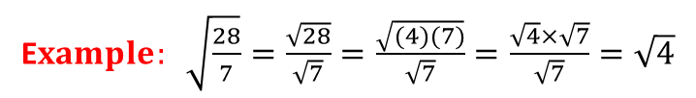



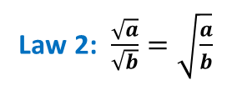

Surds
Roots that are irrational are called surds.
Law 1: $\sqrt{a}\sqrt{b}=\sqrt{ab}$
E$xample: \sqrt{18}=\sqrt{(9)(2)}=\sqrt{9}×\sqrt{2}=3\sqrt{2}$
Law 2: $\frac{\sqrt{a}}{\sqrt{b}}=\sqrt{\frac{a}{b}}$
E$xample: \sqrt{\frac{28}{7}}=\frac{\sqrt{28}}{\sqrt{7}}=\frac{\sqrt{(4)(7)}}{\sqrt{7}}=\frac{\sqrt{4}×\sqrt{7}}{\sqrt{7}}=\sqrt{4}$
Simplify $\sqrt{32}+\sqrt{18}+\sqrt{128}$, without the use of a calculator.
$$\sqrt{32}+\sqrt{18}+\sqrt{128}$$
$$=\sqrt{16×2}+\sqrt{9×2}+\sqrt{64×2}$$
$$=\sqrt{16}\sqrt{2}+\sqrt{9}\sqrt{2}+\sqrt{64}\sqrt{2}$$
Law 1
$$=4\sqrt{2}+3\sqrt{2}+8\sqrt{2}$$
$$=15\sqrt{2}$$

Slide 2












Surds
Write $\sqrt{27}+\sqrt{12}$in the form of k$\sqrt{3}$, where k ∈ N.
$$\sqrt{27}+\sqrt{12}$$
$$=\sqrt{9×3}+\sqrt{4×3}$$
$$=\sqrt{9}×\sqrt{3}+\sqrt{4}×\sqrt{3}$$
$$=3\sqrt{3}+2\sqrt{3}$$
$$=5\sqrt{3}$$
If $\sqrt{8}+\sqrt{50}−\sqrt{2}=n\sqrt{2}$, find the value of n.
$$\sqrt{8}+\sqrt{50}−\sqrt{2}=n\sqrt{2}$$
$$\sqrt{4×2}+\sqrt{25×2}−\sqrt{2}=n\sqrt{2}$$
$$\sqrt{4}\sqrt{2}+\sqrt{25}\sqrt{2}−\sqrt{2}=n\sqrt{2}$$
$$2\sqrt{2}+5\sqrt{2}−\sqrt{2}=n\sqrt{2}$$
$$6\sqrt{2}=n\sqrt{2}$$
$$∴n=6$$

