Slide 1
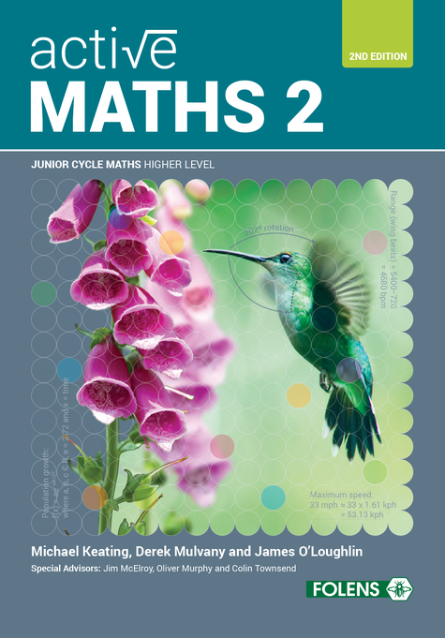
Sets
01
Active Maths 2
SECOND EDITION

Slide 2
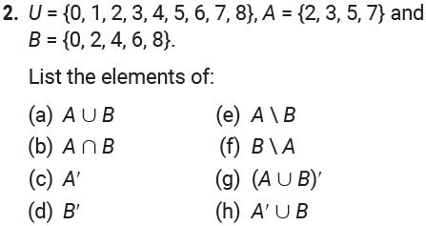
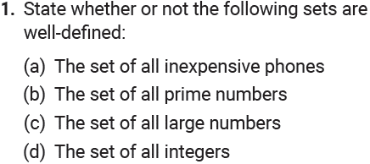
01
Sets
Exercise 1.1

Slide 3
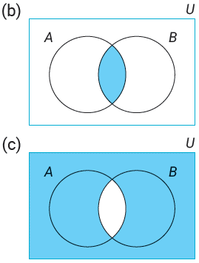
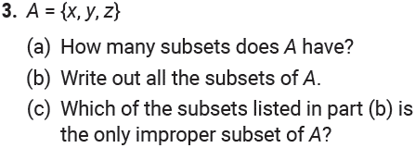
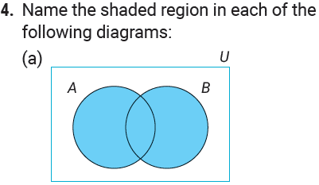
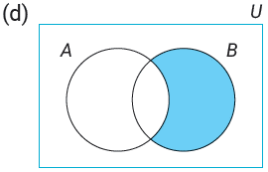
01
Sets
Exercise 1.1

Slide 4
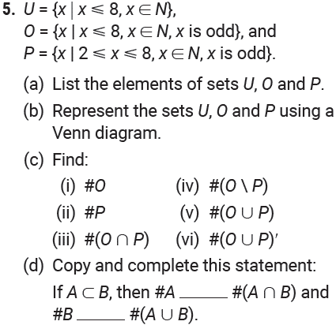
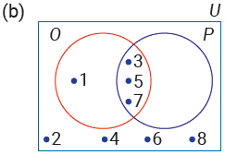
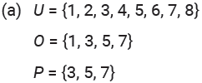
01
Sets
Exercise 1.1

Slide 5
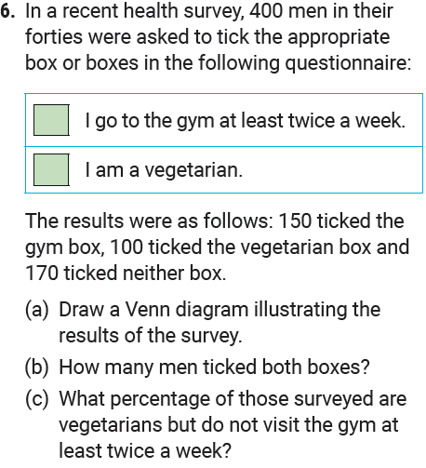
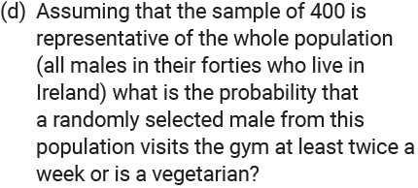
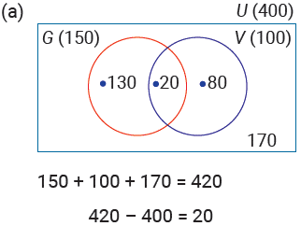
01
Sets
Exercise 1.1

Slide 6
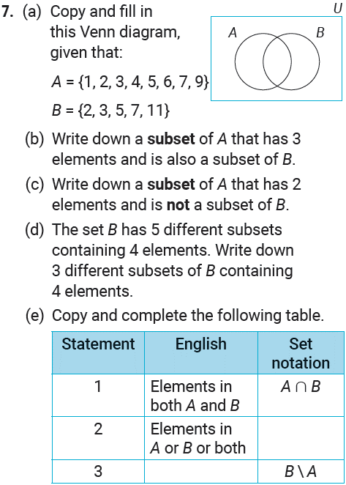
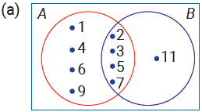
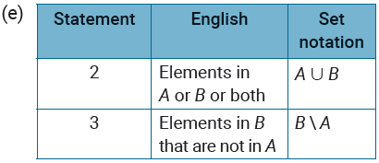
01
Sets
Exercise 1.1

Slide 7
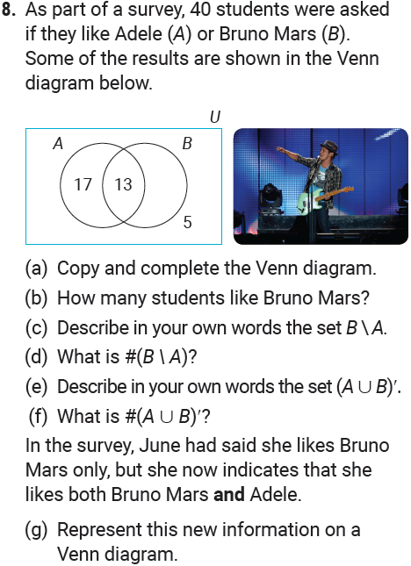
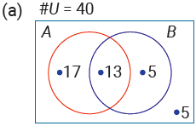
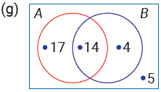
01
Sets
Exercise 1.1

Slide 8
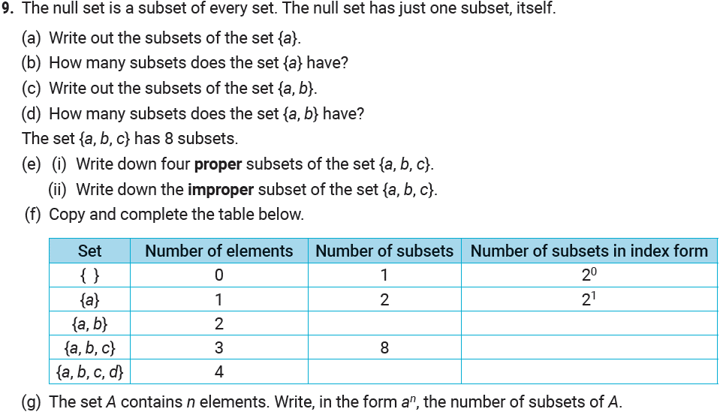
01
Sets
Exercise 1.1

Slide 9
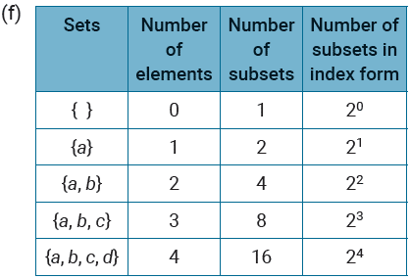
01
Sets
Exercise 1.1

Slide 10
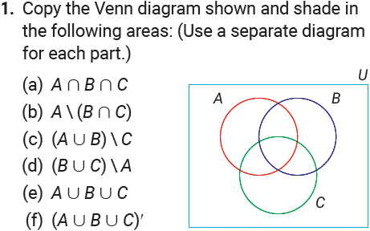
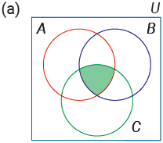
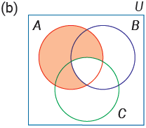
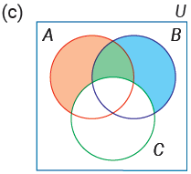
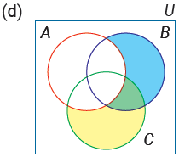
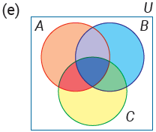
01
Sets
Exercise 1.2

Slide 11
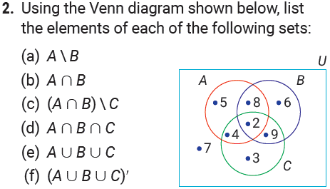
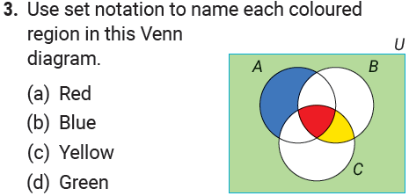
01
Sets
Exercise 1.2

Slide 12
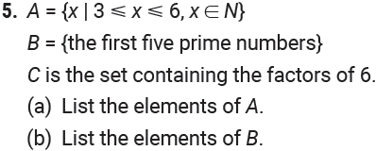
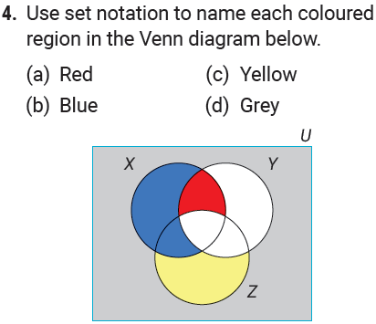
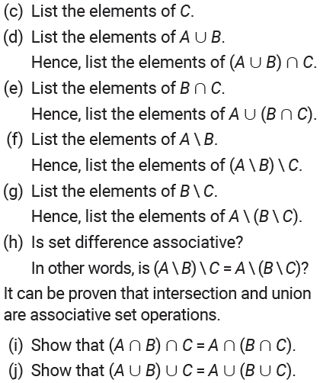
01
Sets
Exercise 1.2

Slide 13
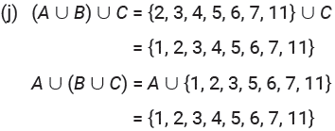
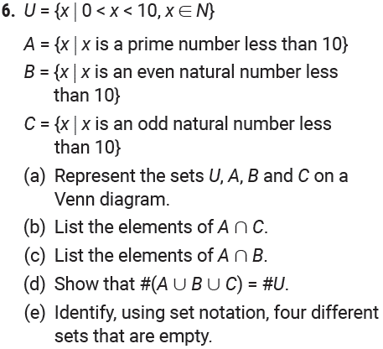
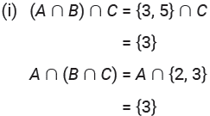
01
Sets
Exercise 1.2

Slide 14
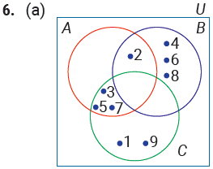
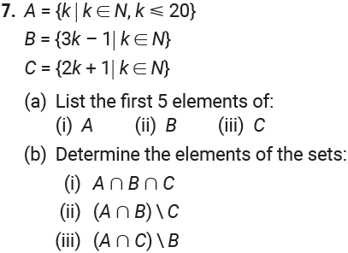
01
Sets
Exercise 1.2

Slide 15
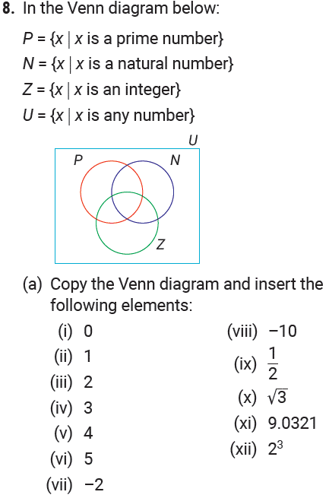
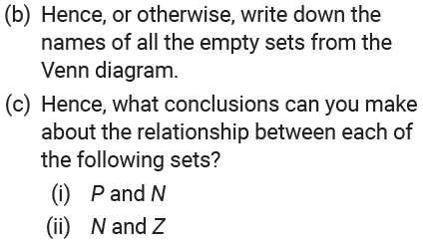
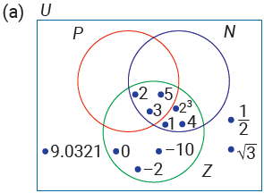
01
Sets
Exercise 1.2

Slide 16
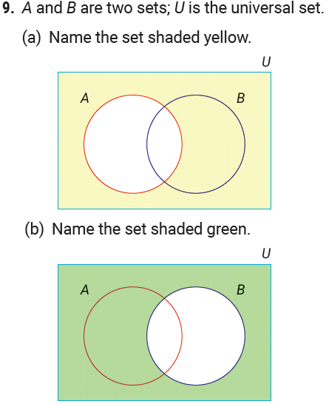
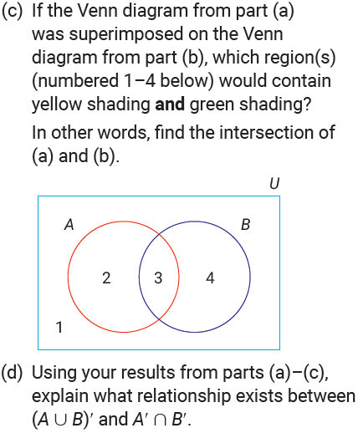
01
Sets
Exercise 1.2

Slide 17
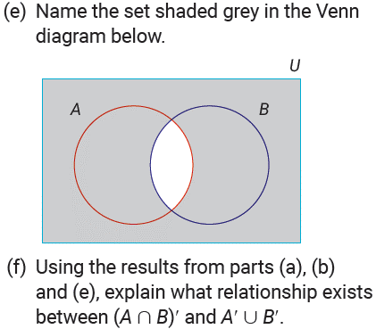
01
Sets
Exercise 1.2

Slide 18
01
Sets
Exercise 1.3

Slide 19
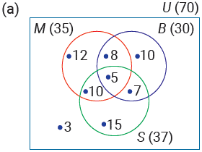
01
Sets
Exercise 1.3

Slide 20
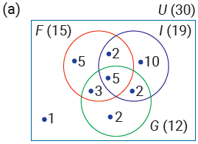
01
Sets
Exercise 1.3

Slide 21
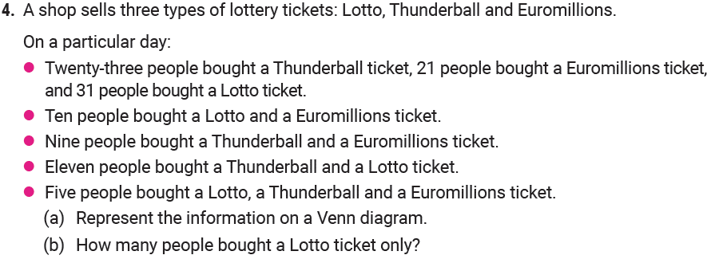
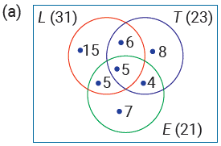
01
Sets
Exercise 1.3

Slide 22
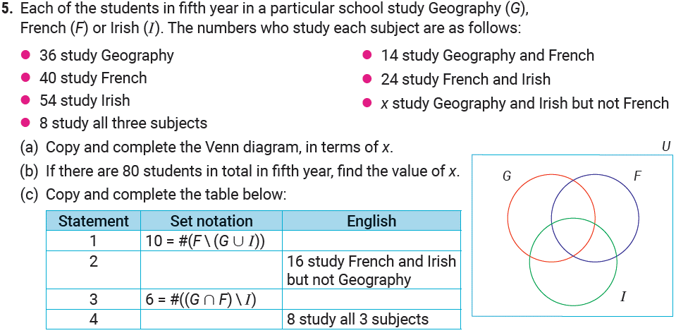
01
Sets
Exercise 1.3

Slide 23
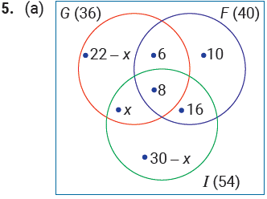
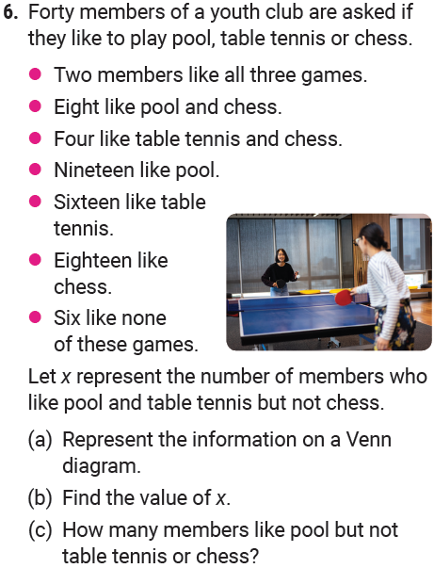
01
Sets
Exercise 1.3

Slide 24
01
Sets
Exercise 1.3

Slide 25
01
Sets
Exercise 1.3

Slide 26
01
Sets
Exercise 1.3

Slide 27
01
Sets
Exercise 1.3

Slide 28
01
Sets
Exercise 1.3

Slide 29
01
Sets
Revision Exercise

Slide 30
01
Sets
Revision Exercise

Slide 31
01
Sets
Revision Exercise

Slide 32
01
Sets
Revision Exercise

Slide 33
01
Sets
Revision Exercise

Slide 34
01
Sets
Revision Exercise

Slide 35
01
Sets
Revision Exercise

Slide 36
01
Sets
Revision Exercise

Slide 37
01
Sets
Revision Exercise

Slide 38
01
Sets
Revision Exercise

Slide 39
01
Sets
End of
Chapter 1 - Sets

