Slide 1
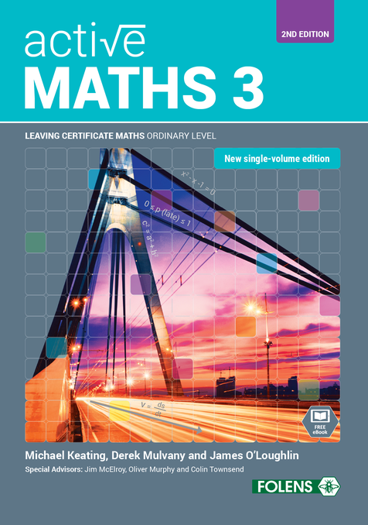
Counting and Permutations
11
Active Maths 3
SECOND EDITION

Slide 2
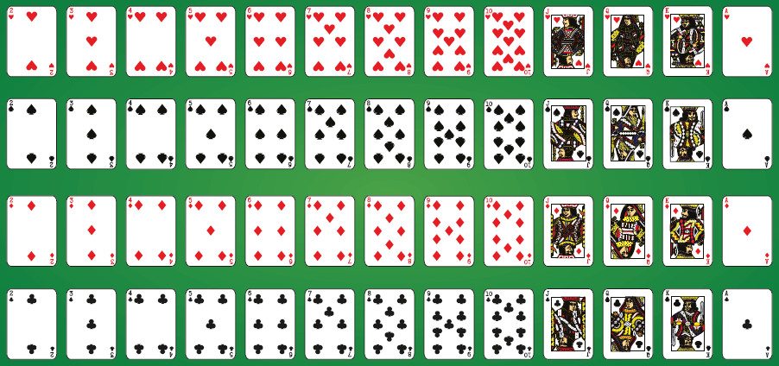
11
Counting and Permutations
Exercise 11.1

Slide 3
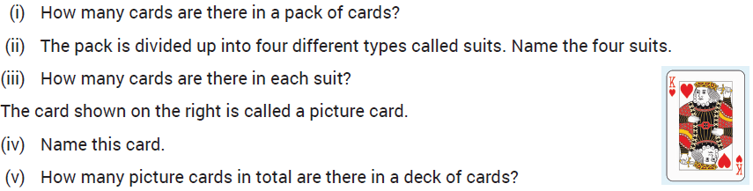
11
Counting and Permutations
Exercise 11.1
2.

Slide 4
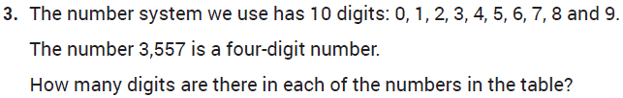
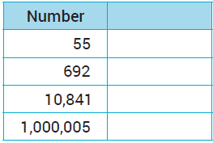
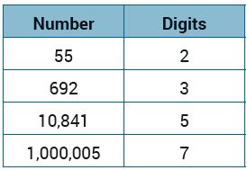
11
Counting and Permutations
Exercise 11.1

Slide 5

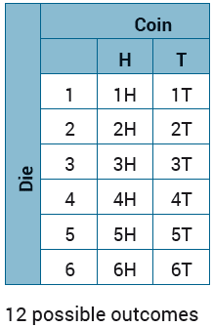
11
Counting and Permutations
Exercise 11.1

Slide 6
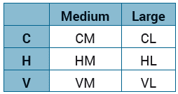
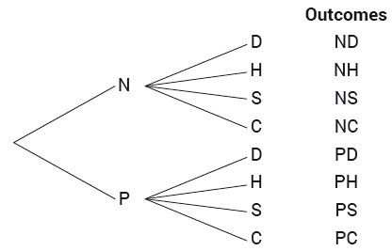
11
Counting and Permutations
Exercise 11.1

Slide 7
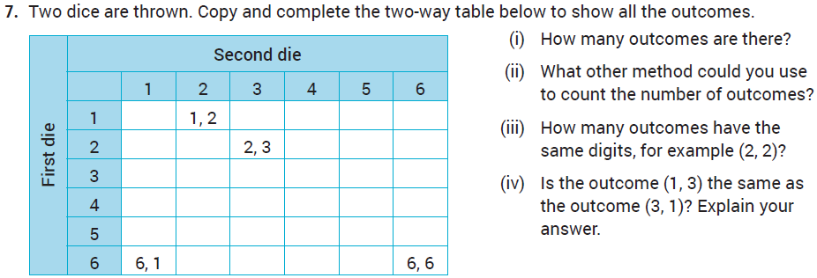
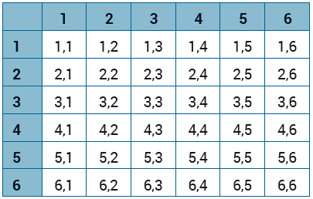
11
Counting and Permutations
Exercise 11.1

Slide 8

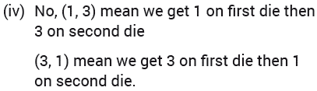
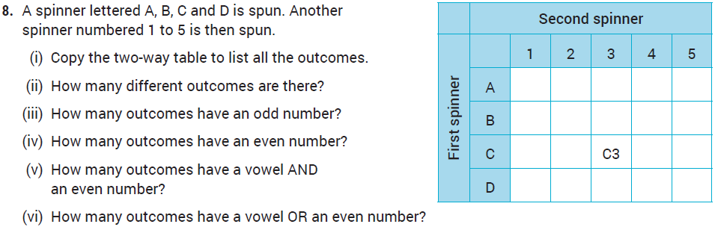
11
Counting and Permutations
Exercise 11.1
7.

Slide 9
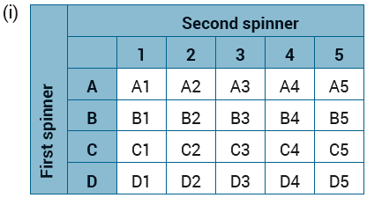

11
Counting and Permutations
Exercise 11.1
8.

Slide 10
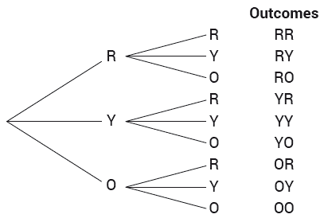
11
Counting and Permutations
Exercise 11.1

Slide 11
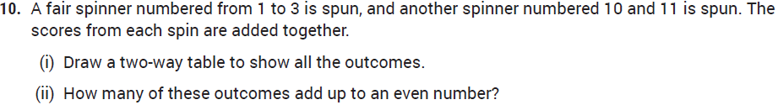
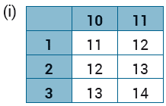
11
Counting and Permutations
Exercise 11.1

Slide 12
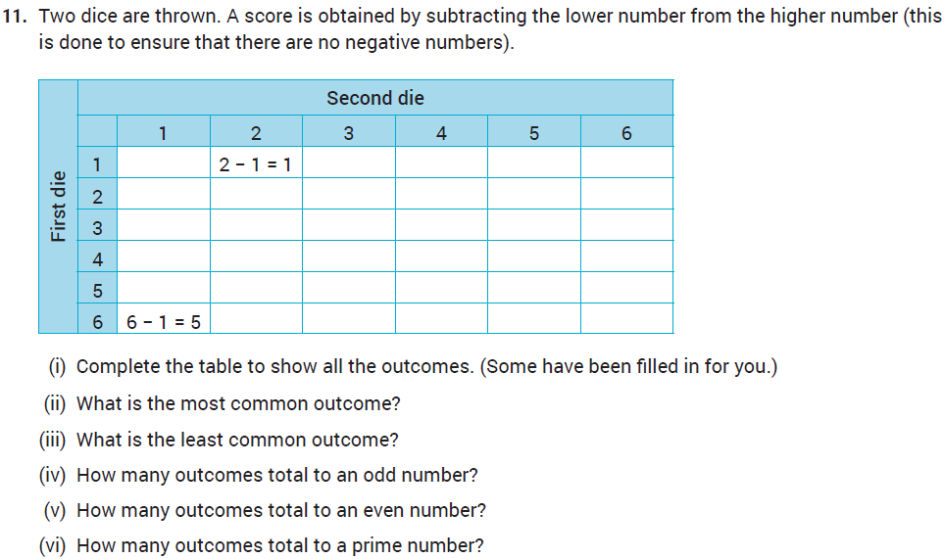
11
Counting and Permutations
Exercise 11.1

Slide 13
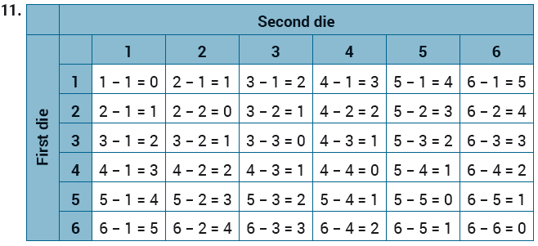
11
Counting and Permutations
Exercise 11.1

Slide 14
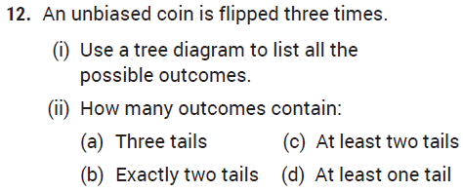
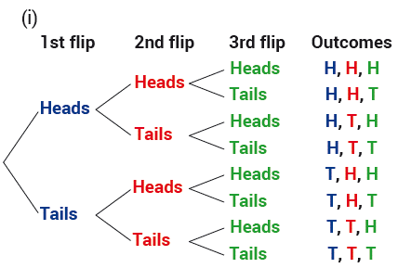

11
Counting and Permutations
Exercise 11.1

Slide 15
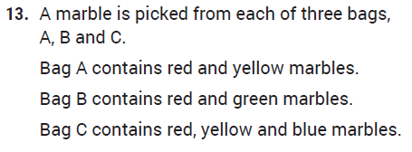
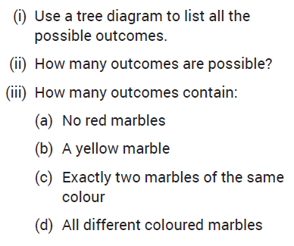
11
Counting and Permutations
Exercise 11.1

Slide 16
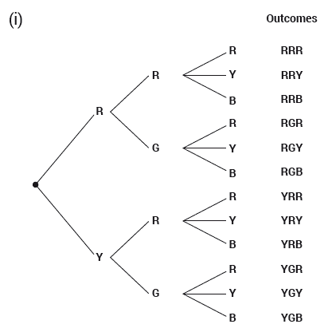


11
Counting and Permutations
Exercise 11.1

Slide 17
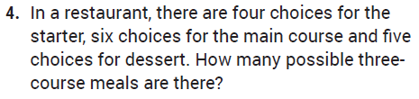



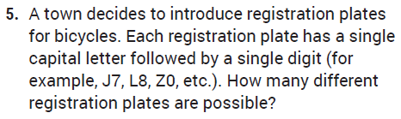


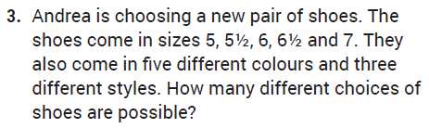



11
Counting and Permutations
Exercise 11.2

Slide 18
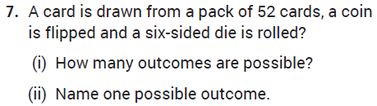
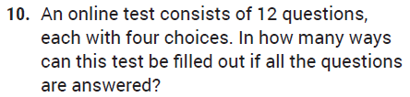



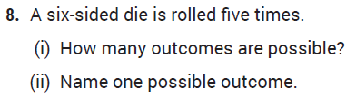




11
Counting and Permutations
Exercise 11.2

Slide 19
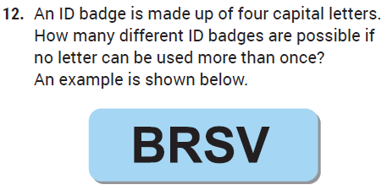
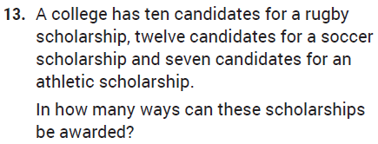

11
Counting and Permutations
Exercise 11.2

Slide 20
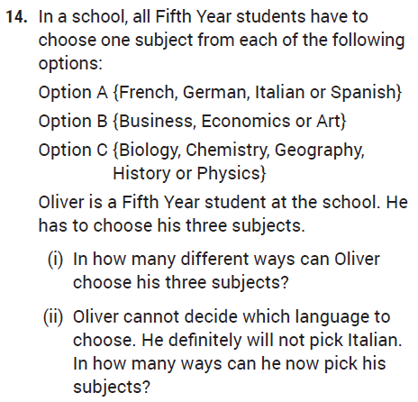
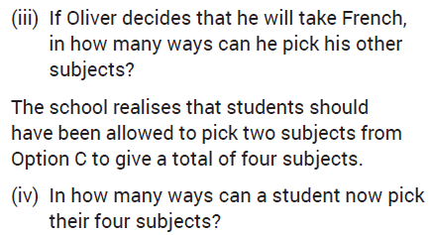

11
Counting and Permutations
Exercise 11.2

Slide 21
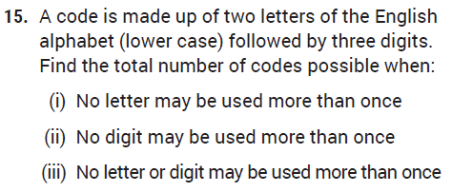
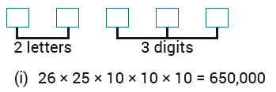
11
Counting and Permutations
Exercise 11.2

Slide 22
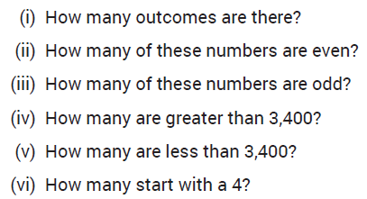



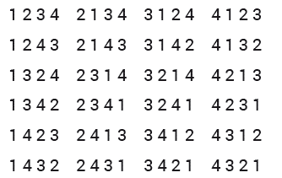
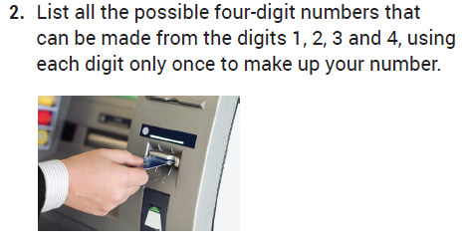



11
Counting and Permutations
Exercise 11.3

Slide 23
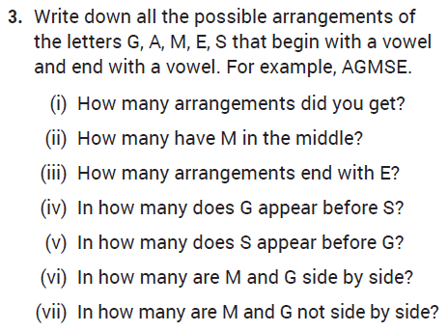


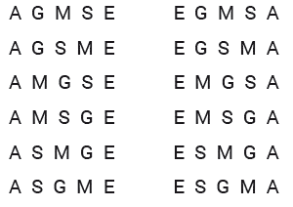


11
Counting and Permutations
Exercise 11.3

Slide 24


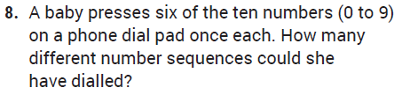

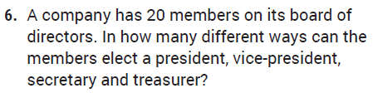


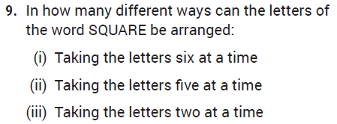
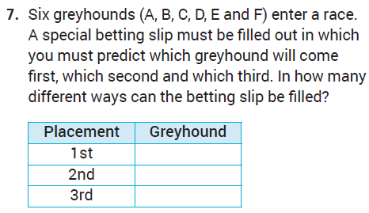



11
Counting and Permutations
Exercise 11.3

Slide 25
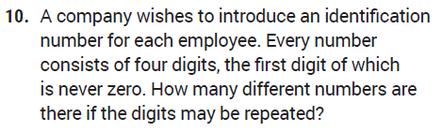
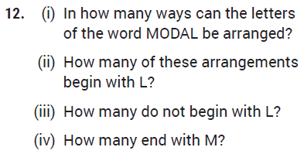


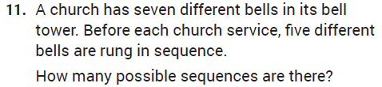


11
Counting and Permutations
Exercise 11.3

Slide 26
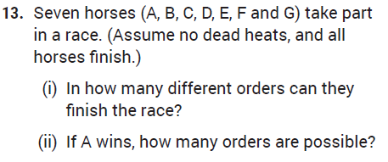


11
Counting and Permutations
Exercise 11.3

Slide 27
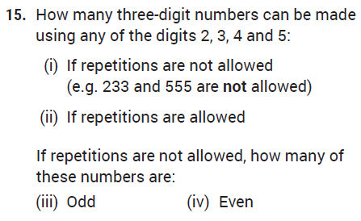




11
Counting and Permutations
Exercise 11.3

Slide 28











11
Counting and Permutations
Exercise 11.3

Slide 29









11
Counting and Permutations
Exercise 11.3

Slide 30






11
Counting and Permutations
Exercise 11.3

Slide 31



Counting and Permutations
Exercise 11.3

Slide 32





11
Counting and Permutations
Revision Exercises

Slide 33



11
Counting and Permutations
Revision Exercises

Slide 34


11
Counting and Permutations
Revision Exercises

Slide 35





11
Counting and Permutations
Revision Exercises

Slide 36





11
Counting and Permutations
Revision Exercises

Slide 37




11
Counting and Permutations
Revision Exercises

Slide 38








11
Counting and Permutations
Revision Exercises

Slide 39












11
Counting and Permutations
Revision Exercises

Slide 40






11
Counting and Permutations
Revision Exercises

Slide 41

11
Counting and Permutations
Exam Questions

Slide 42

11
Counting and Permutations
Exam Questions

Slide 43


11
Counting and Permutations
Exam Questions

Slide 44


11
Counting and Permutations
Exam Questions

Slide 45


11
Counting and Permutations
Exam Questions

Slide 46


11
Counting and Permutations
Exam Questions

Slide 47



11
Counting and Permutations
Exam Questions

Slide 48
11
Counting and Permutations
End of
Chapter 11 - Counting and Permutations

