Slide 1
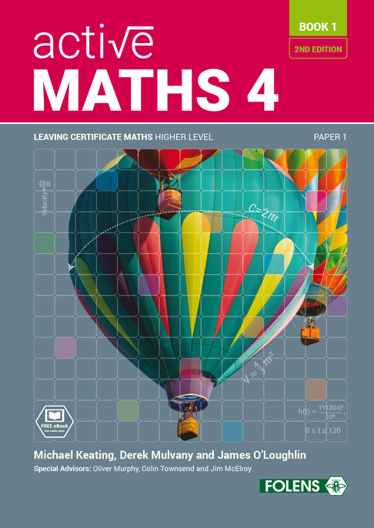
Arithmetic
09
Active Maths 4
BOOK 1
SECOND EDITION

Slide 2
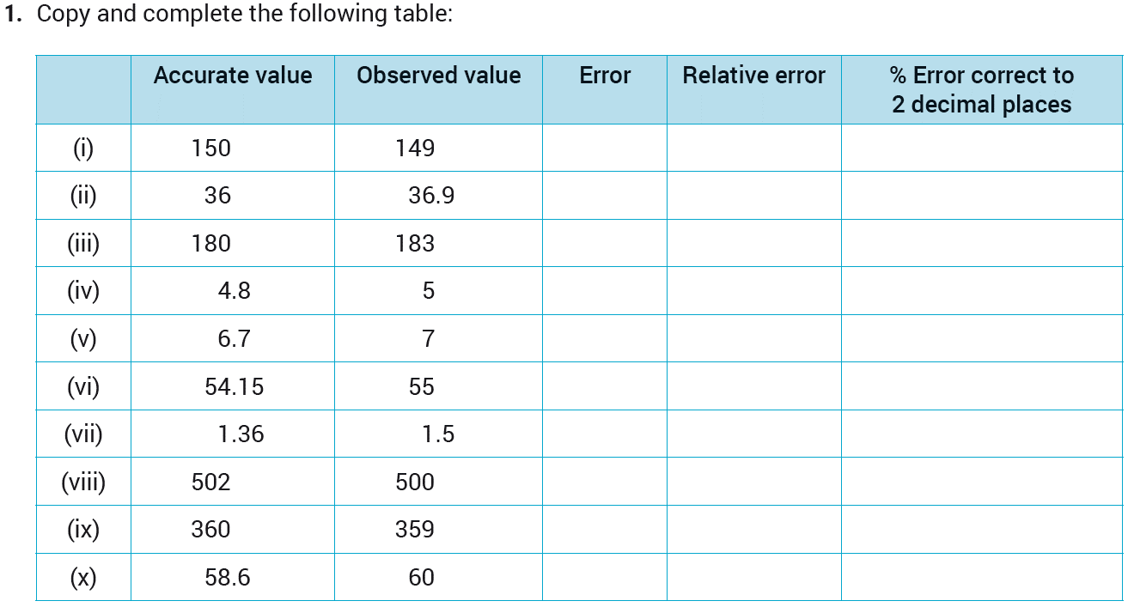
09
Arithmetic
Exercise 9.1

Slide 3
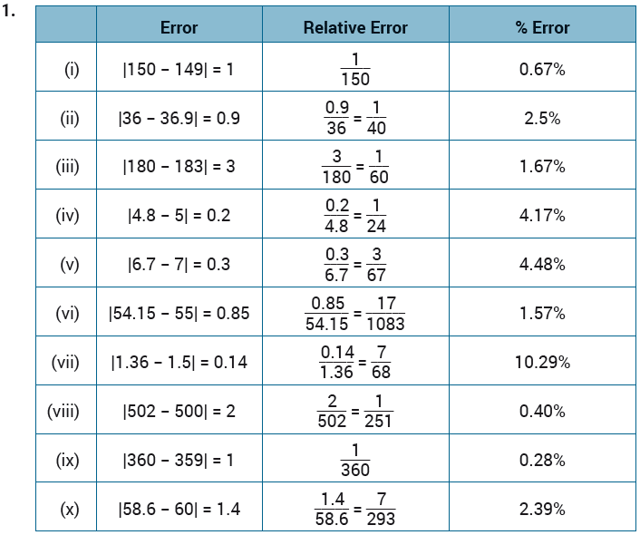
09
Arithmetic
Exercise 9.1

Slide 4

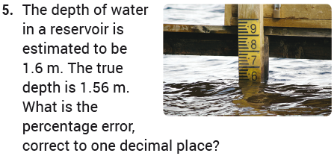






09
Arithmetic
Exercise 9.1

Slide 5
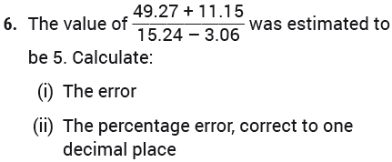
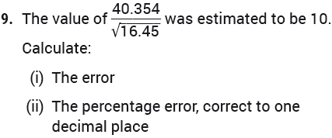




09
Arithmetic
Exercise 9.1

Slide 6
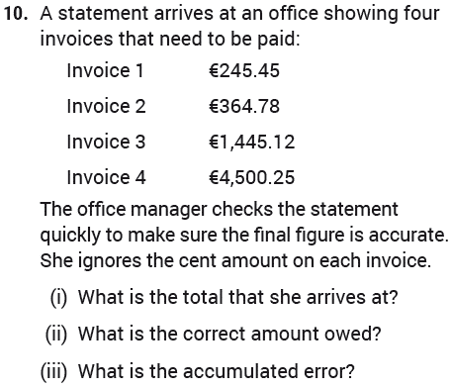
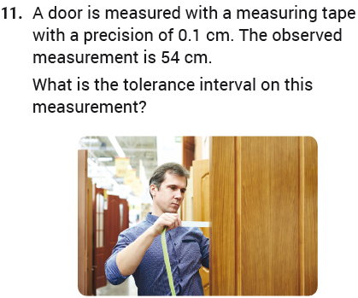
09
Arithmetic
Exercise 9.1

Slide 7
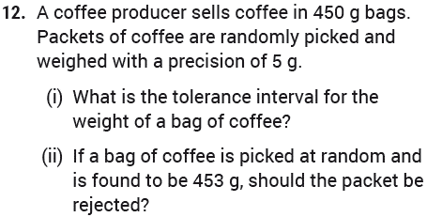

09
Arithmetic
Exercise 9.1

Slide 8

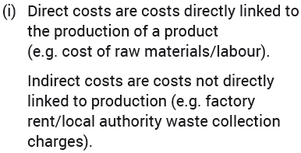
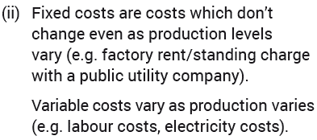
09
Arithmetic
Exercise 9.2

Slide 9
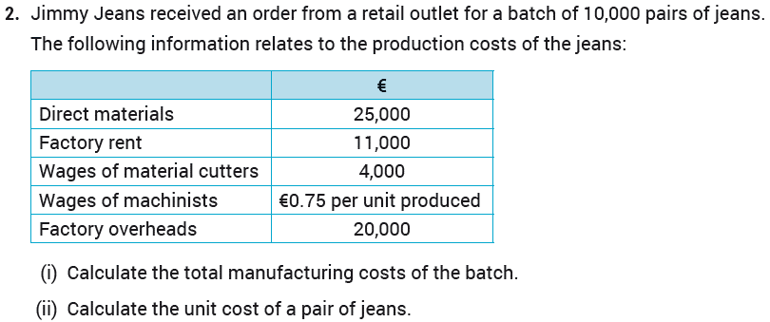

09
Arithmetic
Exercise 9.2

Slide 10
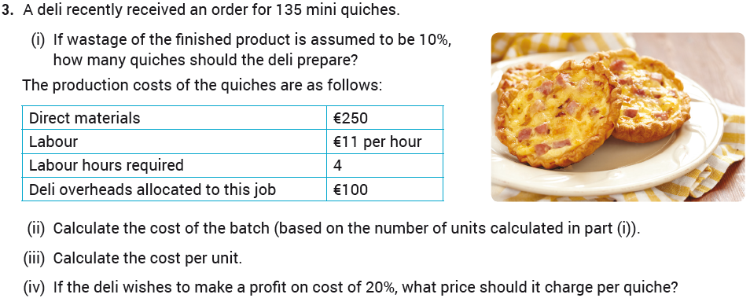
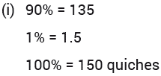
09
Arithmetic
Exercise 9.2

Slide 11
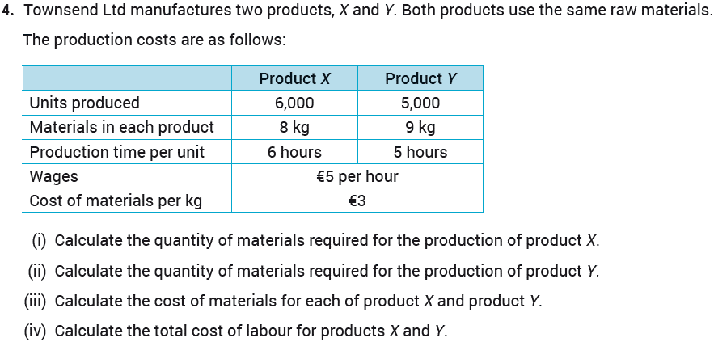

09
Arithmetic
Exercise 9.2

Slide 12
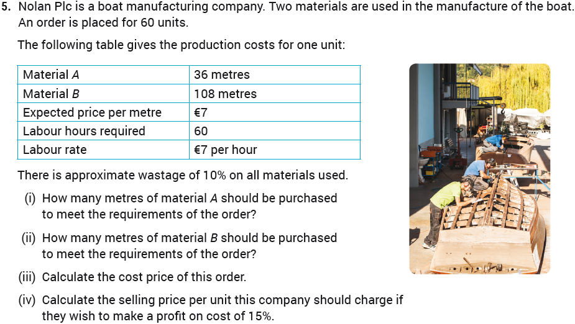
09
Arithmetic
Exercise 9.2

Slide 13



09
Arithmetic
Exercise 9.2

Slide 14
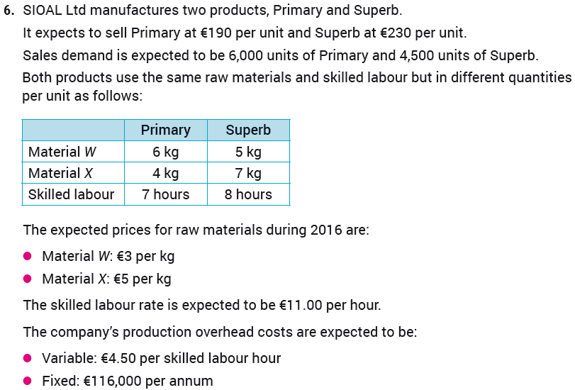
09
Arithmetic
Exercise 9.2

Slide 15
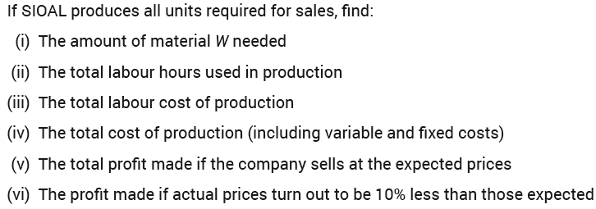



09
Arithmetic
Exercise 9.2

Slide 16

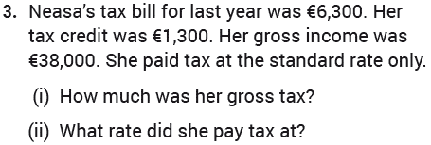



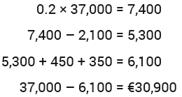
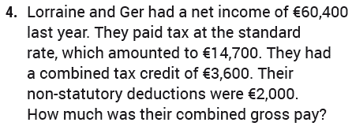

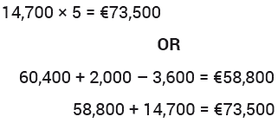

09
Arithmetic
Exercise 9.3

Slide 17
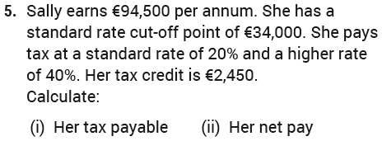

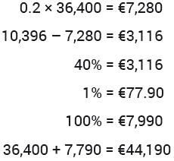

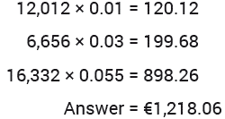
09
Arithmetic
Exercise 9.3

Slide 18
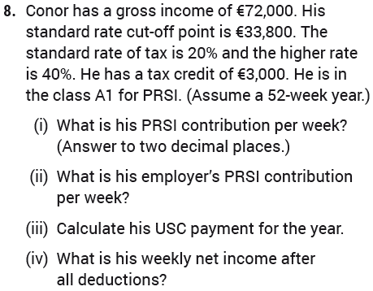


09
Arithmetic
Exercise 9.3

Slide 19
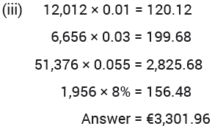
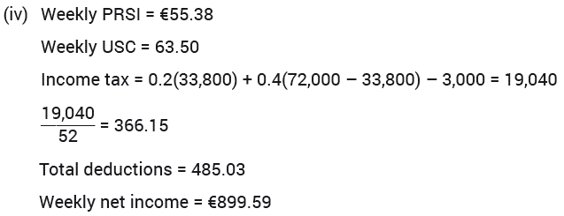
09
Arithmetic
Exercise 9.3

Slide 20
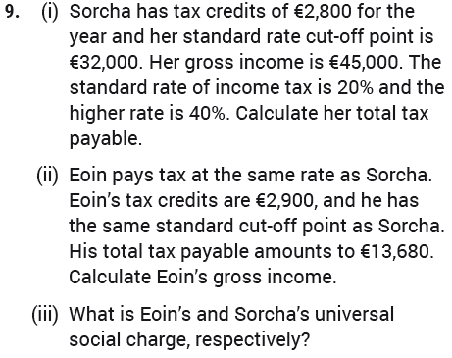
09
Arithmetic
Exercise 9.3

Slide 21
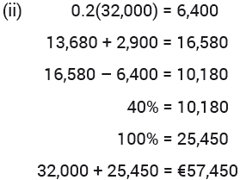
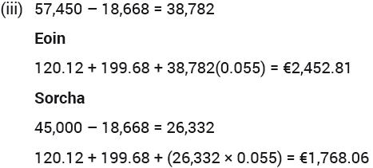
09
Arithmetic
Exercise 9.3

Slide 22

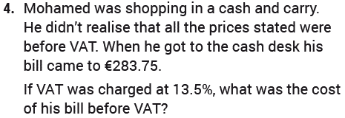






09
Arithmetic
Exercise 9.4

Slide 23

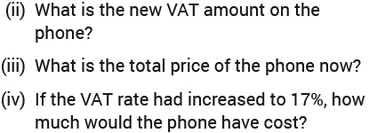

09
Arithmetic
Exercise 9.4

Slide 24

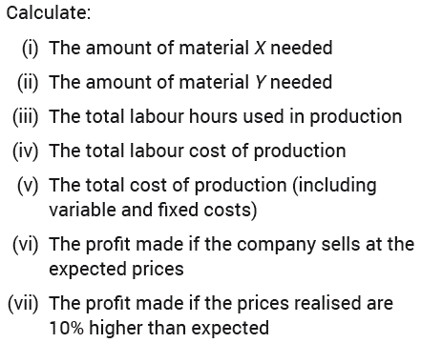
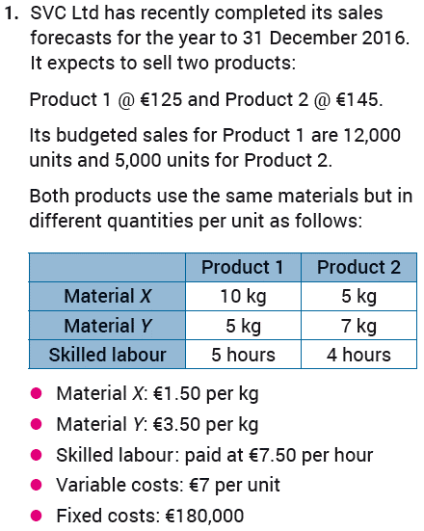
09
Arithmetic
Revision Exercises

Slide 25

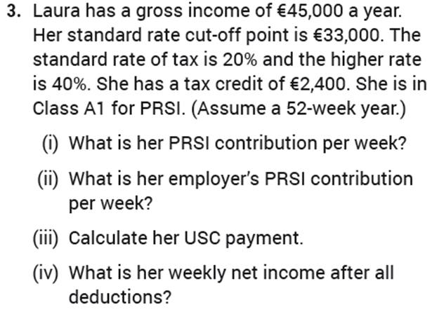





09
Arithmetic
Revision Exercises

Slide 26
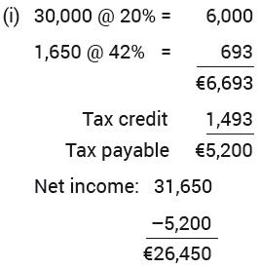
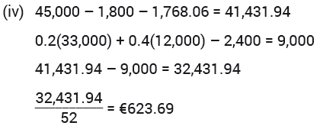
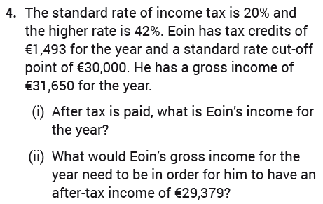
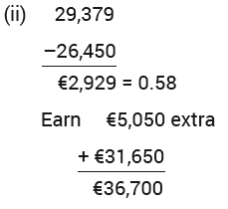
09
Arithmetic
Revision Exercises

Slide 27
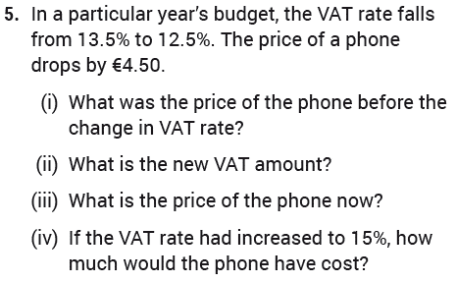

09
Arithmetic
Revision Exercises

Slide 28
09
Arithmetic
End of
Chapter 9 - Arithmetic

