Slide 1
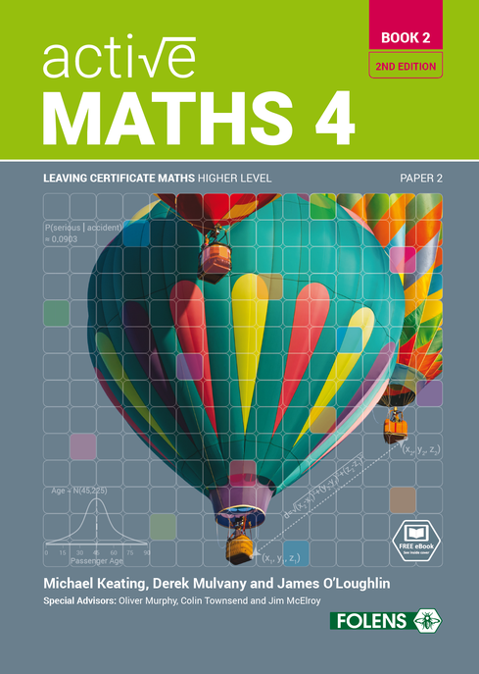
Enlargements
12
Active Maths 4
BOOK 2
SECOND EDITION

Slide 2
12
Enlargements
Exercise 12.2

Slide 3
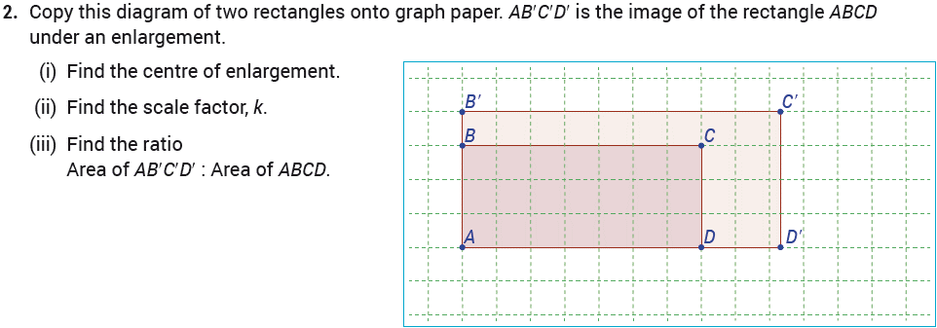
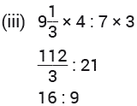
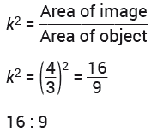
12
Enlargements
Exercise 12.2

Slide 4
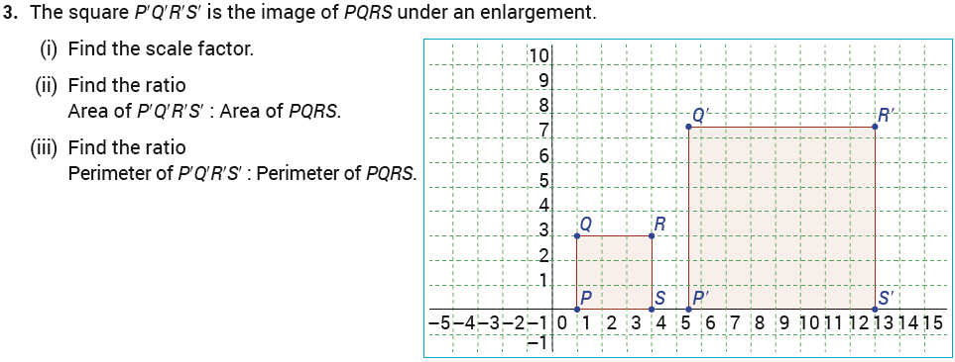
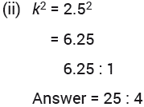
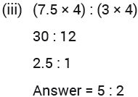
12
Enlargements
Exercise 12.2

Slide 5
12
Enlargements
Exercise 12.2

Slide 6
12
Enlargements
Exercise 12.2

Slide 7
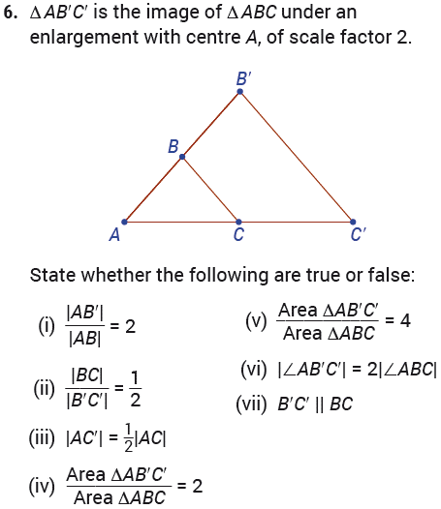
12
Enlargements
Exercise 12.2

Slide 8
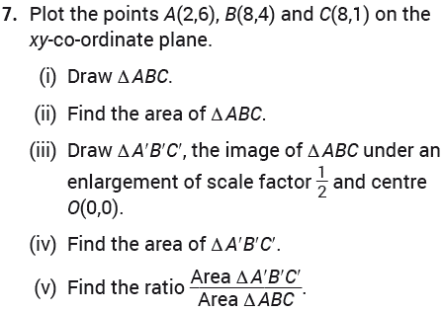
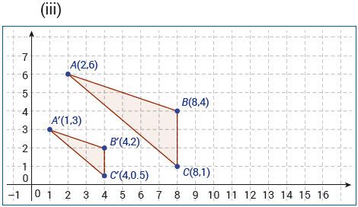
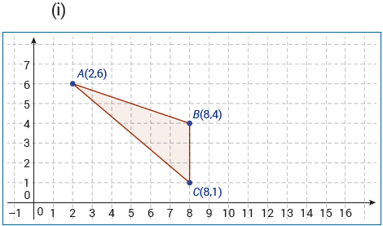
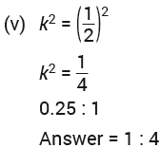
12
Enlargements
Exercise 12.2

Slide 9
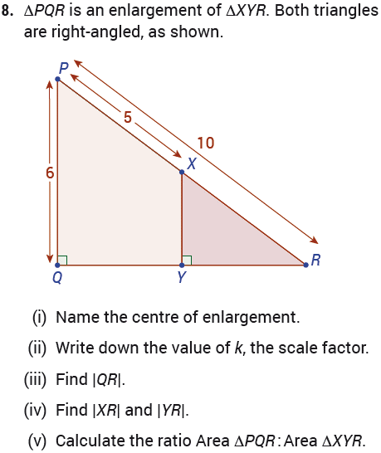
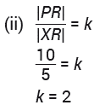
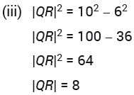
12
Enlargements
Exercise 12.2

Slide 10
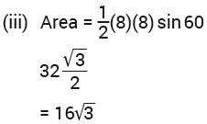
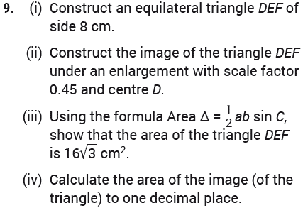
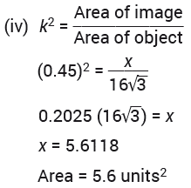
12
Enlargements
Exercise 12.2

Slide 11
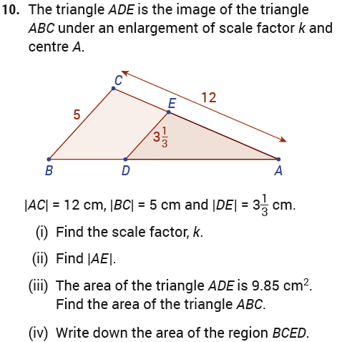
12
Enlargements
Exercise 12.2

Slide 12
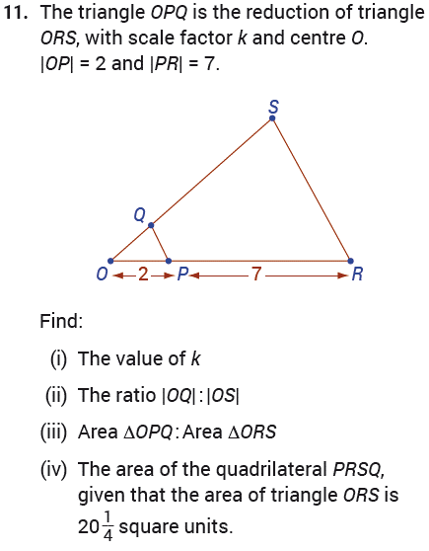
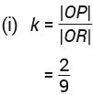
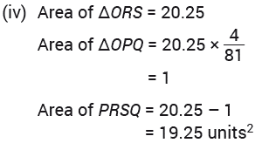
12
Enlargements
Exercise 12.2

Slide 13
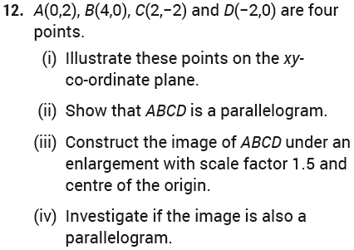
12
Enlargements
Exercise 12.2

Slide 14
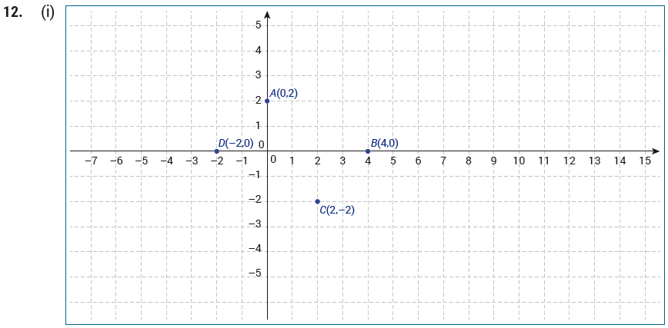
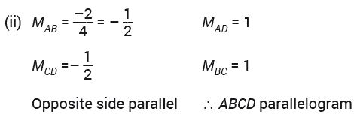
12
Enlargements
Exercise 12.2

Slide 15
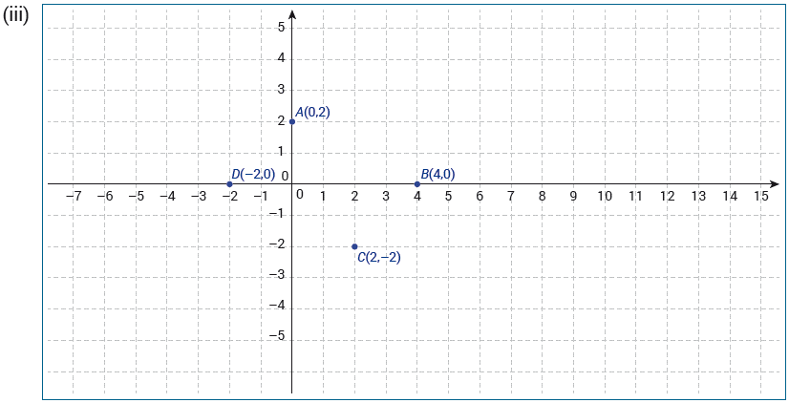
12
Enlargements
Exercise 12.2

Slide 16
12
Enlargements
Exercise 12.2

Slide 17
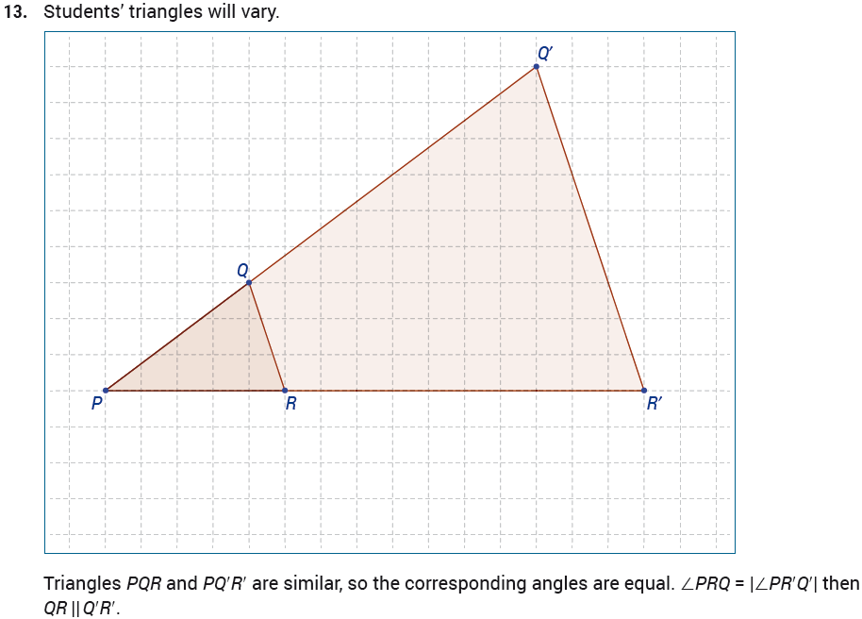
12
Enlargements
Exercise 12.2

Slide 18
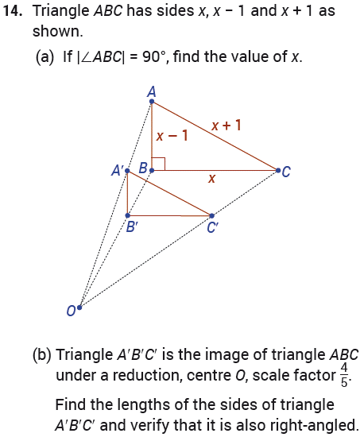
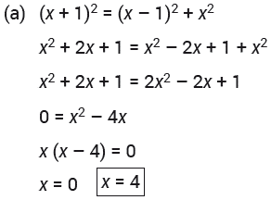
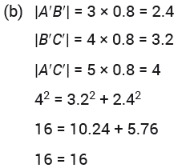
12
Enlargements
Exercise 12.2

Slide 19
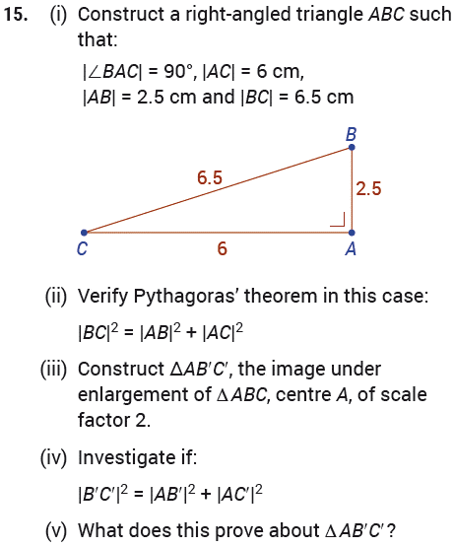
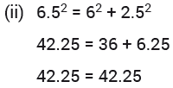
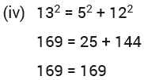
12
Enlargements
Exercise 12.2

Slide 20
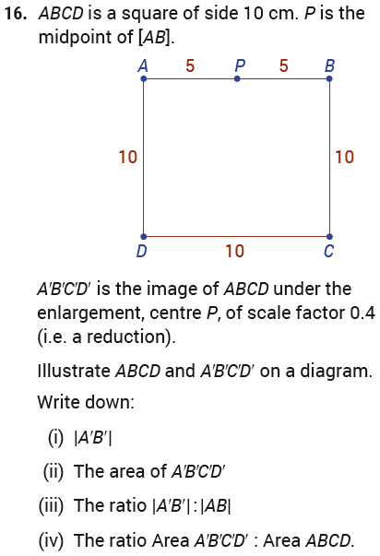
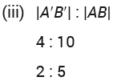
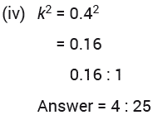
12
Enlargements
Exercise 12.2

Slide 21
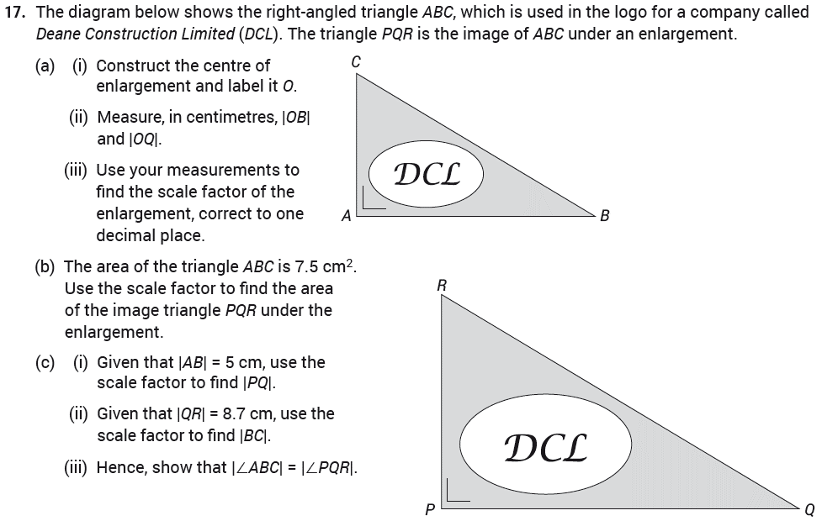
12
Enlargements
Exercise 12.2

Slide 22
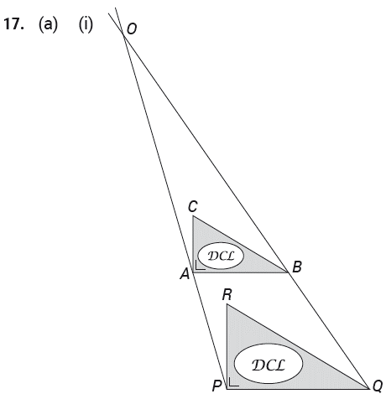
12
Enlargements
Exercise 12.2

Slide 23
12
Enlargements
Exercise 12.2

Slide 24
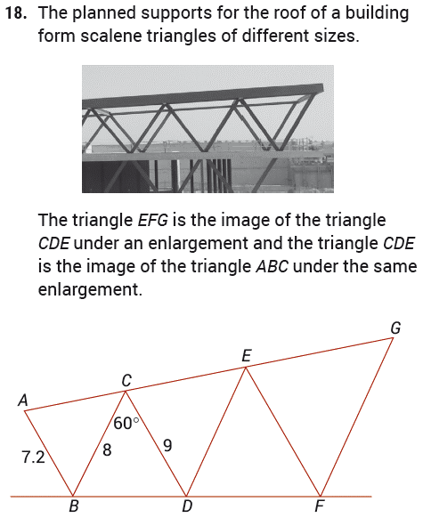
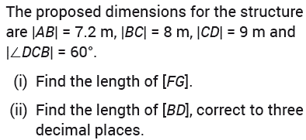
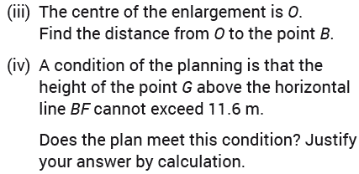
12
Enlargements
Exercise 12.2

Slide 25
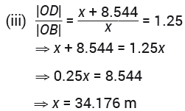
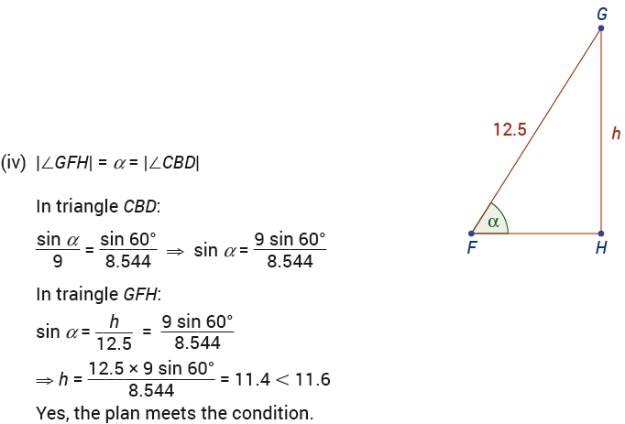
12
Enlargements
Exercise 12.2

Slide 26
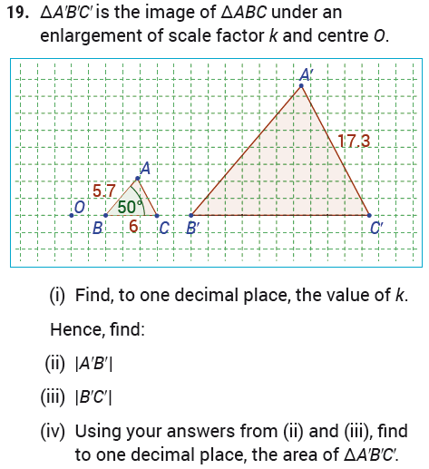
12
Enlargements
Exercise 12.2

Slide 27
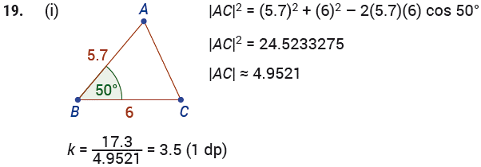
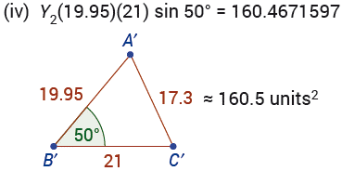
12
Enlargements
Exercise 12.2

Slide 28
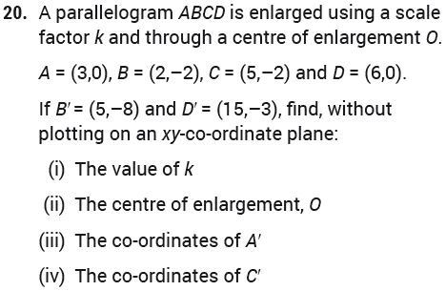
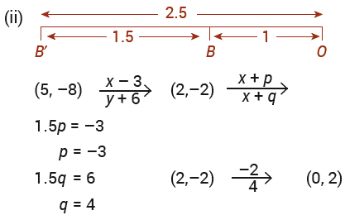
12
Enlargements
Exercise 12.2

Slide 29
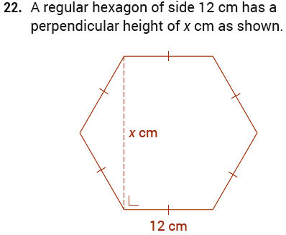
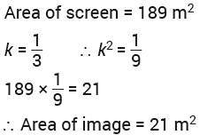
12
Enlargements
Exercise 12.2

Slide 30
12
Enlargements
Exercise 12.2

Slide 31
12
Enlargements
Exercise 12.2

Slide 32
12
Enlargements
Exercise 12.2

Slide 33
12
Enlargements
Exam Questions

Slide 34
12
Enlargements
Exam Questions

Slide 35
12
Enlargements
End of
Chapter 12 - Enlargements

