Slide 1
Chapter 19: Statistics II

Slide 2
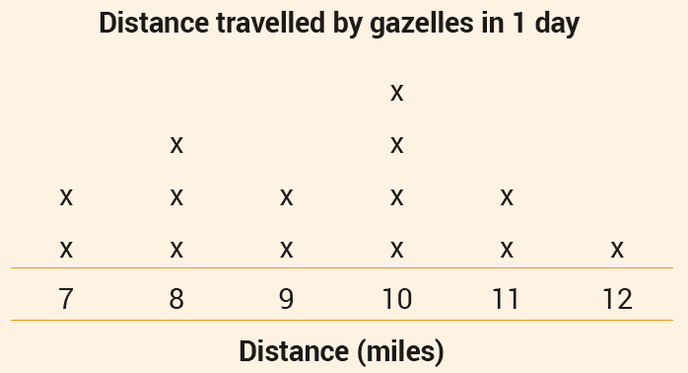
Line Plots
A line plot is a simple and effective way of representing categorical or discrete numerical data.
Line plots are suitable for small amounts of data.
A line plot uses symbols – usually x’s – to represent the frequency of a piece of data.
The Mongolian gazelle can travel up to 12 miles per day. The line plot shows the distance that 14 gazelles travelled in 1 day.
(a) How many gazelles travelled a total of 9 miles?
(b) How many gazelles travelled a total of 10 miles or more?
(c) What fraction of the group travelled a total of 10 miles or more?
(d) What is the sum of the distances (in miles) travelled by the 14 gazelles?
(a) 2
(b) 4 + 2 + 1 = 7 gazelles
(c) $\frac{7}{14}$ = $\frac{1}{2}$
(d) 2 × 7 + 3 × 8 + 2 × 9 + 4 × 10 + 2 × 11 + 1 × 12 = 130 miles

Slide 3
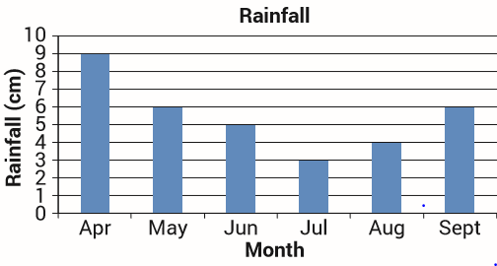
Bar Charts
Bar charts are suitable for displaying categorical or discrete numerical data. If the amount of data is large then bar charts are preferable to line plots.
The bar chart shown displays the monthly rainfall in an area over a six-month period.
(a) Which was the wettest month? (b) Which was the driest month? (c) What was the total rainfall for the six-month period? (d) What fraction of the rain for the period fell during May?
(a) April
(c) 9 + 6 + 5 + 3 + 4 + 6 = 33 cm
(b) July
(d) $\frac{6}{33}=\frac{2}{11}$

Slide 4
Bar Charts
A survey was carried out in a Second Year mathematics class. Students were asked to select their favourite colour from a list of colours. The results are shown in the table below:
(a) Represent the data with a bar chart. (b) What is the most popular colour?
(a)
8
(b) Red
7
6
5
4
Frequency
3
2
1
Blue
Red
Green
Yellow
Black
Orange
Colour

Slide 5
Pie Charts
A pie chart can be used to display the proportion of categorical data in one category in comparison to the proportions in other categories.
Students in a class are asked to name their favourite indoor sport. Here are their findings:
Represent this information in a pie chart.
To draw a pie chart we need to represent each part of the data as a proportion of 360º.
Step 1: Find the total number of students: 12 + 6 + 5 + 1 = 24 students.
Step 2: Find the angle in each sector.
Basketball = $\frac{12}{24}×360°=180°$
Badminton = $\frac{6}{24}×360°=90°$
Squash = $\frac{5}{24}×360°=75°$
Table tennis = $\frac{1}{24}×360°=15°$

Slide 6
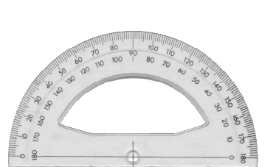
Pie Charts
Step 3: Draw a circle (usually a circle with radius 5–8 cm looks best), and mark its centre.
Using your protractor, construct and label the sectors as follows.
Table tennis
15º
Table Tennis
Squash
Badminton
Squash
Badminton
75º
90º
180º
Basketball
Basketball
Favourite Indoor Sport
Draw a circle showing a horizontal radius.
Draw the diameter which will give an angle of 180º.
With a protractor mark off a 90º angle.
With a protractor mark off a 15º angle.

Slide 7
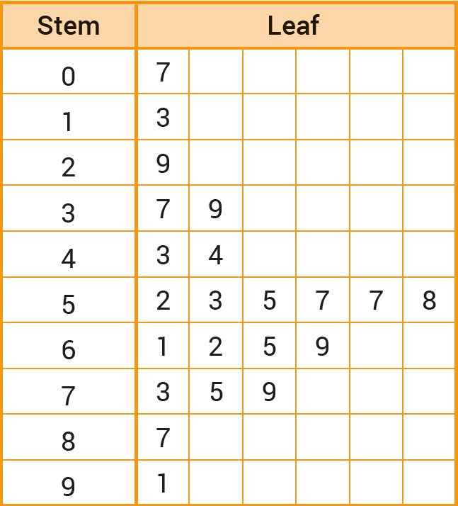
Stem and Leaf Plots
A stem and leaf plot represents numerical data by separating each piece of data into two parts: the stem and the leaf.
Here is a list of the number of emails received by 22 students during October:
87, 57, 29, 79, 7, 55, 53, 65, 69, 62, 39, 43, 13, 91, 61, 57, 75, 44, 73, 58, 52, 37.
Arrange the data in order.
7, 13, 29, 37, 39, 43, 44, 52, 53, 55, 57, 57, 58, 61, 62, 65, 69, 73, 75, 79, 87, 91
Key: 3|7 = 37 emails

Slide 8
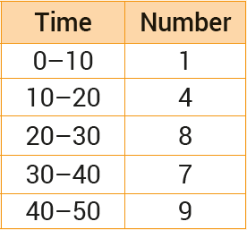
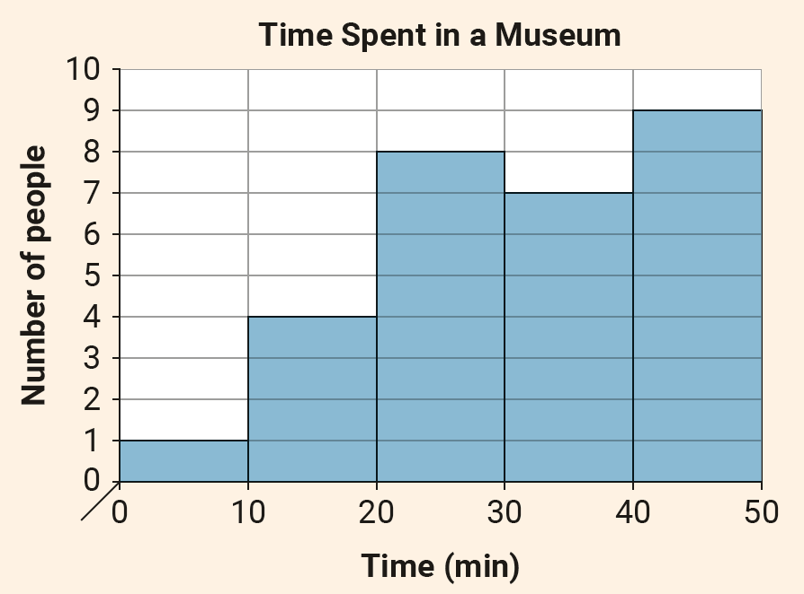
Histograms
Histograms are used to represent continuous data. Unlike a bar chart, there are no spaces between the bars on a histogram.
This frequency table shows the times (in minutes) spent by a group for people in a museum.
Note: 10—20 means 10 or more but less than 20 and so on.
Represent the data in a histogram.
TITLE

Slide 9
Histograms
Histograms are used to represent continuous data. Unlike a bar chart, there are no spaces between the bars on a histogram.
This frequency table shows the times (in minutes) spent by a group for people in a museum.
Note: 10—20 means 10 or more but less than 20 and so on.
Represent the data in a histogram.
Labelled vertical axis
Labelled horizontal axis

Slide 10
Histograms
Histograms are used to represent continuous data. Unlike a bar chart, there are no spaces between the bars on a histogram.
This frequency table shows the times (in minutes) spent by a group for people in a museum.
Note: 10—20 means 10 or more but less than 20 and so on.
Represent the data in a histogram.
Note: Marked and scaled intervals on both axes.

Slide 11
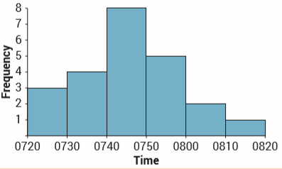
Histograms
A supermarket opens at 0800. The histogram below shows the distribution of the times employees arrived for work on a particular day.
Note: 0720–0730 includes 0720 but excludes 0730, etc.
(a) How many employees arrived before 0730? (b) How many employees arrived at or after 0730 but before 0800? (c) How many employees arrived for work on this particular morning? (d) What fraction of the employees arrived no sooner than 0800?
(a) 3
(b) 4 + 8 + 5 = 17
(c) 3 + 17 + 2 + 1= 23
(d) $\frac{3}{23}$

Slide 12
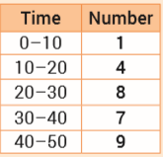
Histograms
The following frequency table shows the times, in minutes, spent by a group of people in a museum.
NOTE: 10–20 means 10 or more but less than 20, and so on.
Represent the data on a histogram.
10
Time spent at the museum
9
8
7
6
Number
5
4
3
2
1
0
10
20
30
40
50
Time (min)

Slide 13
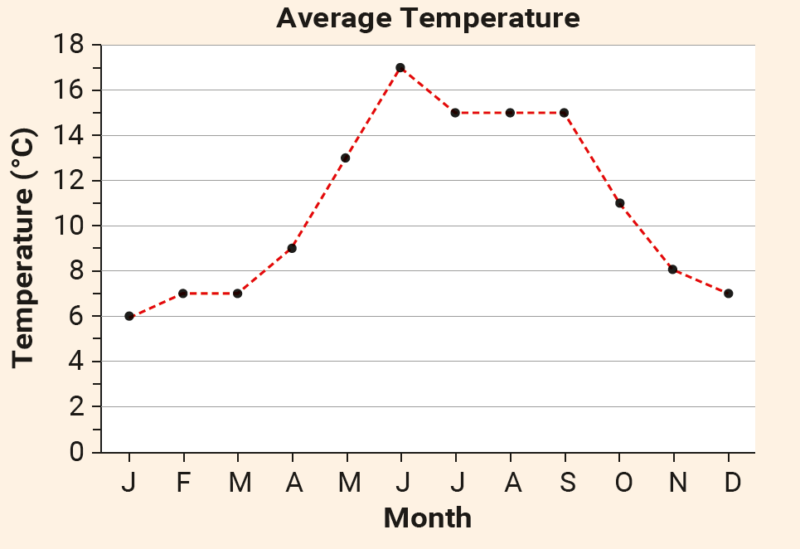
Trend Graphs
Trend graphs are used to show changes or trends in data over time.
The trend graph shows the average monthly temperature in Athenry during 2023. Temperatures are in degrees Celsius and corrected to the nearest whole number.
(a) Based on the graph:
In which month was the highest average monthly temperature recorded
In which month was the lowest average monthly temperature recorded?
What is the difference between the highest average monthly temperature and the lowest average monthly temperature?
June
January
Difference = 17 – 6
= 11 °C

Slide 14
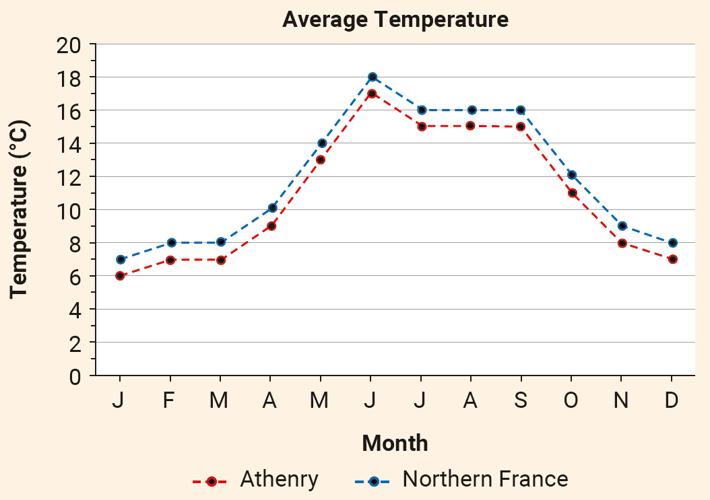
Trend Graphs
Trend graphs are used to show changes or trends in data over time.
(b) The average monthly temperatures for a town in northern France were 1 °C warmer than in Athenry for 2023. Use this information to draw a graph on a copy of the diagram above, showing the average monthly temperature in this town.

Slide 15
Choosing a Suitable Chart
Charts are a very important means of presenting data. The chart that you use to present your data will depend on the type of data that you are working with and on the information that you want your audience to get from the data.
Line plots are useful for data that is categorical or discrete numerical. Line plots are only suited to small data sets.
Bar charts are useful for data that is categorical or discrete numerical. Unlike line plots, bar charts can be used with large data sets.
Pie charts are useful for data that is categorical. The relative size of each category can be seen from a pie chart.
Stem and leaf plots are suitable for small amounts of discrete numerical data or continuous numerical data that has been rounded.
Histograms can be used to display continuous numerical data.
Trend graphs are useful for tracking data over a period of time (e.g. monthly temperatures, monthly sales figures, mobile app usage in a week).

