Slide 1
Chapter 28: Solving Linear Inequalities
Exercises and Revision Questions

Slide 2

Table of Contents
Exercise 28.1
Exercise 28.2
Revision Exercises

Slide 3
Exercise 28.1

Slide 4
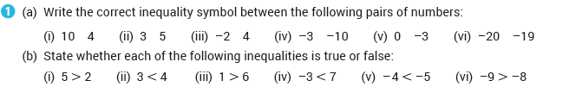
Exercise 28.1
Back to table of contents

Slide 5
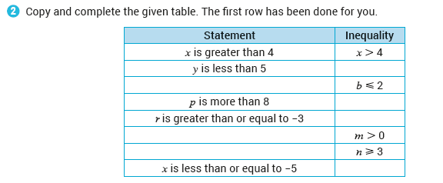
Exercise 28.1
Back to table of contents

Slide 6

Exercise 28.1
Back to table of contents

Slide 7
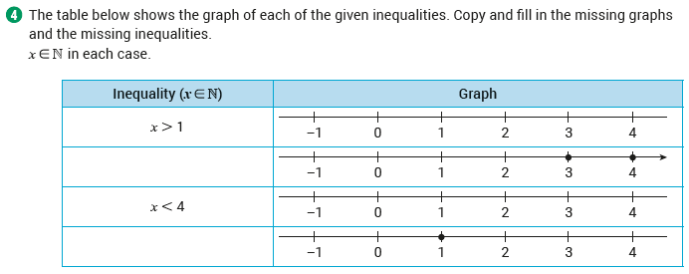
Exercise 28.1
Back to table of contents

Slide 8
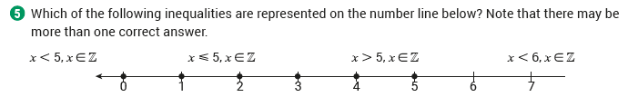
Exercise 28.1
Back to table of contents

Slide 9
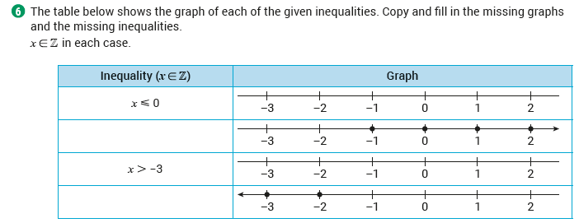
Exercise 28.1
Back to table of contents

Slide 10

Exercise 28.1
Back to table of contents

Slide 11
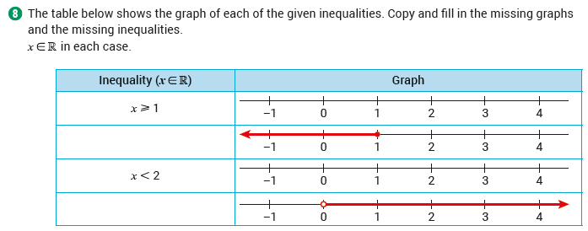
Exercise 28.1
Back to table of contents

Slide 12
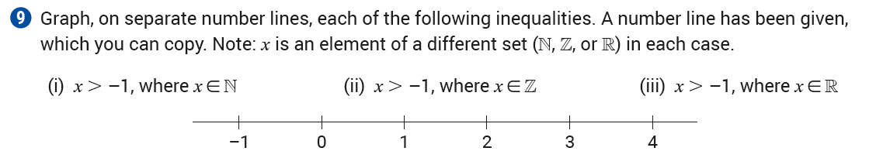
Exercise 28.1
Back to table of contents

Slide 13
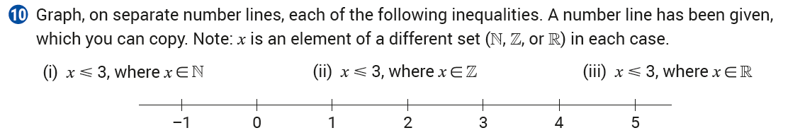
Exercise 28.1
Back to table of contents

Slide 14
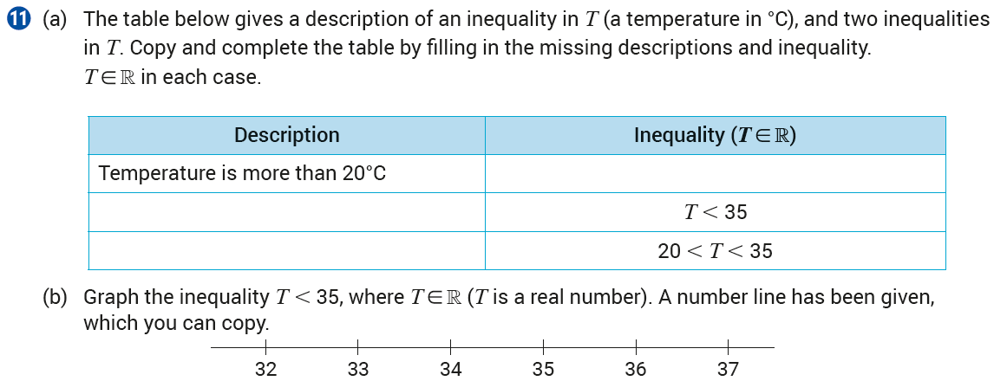
Exercise 28.1
Back to table of contents

Slide 15
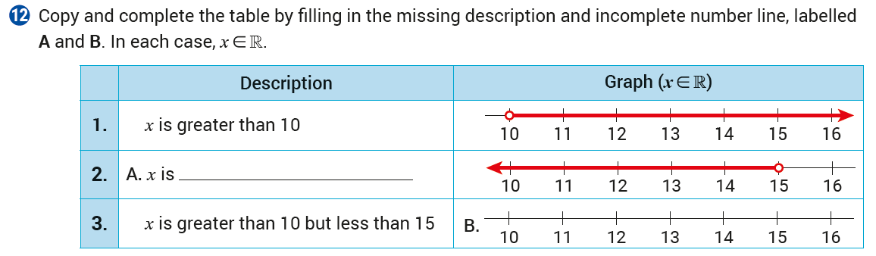
Exercise 28.1
Back to table of contents

Slide 16
Exercise 28.2

Slide 17
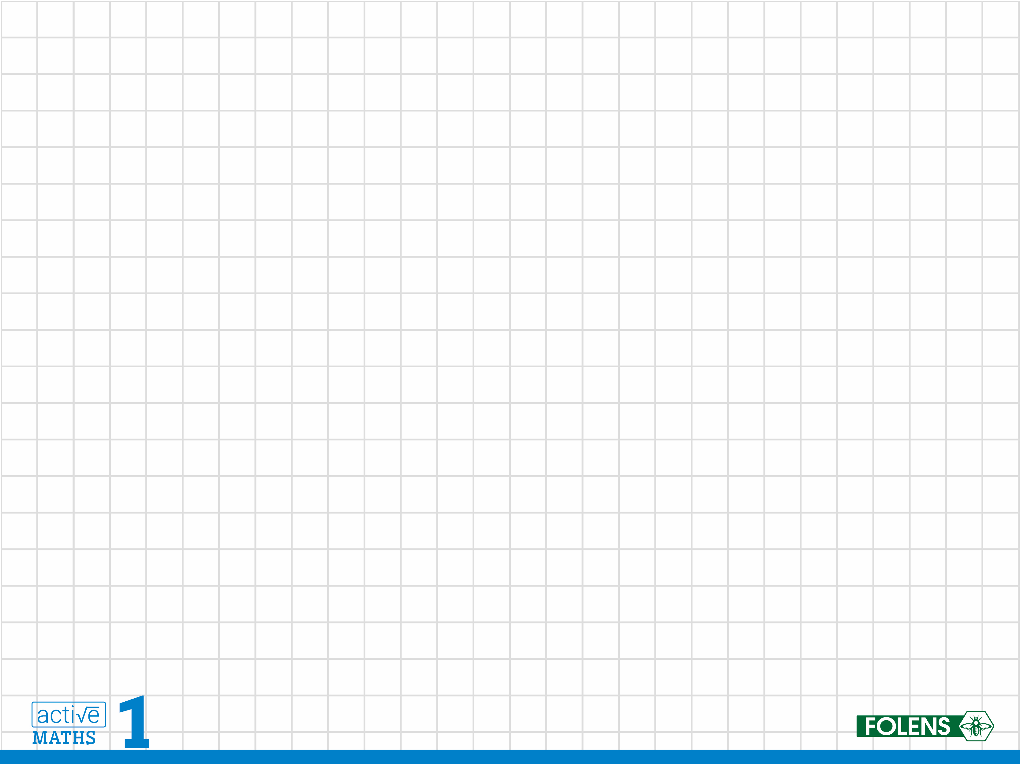

Exercise 28.2
Back to table of contents

Slide 18
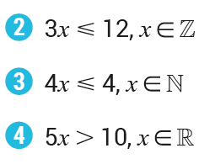
Exercise 28.2
Back to table of contents

Slide 19
Exercise 28.2
Back to table of contents

Slide 20
Exercise 28.2
Back to table of contents

Slide 21
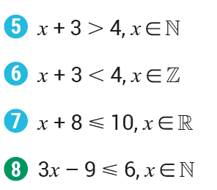
Exercise 28.2
Back to table of contents

Slide 22
Exercise 28.2
Back to table of contents

Slide 23
Exercise 28.2
Back to table of contents

Slide 24
Exercise 28.2
Back to table of contents

Slide 25
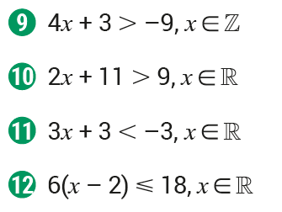
Exercise 28.2
Back to table of contents

Slide 26
Exercise 28.2
Back to table of contents

Slide 27
Exercise 28.2
Back to table of contents

Slide 28
Exercise 28.2
Back to table of contents

Slide 29
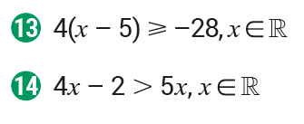
Exercise 28.2
Back to table of contents

Slide 30
Exercise 28.2
Back to table of contents

Slide 31
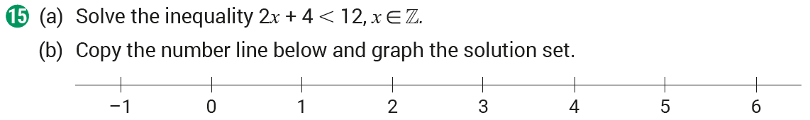
Exercise 28.2
Back to table of contents

Slide 32
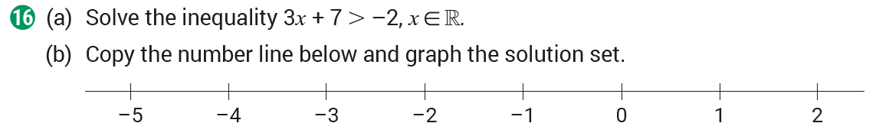
Exercise 28.2
Back to table of contents

Slide 33
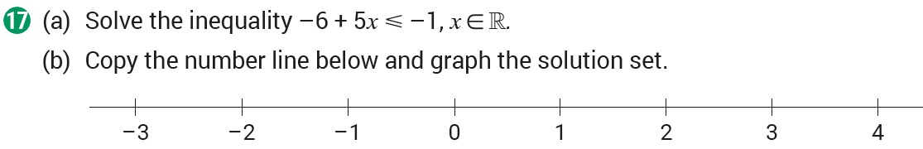
Exercise 28.2
Back to table of contents

Slide 34
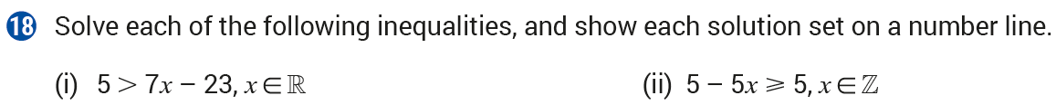
Exercise 28.2
Back to table of contents

Slide 35
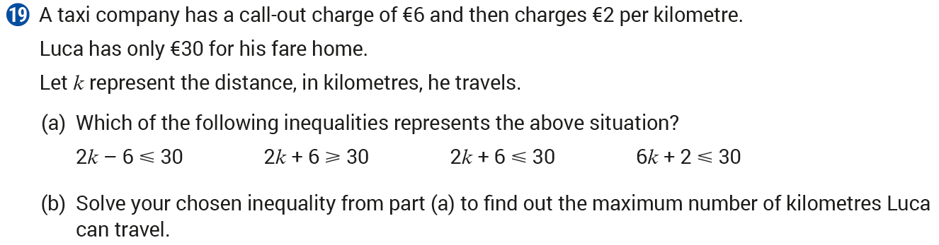
Exercise 28.2
Back to table of contents

Slide 36
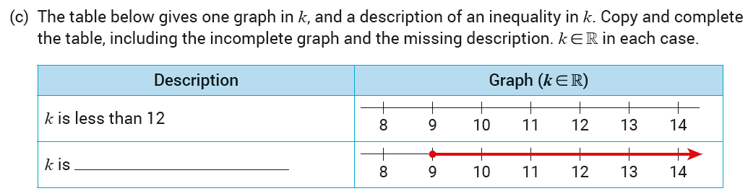
Exercise 28.2
Back to table of contents

Slide 37
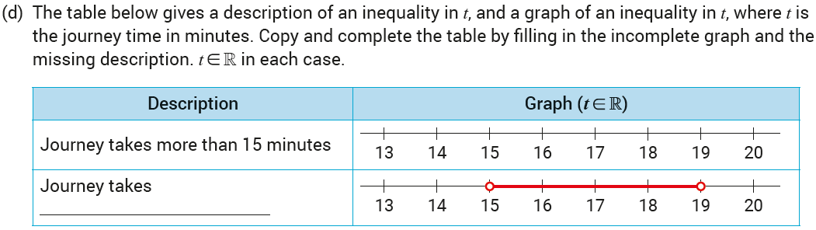
Exercise 28.2
Back to table of contents

Slide 38
Revision Exercises

Slide 39
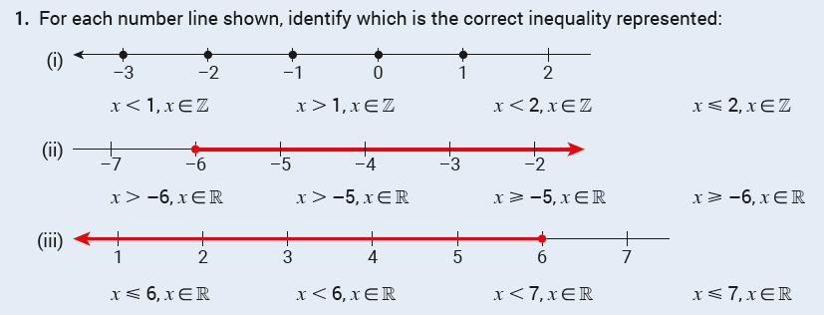
Revision Exercises
Back to table of contents

Slide 40
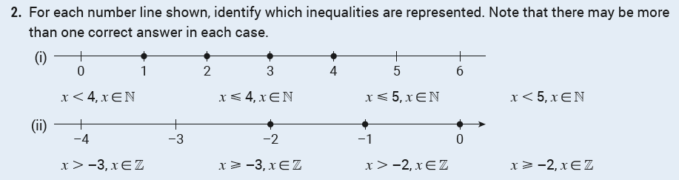
Revision Exercises
Back to table of contents

Slide 41
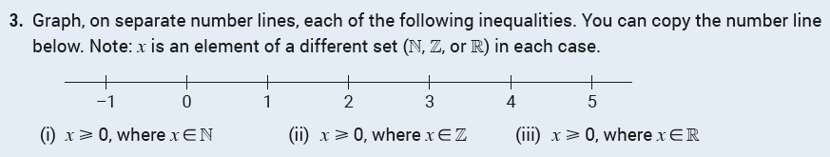
Revision Exercises
Back to table of contents

Slide 42
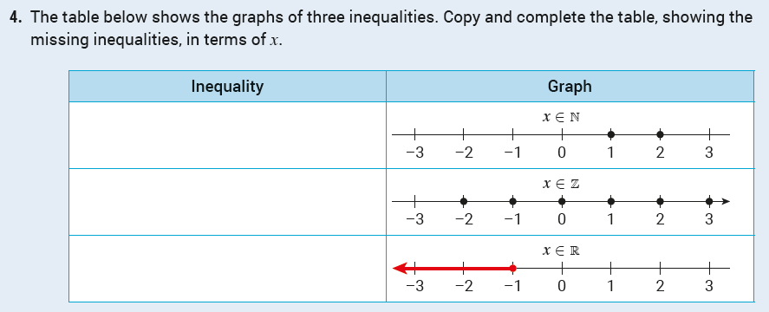
Revision Exercises
Back to table of contents

Slide 43
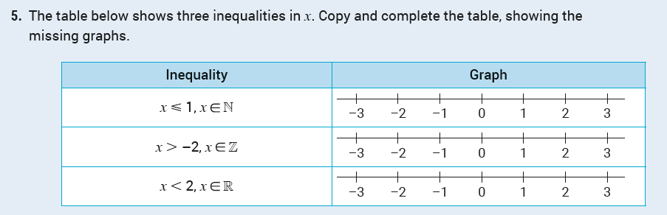
Revision Exercises
Back to table of contents

Slide 44
Revision Exercises
Back to table of contents

Slide 45
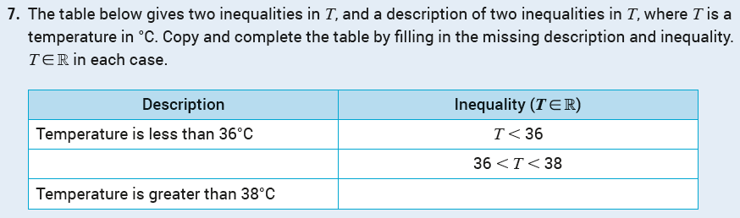
Revision Exercises
Back to table of contents

Slide 46
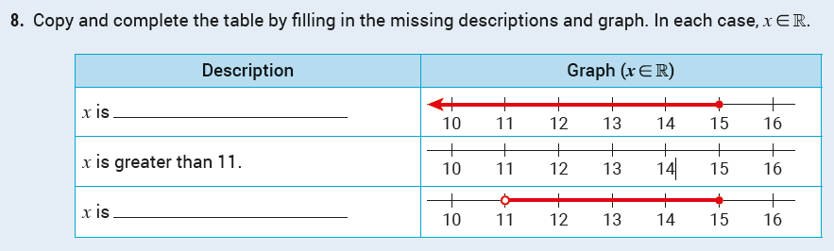
Revision Exercises
Back to table of contents

Slide 47
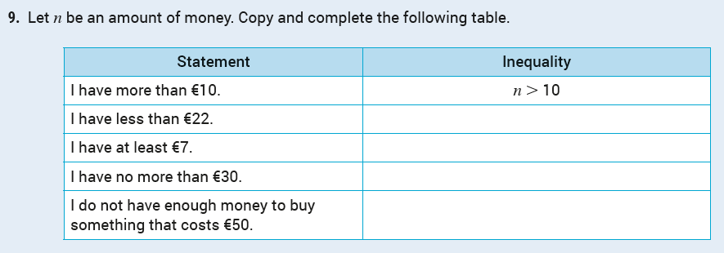
Revision Exercises
Back to table of contents

Slide 48
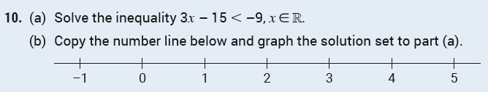
Revision Exercises
Back to table of contents

Slide 49
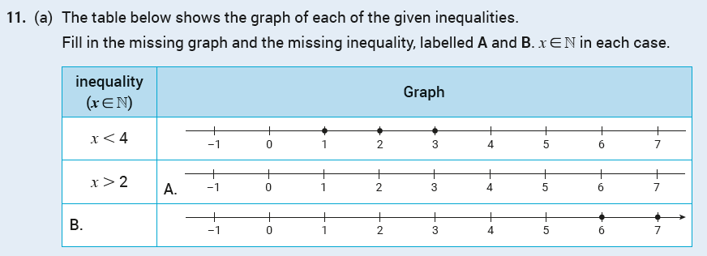
Revision Exercises
Back to table of contents

Slide 50
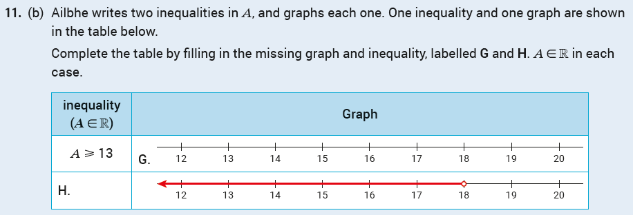
Revision Exercises
Back to table of contents

