Slide 1
Chapter 3 Summary: Algebra I

Slide 2
Chapter 3: Key words
Variable
Coefficient
Constant
Term
Like terms
Factorising
Algebraic expression

Slide 3
3.1 Expressions
Algebra has many uses, from the design of computer games to the modelling of weather patterns.
To be able to use algebra, we must first understand the rules involved in the basic operations of adding, subtracting, multiplying and dividing algebraic terms and expressions.
There are various words that we use when discussing algebra, and it’s important that you know these words, and understand how to use them in the context of algebra.

Slide 4
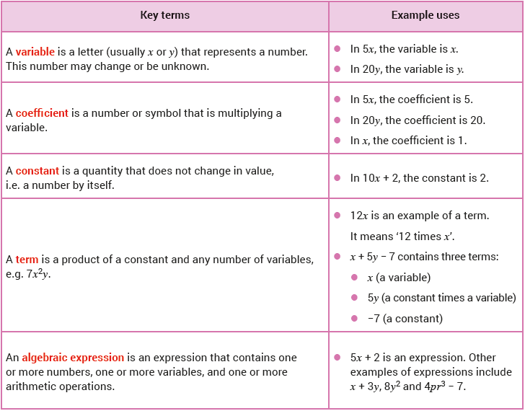

Slide 5
3.1 Expressions
One of the main uses of algebra is to solve problems. Information is given in a ‘real life’ context using words and/or diagrams. You use algebra to represent this information mathematically.
This usually involves writing an algebraic equation (or equations) that can then be solved, giving us the answer (or answers) required.

Slide 6
3.1 Expressions
When answering any problem-solving question we should always:
Be careful of the units in any measurements used in the question, and especially in the answer.
Make sure that we have clearly defined the meanings of any letters (variables) used.
Check that our answer makes sense in the context of the question. For example, the length of a rectangle cannot be −8 cm or 8 kg.

Slide 7
3.1 Expressions
Review Worked Examples 3.1 to 3.4.

Slide 8
3.2 Evaluating Expressions
One of the many cases where we encounter algebra is when we are given a formula and asked to substitute in certain values.
This requires us to replace the variables with the numerical values given.
We must always remember to follow the correct order of operations (i.e. BIMDAS).

Slide 9
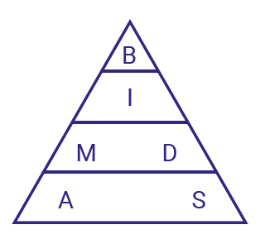
3.2 Evaluating Expressions
BIMDAS
These letters stand for:
Brackets
Indices
Multiplication
Division
Addition
Subtraction

Slide 10
3.2 Evaluating Expressions
BIMDAS
Brackets come first

Slide 11
3.2 Evaluating Expressions
BIMDAS
Then indices (powers/roots)

Slide 12
3.2 Evaluating Expressions
BIMDAS
Next multiplication/division

Slide 13
3.2 Evaluating Expressions
BIMDAS
Finally addition/
subtraction

Slide 14
3.2 Evaluating Expressions
BIMDAS

Slide 15
3.2 Evaluating Expressions
BIMDAS: Example

Slide 16
3.2 Evaluating Expressions
BIMDAS: Example

Slide 17
3.2 Evaluating Expressions
BIMDAS: Example

Slide 18
3.2 Evaluating Expressions
BIMDAS: Example

Slide 19
3.2 Evaluating Expressions
BIMDAS: Example

Slide 20
3.2 Evaluating Expressions
BIMDAS: Example

Slide 21
3.2 Evaluating Expressions
Review Worked Examples 3.5 to 3.6.
An animated Worked Example 3.6 is on the following slide.

Slide 22
3.2 Evaluating Expressions
If $x=3$and $y=−1$, evaluate the following expressions:
(i) $2x^{2}−2y^{3}$ (ii) $\frac{3x+4y}{5x−2y−2}$ (iii) $\sqrt{2x+3y^{2}}$
(ii) $\frac{3x+4y}{5x−2y−2}$
(iii)$\sqrt{2x+3y^{2}}$
(i) $2x^{2}−2y^{3}$
= $2(3)^{2}−2(−1)^{3}$
= $\sqrt{2(3)+3{(−1)}^{2}}$
= $\frac{3(3)+4(−1)}{5(3)−2(−1)−2}$
= $2(9)−2(−1)$
= $\sqrt{6+3(1)}$
= $18+2$
= $\frac{9−4}{15+2−2}$
= $20$
= $\sqrt{6+3}$
= $\frac{5}{15}$
= $\sqrt{9}$
= $3$
= $\frac{1}{3}$

Slide 23
3.3 Simplifying Expressions
Adding and Subtracting Terms
When adding or subtracting algebraic terms, we must pay attention to like terms.
These are terms that have the exact same letter(s) raised to the same power(s).
For example, x, 4x and –10x are like terms, but x and 4x² are not, because they have different powers of x.

Slide 24
3.3 Simplifying Expressions
Adding and Subtracting Terms
There are two rules that we must always remember when we are adding or subtracting like terms:

Slide 25
3.3 Simplifying Expressions
Adding and Subtracting Terms
There are two rules that we must always remember when we are adding or subtracting like terms:

Slide 26
3.3 Simplifying Expressions
Review Worked Example 3.7.
An animated Worked Example 3.7 (ii) is on the next slide.

Slide 27
3.3 Simplifying Expressions
Simplify: $x^{2}−2x−10+4−3x+4x^{2}$
Addition and Subtraction: Only like terms can be added or subtracted.
$$x^{2}−2x−10+4−3x+4x^{2}$$
$$=x^{2}+4x^{2}−2x−3x−10+4$$
$$=5x^{2}−5x−6$$

Slide 28
3.4 Expanding Expressions
We may have to deal with multiplying an expression by a number or a term.
The distributive property of real numbers is used to simplify expressions involving brackets:

Slide 29
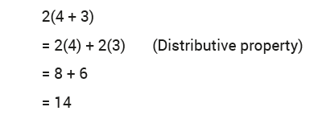
3.4 Expanding Expressions
However, we can use the fact that multiplication distributes over addition and subtraction to help find an alternative way to do this calculation. For example:

Slide 30
3.4 Expanding Expressions
However, we can use the fact that multiplication distributes over addition and subtraction to help find an alternative way to do this calculation. For example:

Slide 31
3.4 Expanding Expressions
Review Worked Examples 3.8 to 3.9.
An animated Worked Example 3.9 (i) is on the following slide.

Slide 32
3.4 Expanding Expressions
Remove the brackets and simplify: $\left(x+2\right)\left(x−3\right)$
Method 1
Method 2: Area model
$$\left(x+2\right)\left(x−3\right)$$
When using the area model we add the areas of the smaller rectangles.
$$=x\left(x−3\right)+2(x−3)$$
$$=x^{2}−3x+2x−6$$
$$\left(x+2\right)\left(x−3\right)$$
$$x$$
$$+2$$
Adding gives $−x$
$$=x^{2}−x−6$$
$$x$$
$$x^{2}$$
$$+2x$$
$$−3$$
$$−3x$$
$$−6$$
$$x^{2}−x−6$$

Slide 33
3.5 Factorising Expressions
Another important skill is finding the factors of an expression. This is called factorising. It is the reverse of expanding.
To factorise an expression, we rewrite the expression as a product.
A product is two or more terms that, when multiplied together, will give the original expression.
For example, 5 and 7 are factors of 35 because 5 × 7 will give us 35. The product in this case is 5 × 7.

Slide 34
3.5 Factorising Expressions
As another example, for the expression 5x + 10, 5 and (x + 2) are factors as 5(x + 2) = 5x + 10.
In this case, 5(x + 2) is the product.
Remember to always factorise each expression fully.

Slide 35
3.5 Factorising Expressions
You will have already met the following methods of factorising at Junior Cycle level:

Slide 36
3.5 Factorising Expressions
You will have already met the following methods of factorising at Junior Cycle level:

Slide 37
3.5 Factorising Expressions
You will have already met the following methods of factorising at Junior Cycle level:

Slide 38
3.5 Factorising Expressions
You will have already met the following methods of factorising at Junior Cycle level:

Slide 39
3.5 Factorising Expressions
Highest Common Factor
Factorise fully 4$a^{2}+6a$
$$4a^{2}+6a$$
$$=2a(2a+3)$$
$2a$ is the highest common factor for both terms.

Slide 40
3.5 Factorising Expressions
Grouping
Factorise fully $ax−ay−cx+cy$
$$ax−ay−cx+cy$$
$$=\left(ax−ay\right)+(−cx+cy)$$
Group.
$$=a\left(x−y\right)−c(x−y)$$
Remove common terms.
$$=\left(x−y\right)(a−c)$$
Remove common term.

Slide 41
3.5 Factorising Expressions
Difference of Two Squares
Quadratic Trinomials
Factorise fully$25a^{2}−144y^{2}$
Factorise fully $x$² – $x$ – 90
$$25a^{2}−144y^{2}$$
$$x^{2} –x –90$$
$$=(5{a)}^{2}−(12{y)}^{2}$$
Write each term as a square.
$=(x−10$)($x+9)$
$=(5a−12y$)($5a+12y)$

Slide 42
3.5 Factorising Expressions
Review Worked Examples 3.10 to 3.13.

Slide 43
3.6 Expressions Involving Fractions
When asked to add or subtract two algebraic fractions, we should first find the lowest common denominator (LCD).
We then apply a similar method to that of adding/subtracting numerical fractions.
The next slide gives an example.

Slide 44
3.6 Expressions Involving Fractions

Slide 45
3.6 Expressions Involving Fractions

Slide 46
3.6 Expressions Involving Fractions

Slide 47
3.6 Expressions Involving Fractions

Slide 48
3.6 Expressions Involving Fractions

Slide 49
3.6 Expressions Involving Fractions
Review Worked Examples 3.14 to 3.16.

Slide 50
3.7 Dividing Algebraic Expressions
Simplifying algebraic fractions is very similar to simplifying numerical fractions.
When we simplify an algebraic fraction, we need to divide the top (numerator) and bottom (denominator) by their Highest Common Factor (HCF).
The following slides give two examples.

Slide 51
3.7 Dividing Algebraic Expressions

Slide 52
3.7 Dividing Algebraic Expressions

Slide 53
3.7 Dividing Algebraic Expressions

Slide 54
3.7 Dividing Algebraic Expressions

Slide 55
3.7 Dividing Algebraic Expressions

Slide 56
3.7 Dividing Algebraic Expressions

Slide 57
3.7 Dividing Algebraic Expressions
Review Worked Example 3.17.

Slide 58
3.8 Long Division in Algebra
We can apply the method of long division from our primary school studies to help us understand how to do long division in algebra.

Slide 59
3.8 Long Division in Algebra
We can apply the method of long division from our primary school studies to help us understand how to do long division in algebra.

Slide 60
3.8 Long Division in Algebra
Review Worked Example 3.18.
An animated Worked Example 3.18 is on the following slide.

Slide 61
3.8 Long Division in Algebra
Divide $6x^{2}+13x+5$ by $2x+1$.
$$3x$$
$$+ 5$$
$$2x+1$$
$6x^{2}+13x+5$
Divide $6x^{2}$ by $2x$to get$3x$.
$$−\left(6x^{2}+ 3x\right)$$
$$10x$$
$$+5$$
$$−\left(10x\right.$$
$$\left.+5\right)$$
Divide $10x$ by $2x$to get$5$.
$$0$$
As the final remainder is 0, we know that $2x$ + 1 divides ‘evenly’ into $6x^{2}+13x+5$ , i.e. $2x$ + 1 is a factor of $6x^{2}+13x+5$.
Factors
$6x^{2}+13x+5=(2x+1)(3x+5)$

Slide 62
3.9 Rearranging Formulae
An example of rearranging formulae is when we convert temperatures from degrees Celsius (°C) to degrees Fahrenheit (°F).
When rearranging formulae:
Move any term you do not want to the other side of the equal sign.
Bring terms that contain the variable you do want to the same side.
Follow the correct mathematical procedures when moving terms from one side of the equal sign to the other.
Include the correct units in your answer.

Slide 63
3.9 Rearranging Formulae
Review Worked Examples 3.19 to 3.22.
An animated Worked Example 3.20 is on the following slide.

Slide 64
3.9 Rearranging Formulae
Make $a$the subject of the formula if $\frac{a+b}{3}=\frac{c}{2}$
The LCD of 3 and 2 is 6.
$$\frac{a+b}{3}=\frac{c}{2}$$
$$\frac{6(a+b)}{3}=\frac{6c}{2}$$
Multiply all the terms by the LCD, which is $6$.
$$2(a+b)=3c$$
$$2a+2b=3c$$
Multiply out the brackets.
$$2a=3c−2b$$
Subtract $2b$from both sides.
$$\frac{2a}{2}=\frac{3c−2b}{2}$$
Divide both sides by $2$.
$$a=\frac{3c−2b}{2}$$

