Slide 1
Chapter 20 Summary Co-ordinate Geometry: The Circle

Slide 2
Chapter 20: Key words
Circle
Radius
Tangent

Slide 3
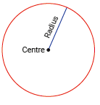
20.1 Circles with Centre (0, 0) and Radius r
A circle is the set of all points in the plane that are equidistant from a fixed point, the centre.
The distance from the centre to any point on the circle is called the radius of the circle.

Slide 4
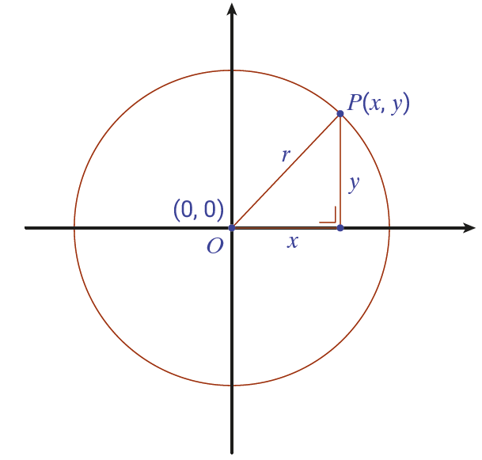
20.1 Circles with Centre (0, 0) and Radius r
Consider the circle with centre O(0, 0) and radius r.
Let P(x, y) be the co-ordinates of any point on the circle.
But |OP| = r
and hence, after squaring both sides,
$x^{2}$+ $y^{2}=r2$

Slide 5
20.1 Circles with Centre (0, 0) and Radius r

Slide 6
20.1 Circles with Centre (0, 0) and Radius r
Review Worked Examples 20.1 to 20.4.
Animated Worked Examples 20.1 to 20.3 are on the following slide.

Slide 7
20.1 Circles with Centre (0, 0) and Radius r
Find the equation of the following circles:
(i) $s_{1}$: centre (0,0) and radius length 7
(ii) $s_{2}$: centre (0,0) and contains the point (3,-4)
(i)
$x^{2}+y^{2}=r^{2}$ Given $r=7$
(ii)
Radius $=$ $\sqrt{(3−0)^{2}+(4−0)^{2}}$
$$x^{2}+y^{2}=7^{2}$$
$=$ $\sqrt{(3)^{2}+(−4)^{2}}$
$=$ $\sqrt{9+16}$
$$x^{2}+y^{2}=49$$
$$=\sqrt{25}$$
$$=5$$
$$x^{2}+y^{2}=r^{2}$$
$$x^{2}+y^{2}=(5)^{2}$$
$$(r=5)$$
$$x^{2}+y^{2}=25$$
(iii) The equation of the circle $t$ is $x^{2}+y^{2}=9.$ Find its centre and radius.
$$x^{2}+y^{2}=9$$
Centre $=$ (0,0) Radius $=$ $\sqrt{9}=3$

Slide 8
20.2 Lines and Circles
If a line and a circle are drawn on the plane, then they may meet at two points, at one point, or not at all.
The diagrams below illustrate these three different situations.

Slide 9
20.2 Lines and Circles
If the line meets the circle at one point only, then we say the line is a tangent to the circle.

Slide 10
20.2 Lines and Circles
Review Worked Examples 20.5 to 20.7.
An animated Worked Example 20.5 is on the following slide.

Slide 11
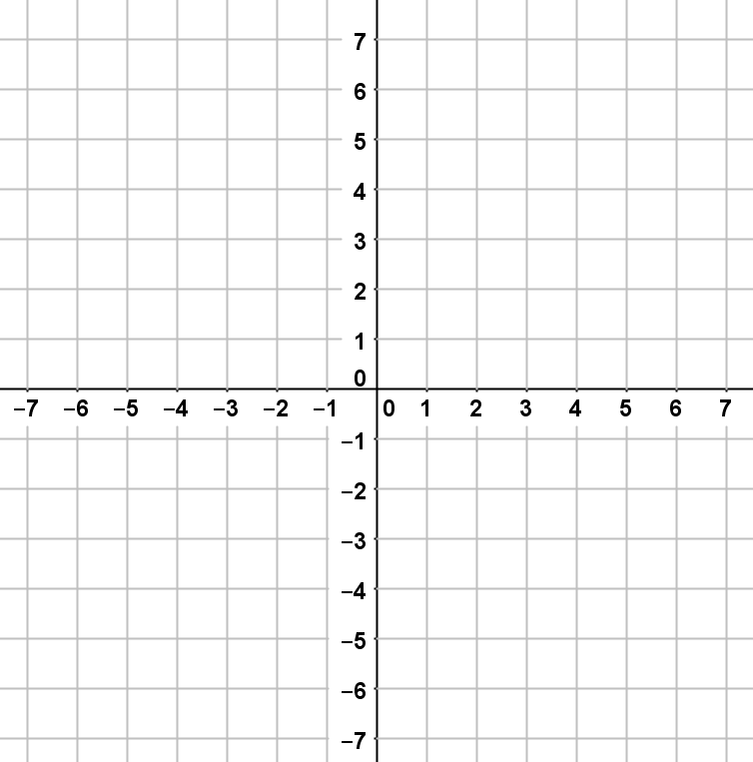
20.2 Lines and Circles
$\text{Find} \text{the} \text{points} \text{of} \text{intersection} \text{of} \text{the} \text{line} x+3y=10$and the circle $x^{2}+y^{2}=50$.
Solving using algebra.
When $y=5, x=−5$
When $y=1, x=7$
1
$$x^{2}+y^{2}=50$$
Couples are $\left(−5,5\right)$ and $\left(7,1\right)$.
2
$$x+3y=10$$
The equations represent a line and a circle.
$$y$$
$$x=10−3y$$
Isolating $x$ from
2
Substitute $10−3y$into equation
$$\left(−5,5\right)$$
1
$${(10−3y)}^{2} + y^{2}=50$$
Simplifying and rearranging gives:
$${10y}^{2}−60y+50=0$$
$$\left(7,1\right)$$
$$x$$
$$y^{2}−6y+5=0$$
10 is HCF
$$\left(y−5\right)\left(y−1\right)=0$$
$$y−5=0$$
$$y−1=0$$
$$y=5$$
or
$$y=1$$
As $x=10−3y$
$$x=10−3(5)$$
$$x=10−3(1)$$
The line and circle intersect at $\left(−5,5\right)$ and $(7,1)$.
$$x=−5$$
or
$$x=7$$

Slide 12
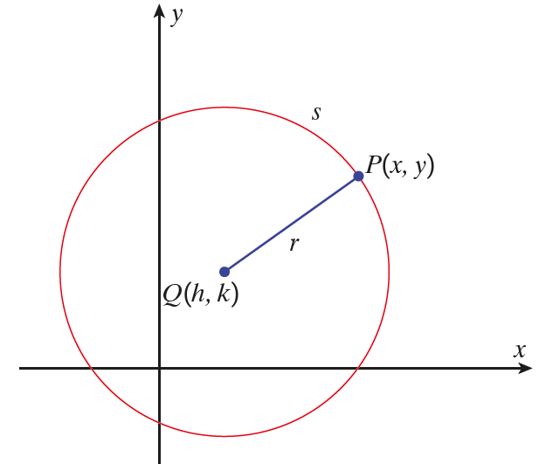
20.3 Circles with Centre (h, k) and radius r
You can derive the equation of a circle centred at a point other than (0, 0).
s is the circle with centre Q(h, k).
Let P(x, y) be any point on s.
Let r be the radius of s.
But |QP| = radius = r

Slide 13
20.3 Circles with Centre (h, k) and radius r
This equation is on page 19 of Formulae and Tables.

Slide 14
20.3 Circles with Centre (h, k) and radius r
Review Worked Examples 20.8 to 20.10.
Animated Worked Example 20.8, 20.9 and 20.10 (a) and (b) are on the following slides.

Slide 15
20.3 Circles with Centre (h, k) and radius r
Find the equation of the circle with centre (1,–4) and radius 5.
$${(x−h)}^{2} + {(y−k)}^{2} =r^{2}$$
$h=1$, $k=−4$, $r=5$
$${(x−1)}^{2} + {(y−(−4))}^{2} ={(5)}^{2}$$
$${(x−1)}^{2} + {(y+4)}^{2} =25$$

Slide 16
20.3 Circles with Centre (h, k) and radius r
Find the centre and radius length of the circle $(x+2)^{2}+(y−8)^{2}=49$.
$${(x−h)}^{2} + {(y−k)}^{2} =r^{2}$$
$(x+2)^{2}+(y−8)^{2}=49$
Comparing: $−h=2$, $−k=−8$, ${ r}^{2} =49$
$∴ h=−2$, $k=8$, $r=7$
∴ The centre of the circle is (–2,8) and the radius length is 7.

Slide 17
20.3 Circles with Centre (h, k) and radius r
The points A(−1, −6) and B(5, −2) are the endpoints of a diameter of the circle w.
(a) Find the co-ordinates of the centre w.
Midpoint of diameter (centre)$=\left(\frac{x_{1}+ x_{2}}{2},\frac{y_{1}+{ y}_{2}}{2}\right)$
$$=\left(\frac{−1+5}{2},\frac{−6−2}{2}\right)=\left(2,−4\right)$$
(b) Find the radius of w.
The radius of the circle is the distance from an endpoint of a diameter to the centre of the circle.
Distance $=$
$$\sqrt{{\left(x_{2}−x_{1}\right)}^{2}+{\left(y_{2}−y_{1}\right)}^{2}}$$
Using the points (5, −2) and (2, −4):
$$=\left(\sqrt{(2−5)^{2}+(−4−(−2))^{2}}\right)$$
r
$$=\left(\sqrt{(2−5)^{2}+(−4+2)^{2}}\right)$$
$$=\left(\sqrt{(−3)^{2}+(−2)^{2}}\right)$$
$$=\left(\sqrt{9+4}\right)$$
∴
$$=\sqrt{13}$$
r

Slide 18
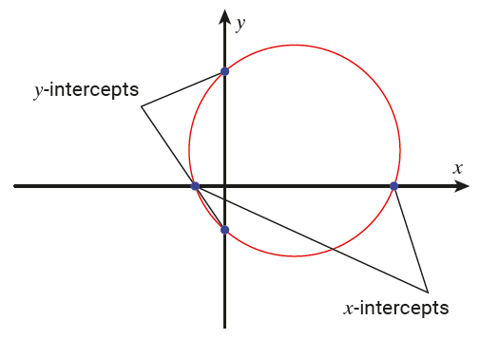
20.4 Intercepts and Points Inside, Outside or On a Circle
The points where a circle intersects the x-axis are called the x-intercepts of the circle.

Slide 19
20.4 Intercepts and Points Inside, Outside or On a Circle
The points where a circle intersects the x-axis are called the x-intercepts of the circle.
The points where a circle intersects the y-axis are called the y-intercepts of the circle.

Slide 20
20.4 Intercepts and Points Inside, Outside or On a Circle
The co-ordinates of points on the x-axis are always of the form (a, 0) and the co-ordinates of points on the y-axis are always of the form (0, b). Hence:
Let y = 0 in the equation of a circle and solve for x to find the co-ordinates of the x-intercepts.
Let x = 0 in the equation of a circle and solve for y to find the co-ordinates of the y-intercepts.

Slide 21
20.4 Intercepts and Points Inside, Outside or On a Circle

Slide 22
20.4 Intercepts and Points Inside, Outside or On a Circle

Slide 23
20.4 Intercepts and Points Inside, Outside or On a Circle

Slide 24
20.4 Intercepts and Points Inside, Outside or On a Circle
Review Worked Examples 20.11 and 20.12.
Animated Worked Examples 20.11 and 2.12 (b) are on the following slides.

Slide 25
20.4 Intercepts and Points Inside, Outside or On a Circle
Find the co-ordinates of the points at which:
(i) The circle $s$:${ x}^{2}+ y^{2}=25$ intersects the $x$-axis
(ii) The circle $t$: ${(x+1)}^{2}+{ (y−9)}^{2} =26$ intersects the $y$-axis
(i) $x^{2}+y^{2}=25$ intersects the $x$-axis
$$y$$
Let $y$ = 0 in the equation of the circle.
$x^{2}+{(0)}^{2} =25$
$x^{2}+0 =25$
$x^{2}=25$
$$\left(−5,0\right)$$
$$\left(5,0\right)$$
$$x$$
$$x=±5$$
Therefore, the co-ordinates of the x-intercepts are (−5,0) and (5,0).

Slide 26
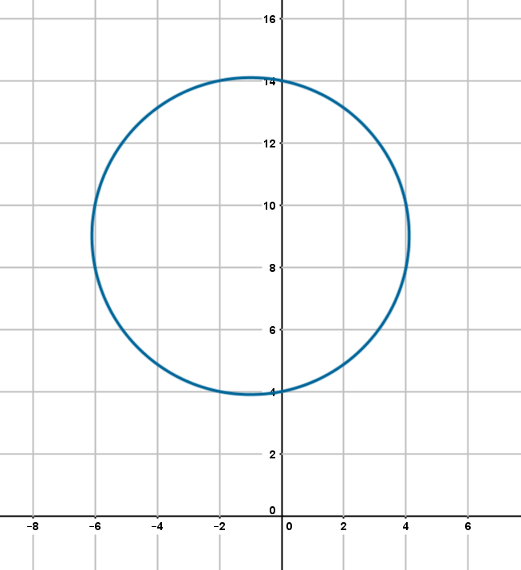
20.4 Intercepts and Points Inside, Outside or On a Circle
Find the co-ordinates of the points at which:
(ii) The circle $t$: ${(x+1)}^{2}+{ (y−9)}^{2} =26$ intersects the $y$-axis
(ii) ${(x+1)}^{2} +{ (y−9)}^{2} =26$ intersects the $y$-axis:
Let $x$ = 0 in the equation of the circle.
$$y$$
$${(0+1)}^{2}+{ \left(y−9\right)}^{2} =26$$
$$\left(0,14\right)$$
$${1+(y−9)}^{2} =26$$
$${(y−9)}^{2} =25$$
$$y−9=±5$$
$$y−9=5$$
$$y−9=−5$$
$$⇒y=14$$
$$⇒y=4$$
$$\left(0,4\right)$$
Therefore, the co-ordinates are (0, 14) and (0, 4).
$$x$$

Slide 27
20.4 Intercepts and Points Inside, Outside or On a Circle
Investigate if the point (7,–5) is outside, inside or on the following circle:
$${(x−4)}^{2} + {(y+1)}^{2} =25$$
The point (7,–5)
$${(x−4)}^{2} +{ (y+1)}^{2} =25$$
Substitute (7,−5) into the left-hand side of the equation and check if it is true.
$${(7−4)}^{2} +{ (−5+1)}^{2} =25$$
$${(3)}^{2} +{ (−4)}^{2} =25$$
$$9+16=25$$
$25=25$ True
$∴\text{(7,–5)}$ is on the circle.

