Slide 1
Chapter 3: Algebra I (Exercise Questions)

Slide 2
Exercise 3.1

Slide 3
Exercise 3.1

Slide 4
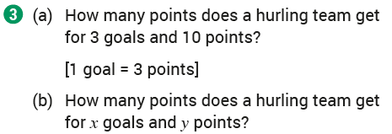
Exercise 3.1

Slide 5
Exercise 3.1

Slide 6
Exercise 3.1

Slide 7
Exercise 3.1

Slide 8
Exercise 3.1

Slide 9
Exercise 3.1

Slide 10
Exercise 3.1

Slide 11
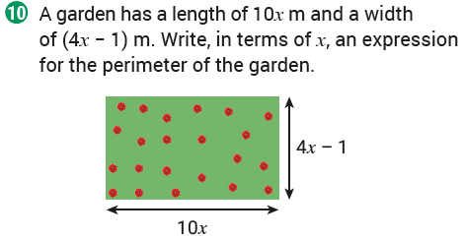
Exercise 3.1

Slide 12
Exercise 3.2

Slide 13
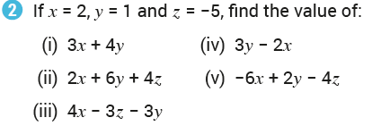
Exercise 3.2

Slide 14
Exercise 3.2

Slide 15
Exercise 3.2

Slide 16
Exercise 3.2

Slide 17
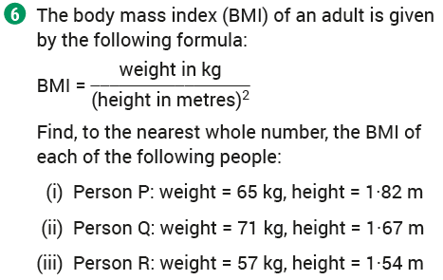
Exercise 3.2

Slide 18
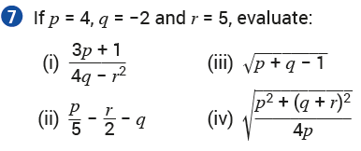
Exercise 3.2

Slide 19
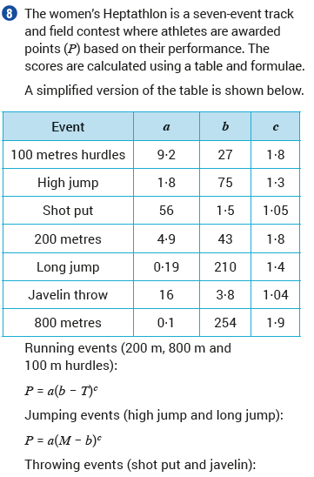
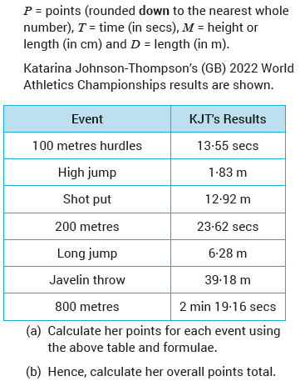
Exercise 3.2

Slide 20
Exercise 3.3

Slide 21
Exercise 3.3

Slide 22
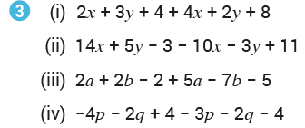
Exercise 3.3

Slide 23
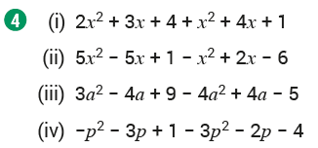
Exercise 3.3

Slide 24
Exercise 3.4

Slide 25
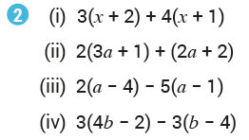
Exercise 3.4

Slide 26
Exercise 3.4

Slide 27
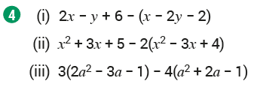
Exercise 3.4

Slide 28
Exercise 3.4

Slide 29
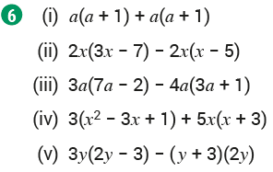
Exercise 3.4

Slide 30
Exercise 3.4

Slide 31
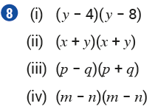
Exercise 3.4

Slide 32
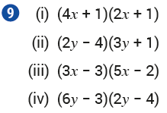
Exercise 3.4

Slide 33
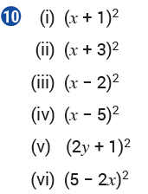
Exercise 3.4

Slide 34
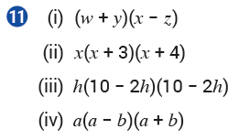
Exercise 3.4

Slide 35
Exercise 3.5

Slide 36
Exercise 3.5

Slide 37
Exercise 3.5

Slide 38
Exercise 3.5

Slide 39
Exercise 3.5

Slide 40
Exercise 3.5

Slide 41
Exercise 3.5

Slide 42
Exercise 3.5

Slide 43
Exercise 3.5

Slide 44
Exercise 3.5

Slide 45
Exercise 3.5

Slide 46
Exercise 3.5

Slide 47
Exercise 3.5

Slide 48
Exercise 3.5

Slide 49
Exercise 3.5

Slide 50
Exercise 3.5

Slide 51
Exercise 3.5

Slide 52
Exercise 3.5

Slide 53
Exercise 3.5

Slide 54
Exercise 3.5

Slide 55
Exercise 3.5

Slide 56
Exercise 3.5

Slide 57
Exercise 3.5

Slide 58
Exercise 3.5

Slide 59
Exercise 3.5

Slide 60
Exercise 3.5

Slide 61
Exercise 3.5

Slide 62
Exercise 3.5

Slide 63
Exercise 3.5

Slide 64
Exercise 3.5

Slide 65
Exercise 3.5

Slide 66
Exercise 3.5

Slide 67
Exercise 3.5

Slide 68
Exercise 3.5

Slide 69
Exercise 3.5

Slide 70
Exercise 3.5

Slide 71
Exercise 3.6

Slide 72
Exercise 3.6

Slide 73
Exercise 3.6

Slide 74
Exercise 3.6

Slide 75
Exercise 3.6

Slide 76
Exercise 3.6

Slide 77
Exercise 3.6

Slide 78
Exercise 3.6

Slide 79
Exercise 3.6

Slide 80
Exercise 3.6

Slide 81
Exercise 3.6

Slide 82
Exercise 3.6

Slide 83
Exercise 3.6

Slide 84
Exercise 3.6

Slide 85
Exercise 3.6

Slide 86
Exercise 3.6

Slide 87
Exercise 3.6

Slide 88
Exercise 3.6

Slide 89
Exercise 3.6

Slide 90
Exercise 3.6

Slide 91
Exercise 3.6

Slide 92
Exercise 3.6

Slide 93
Exercise 3.6

Slide 94
Exercise 3.6

Slide 95
Exercise 3.7

Slide 96
Exercise 3.7

Slide 97
Exercise 3.7

Slide 98
Exercise 3.7

Slide 99
Exercise 3.7

Slide 100
Exercise 3.7

Slide 101
Exercise 3.7

Slide 102
Exercise 3.7

Slide 103
Exercise 3.7

Slide 104
Exercise 3.7

Slide 105
Exercise 3.7

Slide 106
Exercise 3.7

Slide 107
Exercise 3.7

Slide 108
Exercise 3.7

Slide 109
Exercise 3.7

Slide 110
Exercise 3.7

Slide 111
Exercise 3.7

Slide 112
Exercise 3.7

Slide 113
Exercise 3.7

Slide 114
Exercise 3.8

Slide 115
Exercise 3.8

Slide 116
Exercise 3.8

Slide 117
Exercise 3.8

Slide 118
Exercise 3.8

Slide 119
Exercise 3.8

Slide 120
Exercise 3.8

Slide 121
Exercise 3.8

Slide 122
Exercise 3.8

Slide 123
Exercise 3.8

Slide 124
Exercise 3.8

Slide 125
Exercise 3.8

Slide 126
Exercise 3.8

Slide 127
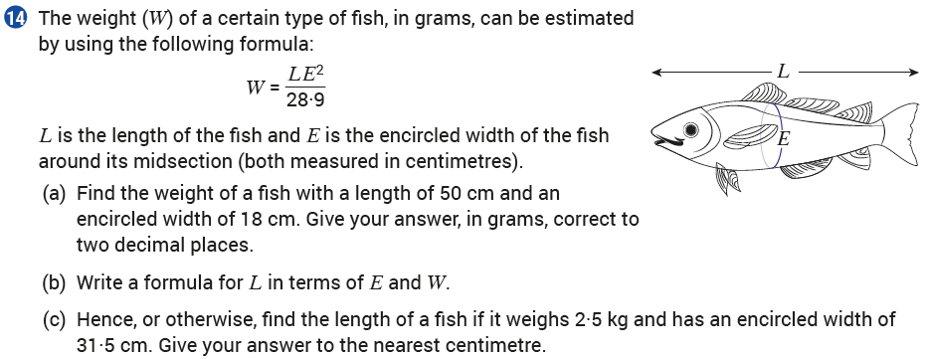
Exercise 3.8

Slide 128
Exercise 3.8

Slide 129
Exercise 3.8

Slide 130
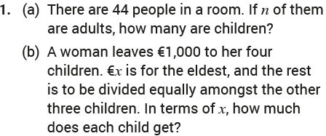
Revision Exercises

Slide 131
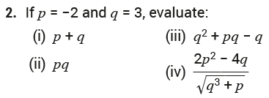
Revision Exercises

Slide 132
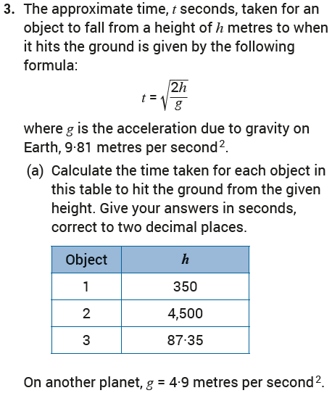
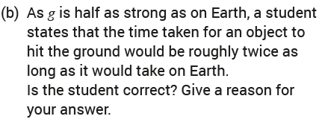
Revision Exercises

Slide 133
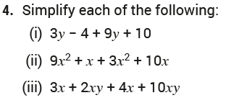
Revision Exercises

Slide 134
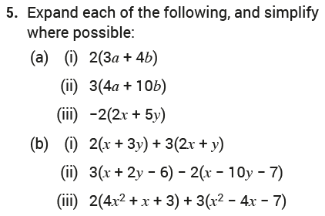
Revision Exercises

Slide 135
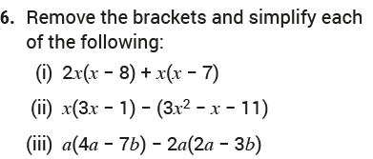
Revision Exercises

Slide 136
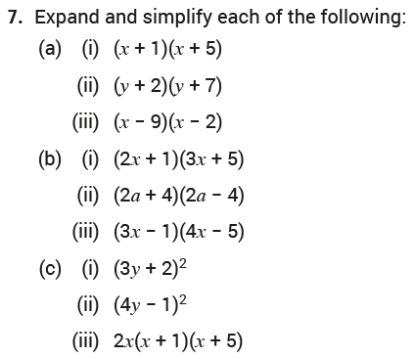
Revision Exercises

Slide 137
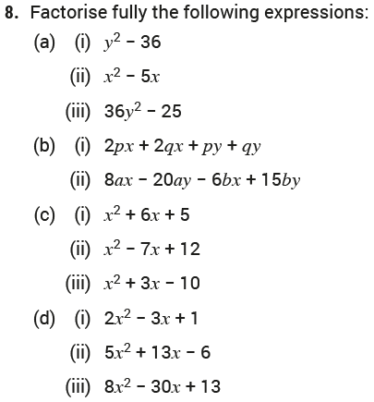
Revision Exercises

Slide 138
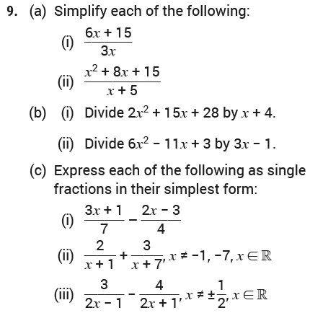
Revision Exercises

Slide 139
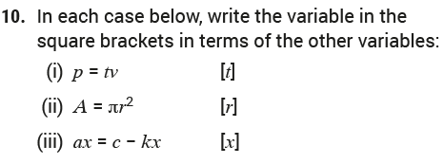
Revision Exercises

Slide 140
Revision Exercises

Slide 141
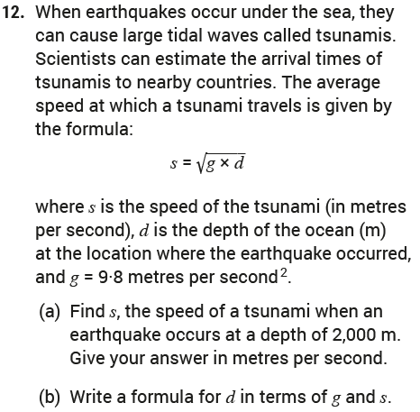
Revision Exercises

Slide 142
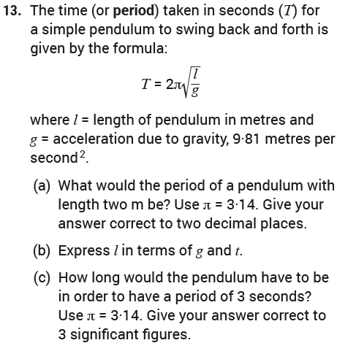
Revision Exercises

Slide 143
End of
Chapter 03: Algebra I

