Slide 1
Chapter 20:
Co-ordinate Geometry: The Circle (Exercise Questions)

Slide 2
Exercise 20.1

Slide 3
Exercise 20.1

Slide 4
Exercise 20.1

Slide 5
Exercise 20.1

Slide 6
Exercise 20.1

Slide 7
Exercise 20.1

Slide 8
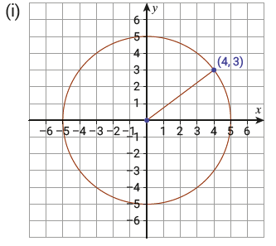
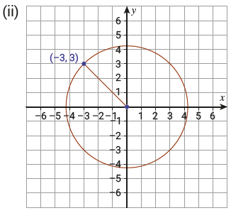
Exercise 20.1

Slide 9
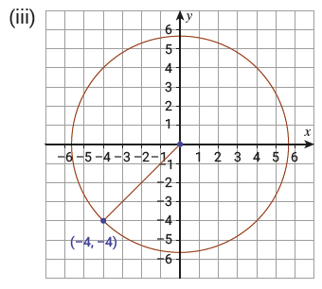
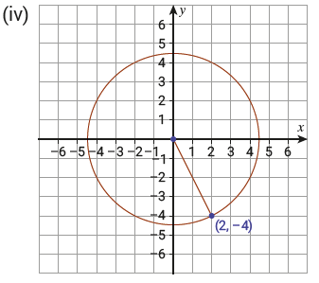
Exercise 20.1

Slide 10
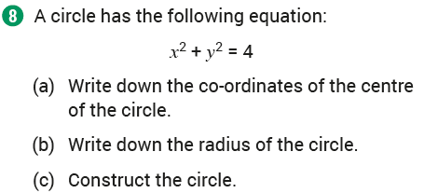
Exercise 20.1

Slide 11
Exercise 20.1

Slide 12
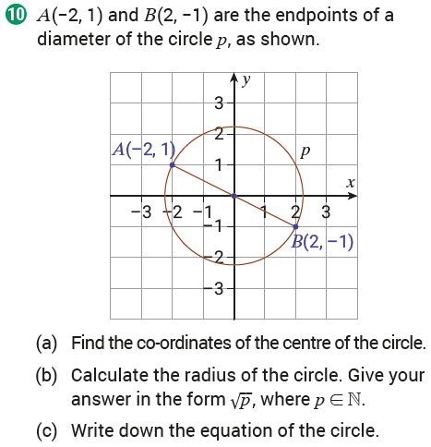
Exercise 20.1

Slide 13
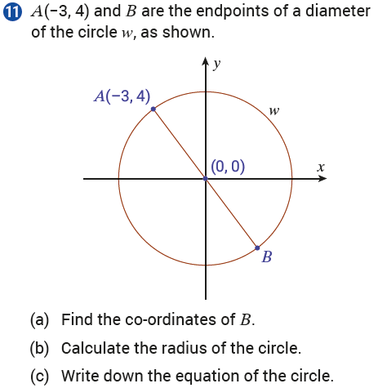
Exercise 20.1

Slide 14
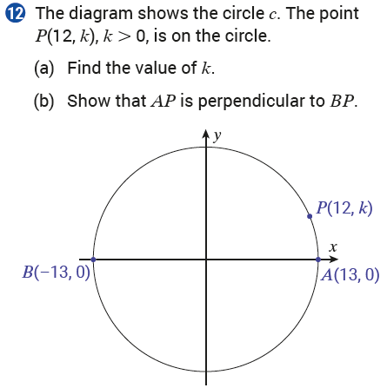
Exercise 20.1

Slide 15
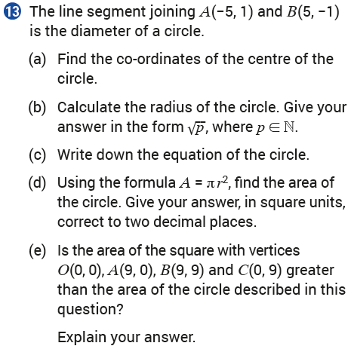
Exercise 20.1

Slide 16
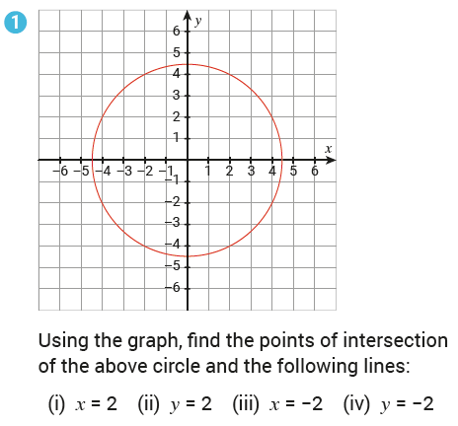
Exercise 20.2

Slide 17
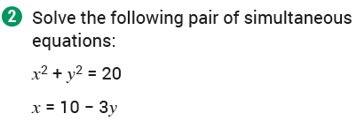
Exercise 20.2

Slide 18
Exercise 20.2

Slide 19
Exercise 20.2

Slide 20
Exercise 20.2

Slide 21
Exercise 20.2

Slide 22
Exercise 20.2

Slide 23
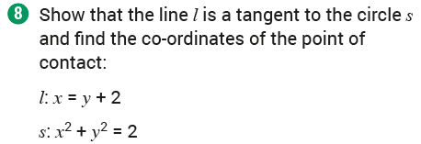
Exercise 20.2

Slide 24
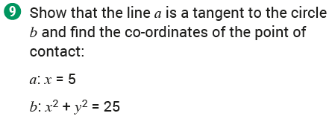
Exercise 20.2

Slide 25
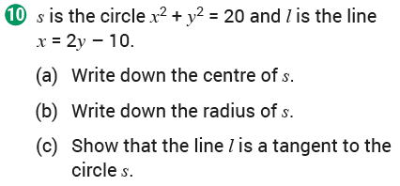
Exercise 20.2

Slide 26
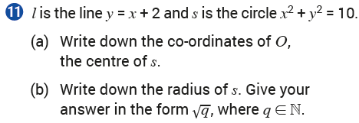
Exercise 20.2

Slide 27
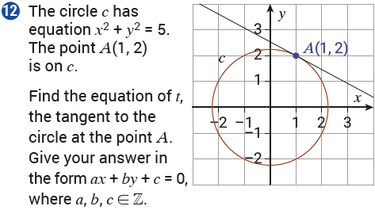
Exercise 20.2

Slide 28
Exercise 20.2

Slide 29
Exercise 20.2

Slide 30
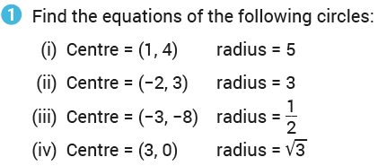
Exercise 20.3

Slide 31
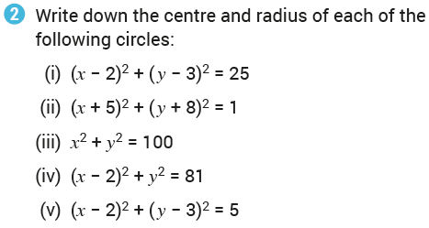
Exercise 20.3

Slide 32
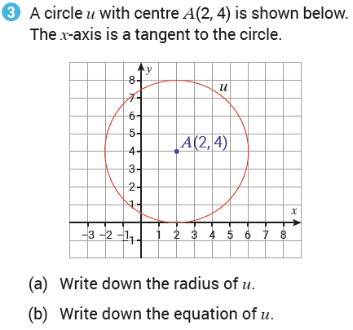
Exercise 20.3

Slide 33
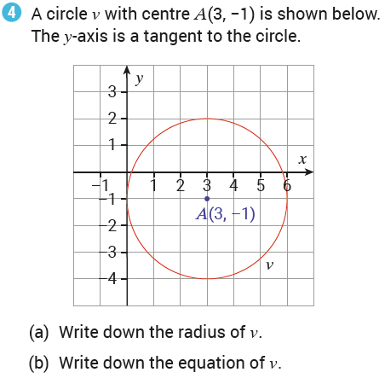
Exercise 20.3

Slide 34
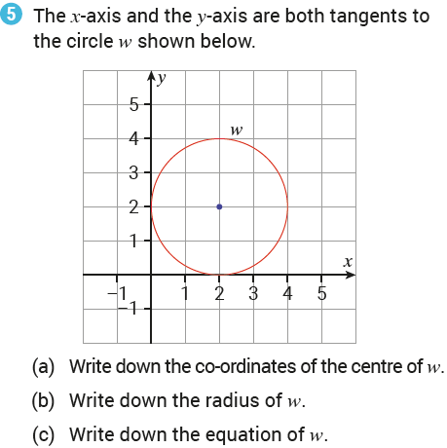
Exercise 20.3

Slide 35
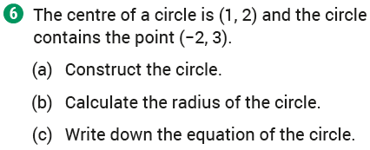
Exercise 20.3

Slide 36
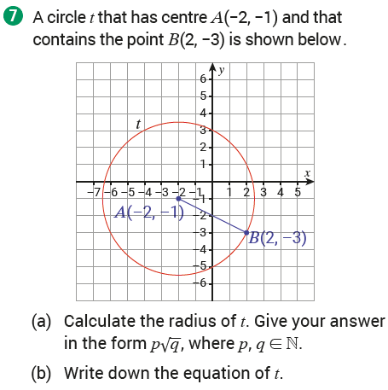
Exercise 20.3

Slide 37
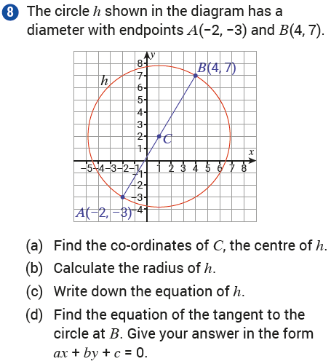
Exercise 20.3

Slide 38
Exercise 20.3

Slide 39
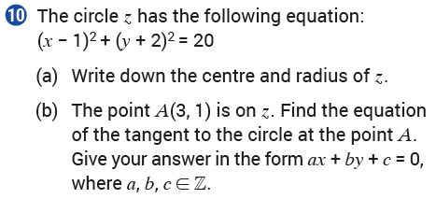
Exercise 20.3

Slide 40
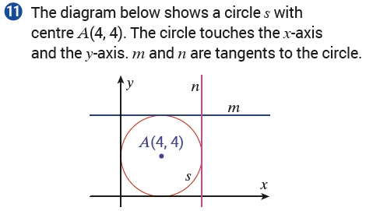
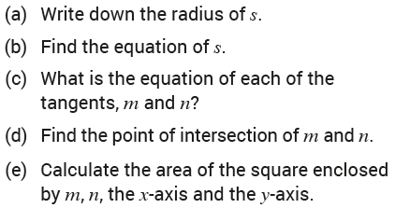
Exercise 20.3

Slide 41
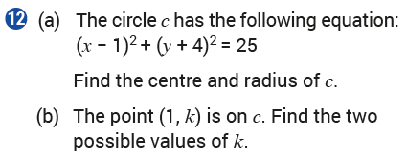
Exercise 20.3

Slide 42
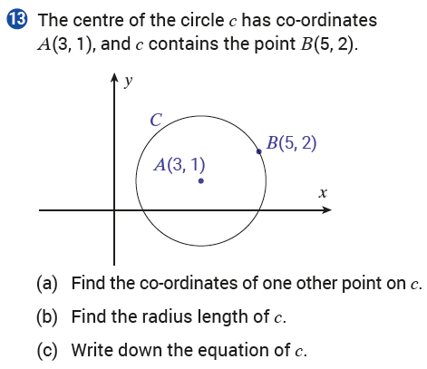
Exercise 20.3

Slide 43
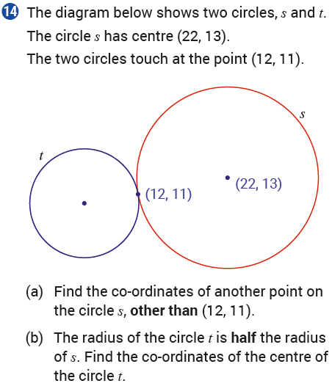
Exercise 20.3

Slide 44
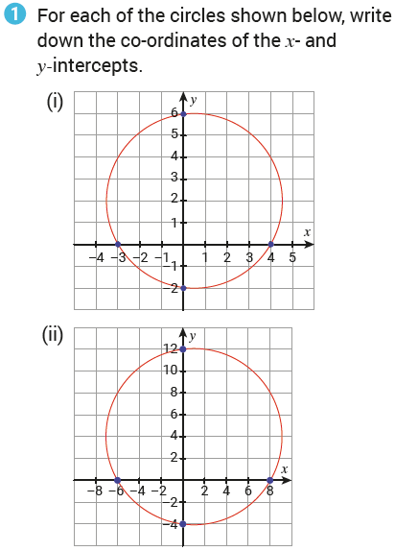
Exercise 20.4

Slide 45
Exercise 20.4

Slide 46
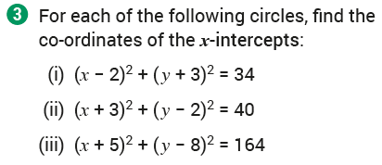
Exercise 20.4

Slide 47
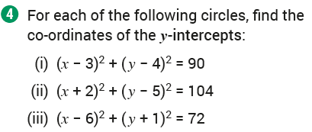
Exercise 20.4

Slide 48
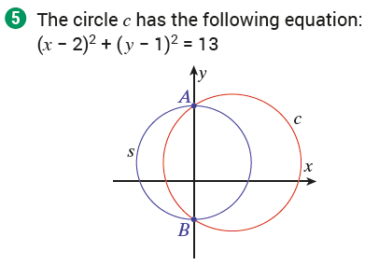
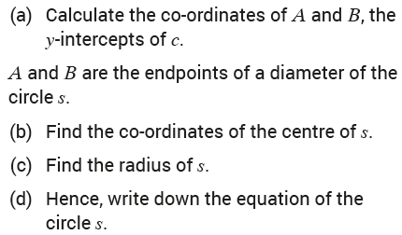
Exercise 20.4

Slide 49
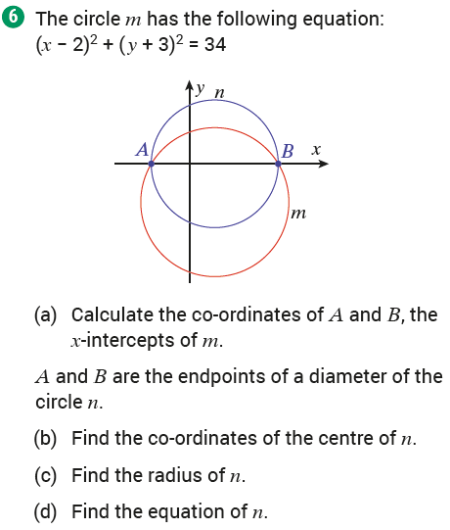
Exercise 20.4

Slide 50
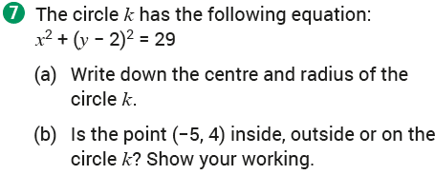
Exercise 20.4

Slide 51
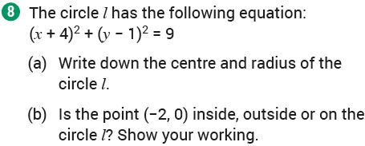
Exercise 20.4

Slide 52
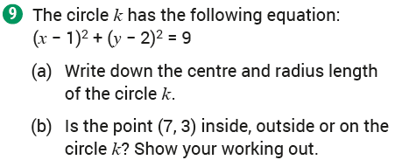
Exercise 20.4

Slide 53
Exercise 20.4

Slide 54
Exercise 20.4

Slide 55
Revision Exercises

Slide 56
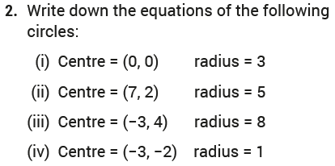
Revision Exercises

Slide 57
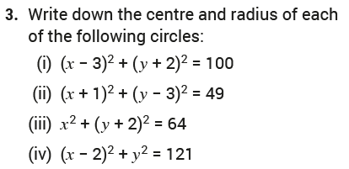
Revision Exercises

Slide 58
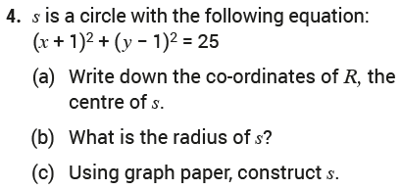
Revision Exercises

Slide 59
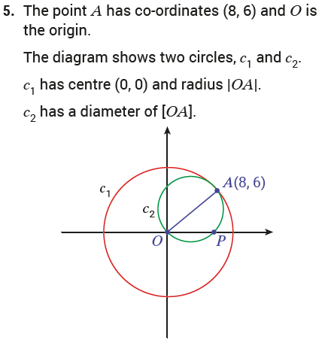
Revision Exercises

Slide 60
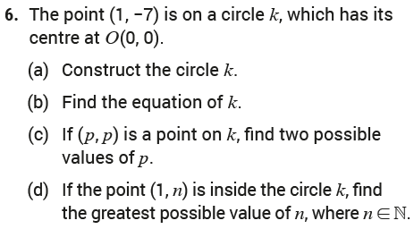
Revision Exercises

Slide 61
Revision Exercises

Slide 62
Revision Exercises

Slide 63
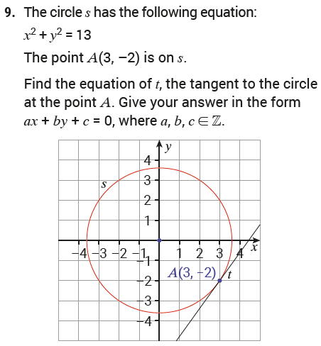
Revision Exercises

Slide 64
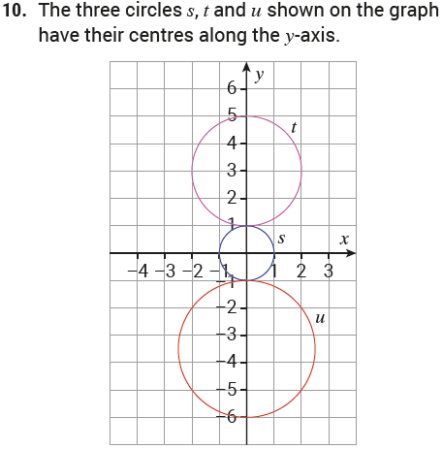
Revision Exercises

Slide 65
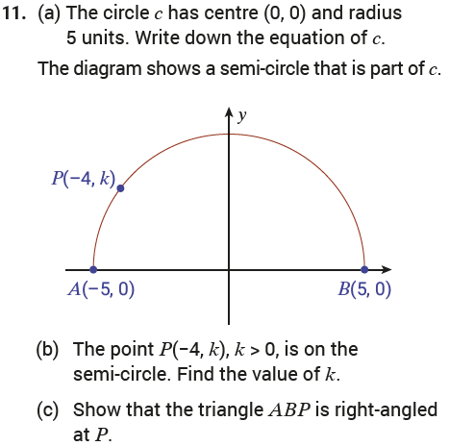
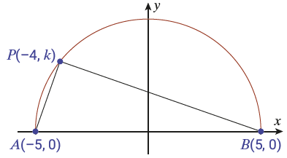
Revision Exercises

Slide 66
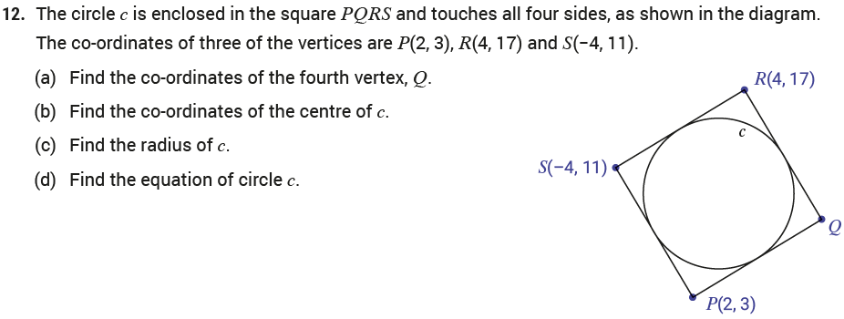
Revision Exercises

Slide 67
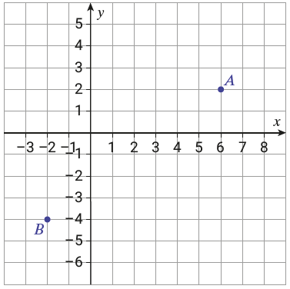
Revision Exercises

Slide 68
End of
Chapter 20 – Co – Ordinate Geometry: The Circle

