Slide 1
Chapter 3: Algebra I
(Exercise Questions and Worked Solutions)

Slide 2




Exercise 3.1

Slide 3

Exercise 3.1

Slide 4
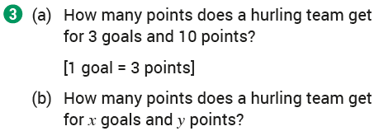


Exercise 3.1

Slide 5
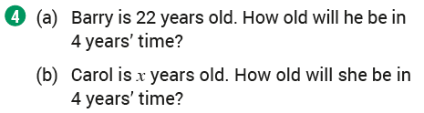

Exercise 3.1

Slide 6
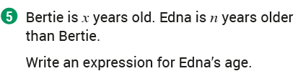

Exercise 3.1

Slide 7
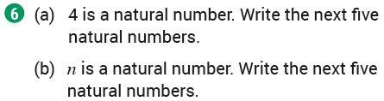

Exercise 3.1

Slide 8
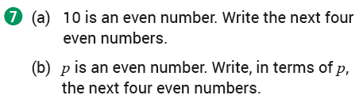
Exercise 3.1

Slide 9
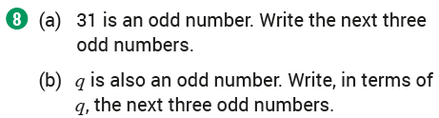

Exercise 3.1

Slide 10
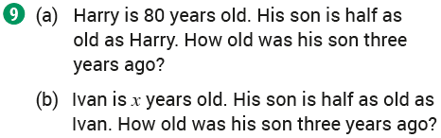


Exercise 3.1

Slide 11
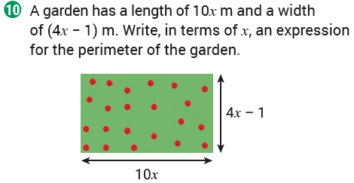

Exercise 3.1

Slide 12
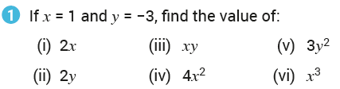




Exercise 3.2

Slide 13
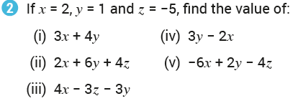





Exercise 3.2

Slide 14
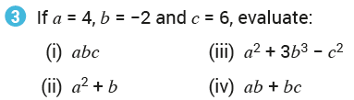



Exercise 3.2

Slide 15
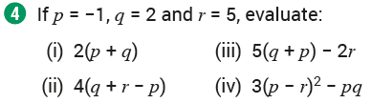
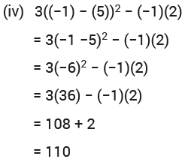
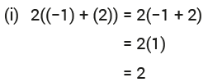

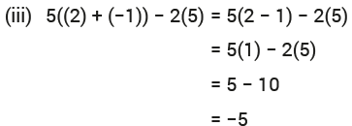
Exercise 3.2

Slide 16
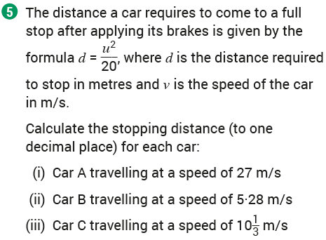


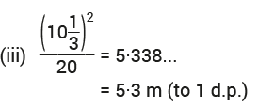
Exercise 3.2

Slide 17
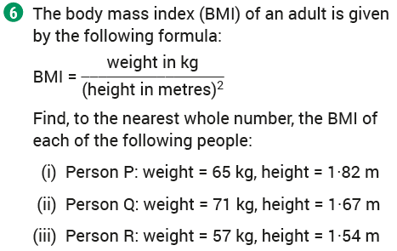



Exercise 3.2

Slide 18
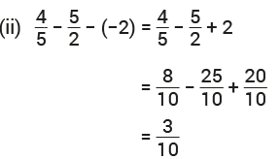
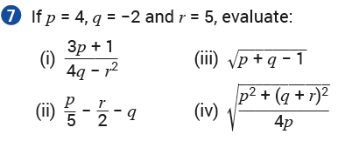
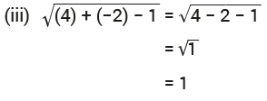
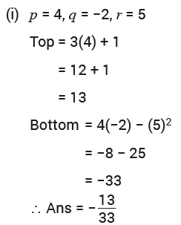
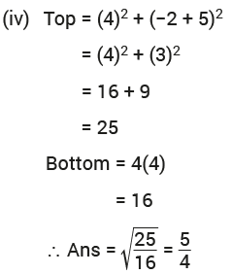
Exercise 3.2

Slide 19
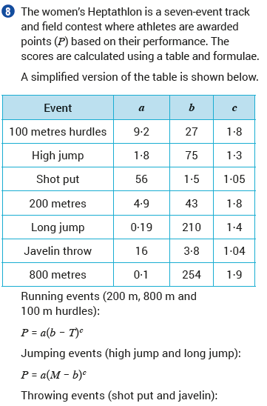
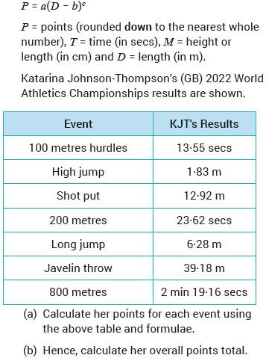
Exercise 3.2

Slide 20
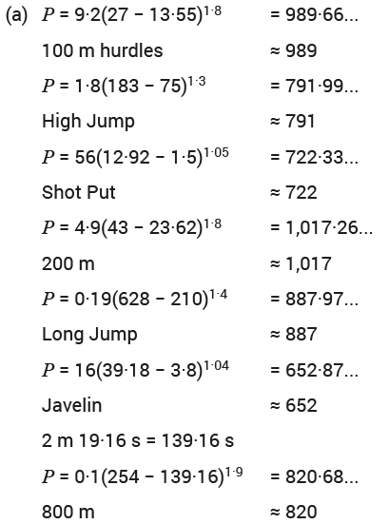

Exercise 3.2

Slide 21
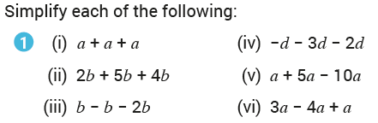



Exercise 3.3

Slide 22
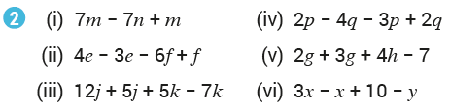




Exercise 3.3

Slide 23
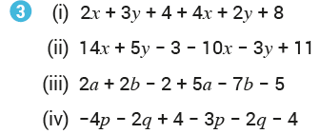
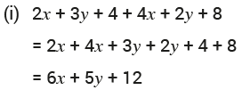
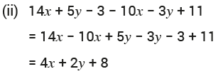
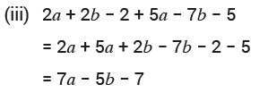
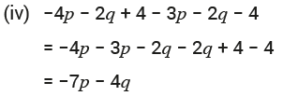
Exercise 3.3

Slide 24
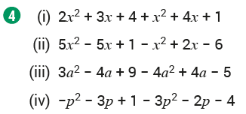
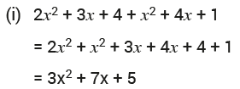
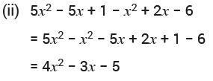

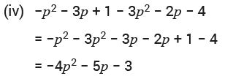
Exercise 3.3

Slide 25
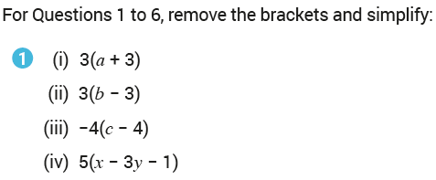
Exercise 3.4

Slide 26
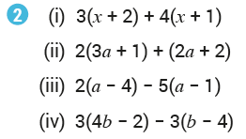

Exercise 3.4

Slide 27
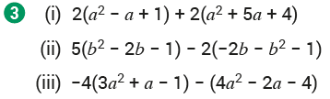



Exercise 3.4

Slide 28
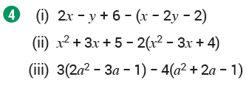
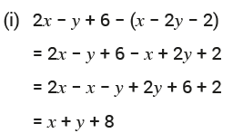
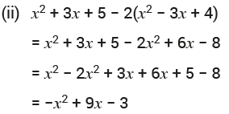
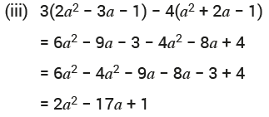
Exercise 3.4

Slide 29
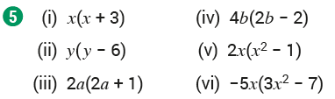






Exercise 3.4

Slide 30
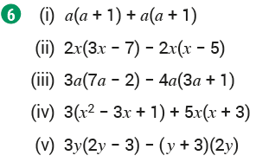


Exercise 3.4

Slide 31
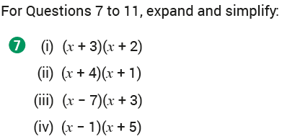
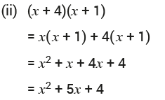
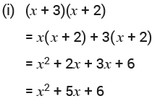
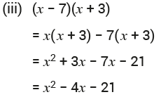

Exercise 3.4

Slide 32





Exercise 3.4

Slide 33





Exercise 3.4

Slide 34







Exercise 3.4

Slide 35





Exercise 3.4

Slide 36


Exercise 3.5

Slide 37


Exercise 3.5

Slide 38


Exercise 3.5

Slide 39


Exercise 3.5

Slide 40

Exercise 3.5

Slide 41


Exercise 3.5

Slide 42

Exercise 3.5

Slide 43


Exercise 3.5

Slide 44


Exercise 3.5

Slide 45


Exercise 3.5

Slide 46


Exercise 3.5

Slide 47


Exercise 3.5

Slide 48


Exercise 3.5

Slide 49

Exercise 3.5

Slide 50


Exercise 3.5

Slide 51

Exercise 3.5

Slide 52

Exercise 3.5

Slide 53

Exercise 3.5

Slide 54

Exercise 3.5

Slide 55

Exercise 3.5

Slide 56


Exercise 3.5

Slide 57


Exercise 3.5

Slide 58


Exercise 3.5

Slide 59


Exercise 3.5

Slide 60

Exercise 3.5

Slide 61

Exercise 3.5

Slide 62


Exercise 3.5

Slide 63


Exercise 3.5

Slide 64

Exercise 3.5

Slide 65

Exercise 3.5

Slide 66

Exercise 3.5

Slide 67

Exercise 3.5

Slide 68


Exercise 3.5

Slide 69

Exercise 3.5

Slide 70


Exercise 3.5

Slide 71


Exercise 3.5

Slide 72


Exercise 3.6

Slide 73


Exercise 3.6

Slide 74


Exercise 3.6

Slide 75


Exercise 3.6

Slide 76


Exercise 3.6

Slide 77


Exercise 3.6

Slide 78


Exercise 3.6

Slide 79


Exercise 3.6

Slide 80


Exercise 3.6

Slide 81


Exercise 3.6

Slide 82


Exercise 3.6

Slide 83


Exercise 3.6

Slide 84


Exercise 3.6

Slide 85


Exercise 3.6

Slide 86


Exercise 3.6

Slide 87


Exercise 3.6

Slide 88


Exercise 3.6

Slide 89


Exercise 3.6

Slide 90


Exercise 3.6

Slide 91


Exercise 3.6

Slide 92


Exercise 3.6

Slide 93


Exercise 3.6

Slide 94


Exercise 3.6

Slide 95


Exercise 3.6

Slide 96


Exercise 3.7

Slide 97


Exercise 3.7

Slide 98


Exercise 3.7

Slide 99


Exercise 3.7

Slide 100


Exercise 3.7

Slide 101


Exercise 3.7

Slide 102


Exercise 3.7

Slide 103


Exercise 3.7

Slide 104


Exercise 3.7

Slide 105


Exercise 3.7

Slide 106


Exercise 3.7

Slide 107


Exercise 3.7

Slide 108


Exercise 3.7

Slide 109


Exercise 3.7

Slide 110


Exercise 3.7

Slide 111


Exercise 3.7

Slide 112

Exercise 3.7

Slide 113

Exercise 3.7

Slide 114

Exercise 3.7

Slide 115









Exercise 3.8

Slide 116


Exercise 3.8

Slide 117


Exercise 3.8

Slide 118


Exercise 3.8

Slide 119


Exercise 3.8

Slide 120


Exercise 3.8

Slide 121


Exercise 3.8

Slide 122


Exercise 3.8

Slide 123


Exercise 3.8

Slide 124


Exercise 3.8

Slide 125


Exercise 3.8

Slide 126


Exercise 3.8

Slide 127




Exercise 3.8

Slide 128




Exercise 3.8

Slide 129




Exercise 3.8

Slide 130






Exercise 3.8

Slide 131



Revision Exercises

Slide 132





Revision Exercises

Slide 133




Revision Exercises

Slide 134




Revision Exercises

Slide 135




Revision Exercises

Slide 136



Revision Exercises

Slide 137


Revision Exercises

Slide 138






Revision Exercises

Slide 139





Revision Exercises

Slide 140



Revision Exercises

Slide 141




Revision Exercises

Slide 142




Revision Exercises

Slide 143





Revision Exercises

Slide 144



Revision Exercises

Slide 145

Revision Exercises

Slide 146
End of
Chapter 03: Algebra I

