Slide 1
Chapter 20:
Co-ordinate Geometry: The Circle (Exercise Questions and Worked Solutions)

Slide 2
Exercise 20.1

Slide 3
Exercise 20.1

Slide 4
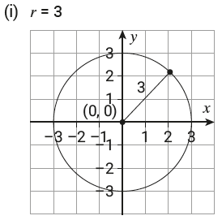
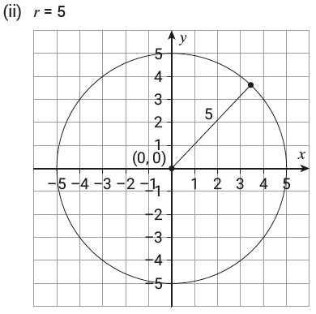
Exercise 20.1

Slide 5
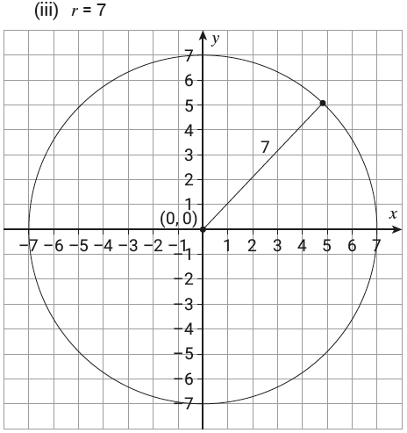
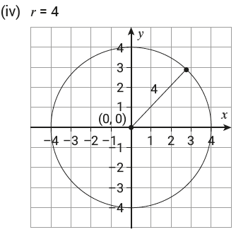
Exercise 20.1

Slide 6
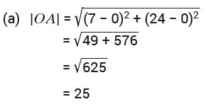
Exercise 20.1

Slide 7
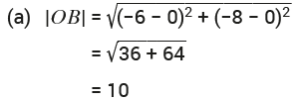
Exercise 20.1

Slide 8
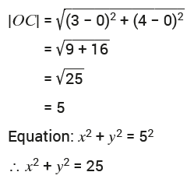
Exercise 20.1

Slide 9
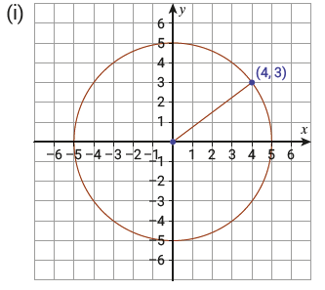
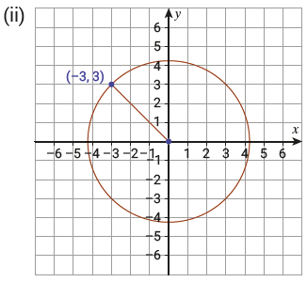
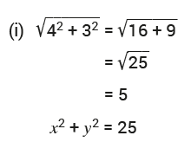
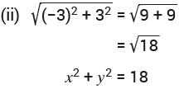
Exercise 20.1

Slide 10
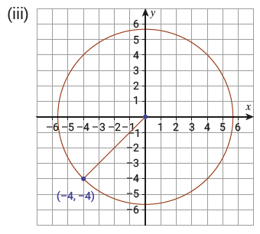
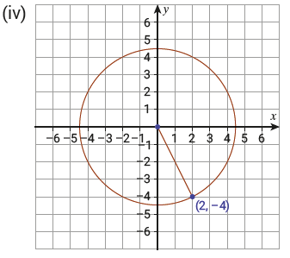
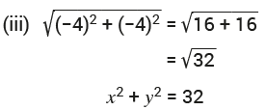
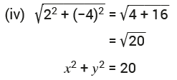
Exercise 20.1

Slide 11
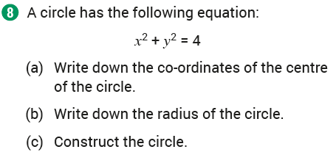
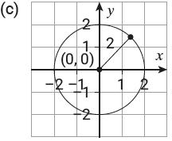
Exercise 20.1

Slide 12
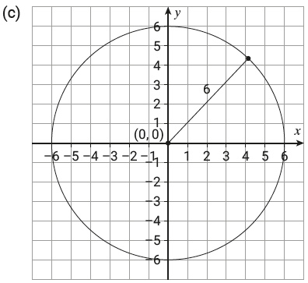
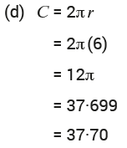
Exercise 20.1

Slide 13
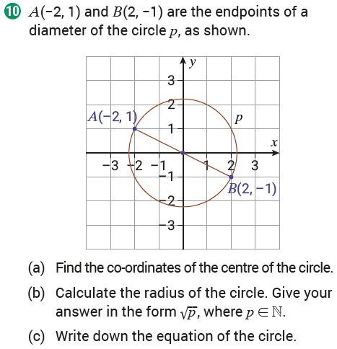
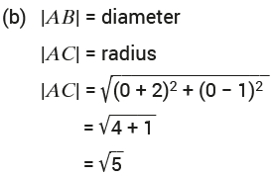
Exercise 20.1

Slide 14
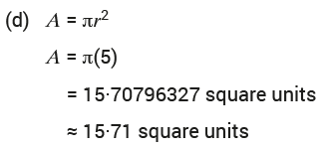
Exercise 20.1

Slide 15
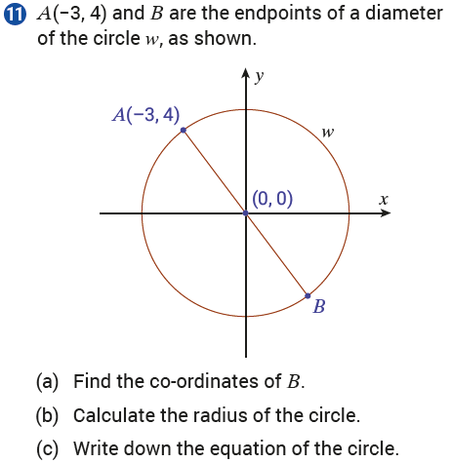
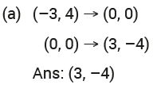
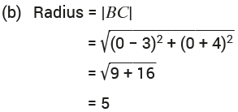
Exercise 20.1

Slide 16
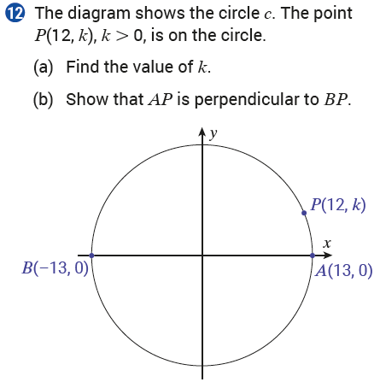
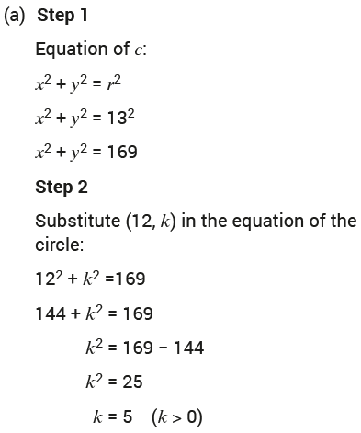
Exercise 20.1

Slide 17
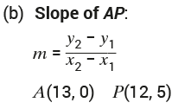
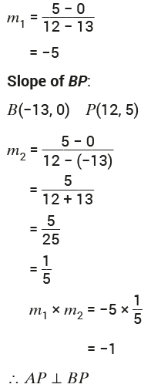
Exercise 20.1

Slide 18
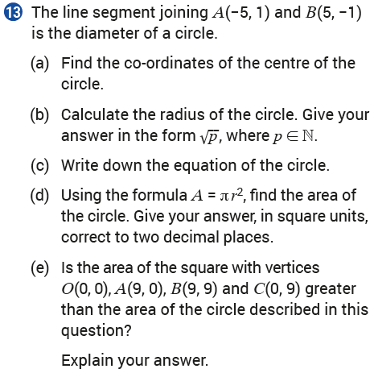
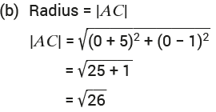
Exercise 20.1

Slide 19
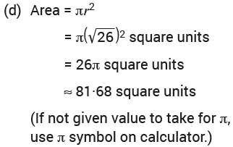
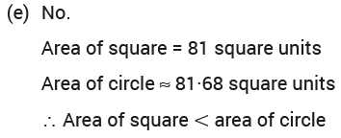
Exercise 20.1

Slide 20
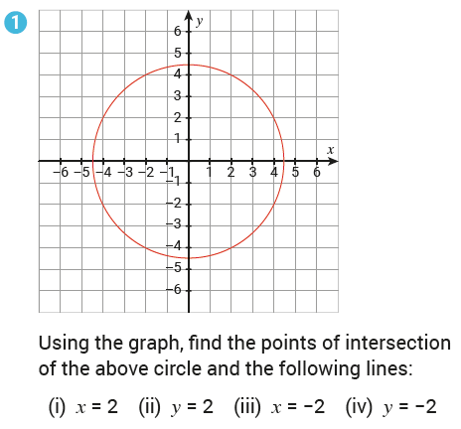
Exercise 20.2

Slide 21
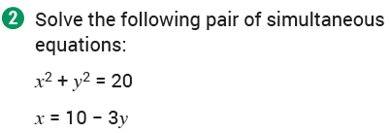
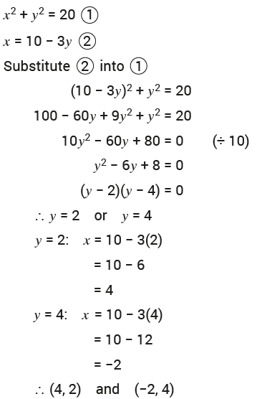
Exercise 20.2

Slide 22
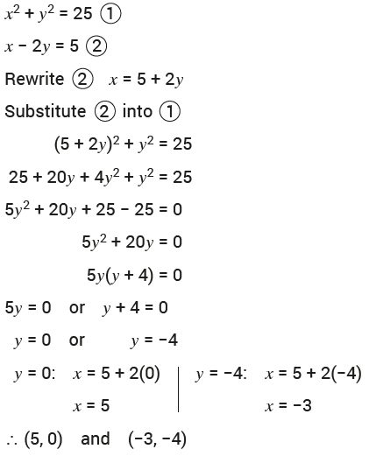
Exercise 20.2

Slide 23
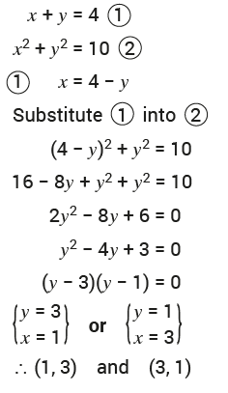
Exercise 20.2

Slide 24
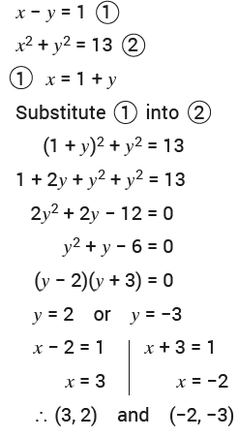
Exercise 20.2

Slide 25
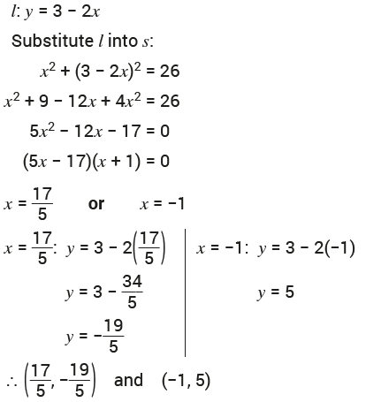
Exercise 20.2

Slide 26
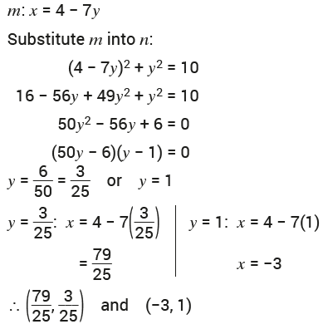
Exercise 20.2

Slide 27
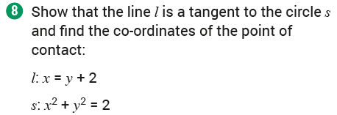
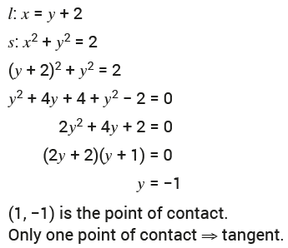
Exercise 20.2

Slide 28
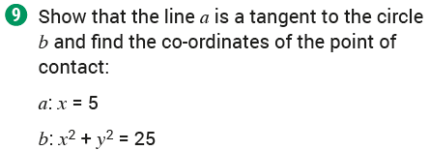
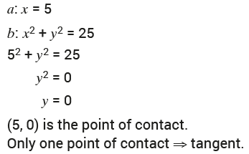
Exercise 20.2

Slide 29
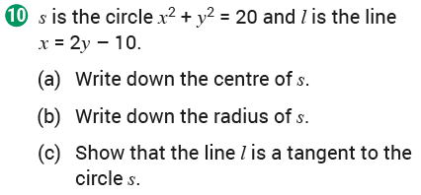
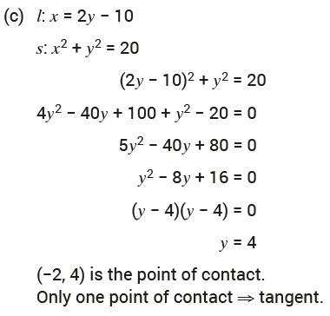
Exercise 20.2

Slide 30
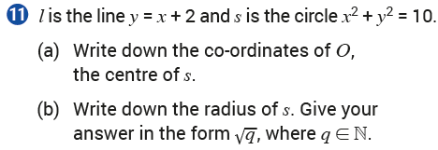
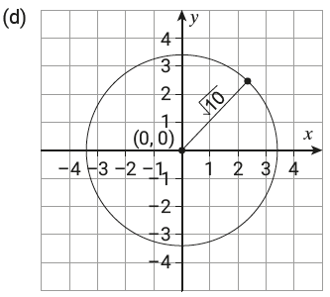
Exercise 20.2

Slide 31
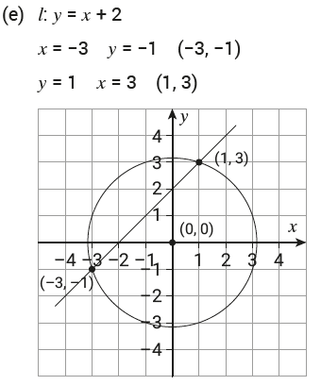
Exercise 20.2

Slide 32
Exercise 20.2

Slide 33
Exercise 20.2

Slide 34
Exercise 20.2

Slide 35
Exercise 20.2

Slide 36
Exercise 20.3

Slide 37
Exercise 20.3

Slide 38
Exercise 20.3

Slide 39
Exercise 20.3

Slide 40
Exercise 20.3

Slide 41
Exercise 20.3

Slide 42
Exercise 20.3

Slide 43
Exercise 20.3

Slide 44
Exercise 20.3

Slide 45
Exercise 20.3

Slide 46
Exercise 20.3

Slide 47
Exercise 20.3

Slide 48
Exercise 20.3

Slide 49
Exercise 20.3

Slide 50
Exercise 20.4

Slide 51
Exercise 20.4

Slide 52
Exercise 20.4

Slide 53
Exercise 20.4

Slide 54
Exercise 20.4

Slide 55
Exercise 20.4

Slide 56
Exercise 20.4

Slide 57
Exercise 20.4

Slide 58
Exercise 20.4

Slide 59
Exercise 20.4

Slide 60
Exercise 20.4

Slide 61
Exercise 20.4

Slide 62
Revision Exercises

Slide 63
Revision Exercises

Slide 64
Revision Exercises

Slide 65
Revision Exercises

Slide 66
Revision Exercises

Slide 67
Revision Exercises

Slide 68
Revision Exercises

Slide 69
Revision Exercises

Slide 70
Revision Exercises

Slide 71
Revision Exercises

Slide 72
Revision Exercises

Slide 73
Revision Exercises

Slide 74
Revision Exercises

Slide 75
Revision Exercises

Slide 76
Revision Exercises

Slide 77
Revision Exercises

Slide 78
Revision Exercises

Slide 79
Revision Exercises

Slide 80
Revision Exercises

Slide 81
Revision Exercises

Slide 82
Revision Exercises

Slide 83
Revision Exercises

Slide 84
End of
Chapter 20 – Co – Ordinate Geometry: The Circle

