Slide 1
Chapter 3
Biomolecules

Slide 2
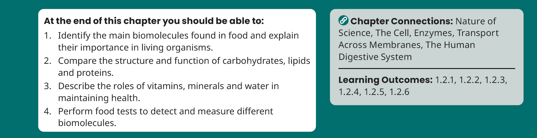
Chapter Learning Objectives

Slide 3
3.1 What are Biomolecules?

Slide 4
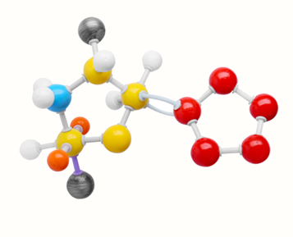
What are Biomolecules?
p.25
All living things are built from the same basic ingredients
Most organisms are made up of six main chemical elements:
Carbon (C)
Hydrogen (H)
Oxygen (O)
Nitrogen (N)
Phosphorus (P)
Sulfur (S)
Biomolecules – the molecules found in organisms
C H O N P S

Slide 5
3.2 Food and Cells

Slide 6
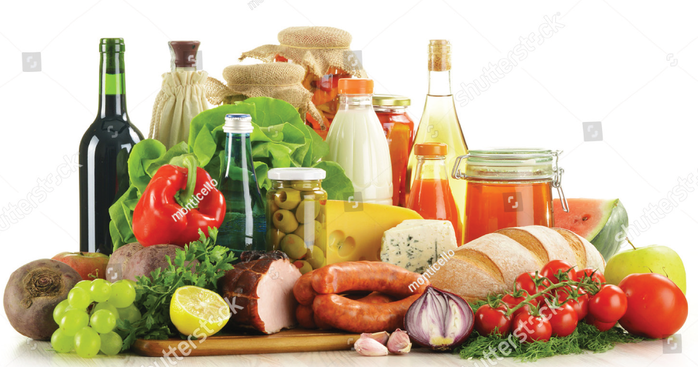
Food and Cells
p.26
All living things need food to survive.
Organisms need food for three main reasons:
Energy – for processes such as movement, heat production and chemical reactions
Structure – food provides materials to build structural units in cells.
Metabolic Control – food provides molecules that control chemical reactions in cells.

Slide 7
3.3 Carbohydrates

Slide 8
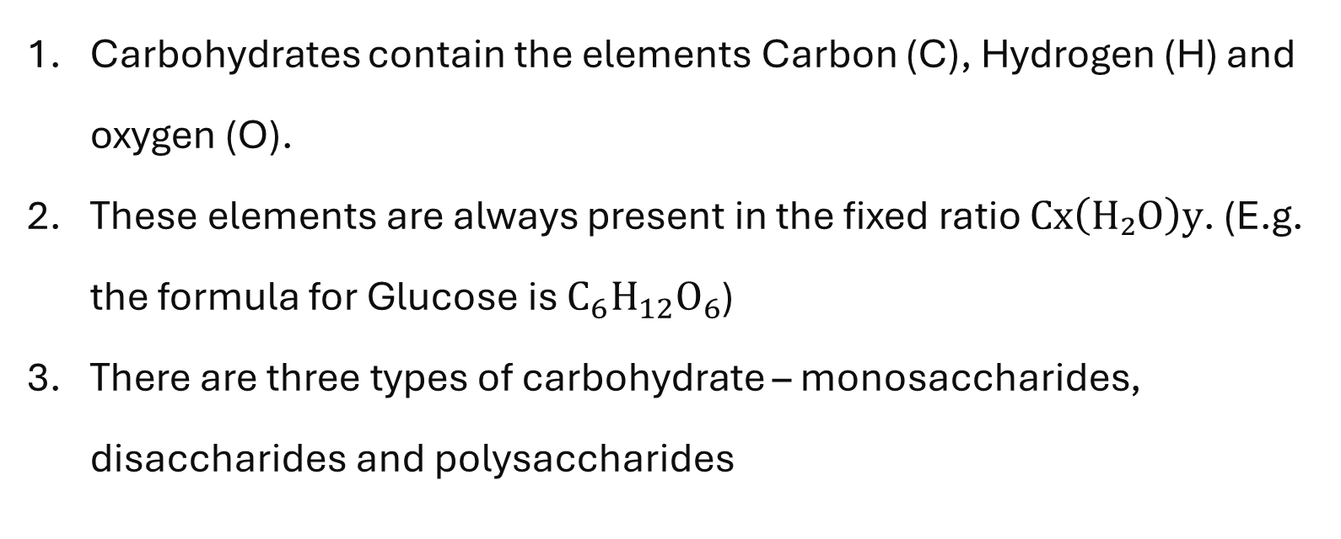
Carbohydrates
p.26
Carbohydrates contain the elements Carbon (C), Hydrogen (H) and oxygen (O).
These elements are always present in the fixed ratio $Cx\left(H₂O\right)y$. (E.g. the formula for Glucose is $C_{6}H_{12}O_{6}$)
There are three types of carbohydrate – monosaccharides, disaccharides and polysaccharides

Slide 9
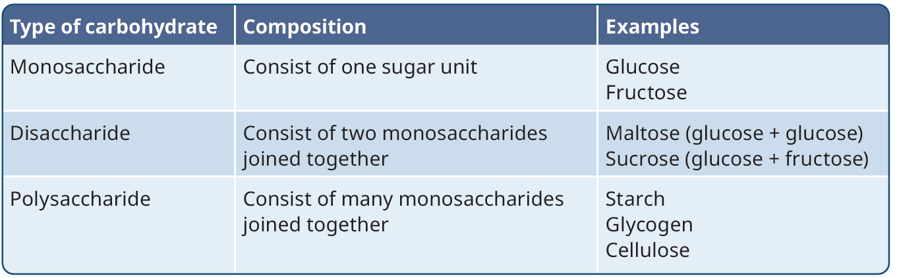
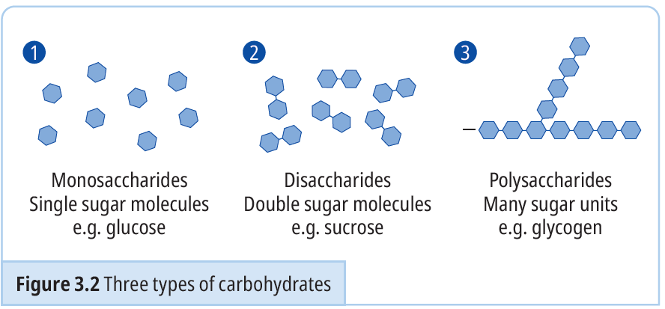
Carbohydrates
p.27

Slide 10
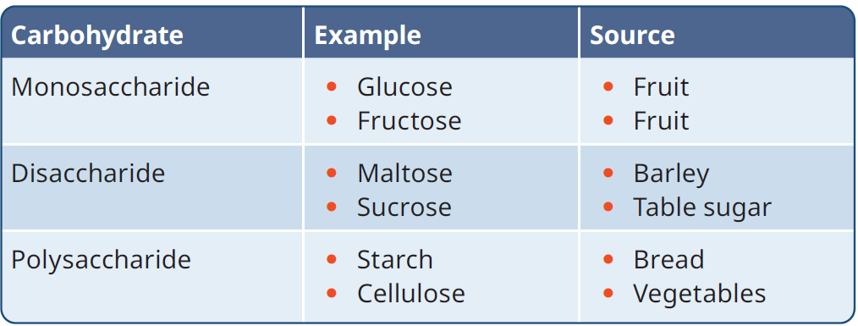
The Roles of Carbohydrates
Structural Role | Metabolic Role
Carbohydrates support cell structures. | Carbohydrates release energy in respiration, and this energy is used in metabolic reactions

Slide 11
3.4 Lipids

Slide 12

Lipids
p.27
Lipids contain the elements Carbon (C), Hydrogen (H) and oxygen (O).
Unlike carbohydrates, lipids do not have a fixed ratio for carbon, hydrogen and oxygen.
Lipids that are solid at room temperature are called fats.
Lipids that are liquid at room temperature are called oils.
Can you list some examples of fats and oils?

Slide 13
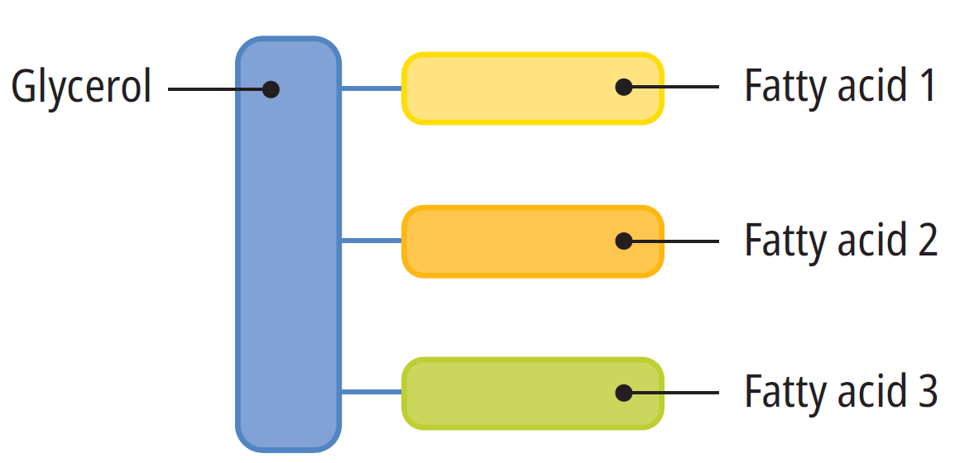
Lipids
p.27
The basic unit of a lipid is called a triglyceride.
It is made up of three fatty acids joined to one glycerol molecule.

Slide 14
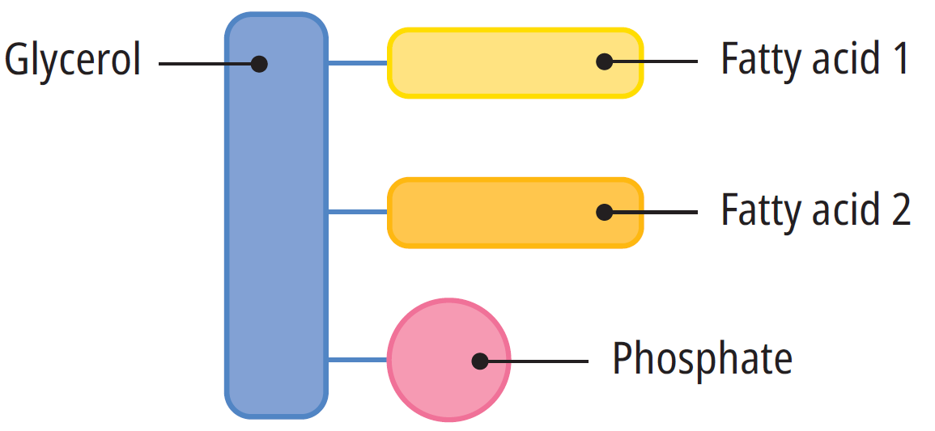
Lipids
p.27
There are many types of lipid.
For example, a phospholipid is like a triglyceride, except it replaces one of the fatty acids with a phosphate group.

Slide 15
The Roles of Lipids
p.28
Structural Role | Metabolic Role
Phospholipids form a major part of the cell membrane. | Adipose tissue acts as a long-term energy reserve in the body. Lipids are broken down during respiration to provide energy for cellular reactions
Sources of Lipids
Fats – butter, cream, cheese Oils – sunflower oil, olive oil, mackerel, salmon

Slide 16
3.5 Proteins

Slide 17
Proteins
p.28
Proteins contain the elements Carbon (C), Hydrogen (H) and oxygen (O) and Nitrogen (N).
Sometimes proteins contain Phosphorous (P) and Sulfur (S).
These elements combine to form the basic unit of a protein – an amino acid.
There are 20 common amino acids.
A protein consists of at least 200 amino acids.
A chain of less than 20 amino acids is known as a peptide
A chain of more than 20 amino acids is known as a polypeptide

Slide 18
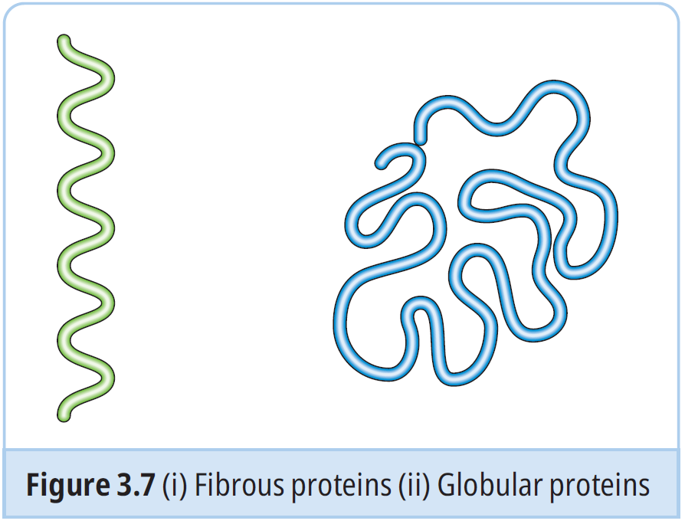
Proteins
p.28
Fibrous Proteins – form long straight chains (e.g. Keratin found in hair, skin and nails.)
Globular proteins – form spherical shaped chains (e.g. Enzymes and Hormones)

Slide 19
The Roles of Proteins
p.29
Structural Role | Metabolic Role
Keratin is a protein that forms our hair, skin and nails | All enzymes are proteins – e.g. amylase Some hormones are made of protein – e.g. insulin Antibodies produced by our white blood cells are special proteins Membrane proteins help to control what enters and exits the cell membrane
Sources of Proteins
Lean meat, egg white, fish, soya, beans, dairy

Slide 20
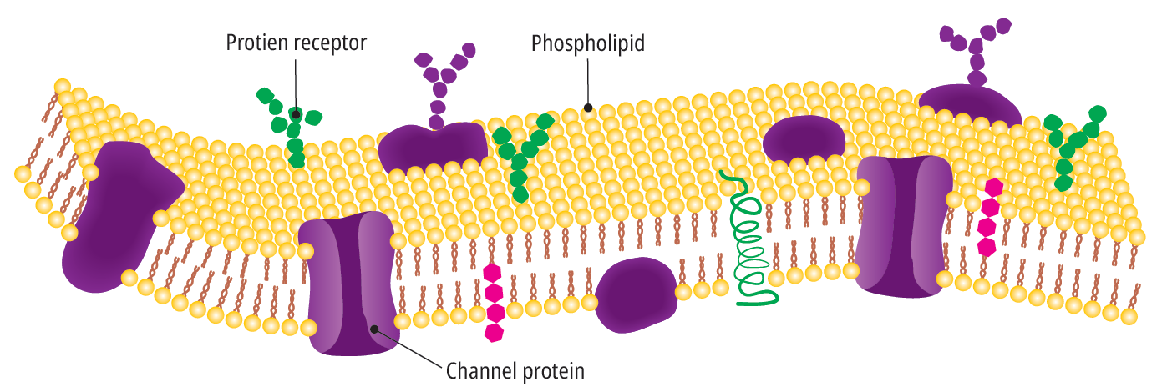
The Roles of Proteins
p.29

Slide 21
3.6 Vitamins

Slide 22

Vitamins
p.30
Vitamins are biomolecules that are needed in small amounts.
They only have a metabolic role.
There are two types of vitamins:
Fat-soluble vitamins (A, D, E, and K)
Water-soluble vitamins (B and C)
Research the metabolic function of all vitamins listed here.

Slide 23
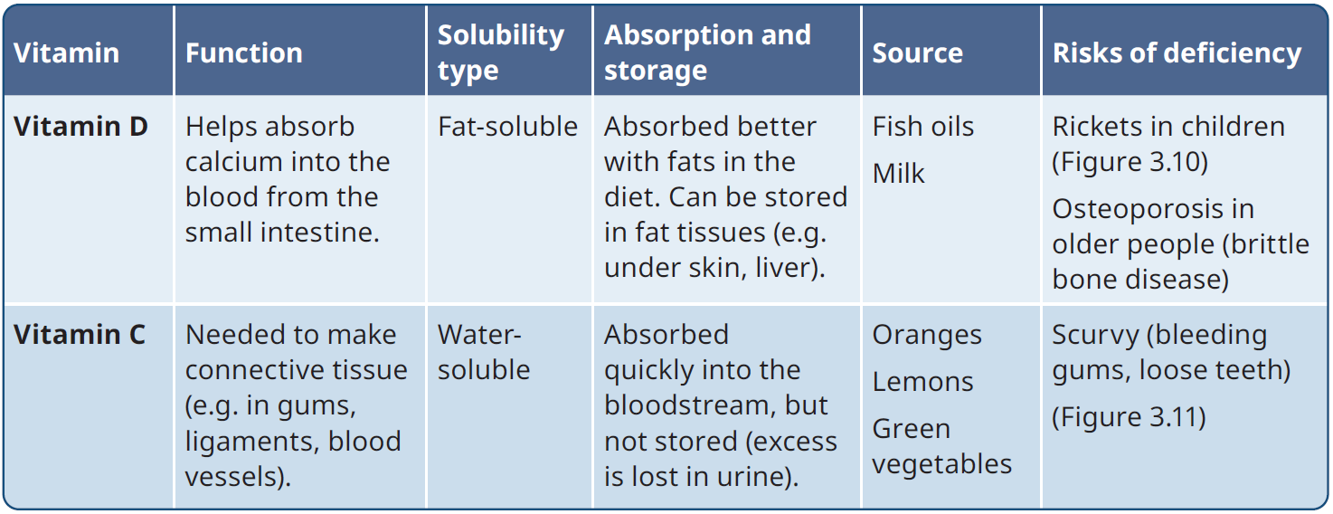
Vitamins
p.30

Slide 24
3.7 Minerals

Slide 25
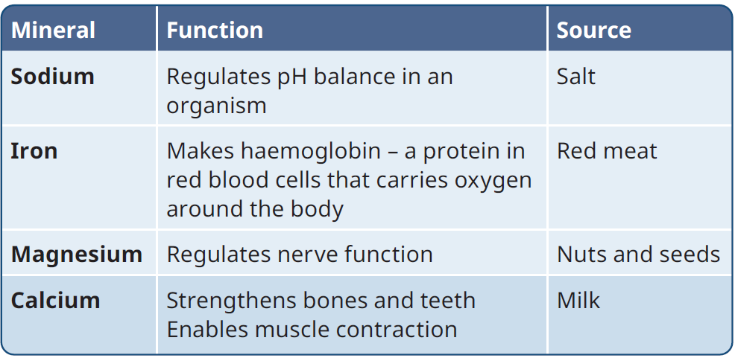
Minerals
p.30
Minerals are biomolecules that are needed in very small amounts.
Minerals ensure that an organism maintains homeostasis.

Slide 26
3.8 Water

Slide 27

Water
p.31
Water is essential for life.
Organisms consist of 65-90% water.
The main functions of water in the body are:
A medium for transport
Supports metabolic reactions
Temperature regulation
pH regulation
Osmoregulation
How does water support
metabolic reactions?
What roles does water play in maintaining
cell shape and structure in plant cells?

Slide 28
3.9 Testing for the Presence of Biomolecules in Food

Slide 29
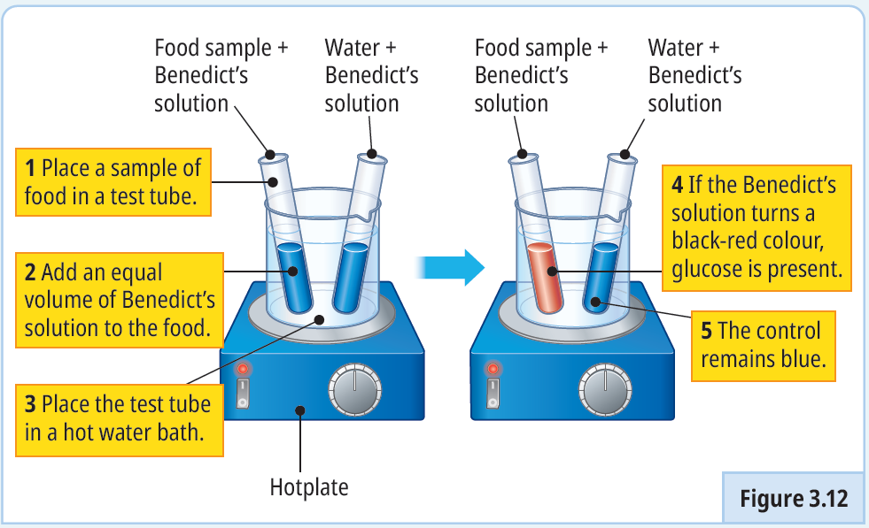

Experiment 3.1 – To carry out a qualitative test for a reducing sugar
p.32

Slide 30
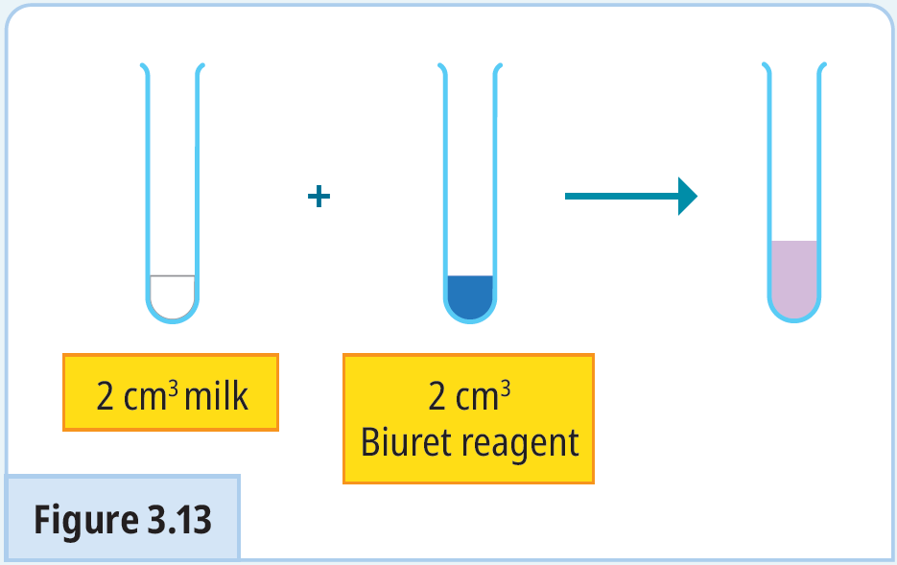

Experiment 3.2 – To carry out a qualitative test for protein
p.32

Slide 31
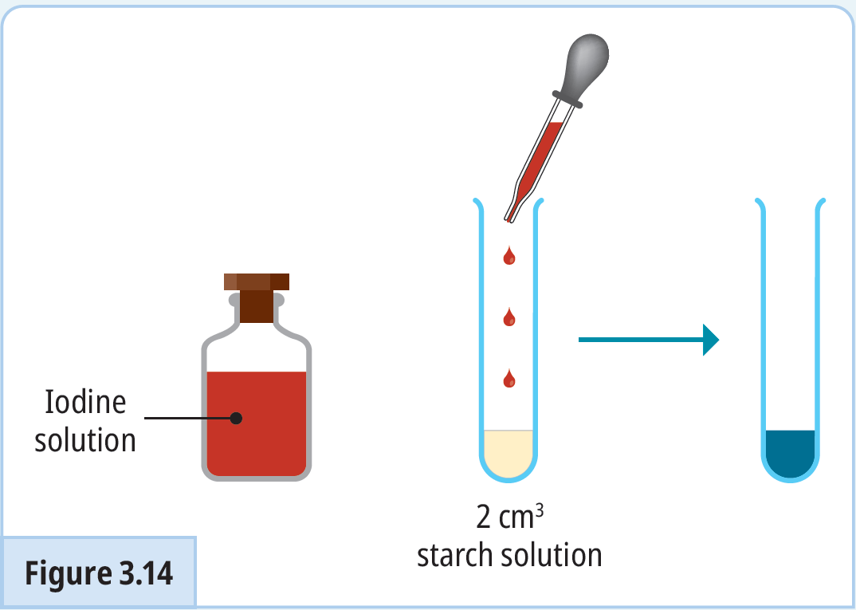

Experiment 3.3 – To carry out a qualitative test for starch
p.33

Slide 32
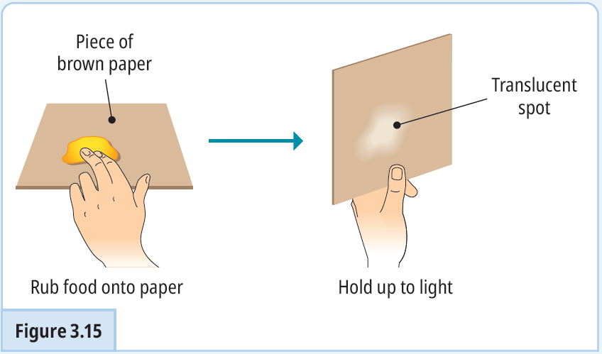

Experiment 3.4 – To carry out a qualitative test for lipids
p.33

Slide 33
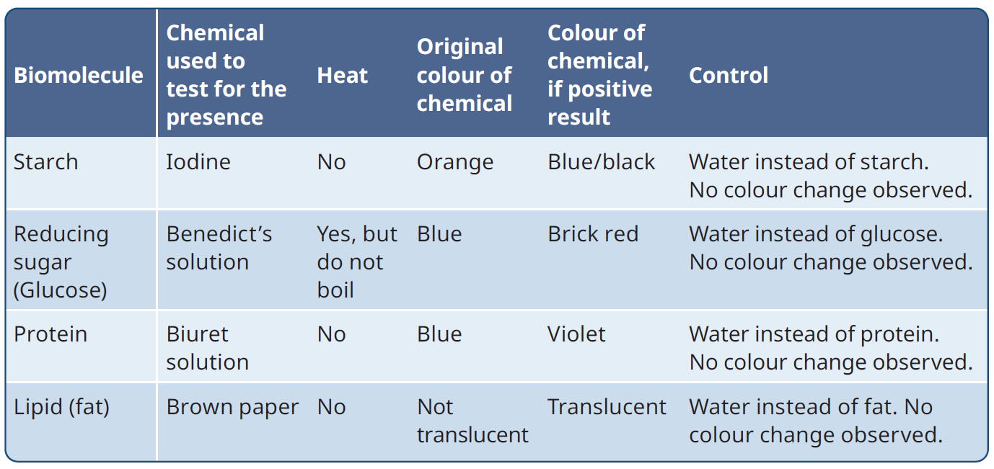
Qualitative Experiments – Results Table
p.35

Slide 34
3.10 Carrying out a Quantitative Food Test

Slide 35
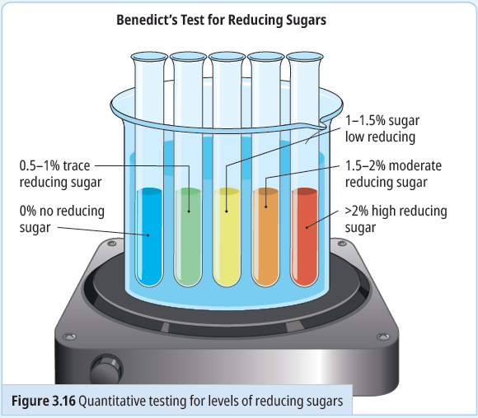

Experiment 3.5 – To investigate quantitatively the level of reducing sugars in a range of food samples
p.34

Slide 36

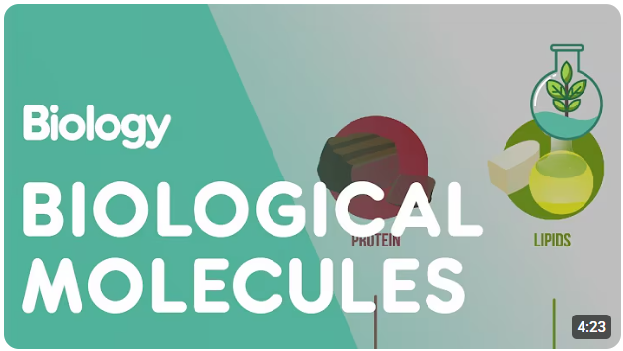
Video Link – Press “Ctrl + Click” to Play

Slide 37
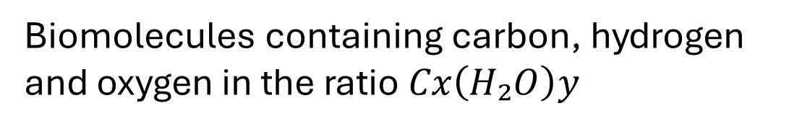
Keyword recap – Click to Reveal
Biomolecules
Chemicals found in living organisms
Biomolecules containing carbon, hydrogen and oxygen in the ratio $Cx\left(H₂O\right)y$
Carbohydrates
Monosaccharide
Carbohydrates consisting of one sugar unit
Disaccharide
Carbohydrates consisting of two sugar units
Polysaccharide
Carbohydrates consisting of many sugar units

Slide 38
Keyword recap – Click to Reveal
Polypeptides
A chain of more than 20 amino acids
Oils
Lipids that are liquid at room temperature
Fats
Lipids that are solid at room temperature
Basic unit of a lipid consisting of glycerol and three fatty acids
Triglyceride
Phospholipid
Lipid unit where one fatty acid is replaced by a phosphate group

Slide 39
Keyword recap – Click to Reveal
Structural Role
When a biomolecule forms part of a cell or tissue – e.g. hair/nails/cell walls
Metabolic Role
When a biomolecule plays a key role in cellular reactions – e.g. enzymes/hormones
Qualitative
Testing that reveals the presence/absence of a substance
Quantitative
Testing that measures the amount of a substance

Slide 40
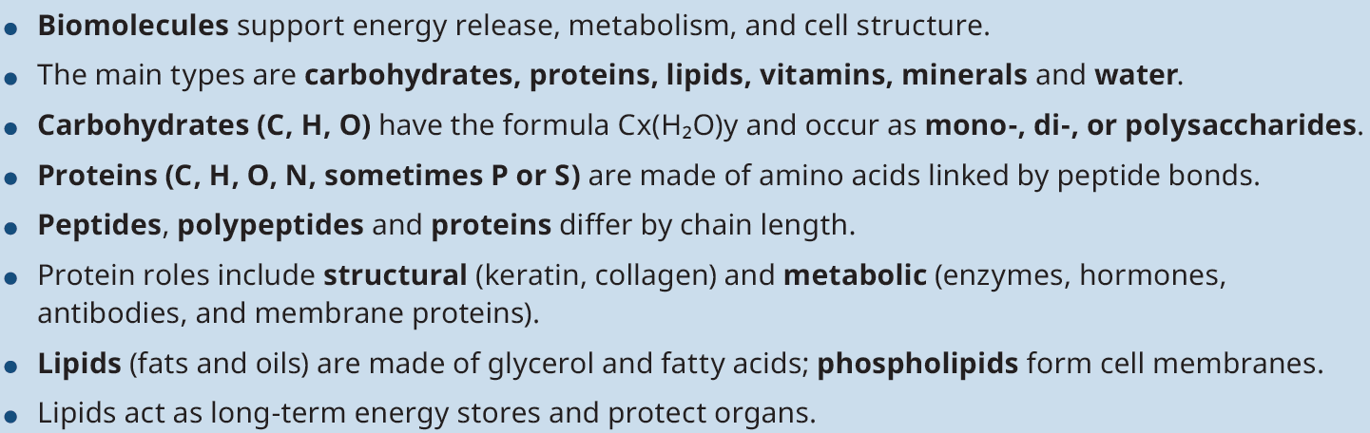
Chapter Summary

Slide 41
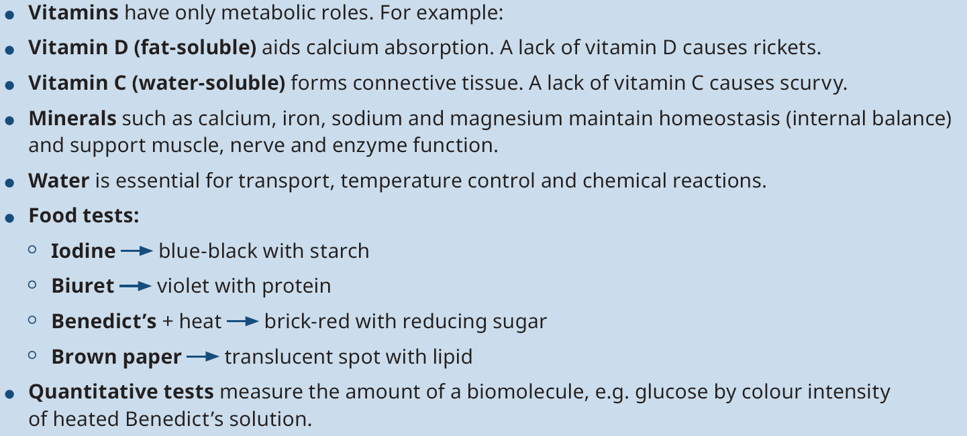
Chapter Summary

