Slide 1
Chapter 5
Enzymes

Slide 2
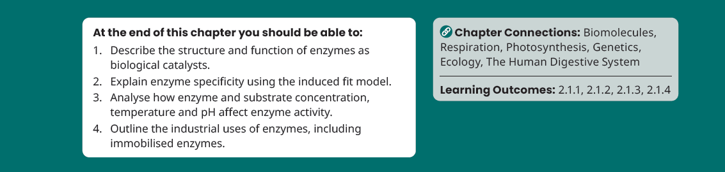
Chapter Learning Objectives

Slide 3
5.1 The Role of Enzymes in Metabolism

Slide 4
The Role of Enzymes in Metabolism
p.61
Metabolism is the sum of all chemical reactions that occur in an organism
Enzymes control the chemical reactions of metabolism
Enzymes are selective catalysts.
Enzyme: a protein biological catalyst
Selective catalyst:
A substance that speeds up a chemical reaction without being used up in the process

Slide 5
5.2 The Structure and Function of Enzymes

Slide 6
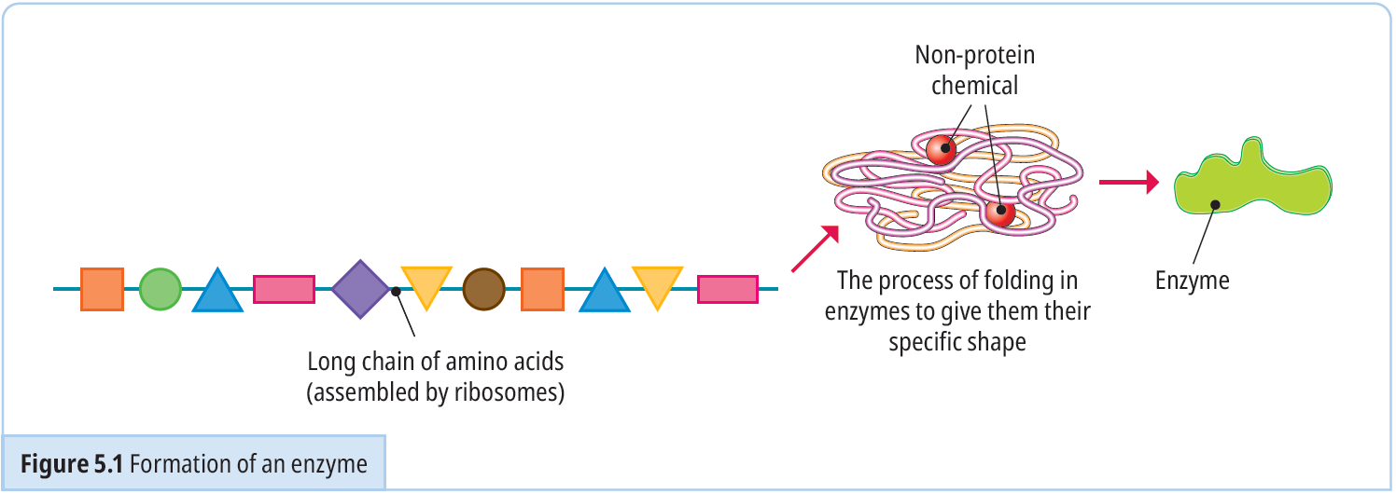
The Structure of Enzymes
p.61
Enzymes are made in the ribosomes of cells.
Each enzyme has a specific 3D shape.

Slide 7
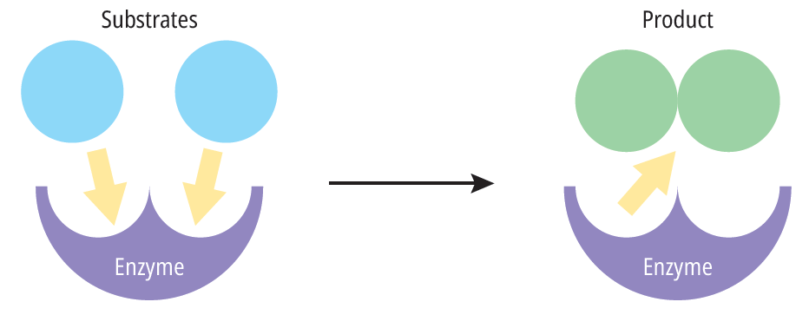
The Function of Enzymes
p.62
Each enzyme reacts with a specific substrate to produce a product.
Substrate: the substance an enzyme works on
Product: the substance(s) produced by the enzyme action

Slide 8
(HL) 5.3 Enzyme Specificity

Slide 9

Enzyme Specificity (HL)
p.63
The specificity of an enzyme refers to the complementary nature between the shape of the active site of the enzyme and its substrate.
Active site: the part of an enzyme that slightly changes shape to match that of the substrate
Specificity: each enzyme will only act on one substrate
Can you give examples of enzymes and their substrates that you have
come across in science previously?

Slide 10
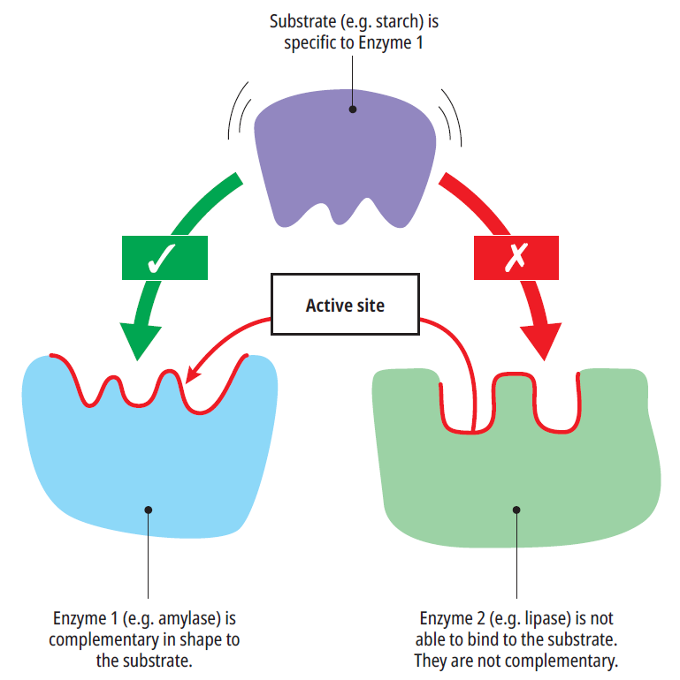
Enzyme Specificity (HL)
p.63

Slide 11
The Induced Fit Model (HL)
p.64
The active site of an enzyme is flexible.
The shape of the active site can change slightly to bind with the substrate.
When the enzyme and substrate are bound together this forms the enzyme-substrate complex.
At the end of the reaction the active site returns to its original shape.

Slide 12
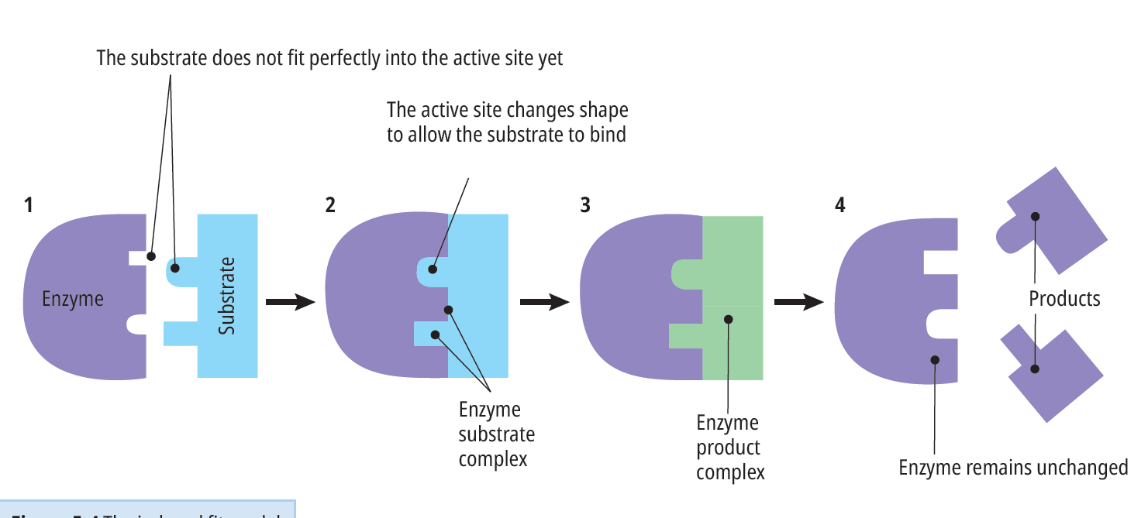
The Induced Fit Model (HL)
p.64

Slide 13

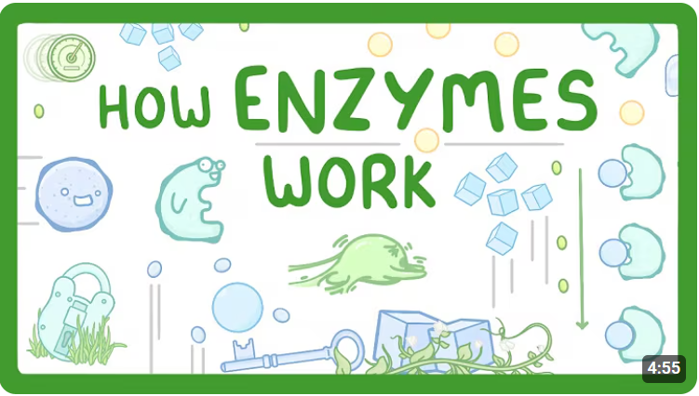
Video Link – Press “Ctrl + Click” to Play

Slide 14
5.4 Factors Affecting Enzyme Action

Slide 15
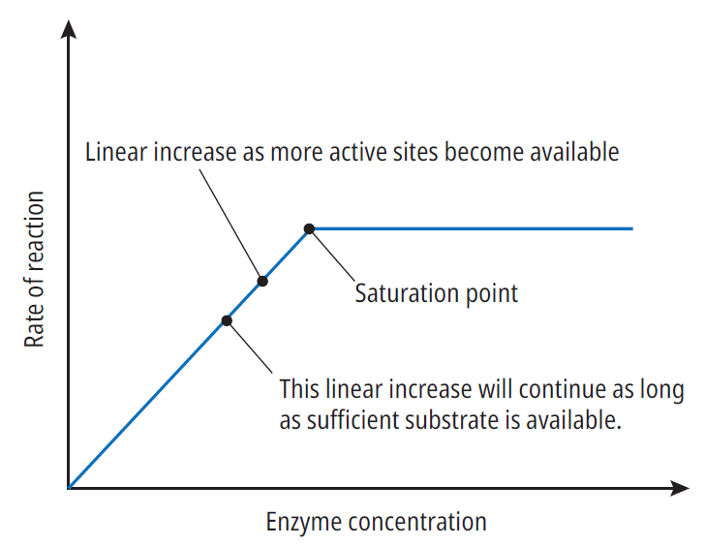
Enzyme Concentration
p.65
Higher enzyme concentration leads to more active sites, this leads to more enzyme-substrate complexes, which increases rate of reaction.
If the substrate is limited the rate of reaction will eventually level off.
Enzyme action: a measure of how quickly an enzyme converts a substrate into a product

Slide 16
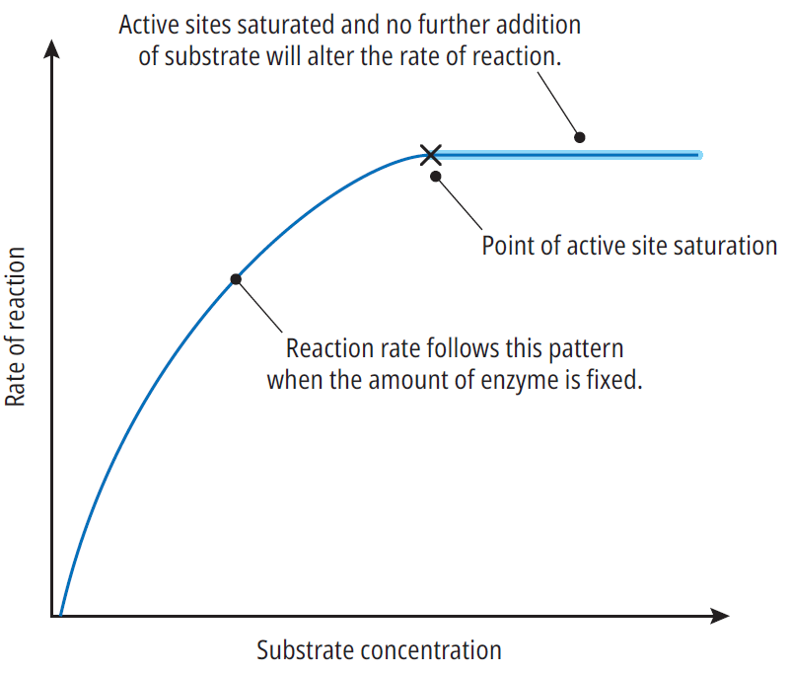
Substrate Concentration
p.65
As substrate concentration increases, rate of reaction increases.
The reaction reaches a maximum rate called the saturation point.
Saturation point: when all active sites are occupied by substrate molecules

Slide 17
Temperature
p.66
As temperature rises the rate of reaction increases.
The rate continues to rise until the enzyme reaches its optimum temperature.
Past the optimum temperature the enzyme becomes denatured.
Optimum Activity: enzymes working at their maximum rate
Denatured: when an enzyme permanently loses it shape and no longer functions

Slide 18
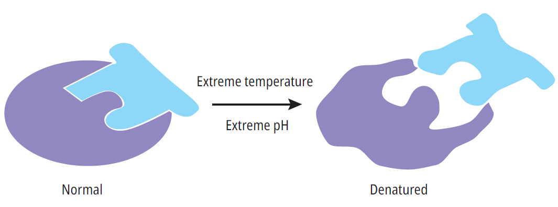
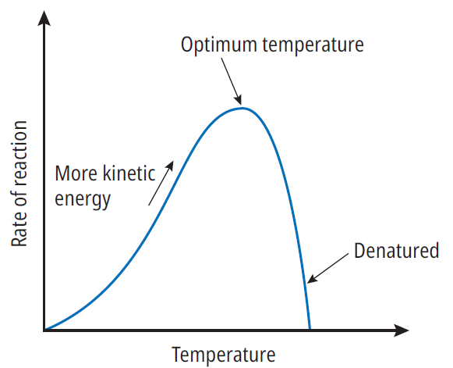
Temperature
p.66

Slide 19
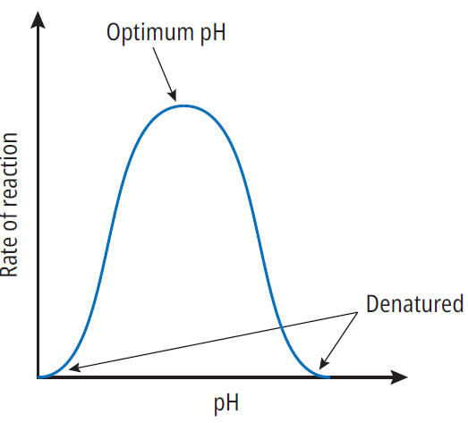
Environmental pH
p.67
Different enzymes have different optimum pH.
If the pH moves above or below optimum the rate of reaction decreases significantly and the enzyme can become denatured.
Research the optimum pH levels in different parts of the body – e.g. the blood, the mouth and the stomach

Slide 20
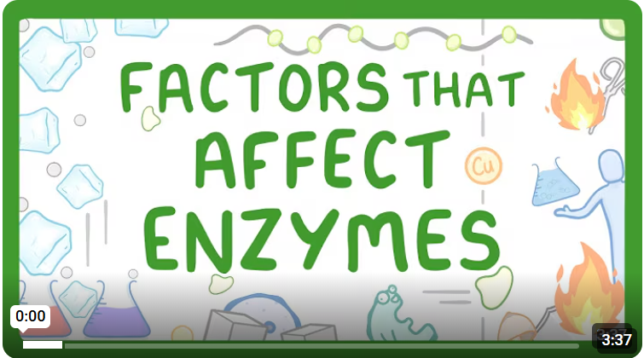
Video Link – Press “Ctrl + Click” to Play

Slide 21
5.5 The Use of Enzymes in Industry

Slide 22
The Use of Enzymes in Industry
p.68
Modern bioprocessing is where enzymes are used to make products in controlled reactions in a bioreactor.
Temperature, pH, oxygen levels and substrate concentration are controlled within the bioreactor to ensure the enzymes can work at their optimum rate.
Bioprocessing: the use of enzymes or cells to make a product through a controlled process.
Bioreactor: a vessel in which microorganisms are used to make products more efficiently

Slide 23
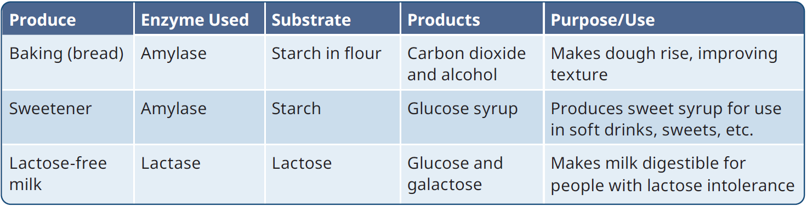
Food and Beverages
p.68
Enzymes are used extensively in the food a drinks industry.

Slide 24
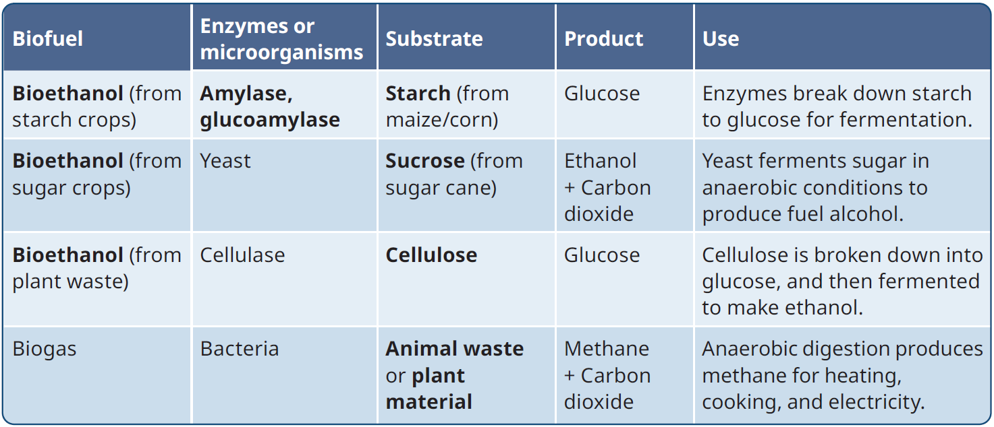
Biofuels
p.69
Biofuels are made from biological materials are a renewable alternative to fossil fuels. Enzymes are used in the production of biofuels.

Slide 25
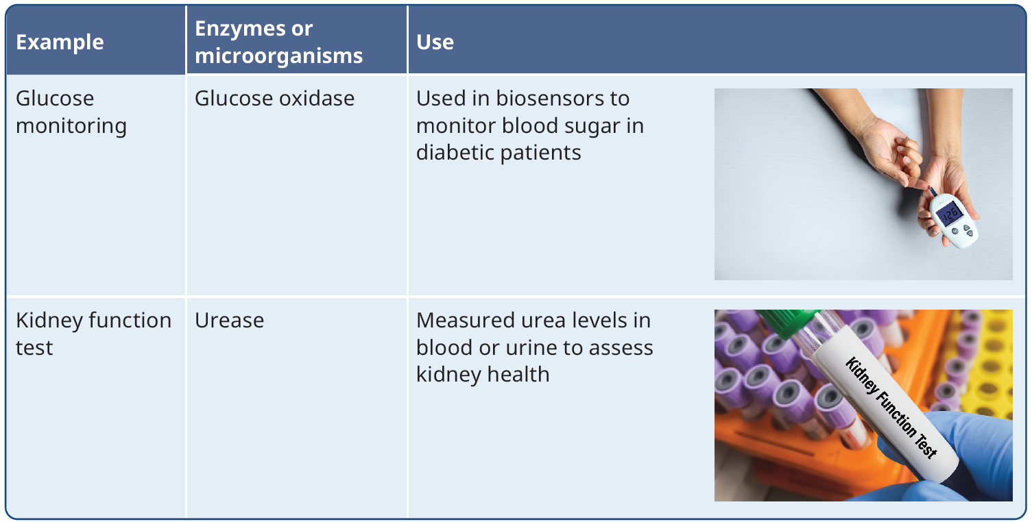
Medicine
p.69
Enzymes have a wide range of medical applications

Slide 26
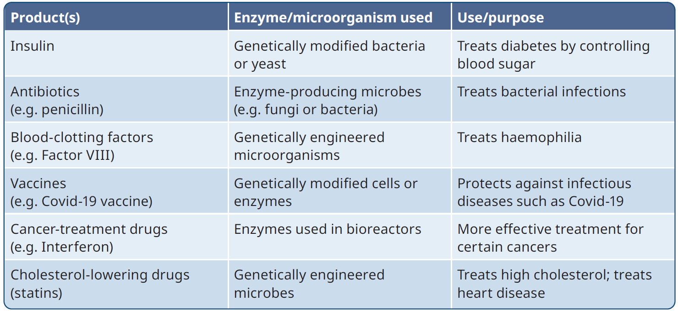
Pharmaceuticals
p.70
Enzymes are used in the pharmaceutical industry to help make medicines quickly, safely and in large amounts.

Slide 27
5.6 Immobilised Enzymes in Industry

Slide 28
Immobilised Enzymes in Industry
p.70
Free enzymes can only be used once. Using this method is wasteful and expensive.
Immobilised enzymes are attached to a support, trapped inside a gel, or enclosed in a membrane.
Immobilised enzymes: enzymes that are fixed to (or trapped in) an insoluble material
There are many advantages to this – they create a pure product, they’re reuseable, increased stability and they’re easily recovered

Slide 29
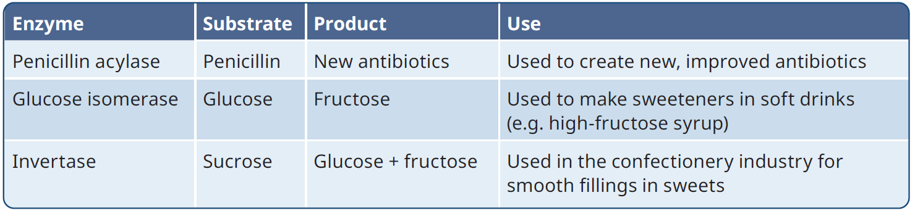
Immobilised Enzymes in Industry
p.70
Examples of immobilised enzymes:

Slide 30
Enzyme Experiments

Slide 31
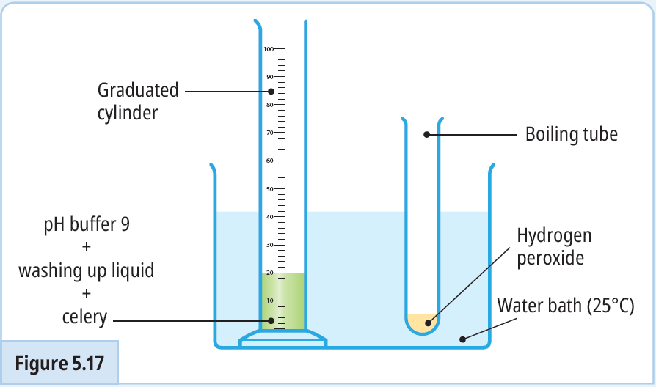

5.1 – To investigate the effect of substrate concentration on the rate of an enzyme-catalysed reaction
p.76

Slide 32
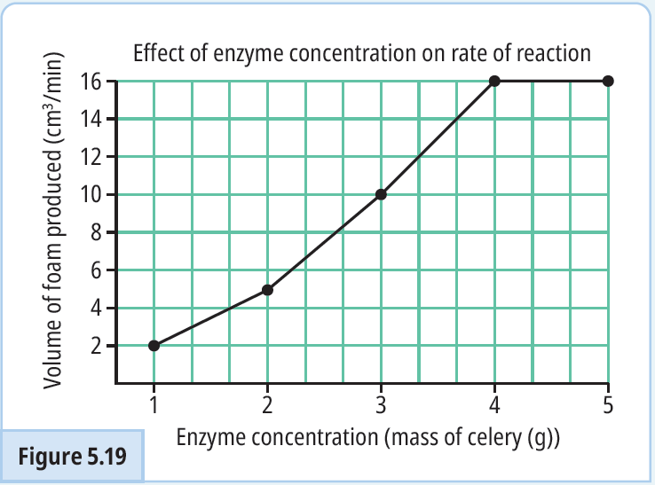
5.2 – To investigate the effect of enzyme concentration on the rate of an enzyme-catalysed reaction
p.77

Slide 33
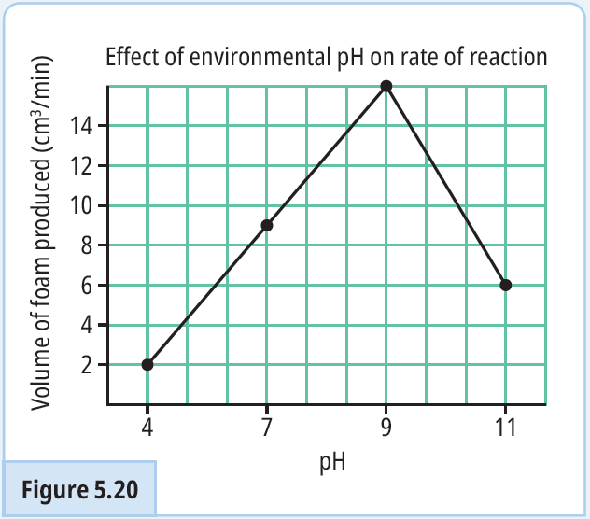
5.3 – To investigate the effect of environmental pH on the rate of an enzyme-catalysed reaction
p.78

Slide 34
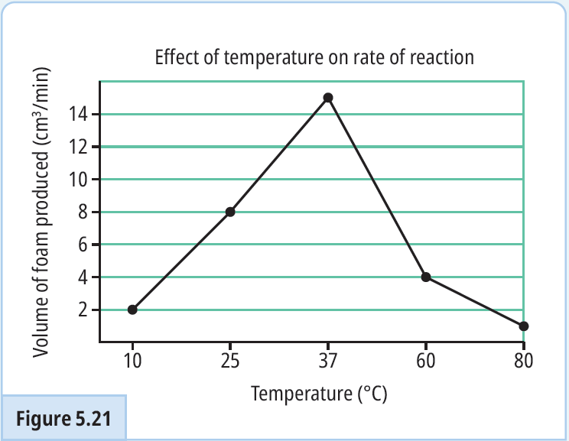
5.4 – To investigate the effect of temperature on the rate of an enzyme-catalysed reaction
p.78

Slide 35
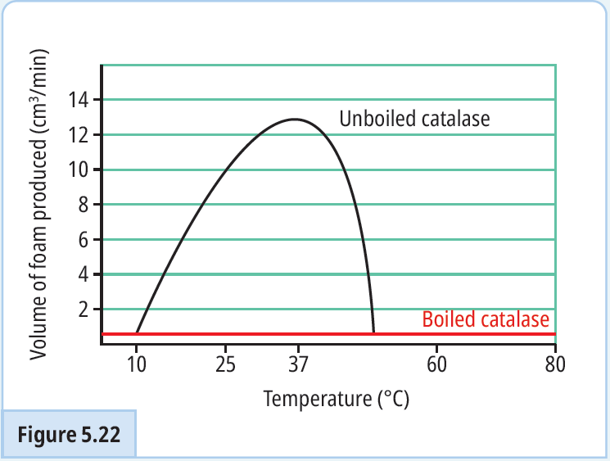
5.5 – To investigate the effect of denaturation on the rate of an enzyme-catalysed reaction
p.79

Slide 36
Keyword recap – Click to Reveal
Enzymes
Proteins that act as biological catalysts
Substance that speeds up a chemical reaction without being used up in the process
Selective Catalyst
Substrate
Substance the enzyme acts on
Substance(s) produced from the enzyme reaction
Product
Part of the enzyme that changes shape slightly to match that of the substrate
Active Site

Slide 37
Keyword recap – Click to Reveal
Specificity
Each enzyme can only bind with one substrate
All active sites of an enzyme are occupied by substrate molecules
Saturation point
Optimum Activity
Enzymes work at maximum rate
Denaturation
Enzyme has permanently lost its shape
Bioprocessing
Use of enzymes or cells to make a product through a controlled process

Slide 38
Keyword recap – Click to Reveal
Bioreactor
Vessel in which microorganisms are used to make products more efficiently
Immobilised enzymes
Enzymes that are fixed to – or trapped in – an insoluble material
Fuels made from biological materials such as plants or food waste
Biofuels

Slide 39
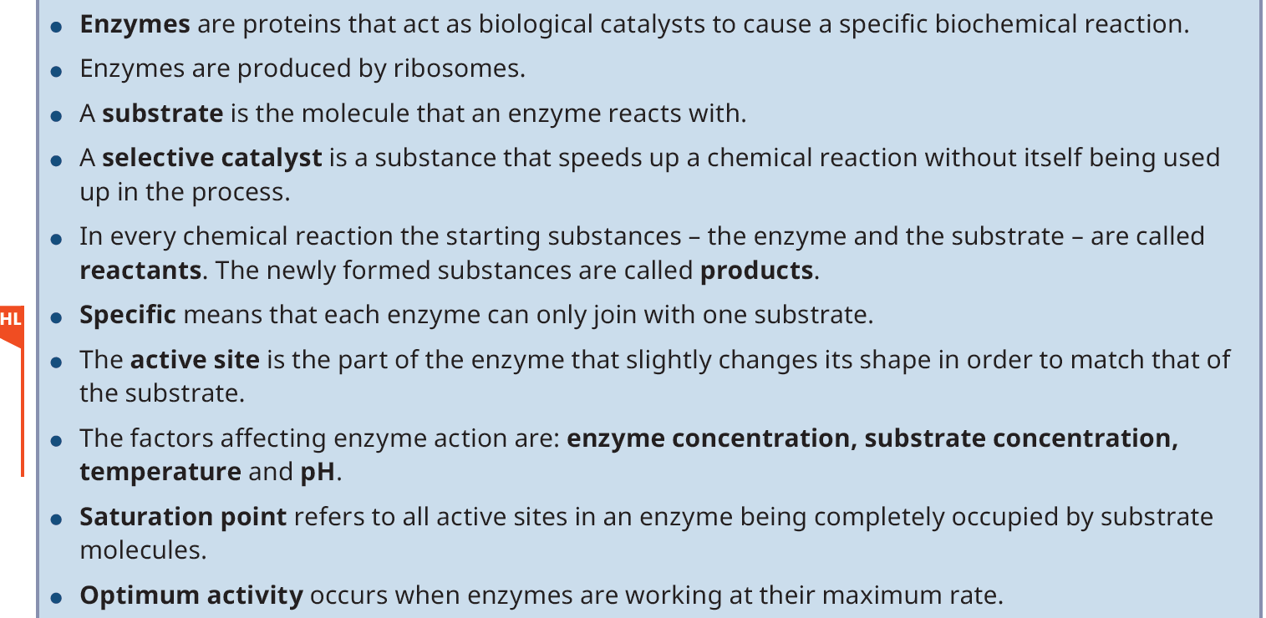
Chapter Summary

Slide 40
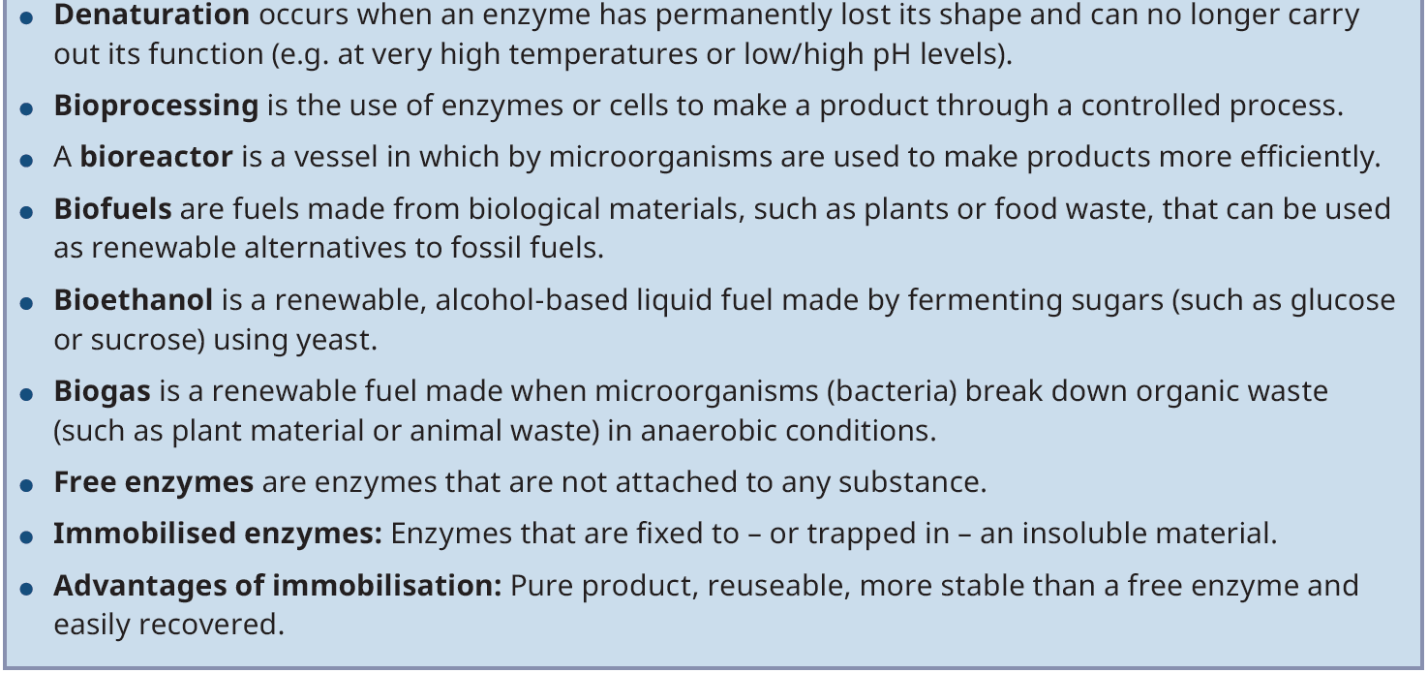
Chapter Summary

