Slide 1
Chapter 3 – The cell
The Biological World – Building Blocks

Slide 2
Objectives:
To give students an understanding of the term cell
To help students understand the characteristics of life
To help students name the parts of the microscope and explain how it is used
To help students investigate the structures of plant and animal cells and relate them to their functions
To show students how to prepare glass slides to observe under the microscope

Slide 3
Keywords:
Cell
Characteristics of life
Microscope
Eyepiece
Objective lens
Fine focus wheel
Coarse focus wheel

Slide 4
3.1 Cells

Slide 5
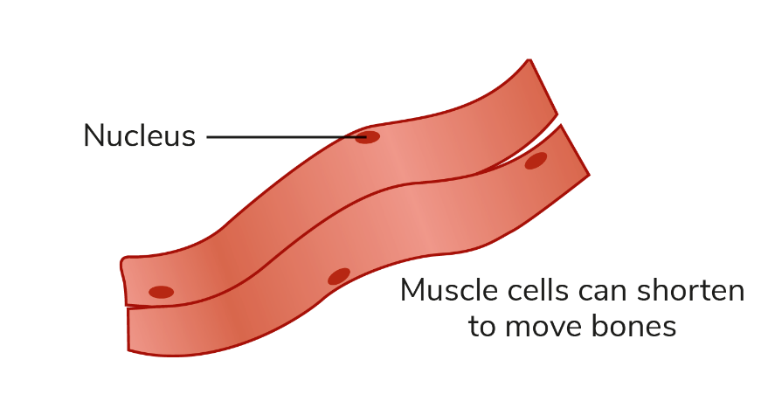
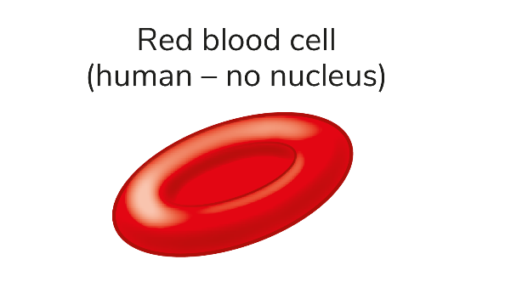
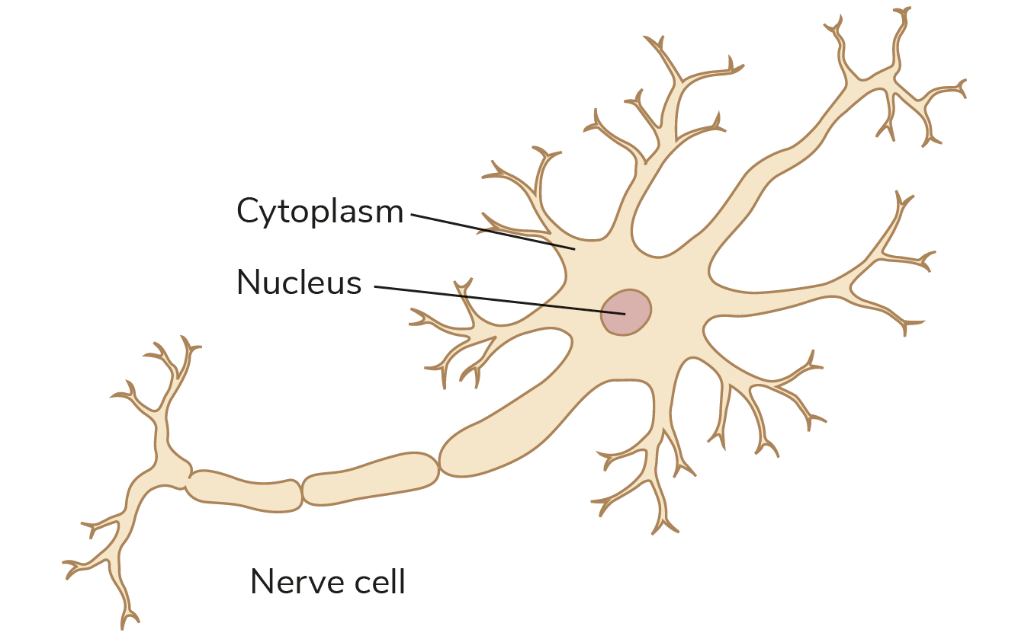
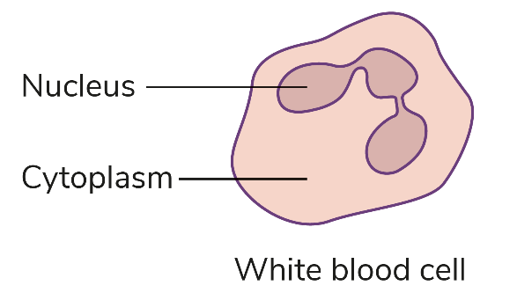
Cells
The word cell was first used by Robert Hooke in 1665.
A cell is the smallest working unit of a living thing (organism).
Cells come in all shapes and sizes, depending on the role they play in an organism.

Slide 6
Cells
All living things are made of cells.
Some are unicellular (made of just one cell, for example bacteria).
Some are multicellular (made of many cells, for example humans).

Slide 7
3.2 The characteristics of life

Slide 8
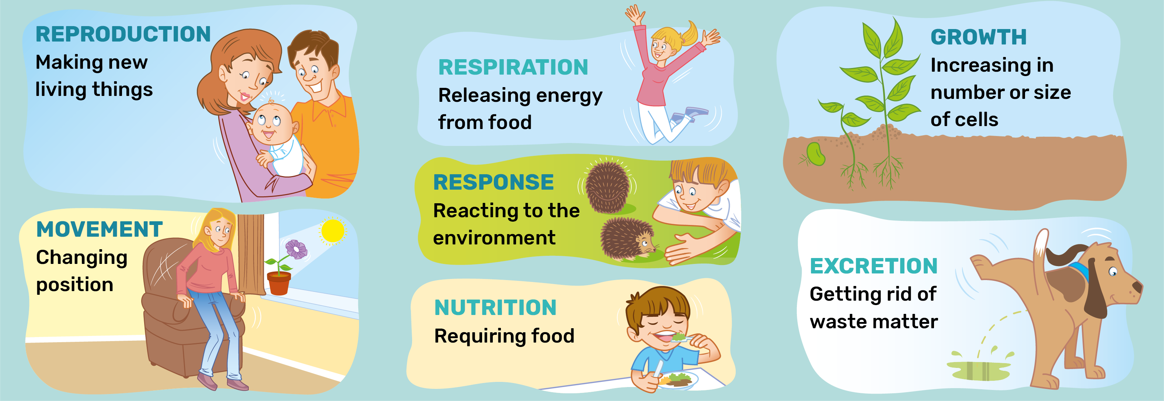
The characteristics of life
All living things have the following characteristics:

Slide 9
3.3 The microscope

Slide 10
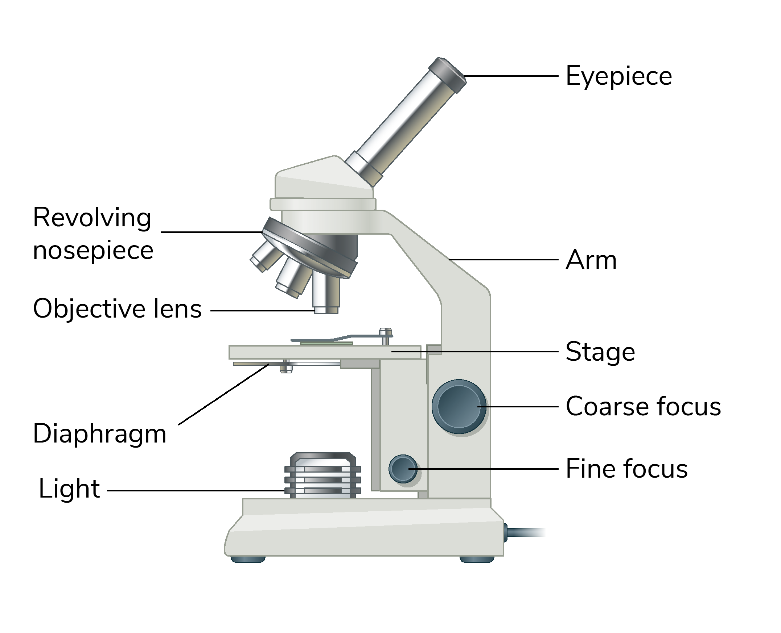
The microscope
Light microscopes are used in school laboratories to see tiny objects more closely. Light shines up through the object you are observing, and lenses are used to magnify the object.
A scanning electron microscope is used to see tiny cell structures in great detail.

Slide 11
Parts of the microscope
Part | Function
Eyepiece lens | Look through this lens; it magnifies the object by 10×
Objective lens | Change the magnification; it magnifies by 4×, 10× or 40×
Stage | The slide is placed here and secured in place with the stage clips
Diaphragm | Adjusts the light coming through the stage
Light | Shines light through the slide on the stage
Coarse focus | Brings the object into focus
Fine focus | Brings the object into sharper focus

Slide 12
Calculating magnification
Eyepiece lens × Objective lens = Total magnification
Q: What is the total magnification of the object when the lowest power objective lens is used?
Q: What is the total magnification of the object when the middle power objective lens is used?
Q: What is the total magnification of the object when the highest power objective lens is used?

Slide 13
3.4 The animal cell

Slide 14
Parts of the animal cell
Q: What stain is used to view animals cells more clearly under the microscope?
Part | Function
Cell membrane | Controls what enters and exits the cell
Nucleus | Carries genes that control the cell activities
Cytoplasm | Watery fluid in which the parts of the cell float
Mitochondria | Release energy from respiration
Ribosome | Make proteins – e.g. enzymes and hormones
Q: Where could you obtain a sample of animal cells to view under the microscope?

Slide 15
3.5 The plant cell

Slide 16
Parts of the plant cell
Q: What stain is used to view plant cells more clearly under the microscope?
Part | Function
Chloroplast | Contains a green pigment called chlorophyll – this is where photosynthesis occurs
Cell wall | Provides protection, shape and structure
Large vacuole | Stores food and water
Plant cells also contain all of the other organelles found in animal cells.
Q: Where could you obtain a sample of plant cells to view under the microscope?

Slide 17
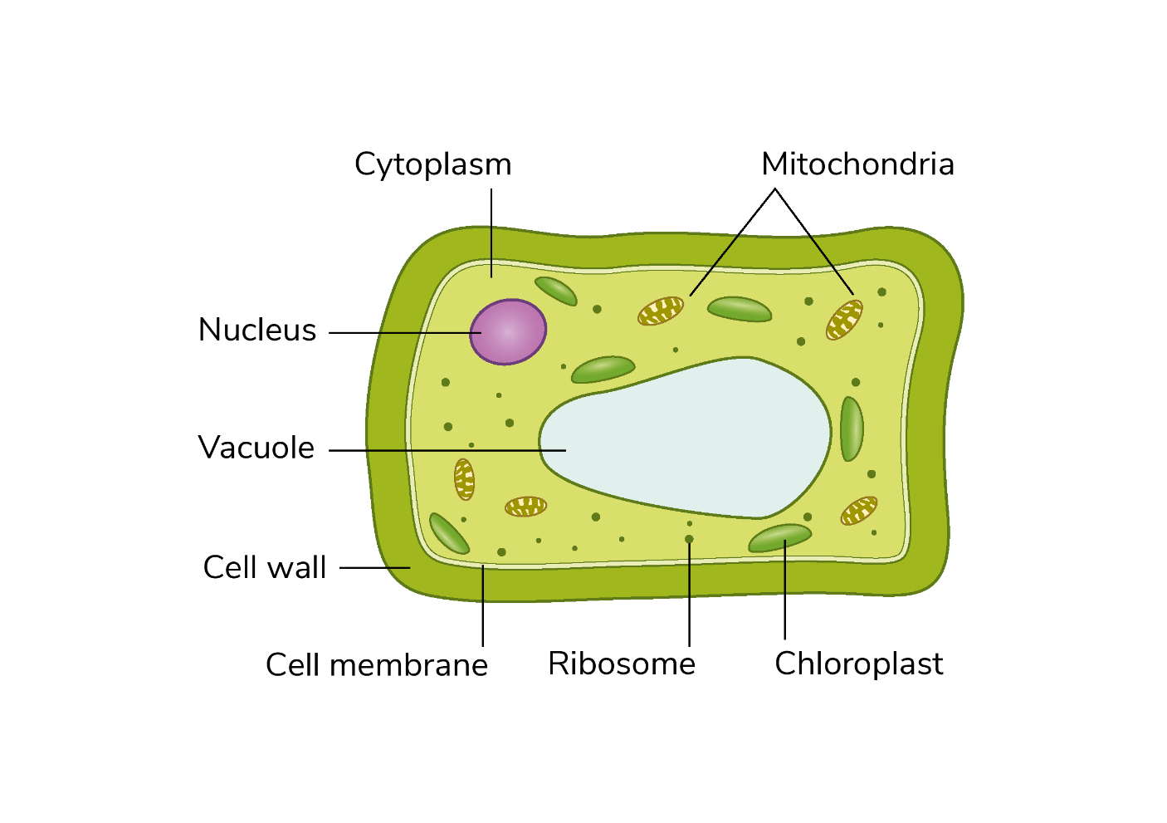
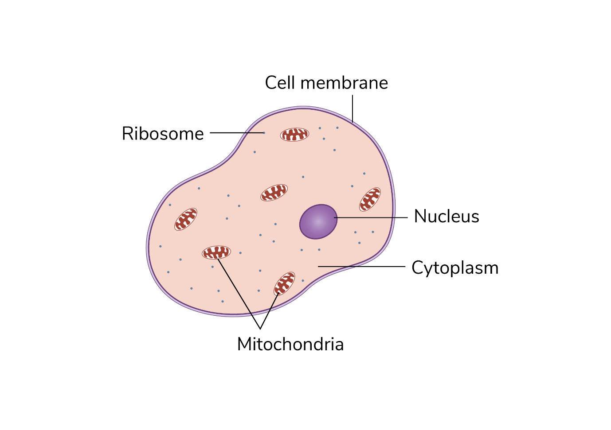
Diagrams of the animal and plant cell
An animal cell
A plant cell

Slide 18
Learning outcomes: ‘Now I am able to…’
Tick
List and explain the characteristics of life.
Name the parts of a light microscope.
Describe how to use a light microscope.
Draw and label an animal cell to include the cell membrane, cytoplasm, nucleus, mitochondrion and ribosome.
Name the structures in an animal cell and state their functions.
Describe how to prepare a slide to observe animal cells under a microscope.

Slide 19
Learning outcomes: ‘Now I am able to…’
Tick
Draw and label a plant cell to include the cell wall, cell membrane, cytoplasm, nucleus, mitochondrion, ribosome, chloroplast and vacuole.
Name structures in a plant cell and state their functions.
Describe how to prepare a slide to observe plant cells under a microscope.
State the differences between plant and animal cells.

