Slide 1
Chapter 16 – Materials
The Chemical World – Building Blocks

Slide 2
Objectives:
To give students an understanding of the properties of the three states of matter
To help students appreciate how the properties of solids, liquids and gases can be explained in terms of the particle theory

Slide 3
Keywords:
Matter
Compress
Diffusion
Evaporation
Condensation

Slide 4
16.1 States of matter

Slide 5
Matter
Q: What experiment could you carry out to show that a gas has mass?
Matter is anything that takes up space and has mass.
The three states of matter are solids, liquids and gases.
Q: What experiment could you carry out to show that a gas takes up space?

Slide 6
16.2 The particle theory

Slide 7
The particle theory
Scientists have developed a theory to explain the properties of solids, liquids and gases.
Solids, liquids and gases are made up of tiny particles that can only be seen with a special type of microscope.
The particle theory explains how these particles appear or behave in the three states of matter.

Slide 8
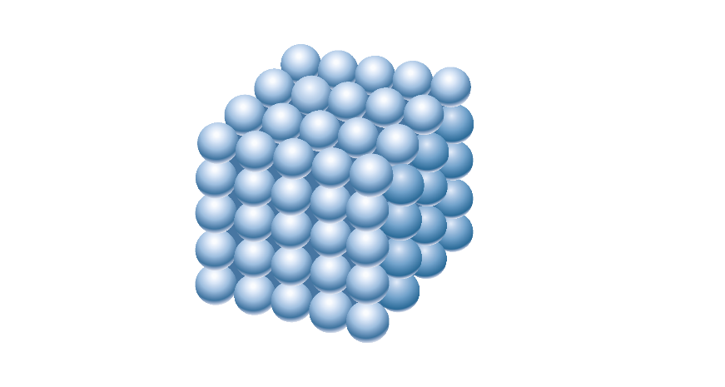
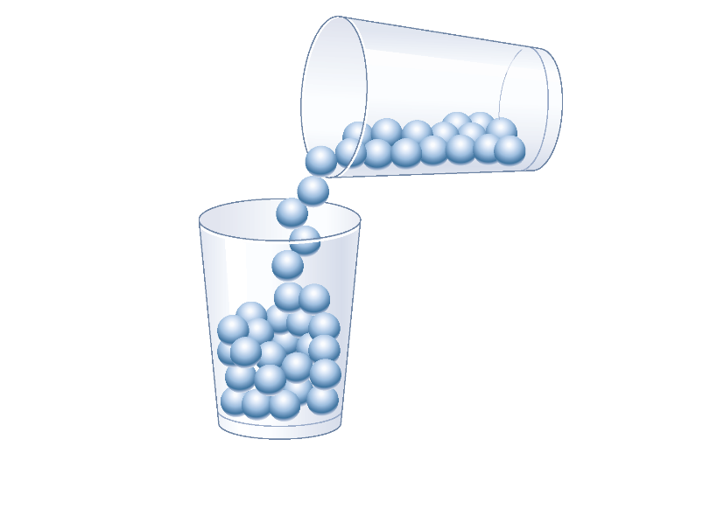
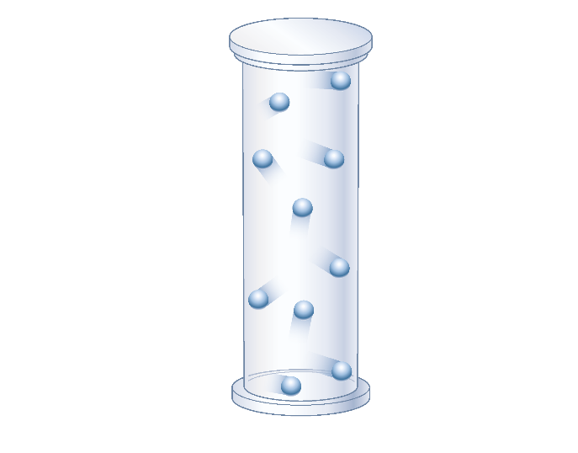
The particle theory
Solid particles | Liquid particles | Gas particles
Fixed positions Do not move but can vibrate Strong forces holding particles together | Particles can slide over each other Forces holding particles together are not as strong as in a solid | Particles farther apart than a liquid or a solid Very weak forces between particles

Slide 9
16.3 Properties of the states of matter

Slide 10
Properties of the states of matter
Solids | Liquids | Gases
Definite shape | No definite shape | No definite shape
Definite volume | Definite volume | No definite volume
Difficult to compress | Difficult to compress | Easy to compress
Do not flow | Flow easily | Diffuse to fill all available space

Slide 11
16.4 Change of state

Slide 12
Change of state
Substances can change state by undergoing the following processes:
Melting is when a solid is heated and changes to a liquid.
Evaporation is the changing of a liquid to a gas at the surface of the liquid.
Boiling is when a liquid is changed to a gas throughout the liquid.
Condensation is the changing of a gas to a liquid.
Freezing is when a liquid is cooled and changes to a solid.

Slide 13
Change of state
On a cold day, the warm water vapour in your breath – which is normally invisible – condenses into visible water droplets.

Slide 14
Measuring the melting point of a solid
When a solid melts, the particles vibrate so much that they break away from their fixed positions. The solid now begins to change into a liquid.
Q: What is the difference between the terms ‘melting’ and ‘melting point’?

Slide 15
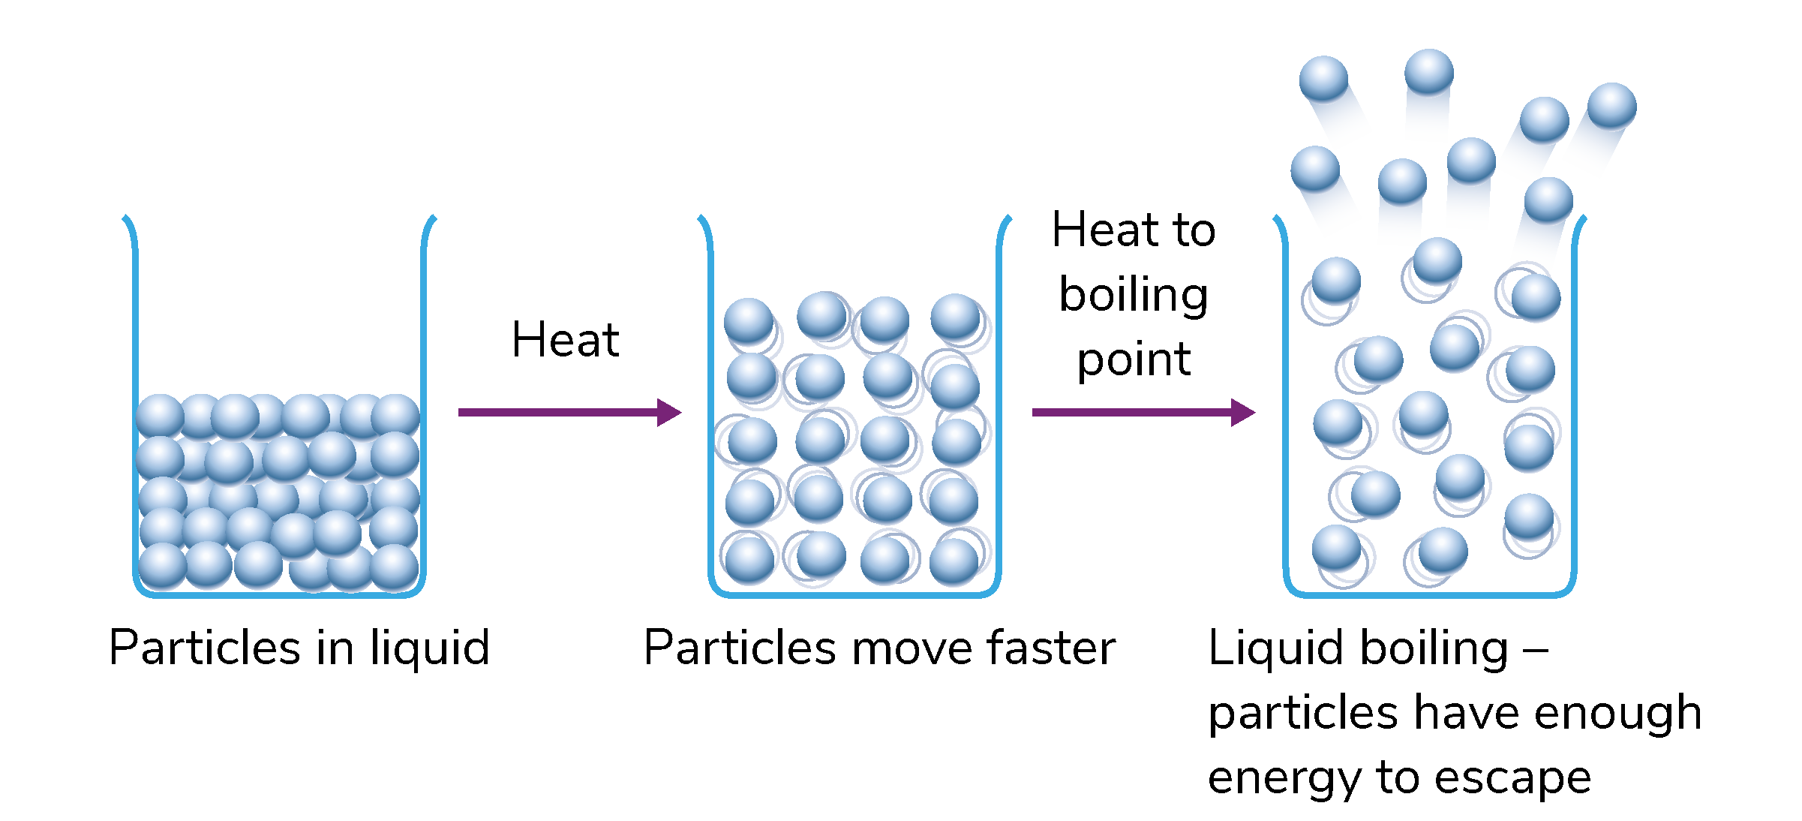
Measuring the boiling point of a liquid
Q: What is the difference between the terms ‘boiling’ and ‘boiling point’?
At the boiling point of a liquid, the particles break away from all parts of the liquid and form a gas.

Slide 16
Learning outcomes: ‘Now I am able to…’
Tick
Define the term matter.
Name the three states of matter.
Describe the properties of solids, liquids and gases.
Use the particle theory to explain the properties of the three states of matter.
Measure the melting point of a solid and the boiling point of a liquid.

