Slide 1
Chapter 34 –
Current electricity
The Physical World – Building Blocks

Slide 2
Objectives:
To help students understand, construct and draw some simple electric circuits
To ensure that students know how to measure voltages (potential difference) and currents in simple circuits
To enable students to measure the resistance of electronic components

Slide 3
Keywords:
Voltmeter
Potential difference
Ammeter
Voltage
Variable resistor
Volt
Amp

Slide 4
Keywords:
Light-dependent resistor (LDR)
Ohmmeter
Parallel
Series
Ohm
Resistor

Slide 5
34.1 Electricity

Slide 6
Electricity
Electricity has been studied by scientists for the past 400 years.
In 1786, Luigi Galvani showed that when an electric current was applied to the muscle of a frog, it caused the muscle to twitch. Eventually this led to the development of the battery.
We would find it very difficult to live without electricity.
Q: How many different ways have you used electricity so far today?

Slide 7
34.2 How to get a bulb to light

Slide 8
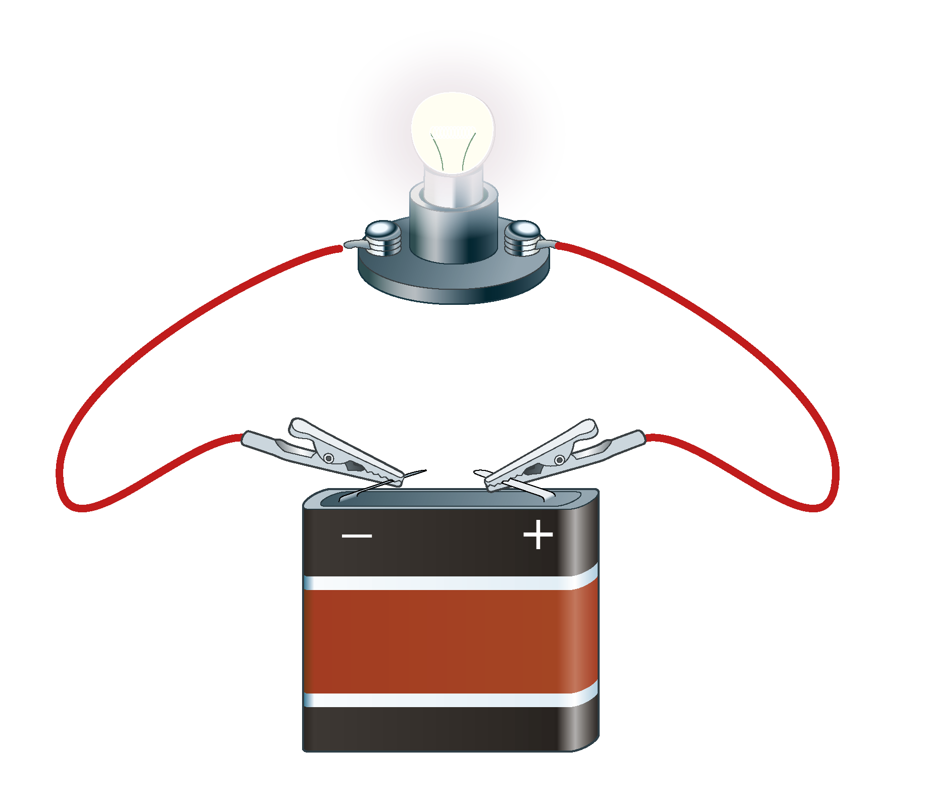
How to get a bulb to light
An electrical circuit is a continuous loop of metal that allows electricity to flow through it.
Q: What things are necessary for the bulb to light?

Slide 9
34.3 & 34.4 Current flow

Slide 10
34.3 What is flowing in the wires?
Electrons flow in the wires of an electric circuit.
Electrons leave the negative terminal of the battery, travel through the wires and return back to the positive terminal of the battery.
The flow of electrons is called an electric current.
The more electrons that pass a point in the circuit per second, the great the current flowing.

Slide 11
34.4 Conductors and insulators
Conductors are substances that allow electricity to travel through them.
Insulators are substances that do not allow electricity to travel through them.
Q: Can you name any substances that are good conductors of electricity?
Q: Can you name any substances that are good insulators?

Slide 12
34.5 Circuit diagrams

Slide 13
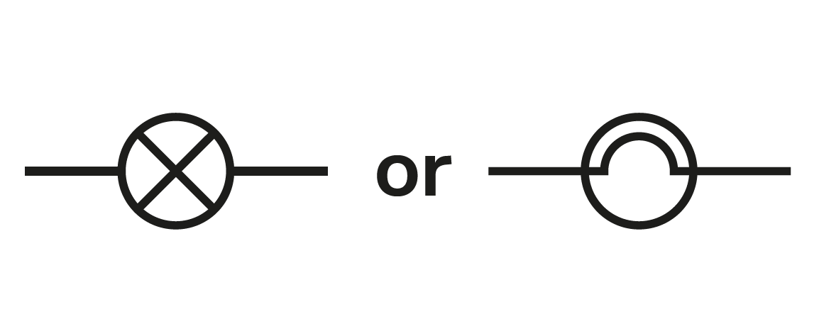
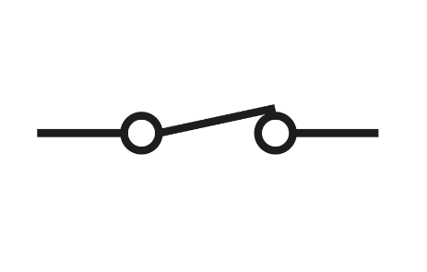
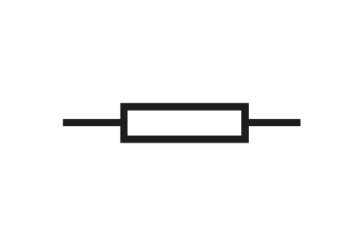
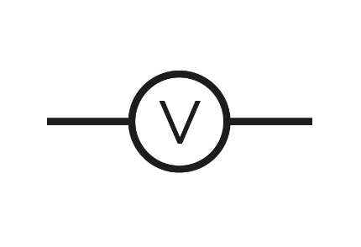
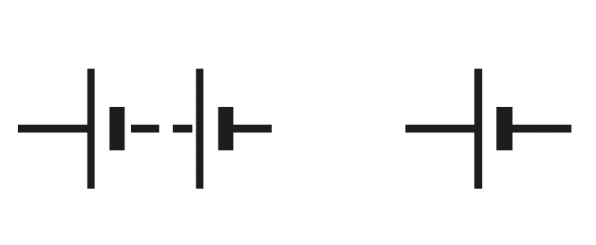
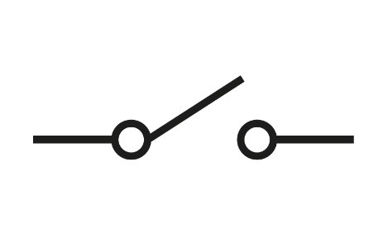
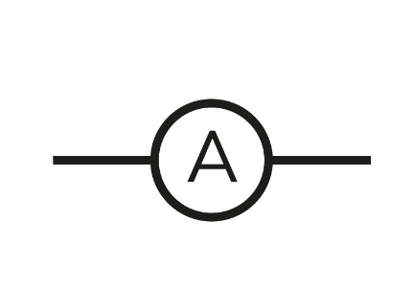
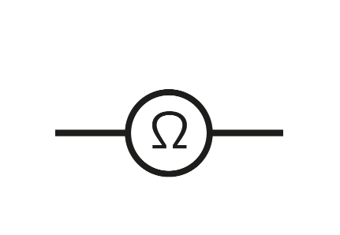
Circuit diagrams
Component | Bulb | Switch on | Resistor | Voltmeter
Symbol
Component | Battery | Switch off | Ammeter | Ohmmeter
Symbol

Slide 14
34.6 Measuring current

Slide 15
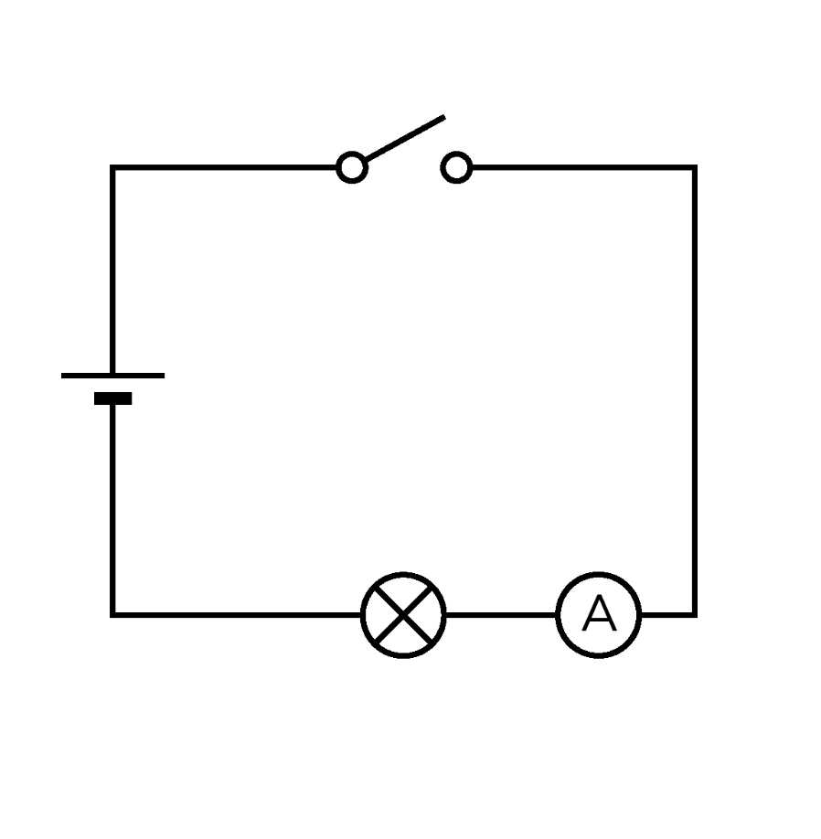
How can you measure the amount of current flowing in a circuit?
An ammeter measures the current flowing in a circuit.
Current is measured in units called amps (A).
An ammeter must be placed within the circuit to measure the amount of current passing through it per second.

Slide 16
34.7 & 34.8 Bulbs in series and in parallel

Slide 17
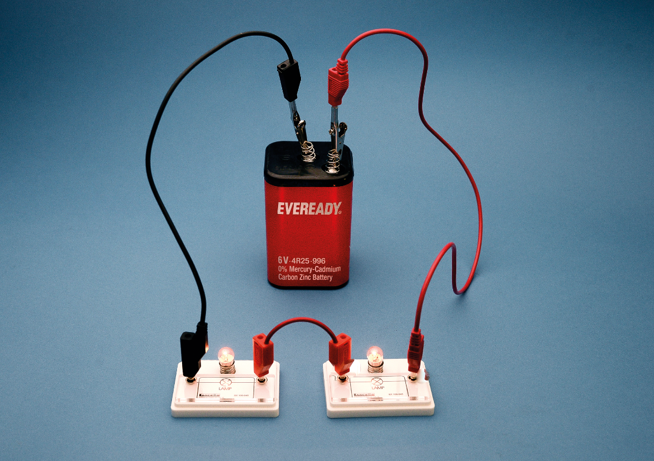
34.7 Bulbs in series
We say bulbs are in series when electrons that flow through the first bulb must flow through the second bulb before returning to the battery.
The same amount of current flows through each part of the circuit.
Q: Each time you add another bulb to the circuit, what do you notice about the brightness of the bulbs?

Slide 18
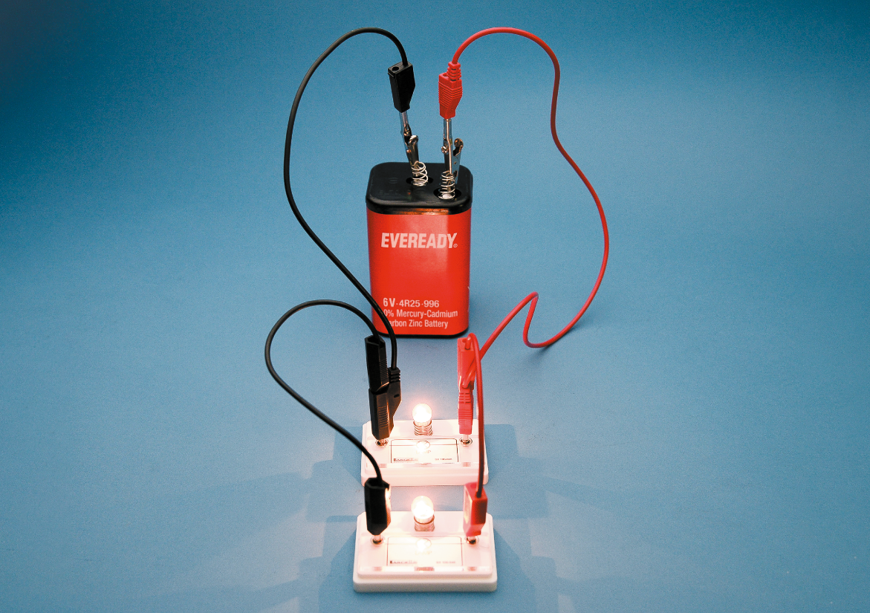
34.8 Bulbs in parallel
We say bulbs are in parallel when each bulb has an independent circuit connecting it to the battery.
In a parallel circuit, the current is split between the bulbs.
Q: If bulb 1 is disconnected or blows, what will happen to bulb 2?

Slide 19
34.9 Voltage

Slide 20
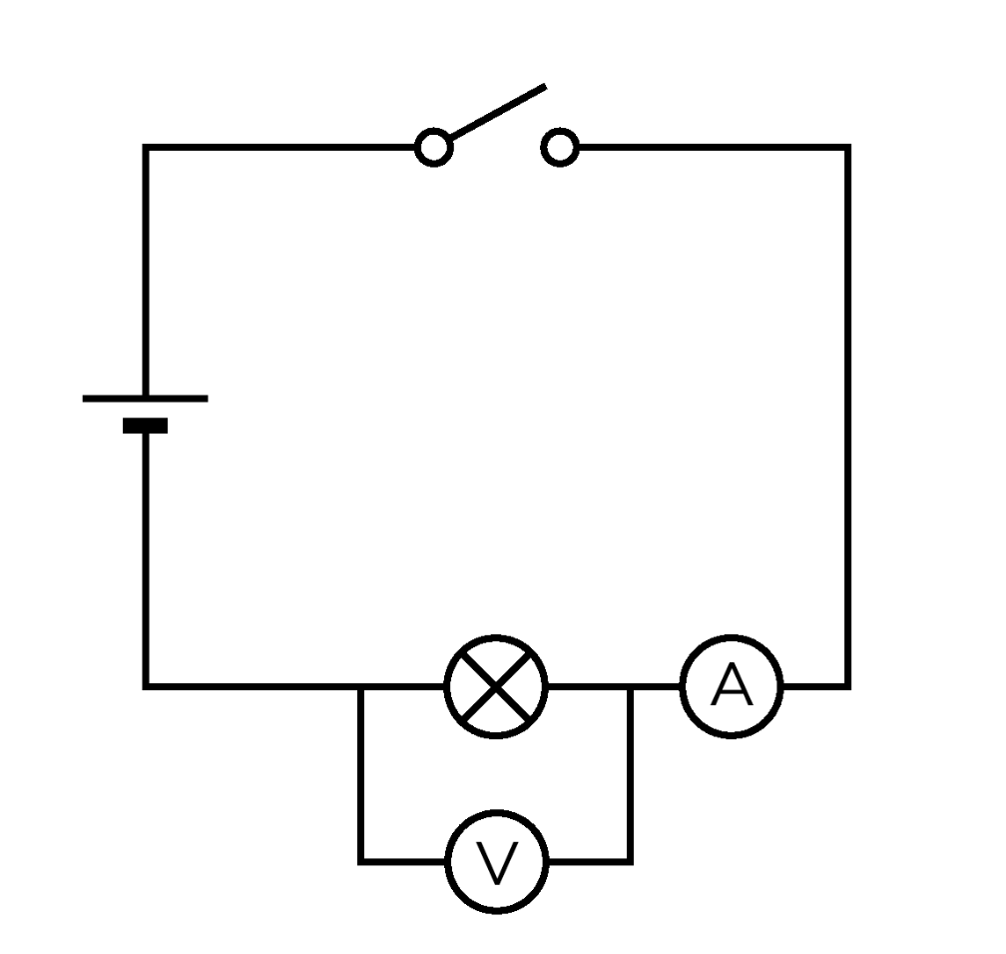
What causes current to flow in a circuit?
Electrons must be given energy to flow around the circuit. This comes from the battery.
The voltage of the battery is measured using a voltmeter. Voltage is also referred to as potential difference.
The unit of voltage is the volt (V).

Slide 21
34.10 Resistance

Slide 22
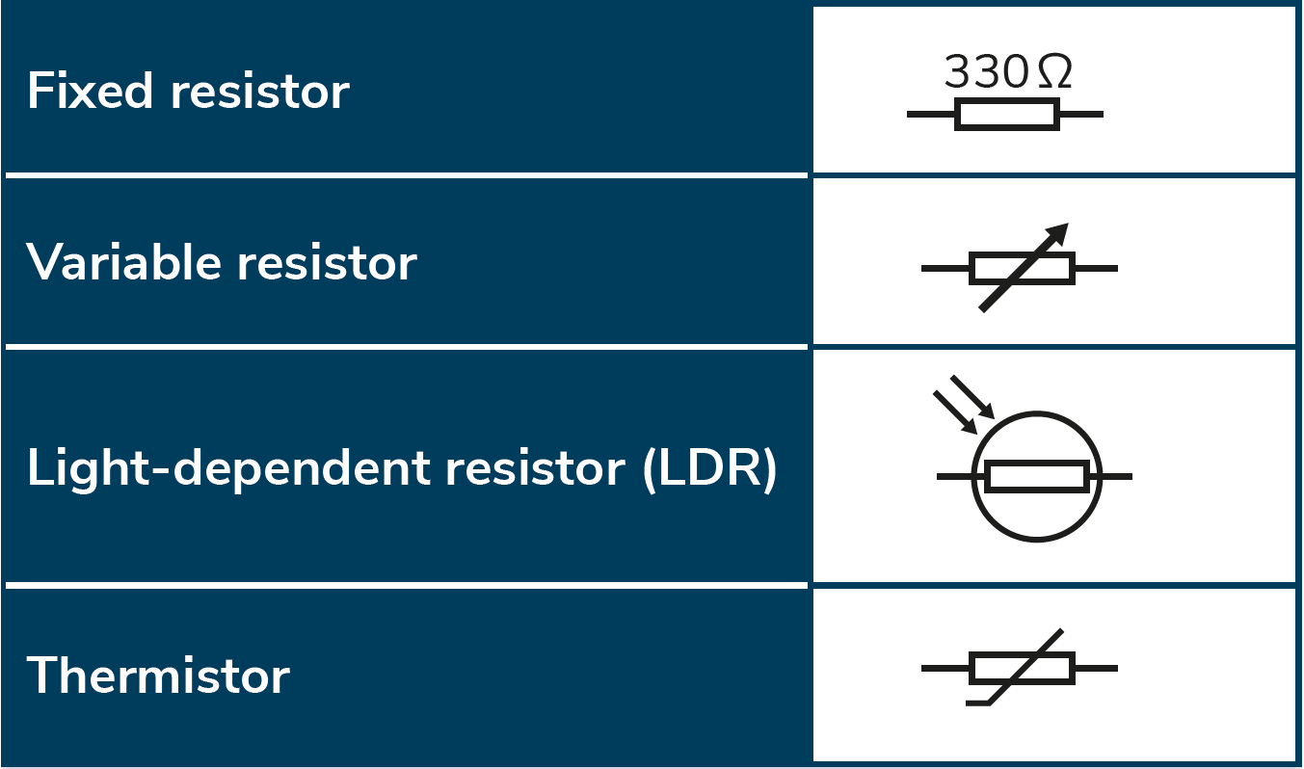
Resistance
Resistance in a circuit slows down the movement of electrons. Items that cause this to happen are called resistors.
Resistance is measured using an ohmmeter.
The unit of resistance is the ohm (Ω).

Slide 23
Learning outcomes: ‘Now I am able to…’
Tick
Explain the meaning of current electricity and electrical circuit.
Measure current, voltage (potential difference) and resistance.
Investigate whether a substance is a conductor or an insulator.
Compare series and parallel circuits.
Construct simple circuits using wires, bulbs, voltmeters and ammeters.

