Slide 1
Chapter 38 –
The Earth, sun and moon
Earth & Space – Building Blocks; Systems and Interactions; Sustainability

Slide 2
Objectives:
To give students an understanding of how seasons, lunar phases and eclipses of the sun and moon occur
To make students aware of the current hazards and benefits of space exploration
To give students an appreciation of the future role and implications of space exploration in society

Slide 3
Keywords:
Phases
Lunar
Gravity
Waning
Crescent
Waxing
Gibbous
Debris
Eclipse
Astronaut
Shuttle

Slide 4
38.1 The Earth, sun and moon

Slide 5
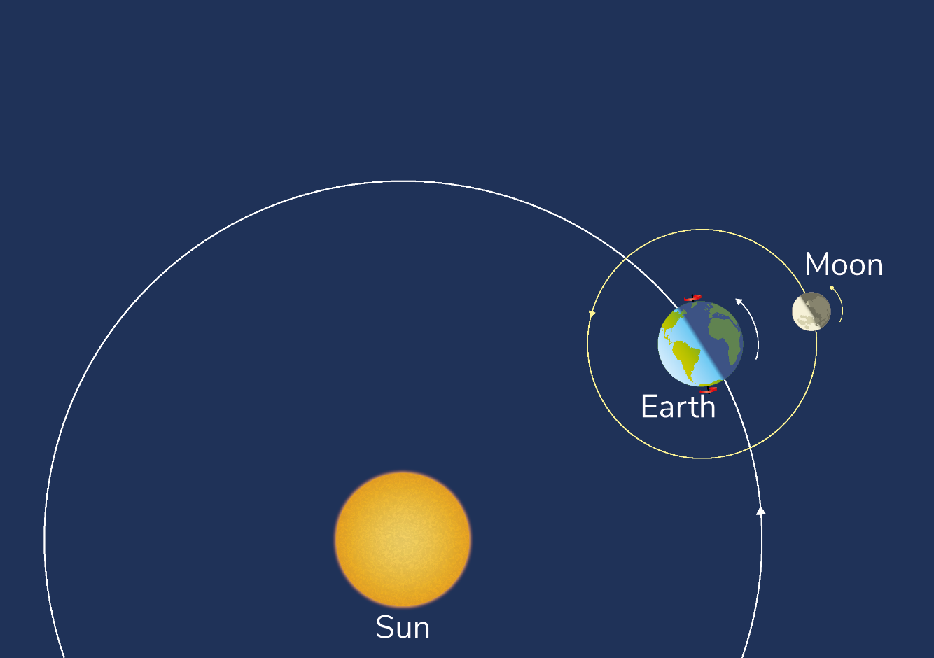
The Earth, sun and moon
The Earth is said to be a satellite of the sun. It takes 365.25 days to make one full orbit around the sun.
In addition, the Earth revolves on its own axis every 24 hours.
The moon is a satellite of the Earth.

Slide 6
38.2 Days

Slide 7
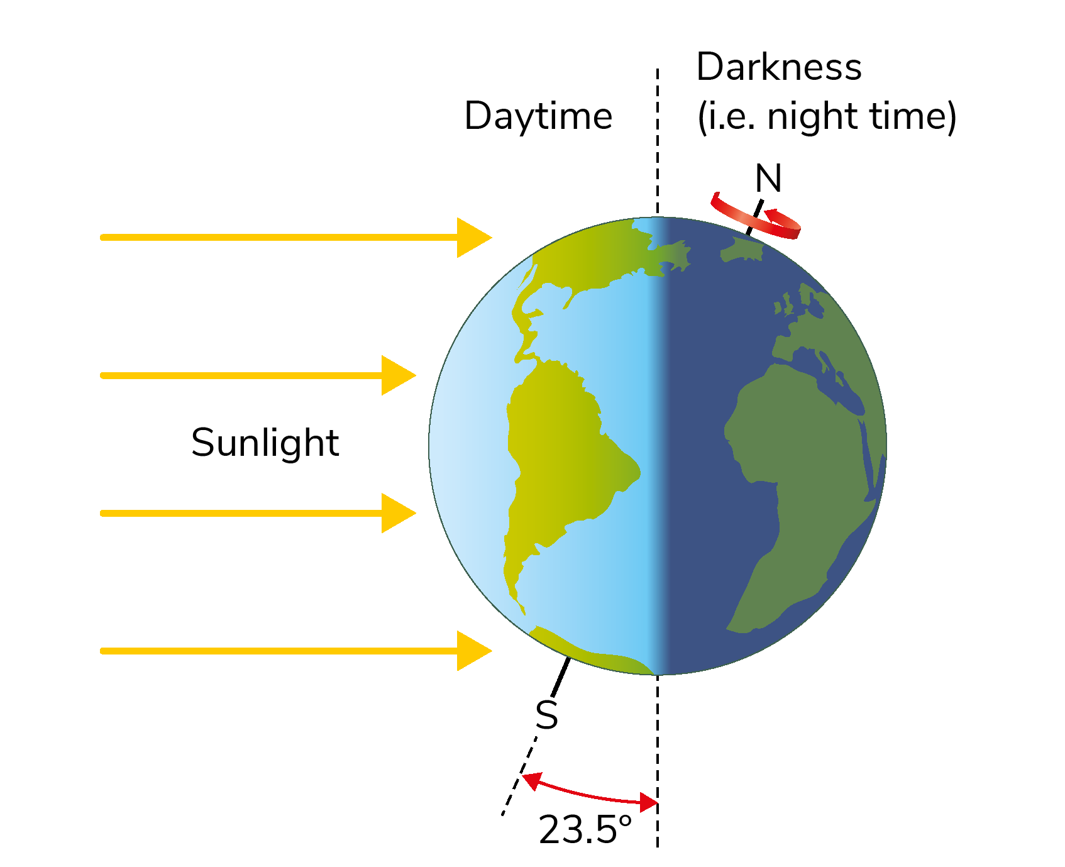
Days
At any one time, half of the Earth is facing the sun.
The side of the Earth facing the sun has day and the other side has night.
The Earth rotates on its own axis every 24 hours.

Slide 8
38.3 Seasons

Slide 9
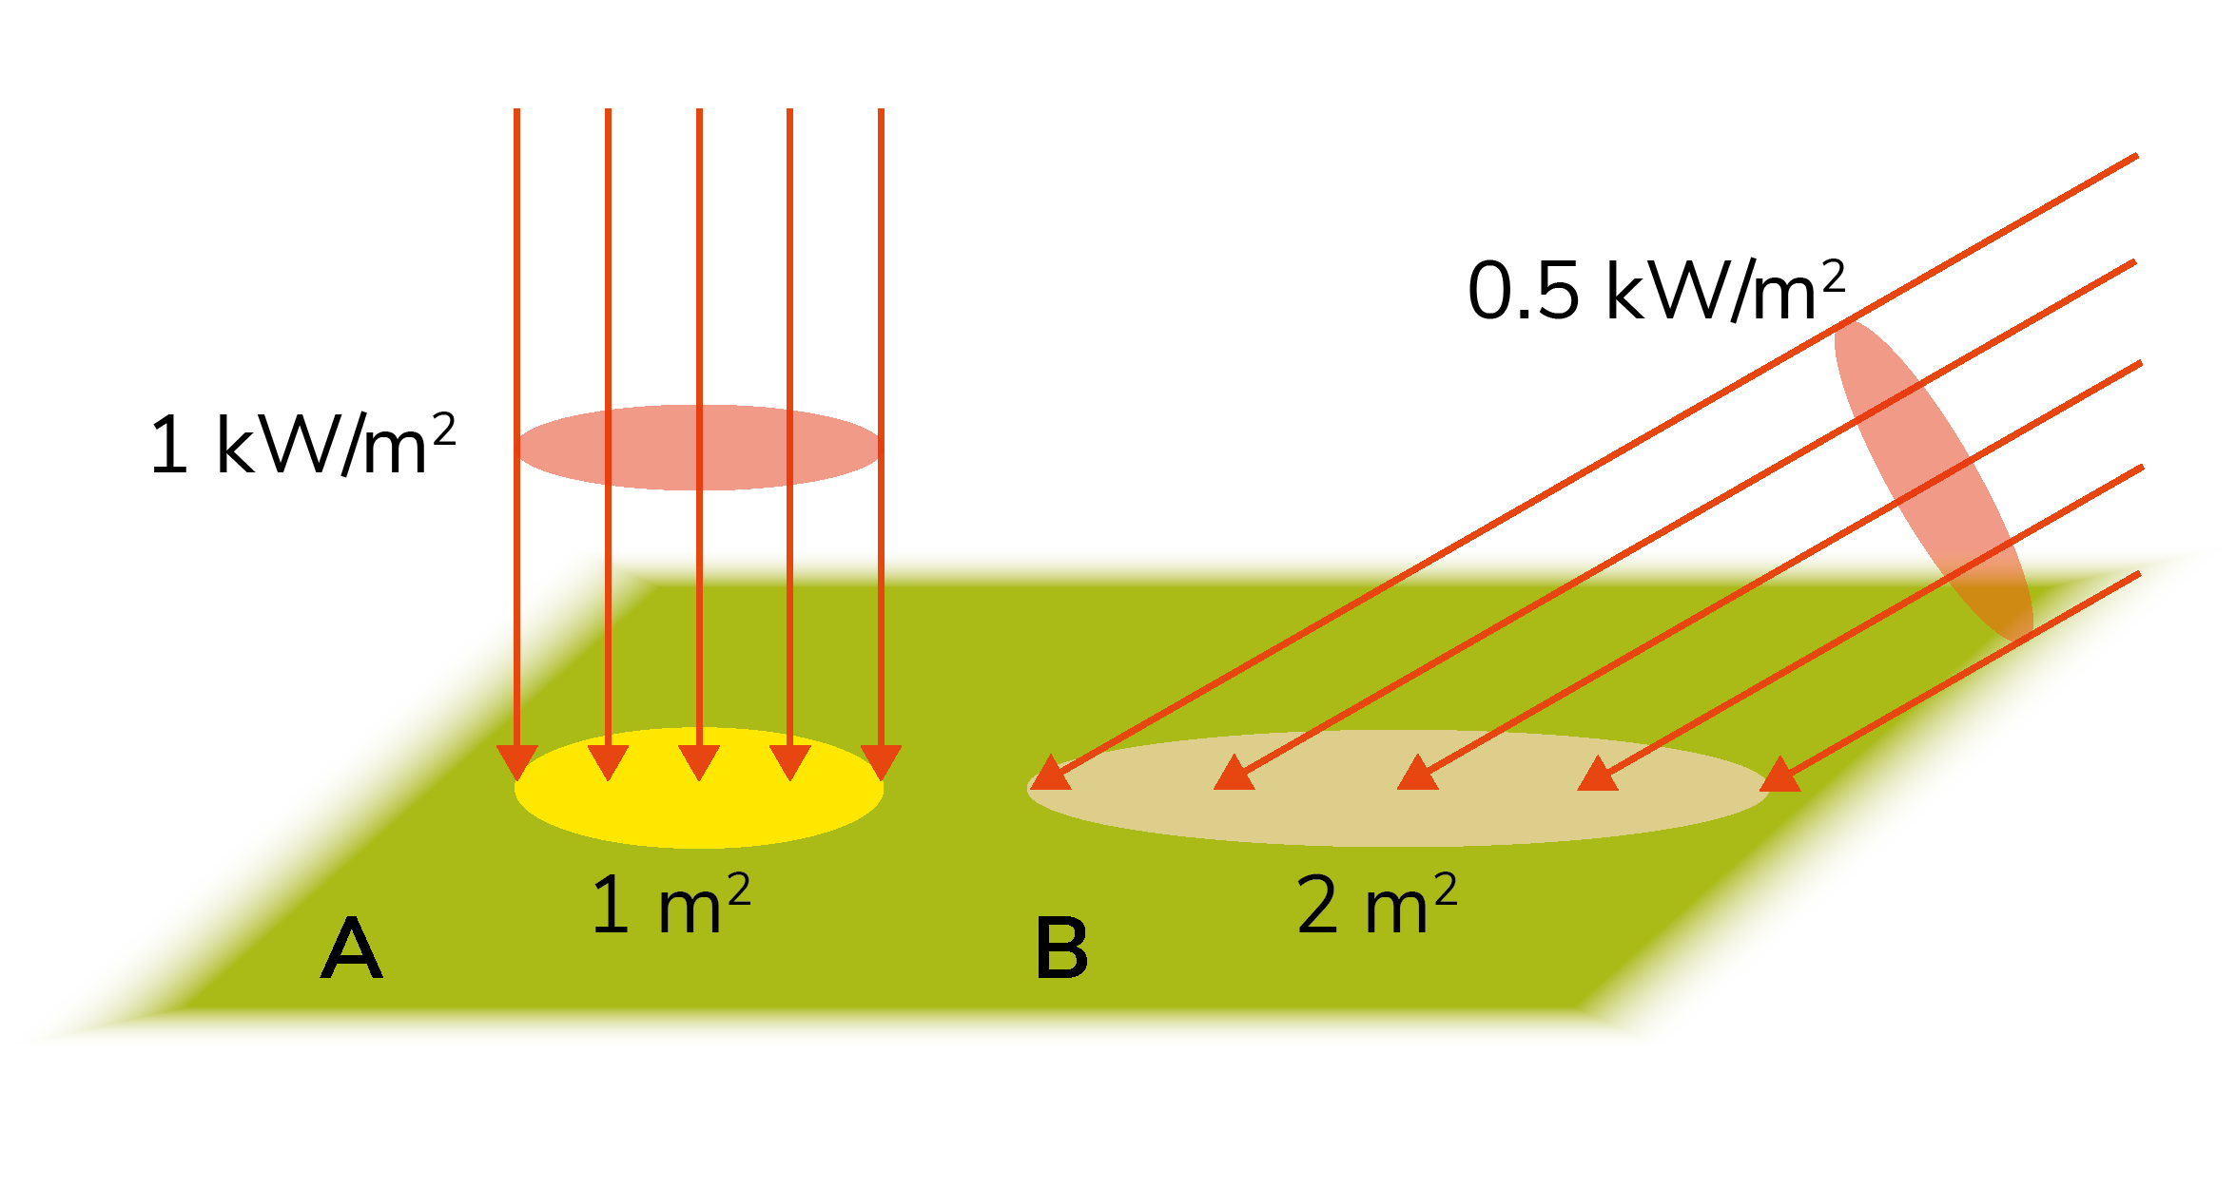
Seasons
The more light energy is falling on a region, the warmer it will be.
The seasons are caused by the Earth tilting towards the sun in the summer and tilting away from the sun in the winter.
The Earth is always tilted at the same angle of 23.5°.

Slide 10
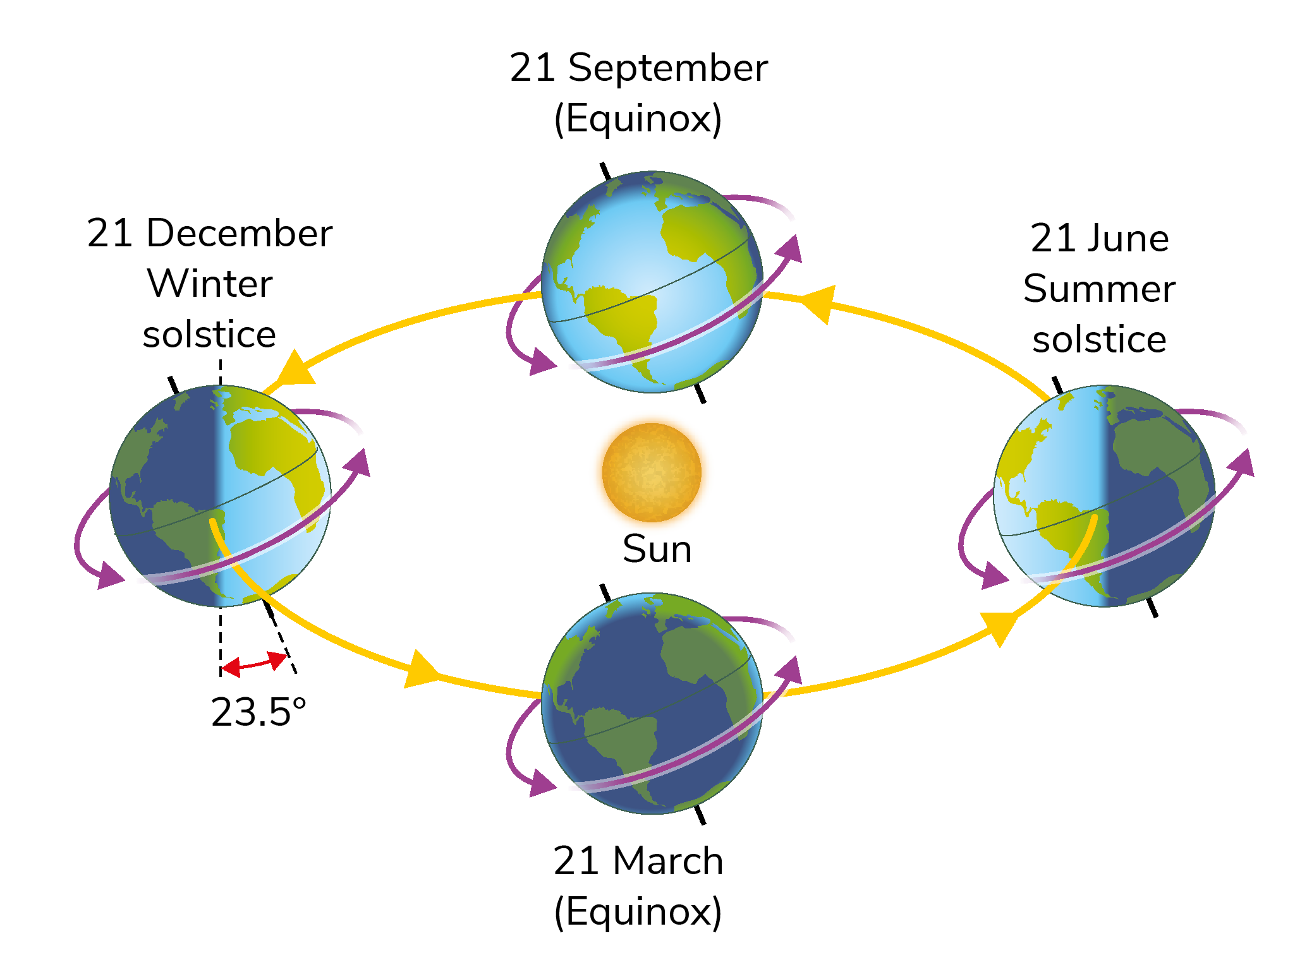
Seasons
Q: When it is winter in the Northern Hemisphere,
what season is it in the Southern Hemisphere?

Slide 11
38.4 Phases of the moon

Slide 12
The phases of the moon
The moon orbits the Earth every 27.3 days
The moon also rotates on its own axis every 27.3 days.
For this reason, the same side of the moon is always facing the Earth.
The moon is visible on Earth when it reflects light from the sun.

Slide 13
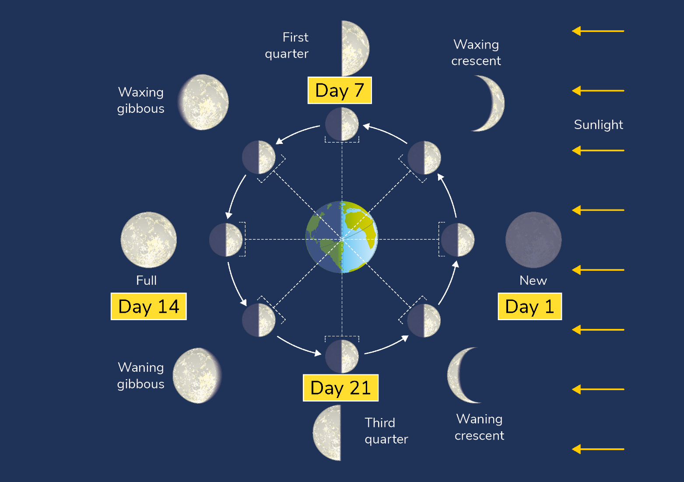
The phases of the moon
The phases of the moon are caused by the rotation of the moon around the Earth. This causes us to see different amounts of the lit half of the moon.

Slide 14
The phases of the moon
A ‘new moon’ is the beginning of the cycle, when the lit half of the moon is facing fully away from the Earth.
A crescent is where less than half of the moon is visible.
A gibbous is where more than half of the moon is visible.
‘Waxing’ means ‘getting bigger’.
‘Waning’ means ‘getting smaller’.
Q: At what stage of the moon’s cycle do we see a full moon?

Slide 15
38.5 Eclipses

Slide 16
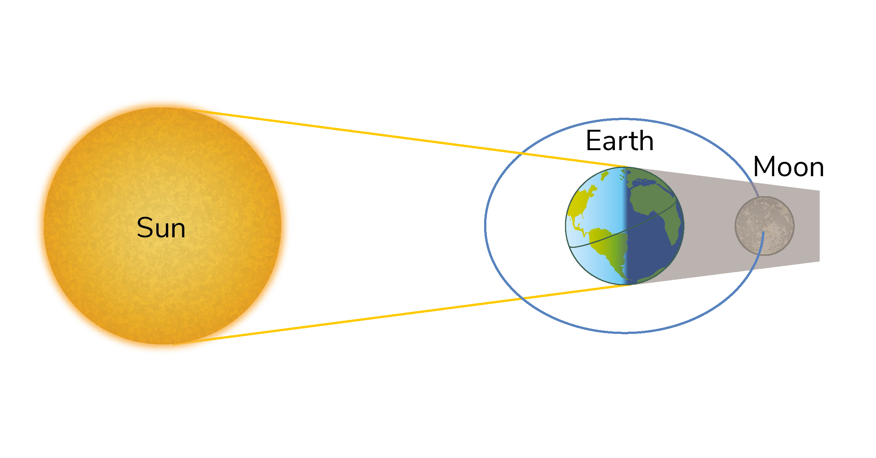
Eclipses
The word ‘eclipse’ means ‘to obscure’.
A lunar eclipse happens when the moon passes into the Earth’s shadow.

Slide 17
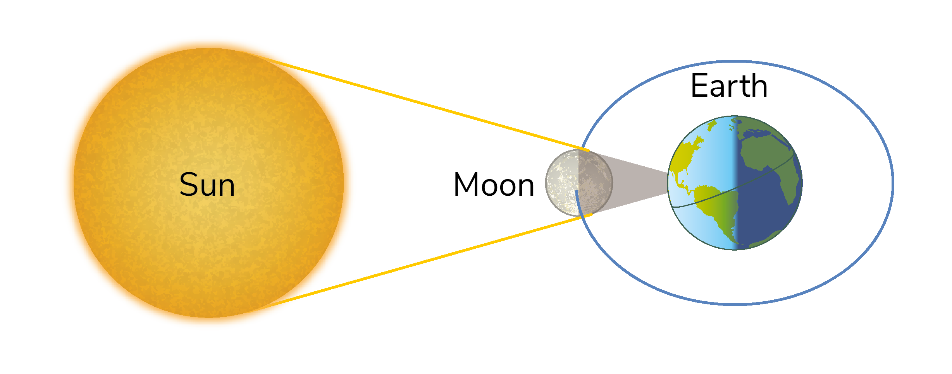
Eclipses
A solar eclipse occurs when the moon passes between the Earth and the sun.

Slide 18
38.6 Benefits of space exploration

Slide 19
Some benefits of space exploration include…
Satellites
Efficient solar panels
Battery technology
New materials
Water purification systems
Q: Can you research any more benefits?

Slide 20
38.7 Hazards of space exploration

Slide 21
Some hazards of space exploration include…
Explosions
Burning up
Space debris
Cosmic radiation
Mechanical failure
Lack of gravity
Psychological effects
Emergency

Slide 22
38.8 Future of space exploration

Slide 23
Some things to consider about the future of space exploration include…
Is it unethical to send astronauts on hazardous space exploration journeys?
The cost of space exploration
Finding a new habitable planet for humans to live on
Development of new technologies
International co-operation

Slide 24
Learning outcomes: ‘Now I am able to…’
Tick
Use a model of the Earth-sun-moon system to describe the seasons, lunar phases and eclipses of the sun and moon.
Examine some of the current hazards and benefits of space exploration.
Discuss the future role and implications of space exploration on society.

