Slide 1
Chapter 10
Inheritance and Variation
The Biological World – Building Blocks

Slide 2
Objectives:
To ensure that students understand the difference between sexual and asexual reproduction
To make students familiar with the basic structure of DNA
To help students understand what variation means and how it is achieved in nature
To give students an understanding of chromosomes and genes
To give students and understanding of Mendelian inheritance and how to carry out some genetic crosses

Slide 3
Keywords:
Asexual reproduction
DNA
Chromosome
Gene
Variation

Slide 4
Keywords:
Environment
Inheritance
Species
Dominant
Recessive

Slide 5
10.1 Asexual and sexual reproduction

Slide 6
Sexual Reproduction
Sexual reproduction involves two parents, where the male and female gametes join to form a zygote.
In sexual reproduction, DNA from two different individuals (the parents) combines during fertilization.
The offspring produced by sexual reproduction show much greater variation.
P.78

Slide 7
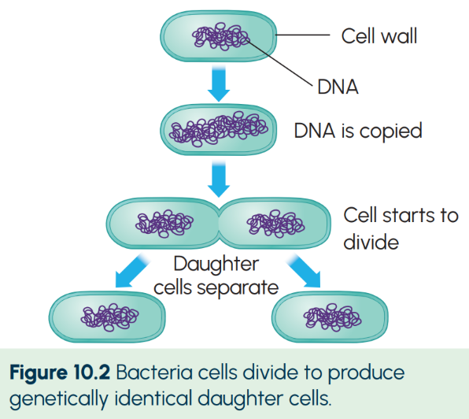
Asexual reproduction
Asexual reproduction involves only one parent.
As DNA is only being passed on from one parent, there is less variation involved in asexual reproduction.
P.78

Slide 8
10.2 DNA (deoxyribonucleic acid)

Slide 9
DNA
DNA carries genetic information. It controls all activities in all cells.
The structure of DNA was discovered by Rosalind Franklin, James Watson and Francis Crick.
The shape of DNA is called a double helix.
There is a code within DNA called the genetic code. This code controls the production of thousands of proteins that make up the human body.
P.79

Slide 10
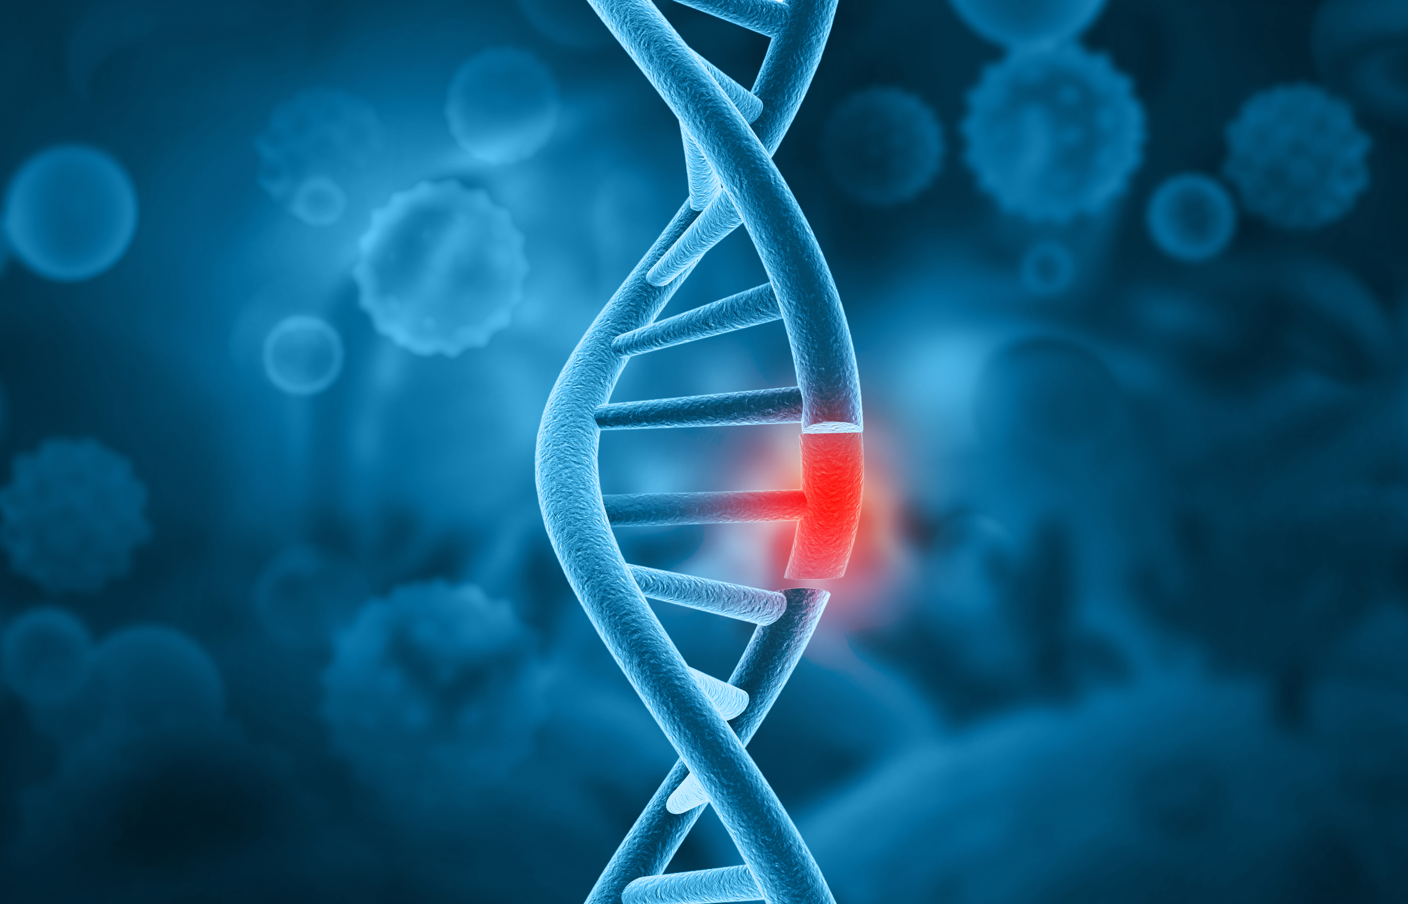
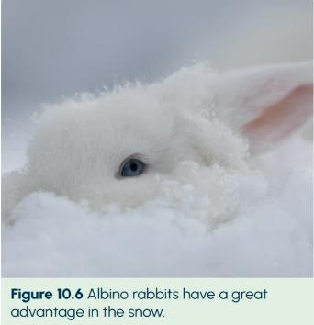
Mutations
A mutation is a change in the genetic code of DNA.
Mutations can lead to serious genetic disorders such as cystic fibrosis and haemophilia.
Mutations are not always harmful. They can also bring about advantageous changes. For example, a change in an animals colouring can give it better camouflage in its environment.
P.80

Slide 11
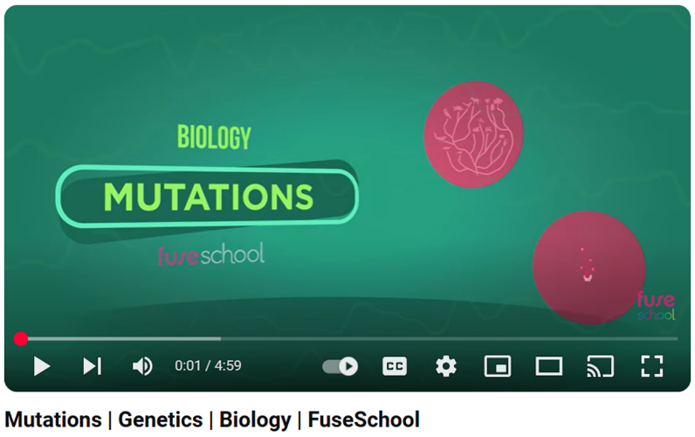
Video Link – Click to Play
P.81

Slide 12
10.3 Variation

Slide 13
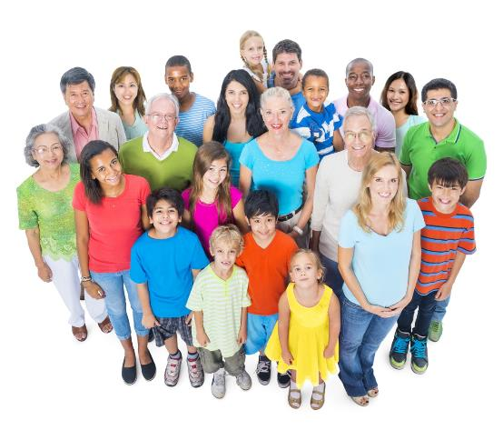
Variation
Variation is the way members of the same species differ.
A species is a group of organisms that can breed with each other and produce fertile offspring.
Fertile means that an organism is capable of producing young.
P.80

Slide 14
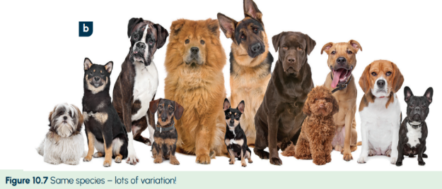
Inherited Characteristics
Inherited characteristics are controlled by DNA.
Examples include eye colour, hair colour, blood, type, etc.
Can you think of any other characteristics that might be inherited?
P.80

Slide 15
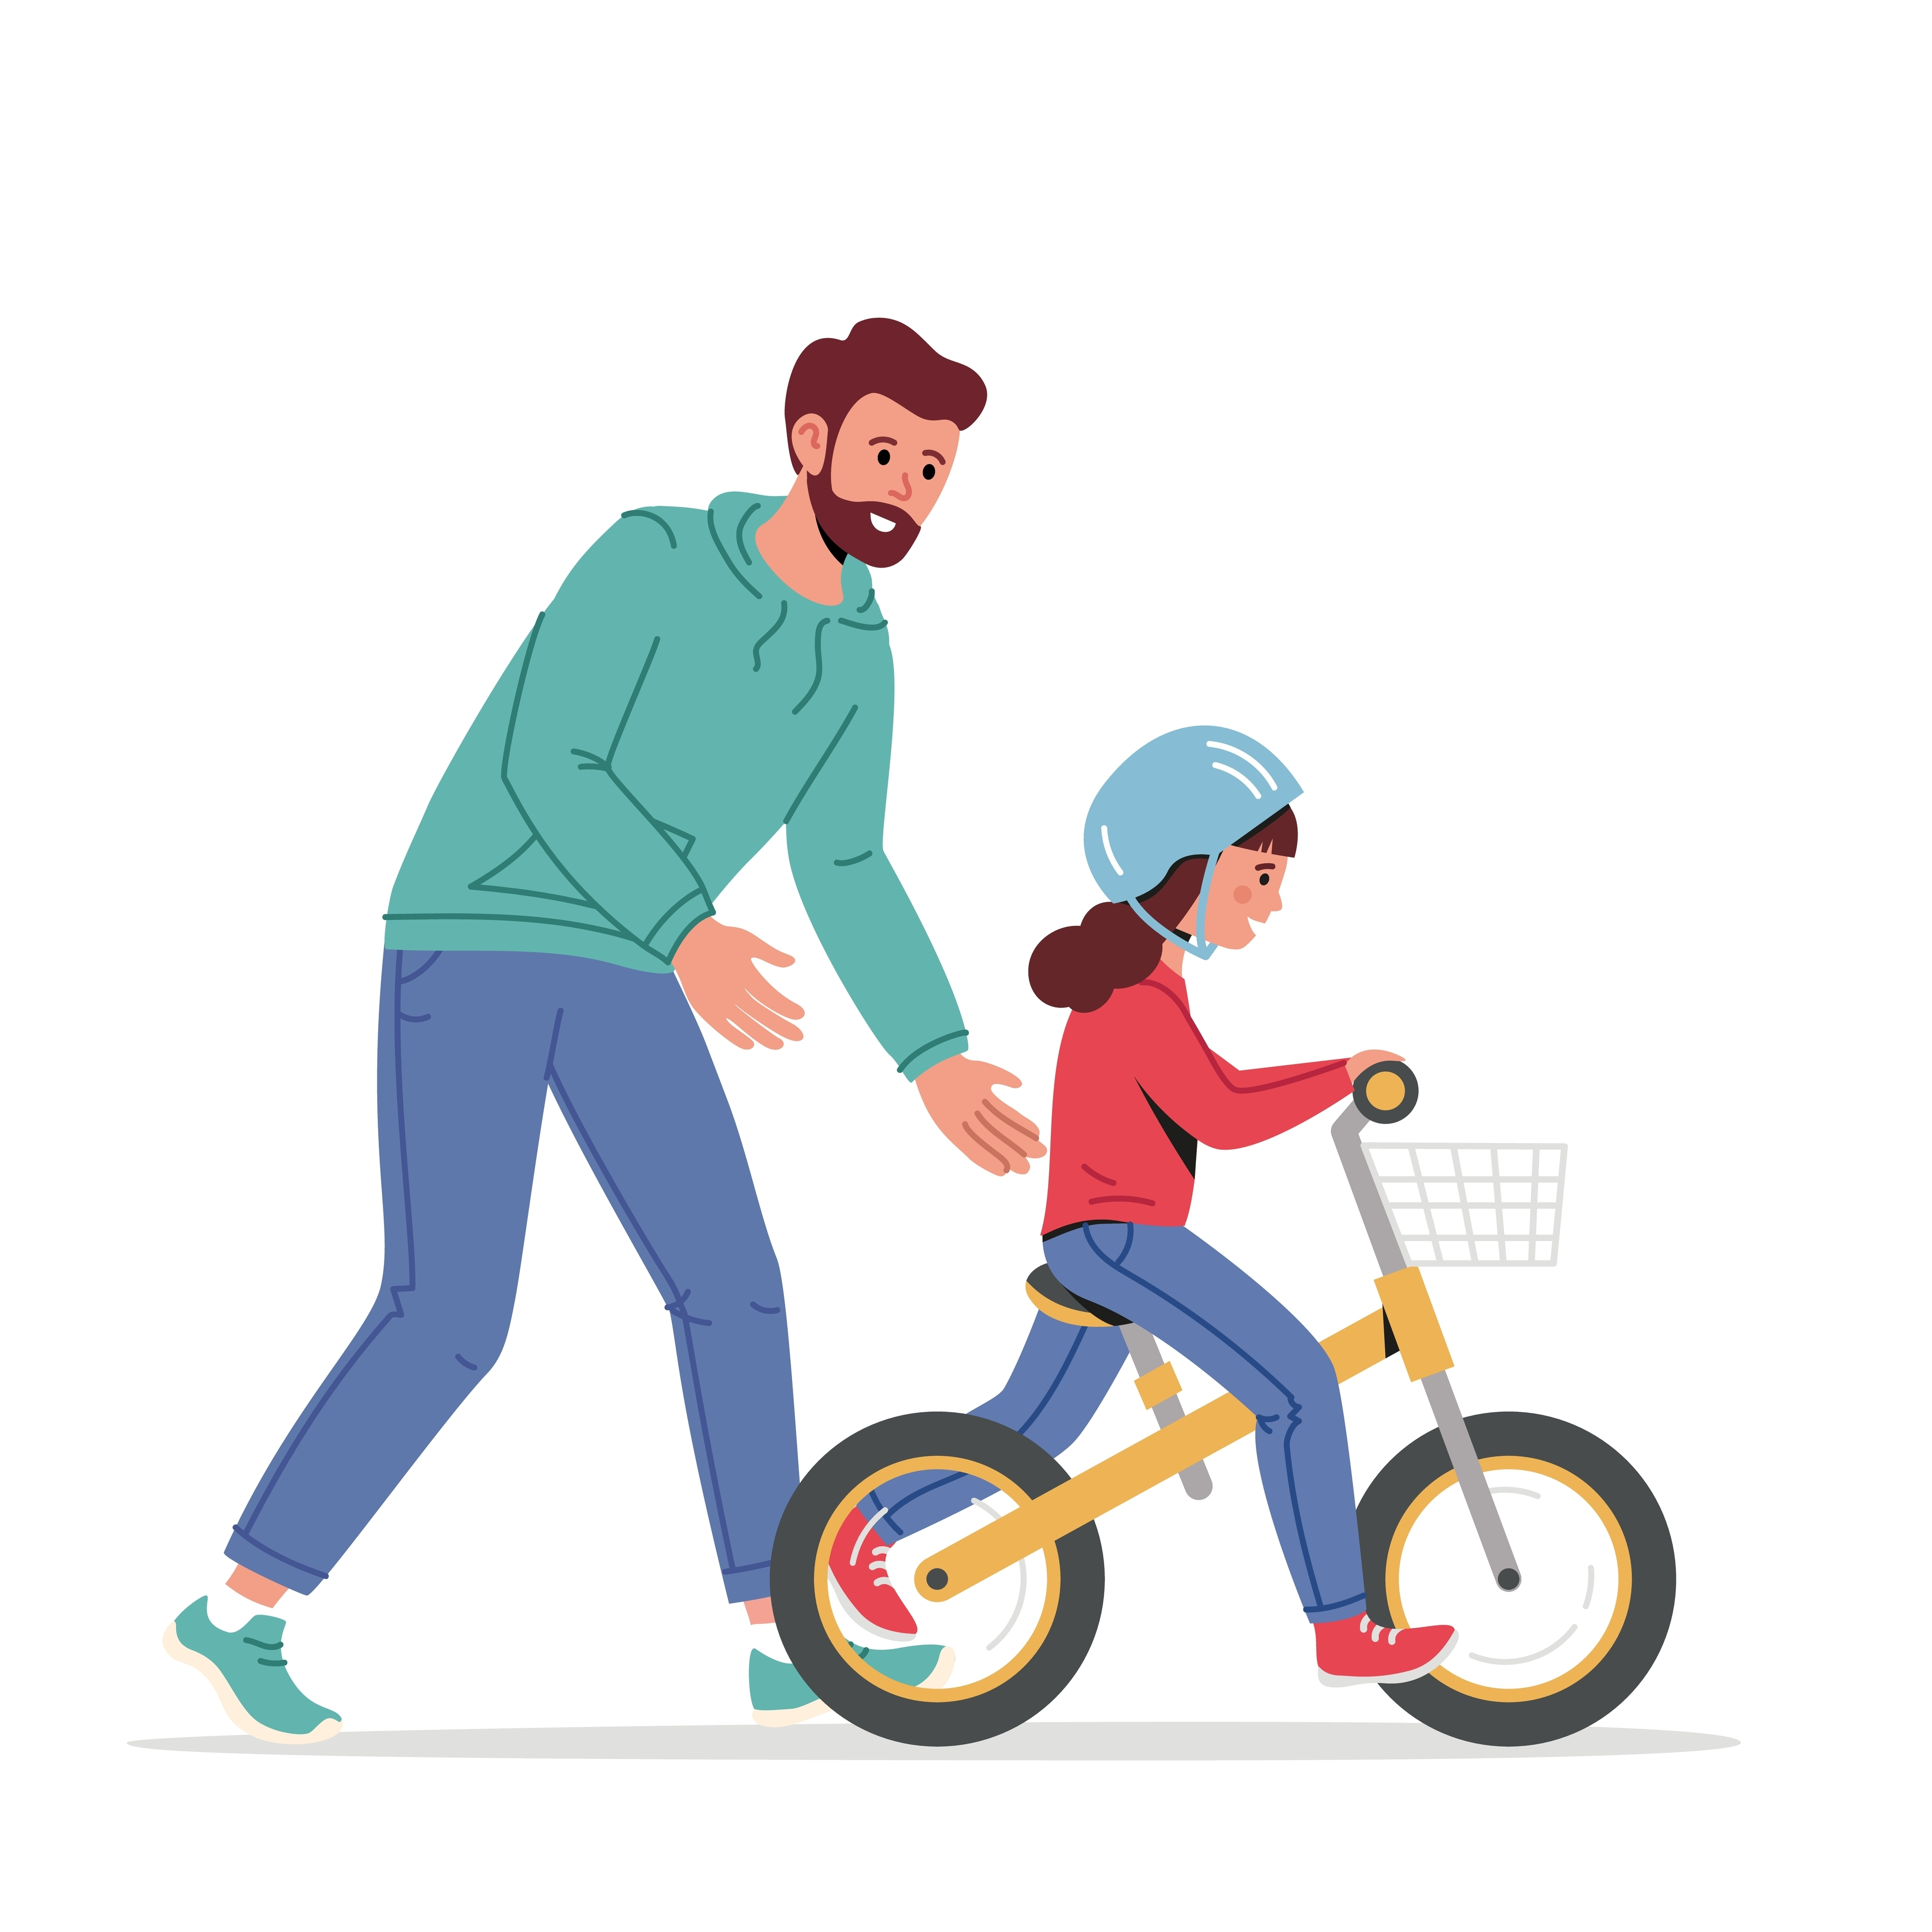
Acquired Characteristics
Acquired characteristics are not controlled by DNA, they are learned during our lifetime.
Examples include the ability to ride a bicycle, the ability to play the piano and your accent!
Can you think of any other characteristics that might be acquired?
P.80

Slide 16
10.4 Chromosomes and genes

Slide 17
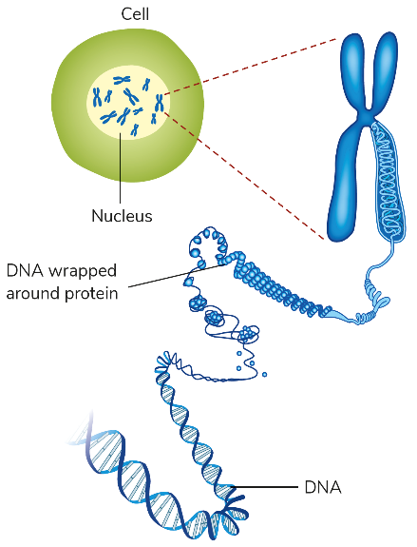
Chromosomes and genes
Chromosomes are thread-like structures in the nucleus of a cell. They are made up of DNA.
Genes are lengths of DNA along a chromosome.
How many chromosomes are in a normal human body cell?
How many chromosomes are in a human sex cell?
P.81

Slide 18
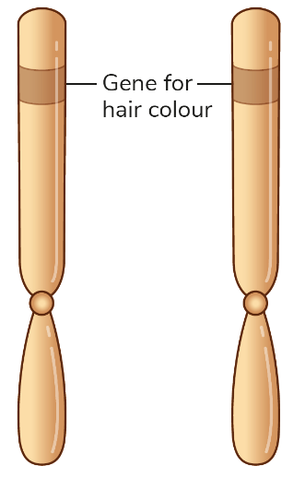
Genes
We have two genes for each trait: one comes from the mother and one from the father. Each member of the pair of genes is located on the same place in the partner chromosome.
Environment can affect the outcomes of some genes. For example, if someone has the genes to grow tall but is malnourished, they may never grow as tall.
P.81

Slide 19
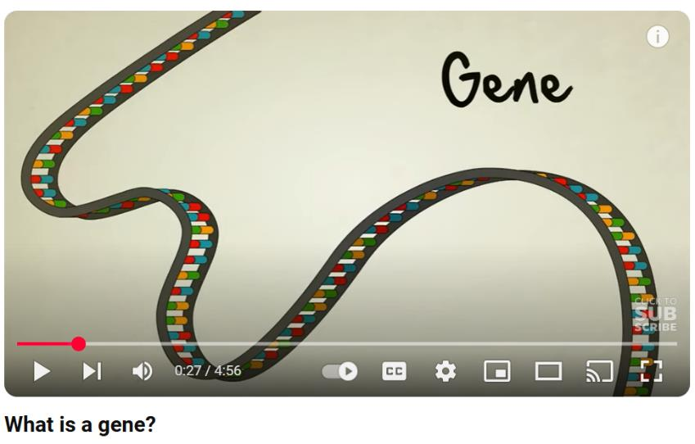
Video Link – Click to Play
P.81

Slide 20
10.5 Mendelian inheritance

Slide 21
Mendelian inheritance
Inheritance is the way traits are passed from parents to offspring.
Gregor Mendel is known as ‘the father of genetics’. He carried out research to explain how traits are passed from parent to offspring.
Non-inherited traits do not involve genes, for example learning a foreign language.
Inherited traits do involve genes, for example eye colour.
P.82

Slide 22
10.6 Genetic crosses

Slide 23
Mendelian crosses
A genetic cross shows how certain genes are inherited by offspring from their parents.
Some vocabulary that is needed before attempting these genetic crosses:
Expressed: This is when a protein controlled by a gene is actually made.
Genotype: The genes that an organism possesses.
Phenotype: The traits that can be seen in the organism.
Dominant: A gene that prevents another gene from being expressed.
Recessive: A gene that is prevented from being expressed.
P.82

Slide 24
Genetic crosses
When carrying out genetic crosses:
Letters are used to denote genes.
Dominant genes are given capital letters.
Recessive genes are given a lowercase version of the letter.
For example: Brown eye (B) is dominant to blue eyes (b).
Q: If a person has the genotype BB, what colour eyes will they have?
Q: If a person has the genotype Bb, what colour eyes will they have?
Q: If a person has the genotype bb, what colour eyes will they have?
P.83

Slide 25
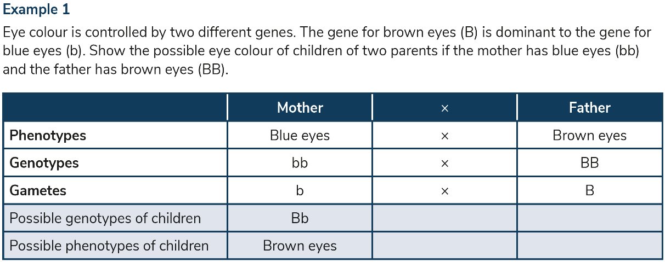
Genetic crosses
P.83

Slide 26
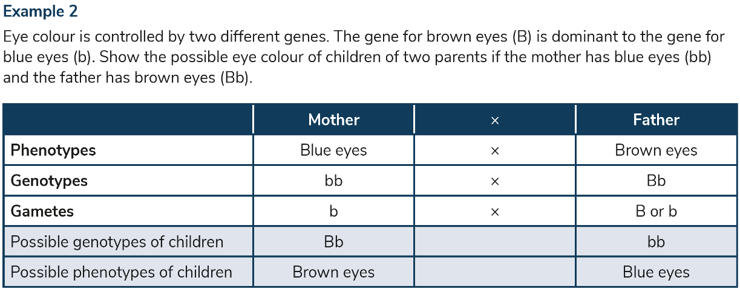
Genetic crosses
P.84

Slide 27
Pedigree charts
Pedigree charts are also known as family trees.
A pedigree chart will always give you a guide for the symbols used so that you can read the chart and answer questions about it.
P.84

Slide 28
Pedigree charts
What information does the pedigree chart tell us about person 1 and person 2?
P.84

Slide 29
Experiment 10.1 To extract DNA from kiwi fruit

Slide 30
Experiment 10.1 – To extract DNA from kiwi fruit
Video Link –Click to Play
Scan the QR code
P.85

Slide 31
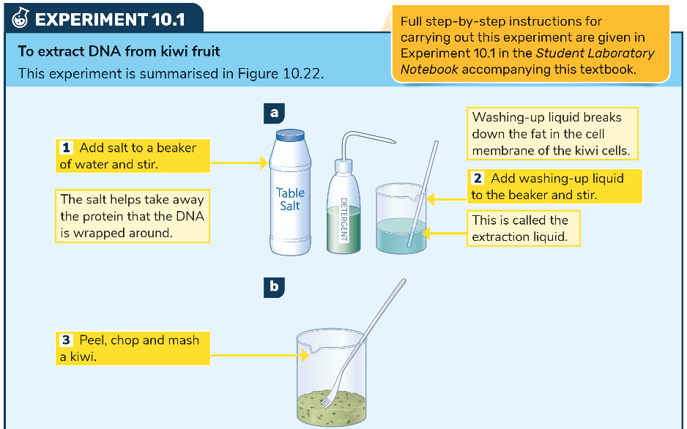
P.85

Slide 32
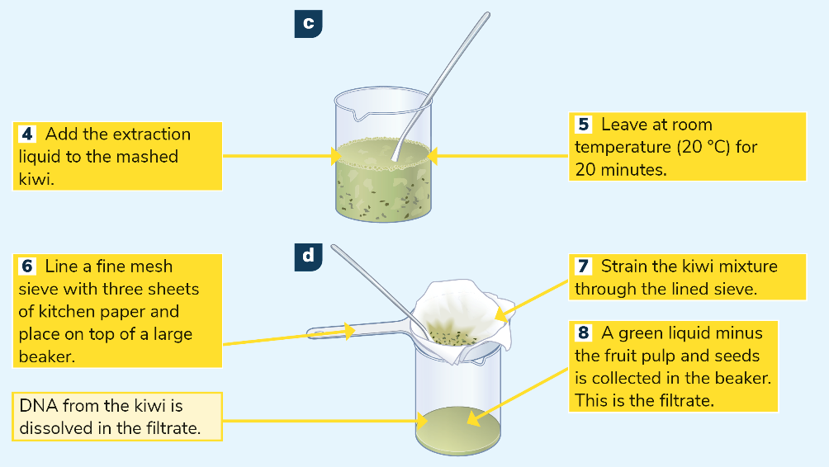
P.85

Slide 33
P.85

Slide 34
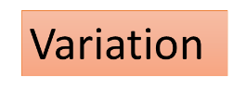
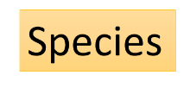
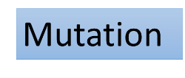
Keyword Recap – Click to Reveal
Reproduction involving only one parent
The way members of the same species differ
A gene that prevents another gene from being expressed
Organisms that can breed to produce fertile offspring
A change in the genetic code of DNA

Slide 35
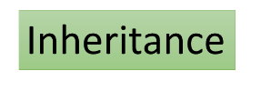
Keyword Recap – Click to Reveal
Thread-like structures located within the nucleus, made of DNA.
Lengths of DNA found along a chromosome
A gene that is prevented from being expressed
DNA
Controls genetic information
Characteristics that are controlled by DNA

Slide 36
P.87

Slide 37
Learning outcomes: Now I am able to…
Tick
Distinguish between sexual and asexual reproduction.
Recognise the structure of DNA.
Explain what is meant by variation and how it occurs in nature.
Describe chromosomes and genes and explain the difference between them.
Explain Mendelian inheritance and work out some simple genetic crosses.
Recall examples of the environment affecting gene expression.

Slide 38
Exam Focus

Slide 39
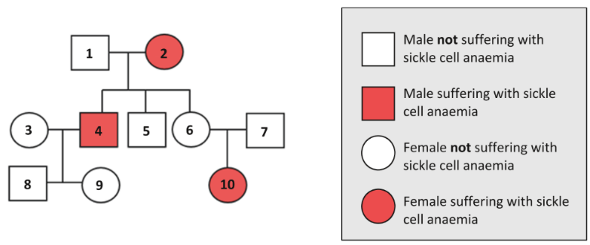
Exam Focus – 2019 State Exam – Q5

Slide 40
Exam Focus – 2019 State Exam – Q5

Slide 41
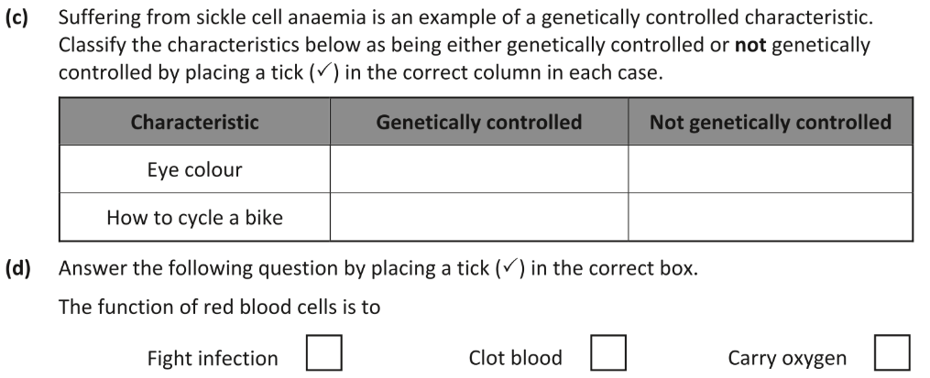
Exam Focus – 2019 State Exam – Q5

