Slide 1
Chapter 16 – Materials
The Chemical World – Building Blocks

Slide 2
Objectives:
To give students an understanding of the properties of the three states of matter
To help students appreciate how the properties of solids, liquids and gases can be explained in terms of the particle theory
P.138

Slide 3
Keywords:
Matter
Diffusion
Evaporation
Compress
Condensation
P.138

Slide 4
16.1 States of matter

Slide 5
Matter
Matter is anything that takes up space and has mass.
The three states of matter are solid, liquid and gas.
Q: What experiment could you carry out to show that a gas takes up space?
Q: What experiment could you carry out to show that a gas has mass?
P.138

Slide 6
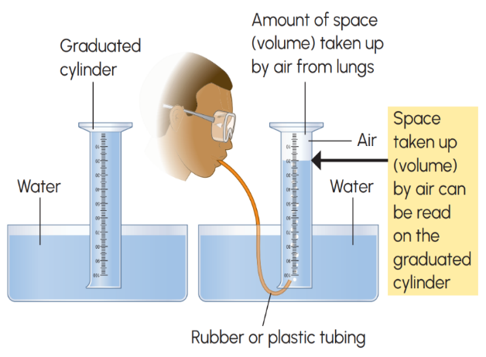
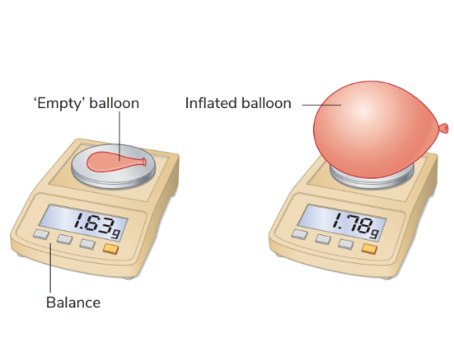
Gas has volume
Gas has mass
P.138

Slide 7
16.2 The particle theory

Slide 8
The particle theory
Scientists have developed a theory to explain the properties of solids, liquids and gases.
Solids, liquids and gases are made up of tiny particles that can only be seen with a special type of microscope.
The particle theory explains how these particles appear in the three states of matter.
P.139

Slide 9
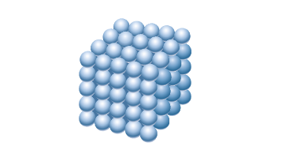
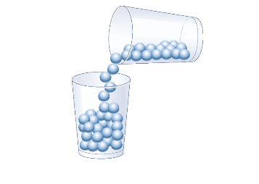
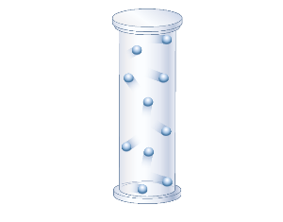
The particle theory
Solid | Liquid | Gas
Fixed positions Do not move but can vibrate Strong forces holding particles together | Particles can slide over each other Forces holding particles together are not as strong as in a solid | Particles farther apart than a liquid or a solid Very weak forces between particles
P.139

Slide 10
16.3 Properties of the states of matter

Slide 11
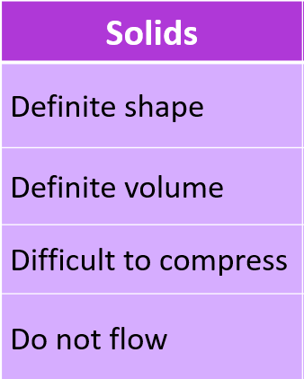
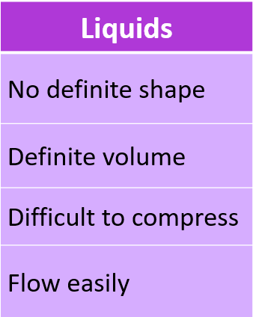
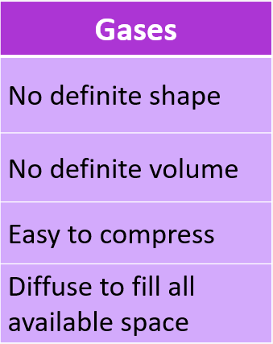
Properties of the states of matter
P.139 & p.140

Slide 12
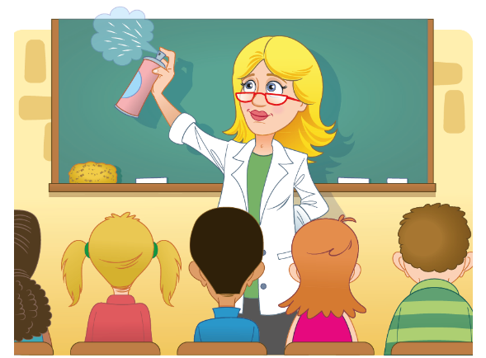
Diffusion
Diffusion is the spreading out of materials due to the movement of their particles. Diffusion takes place from an area of high concentration to an area of low concentration.
p.140

Slide 13
16.4 Change of state

Slide 14
Change of State - Melting
When a solid melts, the particles vibrate so much that they break away from their fixed positions. The solid now begins to change into a liquid.
Q: What is the difference between the terms melting and melting point?
p.141

Slide 15
Measuring the melting point of a solid
Video Link – Click to Play
Scan QR code for full video
p.142

Slide 16
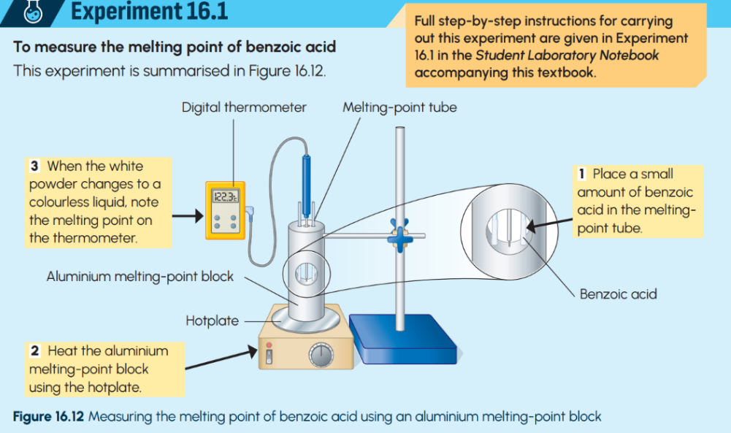
p.142

Slide 17
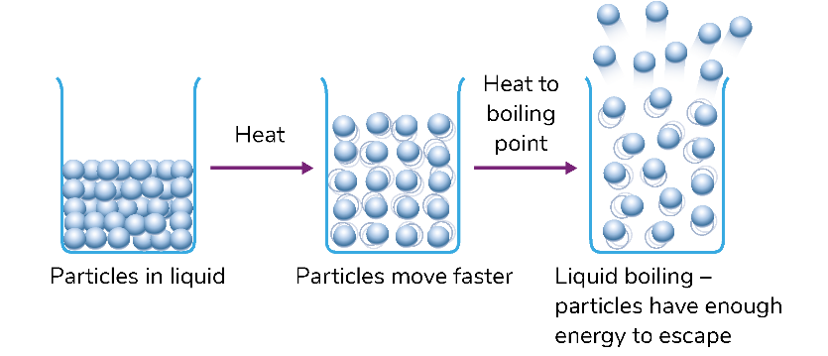
Change of State - Boiling
At the boiling point of a liquid, the particles break away from all parts of the liquid and form a gas.
Q: What is the difference between the terms boiling and boiling point?
p.143

Slide 18
p.143

Slide 19
Change of state - Match the definition activity
Melting point
The temperature at which a liquid changes to a solid
Evaporation
The changing of a gas to a liquid
The changing of a liquid to a gas
at the surface of the liquid
Boiling point
Condensation
The temperature at which a liquid changes to a gas
Freezing point
The temperature at which a solid changes to a liquid

Slide 20
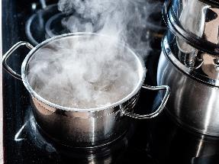
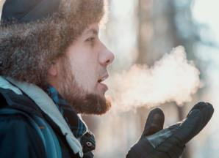
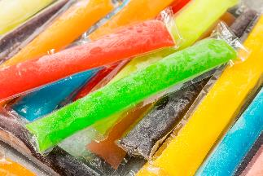
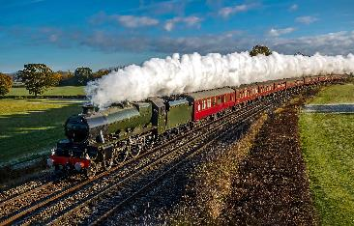
Change of states of state – Everyday life examples
Q: What changes of state are evident in the photos?

Slide 21
Video Link – Click to Play

Slide 22
Keyword Recap – Click to Reveal
Matter
Anything that takes up space and has mass
Diffusion
The movement of particles from an area of high to low concentration
Evaporation
The changing of a liquid to a gas at the surface of the liquid
Compress
The particles can be squeezed into a smaller volume
Condensation
The changing of a gas to a liquid

Slide 24
Learning outcomes: Now I am able to…
Tick
Define the term matter.
Name the three states of matter.
Describe the properties of solids, liquids and gases.
Use the particle theory to explain the properties of the three states of matter.
Measure the melting point of a solid and the boiling point of a liquid.

Slide 25
Exam Focus

Slide 26
Exam Focus – State exam 2024 – Q16

Slide 27
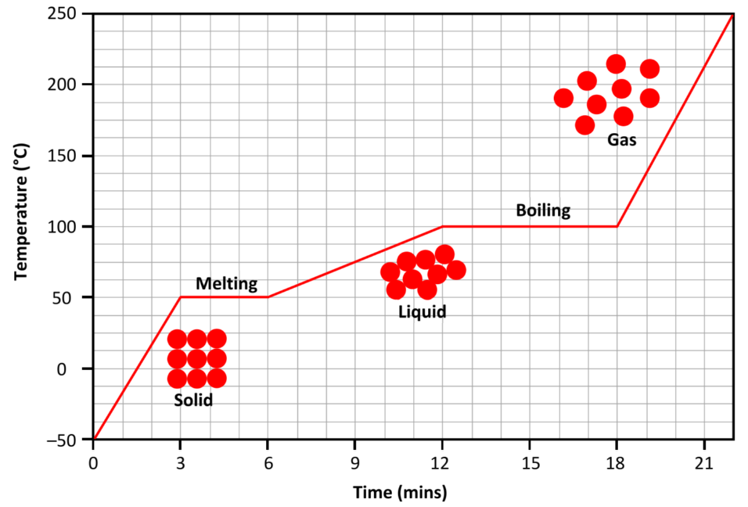
Exam Focus – State exam 2024 – Q16
(a) In which state does substance X have the highest temperature?
(b) In which state does substance X have a fixed volume and shape?
(c) In which state does substance X have a fixed volume but variable shape?

Slide 28
Exam Focus – State exam 2024 – Q16
(d) At what temperature does substance X change from a solid to a liquid?
(e) How long did it take for substance X to completely evaporate (change from a liquid to a gas) after is reached boiling point?

