Slide 1
Chapter 29:
Measurement in Physics
The Physical World – Building Blocks

Slide 2
Objectives:
To give students an understanding of how to measure length, area, volume, time, temperature and mass
To help students choose suitable instruments to measure length, area, volume, time, temperature and mass
p.264

Slide 3
Keywords:
Callipers
Opisometer
Trundle wheel
Graduated cylinder
Meniscus
p.264

Slide 4
Keywords:
Overflow can
Mass
Precision
Reliability
Accuracy
p.264

Slide 5
29.1 Measurements

Slide 6
Measurements
In physics it is important to learn how to take measurements accurately.
To do this, a suitable instrument must be used.
In addition, suitable units of measurement need to be used.
Q: How many different things can you name that we measure on a daily basis?
p.264

Slide 7
29.2 Measuring length

Slide 8
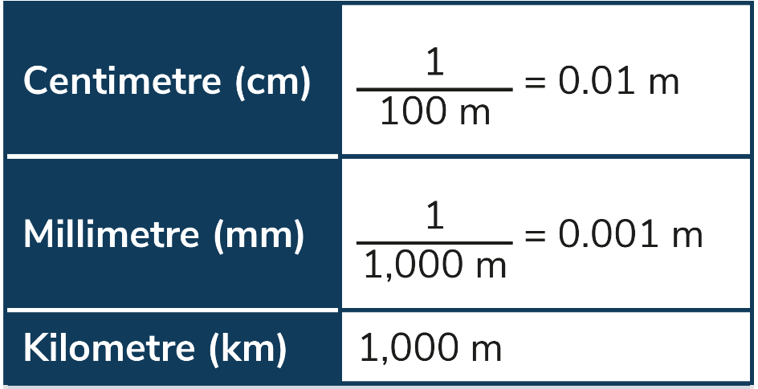
Measuring length
The unit of length is the metre.
Lengths that are smaller than a metre can be measured in centimetres or millimetres.
Lengths that are much larger than a metre can be measured in kilometres.
p.264

Slide 9
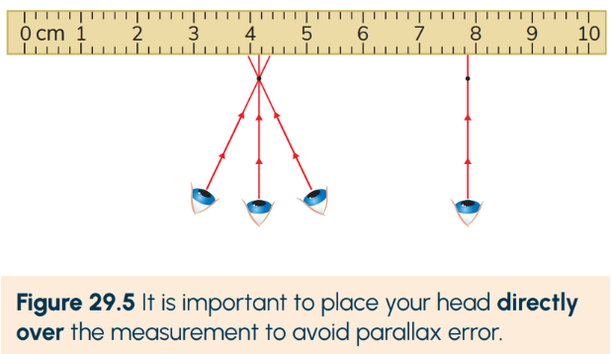
Measuring length
p.265
The most basic instrument to measure length is the ruler or metre stick.
Two things to watch out for when you are using this instrument to ensure accuracy are zero error and parallax error.

Slide 10
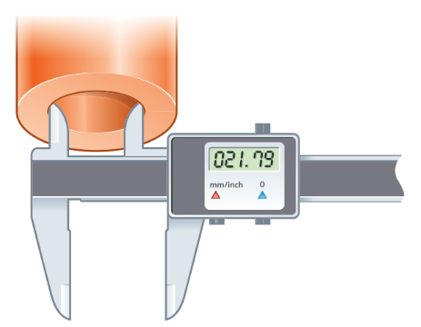
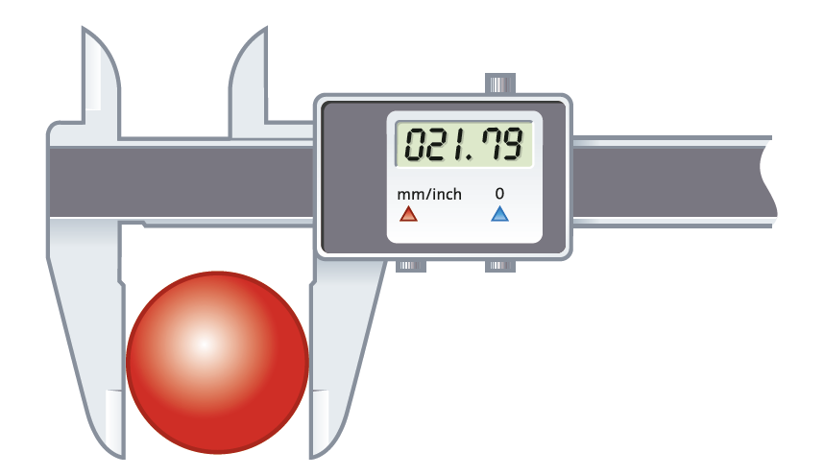
Measuring length
A digital callipers can be used to measure small distances.
It is especially useful for measuring the diameter of circular objects.
p.265

Slide 11
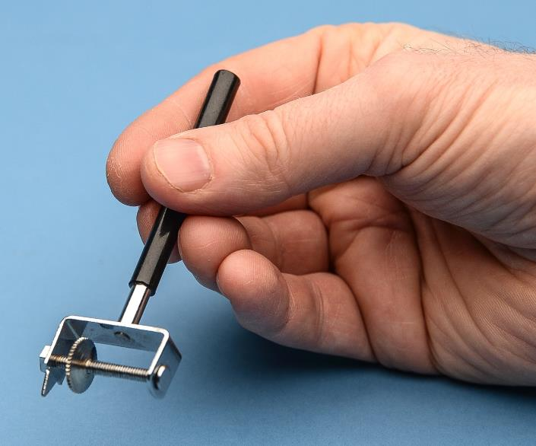
Measuring the length of a curved line
An opisometer can be used to measure the length of a curved line for a short distance, for example a road on a map.
p.266

Slide 12
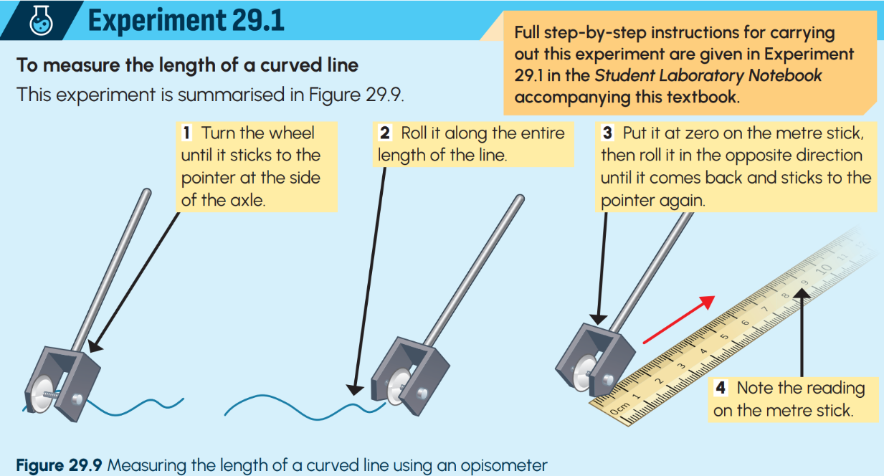
p.266

Slide 13
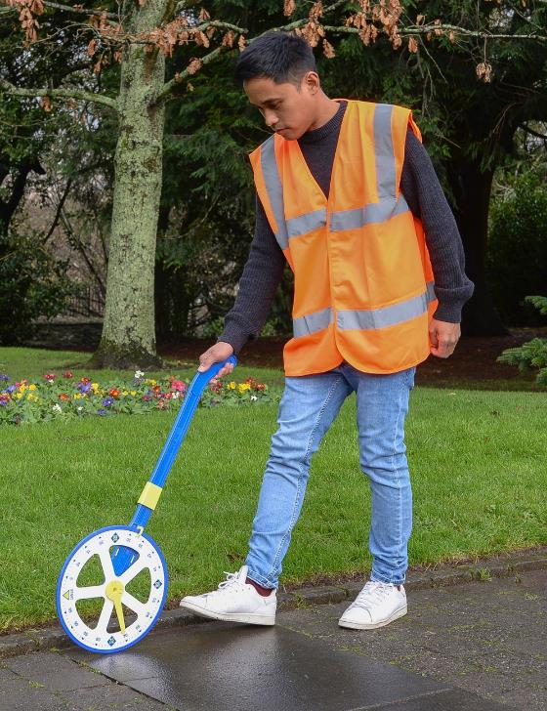
Measuring larger distances
A trundle wheel can be used to measure the length of a long distance, for example the length of a running track.
p.266

Slide 14
29.3 Measuring area

Slide 15
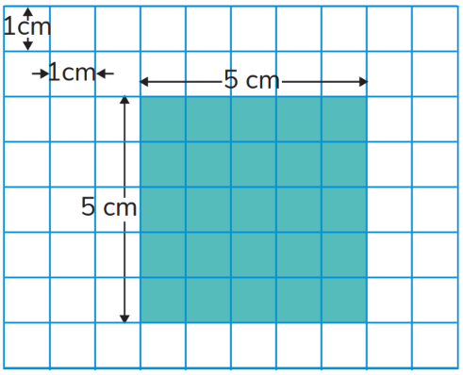
Measuring area
The area of an object is the amount of surface enclosed within its lines.
To calculate the area of a regular shape (a square or a rectangle) we use the formula:
area = length x width
p.267

Slide 16
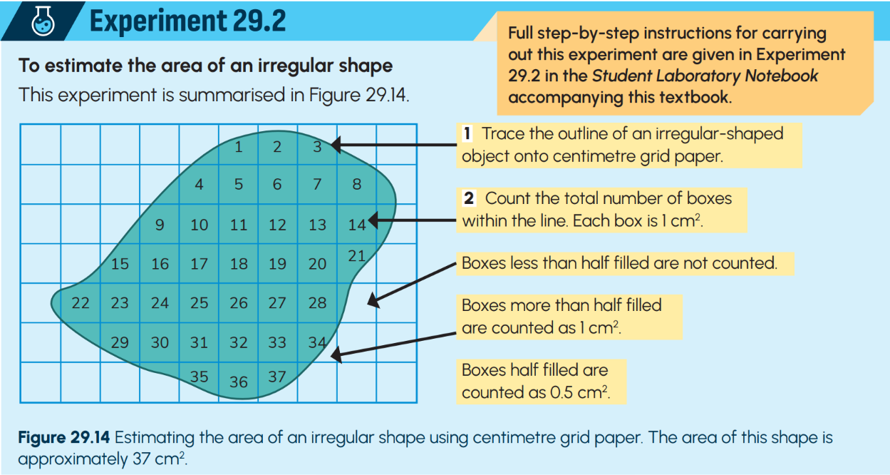
p.268

Slide 17
29.4 Measuring volume

Slide 18
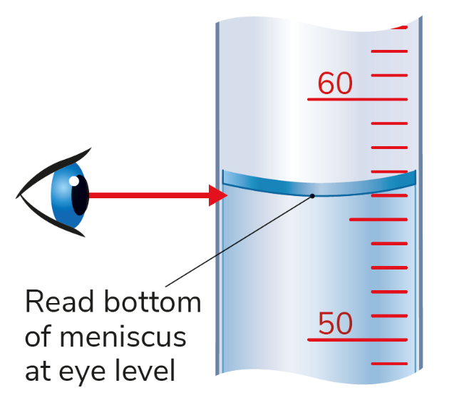
Measuring volume - liquids
The volume of an object is the amount of space that an object takes up.
Volume of a liquid is measured using a graduated cylinder.
We must take the reading from eye level and read from the bottom of the meniscus.
p.269

Slide 19
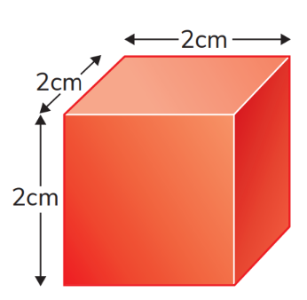
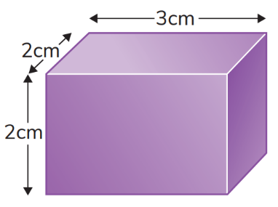
Measuring volume – cubes & cuboids
The volume of a cube or a rectangular-shaped object can be found by using the following measurements:
Volume = length x width x height
p.269 & p.270

Slide 20
Measuring volume – irregular shapes
To find the volume of an irregular-shaped object, the method of water displacement is used.
The object is placed into an overflow can filled with water and a graduated cylinder placed below the spout fills with a volume of water that is equal to the volume of the stone.
p.270

Slide 21
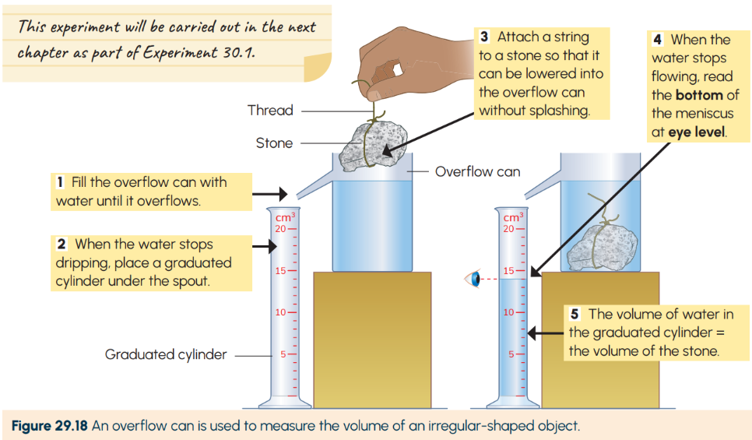
p.270

Slide 22
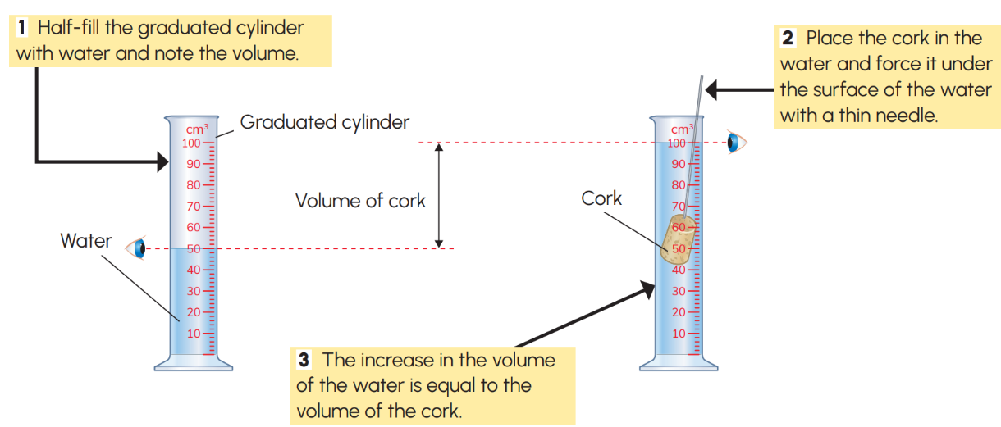
Measuring volume – objects that float
To find the volume of an object that floats on water, a needle can be used to push the object under the water without adding to the reading.
p.271

Slide 23
29.5 Measuring time

Slide 24
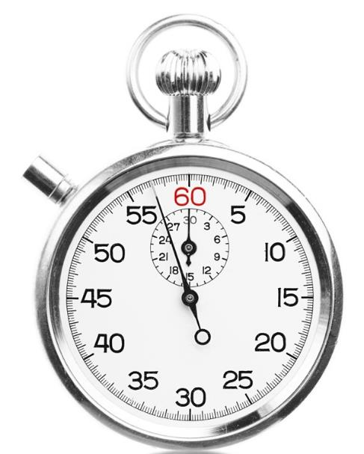
Measuring time
Time can be measured using a watch, clock or an electronic time.
The unit of time is the second.
Q: What measurement is used when time is less than a second?
Q: What measurement is used when time is more than a second?
p.271

Slide 25
29.6 Reliability, accuracy and precision

Slide 26
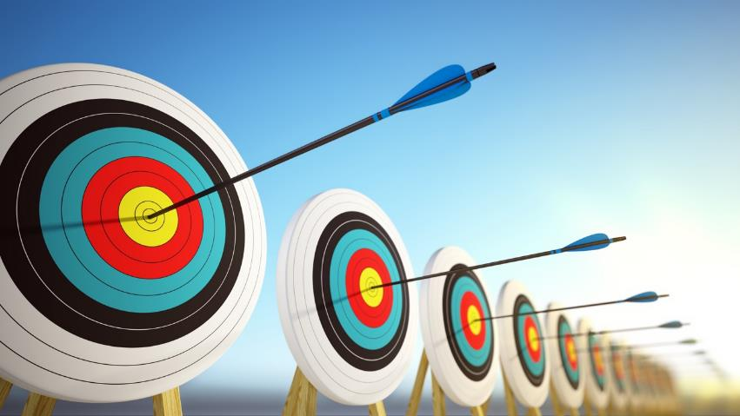
Reliability, accuracy and precision
A measurement is reliable if the same experiment is repeated and you get the same or similar results over and over again.
Accuracy means how close a measured value is to its actual value.
Precision means how close a set of measurements are to each other.
p.272

Slide 27
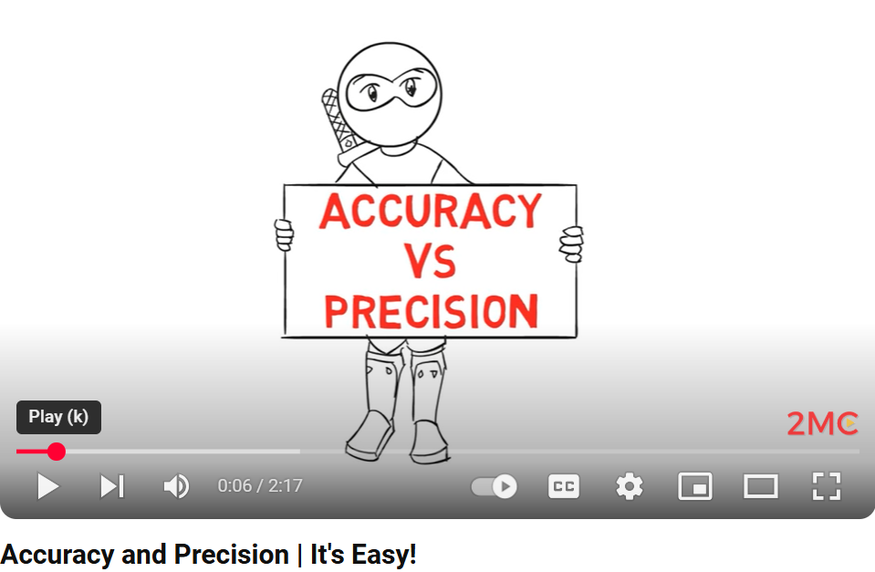
Video Link – Click to Play

Slide 28
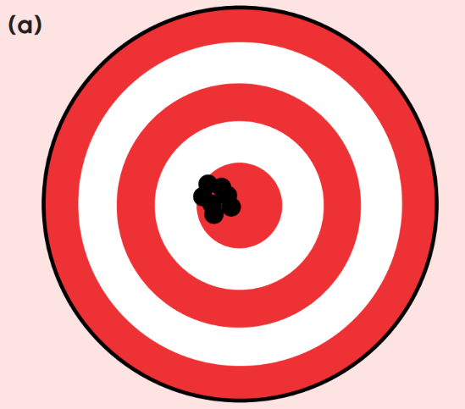
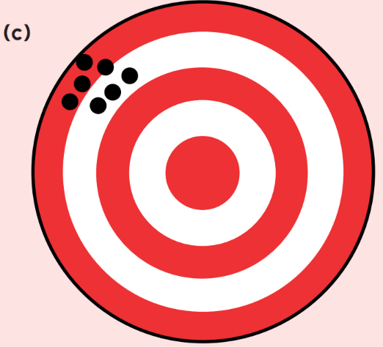
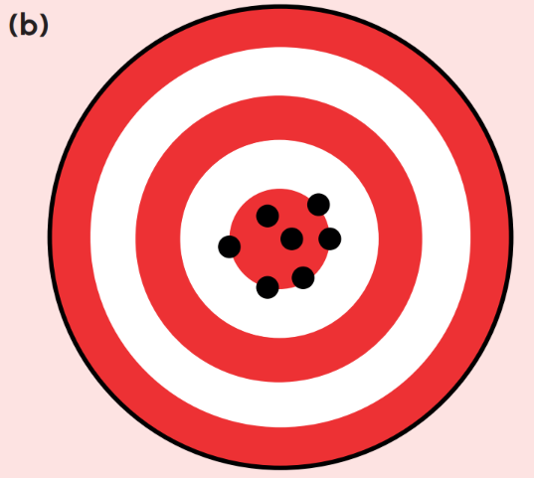
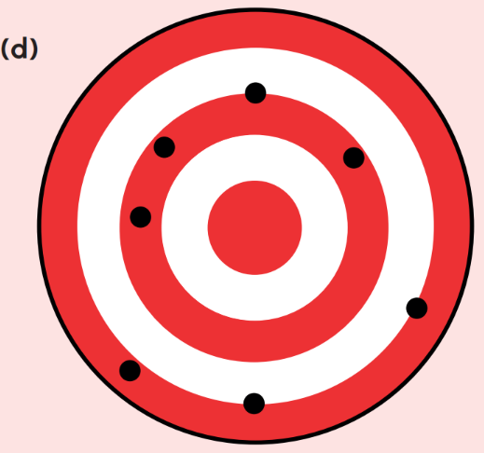
Reasonable Accuracy
Lower Precision
Low Accuracy
Low Precision
High Accuracy
High Precision
Low Accuracy
Reasonable Precision
p.273

Slide 29
29.7 Measuring temperature

Slide 30
Measuring temperature
Temperature is a measure of how hot or cold something is.
The unit of temperature is the degree Celsius.
The instrument used to measure temperature is called a thermometer.
Q: There are two other scales that temperature can be measured on. Can you name these scales?
p.274

Slide 31
29.8 Measuring mass

Slide 32
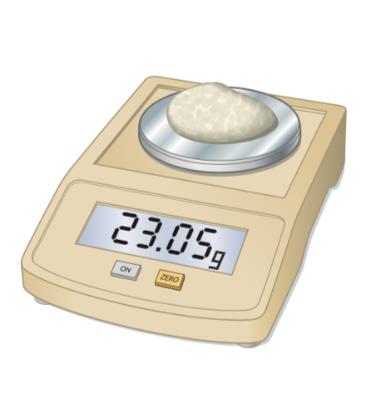
Measuring mass
Mass is a measure of the amount of matter in a body.
The unit of mass is the kilogram (kg). However, in the lab grams (g) are used more often.
Mass is measured using an electronic balance.
p.274
p.274

Slide 33
29.9 Units

Slide 34
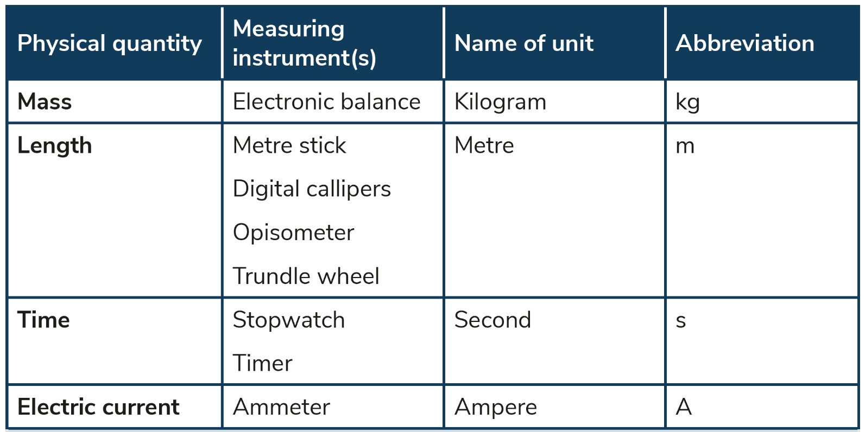
Units
p.275

Slide 35
Keyword Recap – Click to Reveal
Callipers
Used to measure small distances and diameters
Opisometer
Used to measure the length of curved lines
Trundle wheel
Used to measure the length of larger distances
Graduated cylinder
Used to measure the volume of liquids
Meniscus
The curved surface of the liquid in a narrow container

Slide 36
Keyword Recap – Click to Reveal
Overflow can
Used to measure the volume of irregular shapes
Mass
The amount of matter in a body
Precision
How close a set measurements are to each other
Reliability
When the same results can be achieved in an experiment repeatedly
Accuracy
How close a measured value is to its actual value

Slide 37
p.276

Slide 38
Learning outcomes: Now I am able to…
Tick
Accurately measure the length of a variety of objects.
Calculate the area of square and rectangular objects and estimate the area of an irregular shape.
Calculate the volume of a cube or a rectangle.

Slide 39
Learning outcomes: Now I am able to…
Tick
Measure the volume and temperature of a liquid or solid.
Choose, name and use appropriate instruments to measure length, area, volume, mass, temperature and time.
Choose appropriate units for length, area, volume, mass, temperature and time.

Slide 40
Exam Focus

Slide 41
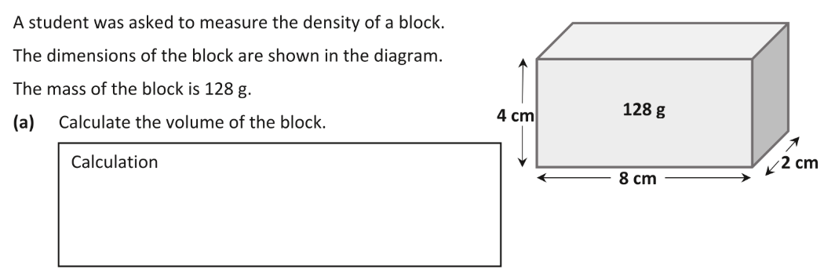
Exam Focus – 2019 State Exam – Q2

Slide 42
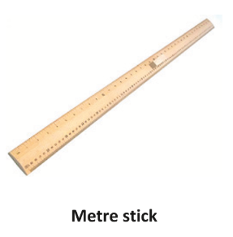
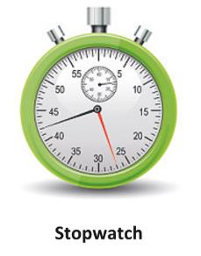
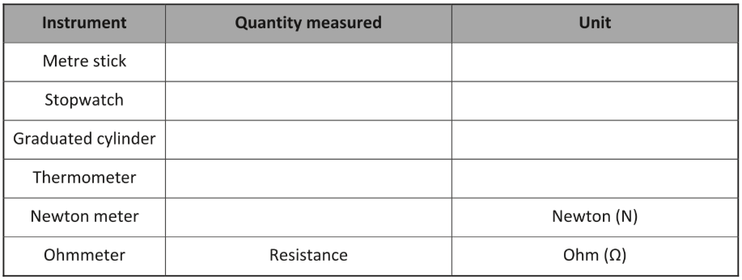
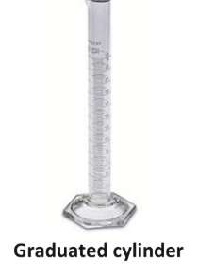
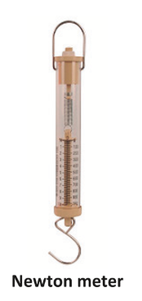
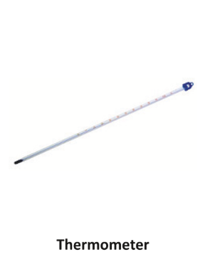
Exam Focus – 2019 Sample paper – Q2
Covered in Chapter 32

