Slide 1
John Williams
4th Class
Unit 1, Lesson 2

Slide 2
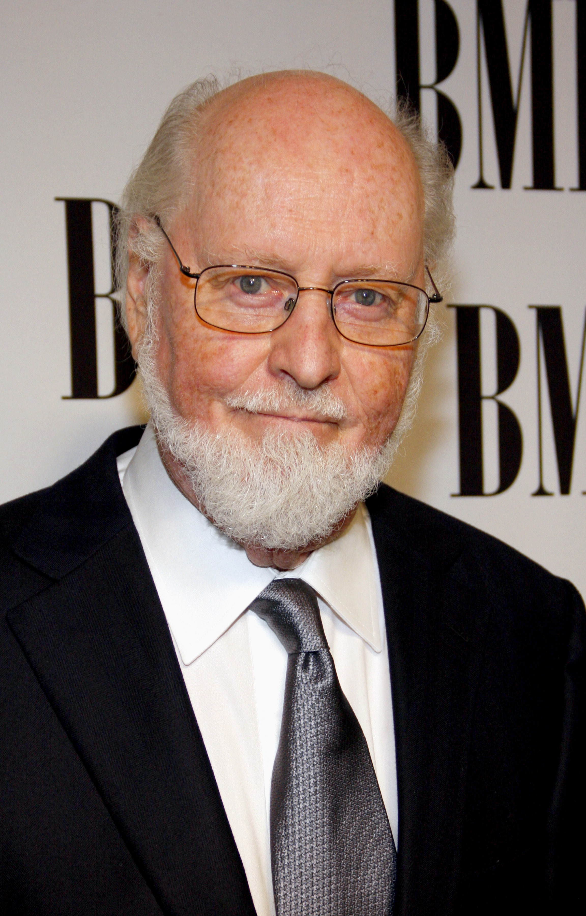
Who is John Williams?
John Williams is an American film composer.
He was born in New York City, United States on February 8th, 1932.
John Williams has composed some of the most popular and recognizable film scores in the world.
These include E.T., Harry Potter, Indiana Jones and Jurassic Park!

Slide 3
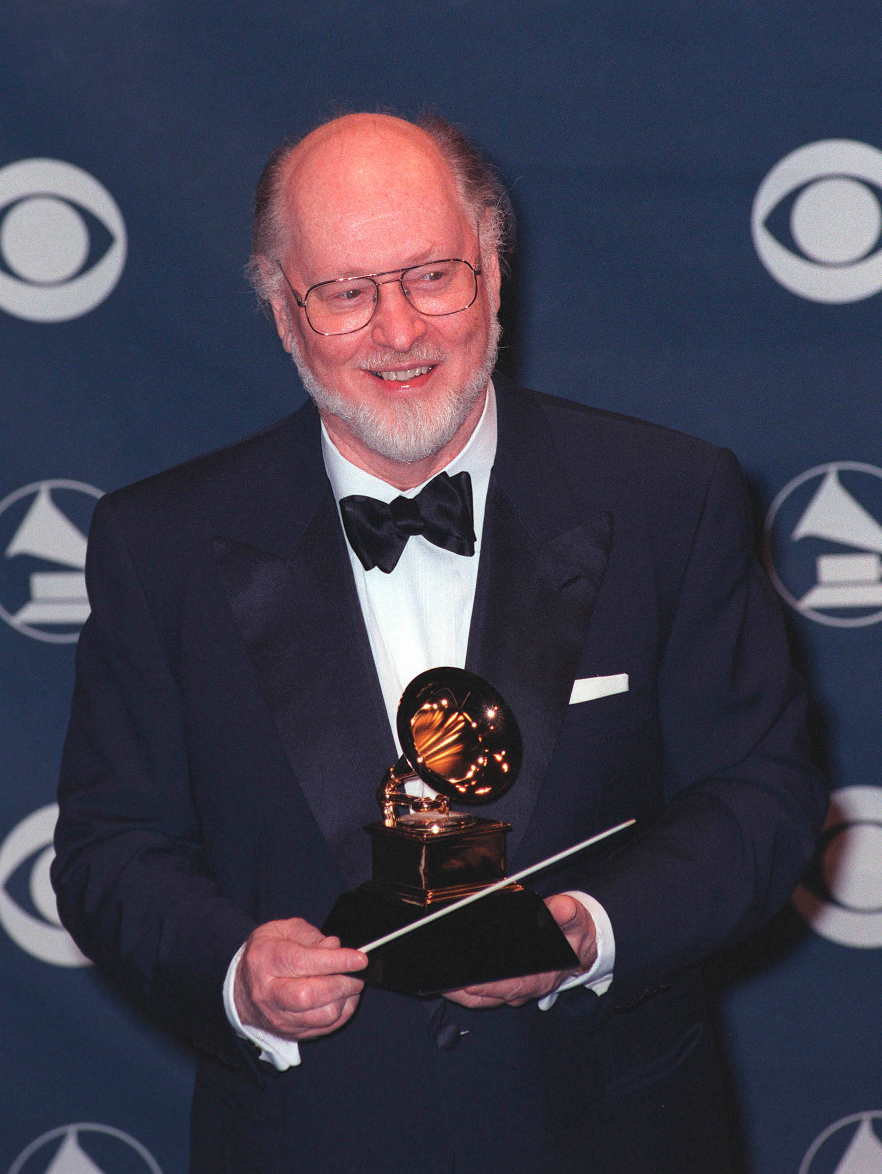
Who is John Williams?
John Williams liked music from a young age. He began studying piano as a child.
He started writing music early – he even tried to orchestrate his own pieces as a teenager!
Later, he joined the U.S. Air Force, where he arranged band music and first began conducting.
After, he worked as a Hollywood studio pianist.
His big break came when he started composing music for the films of Steven Spielberg!

Slide 4
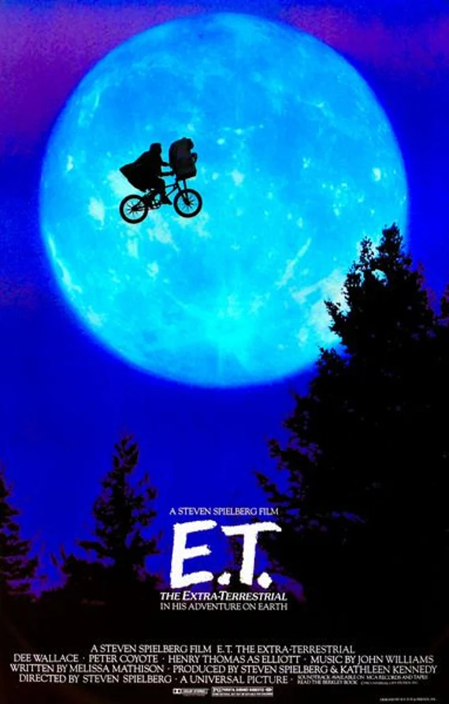
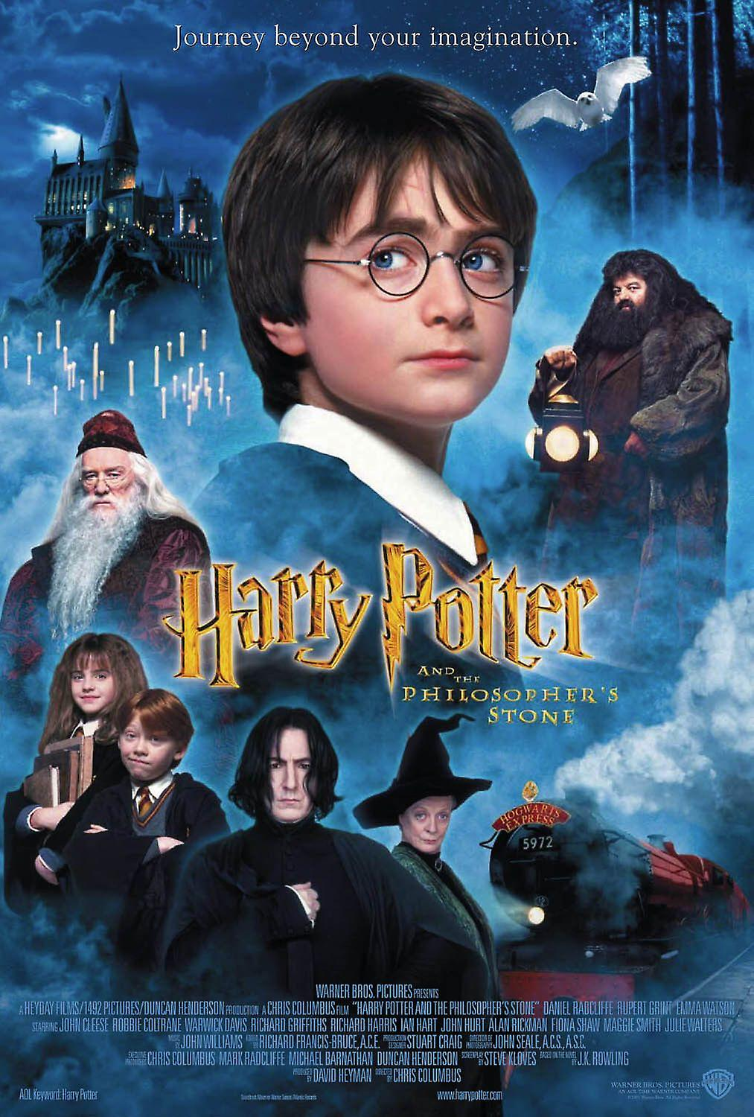
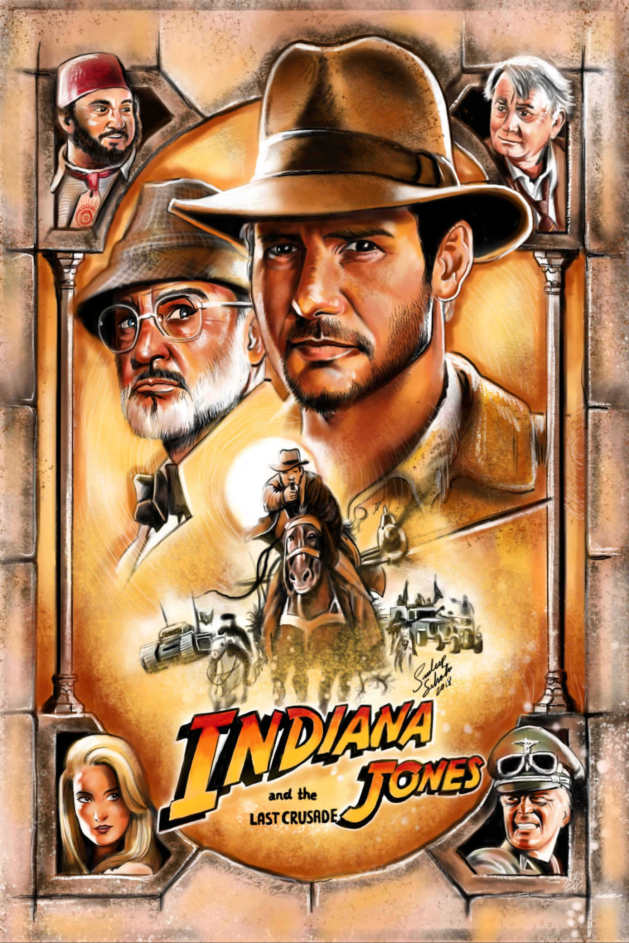
What has John Williams composed?
Click the film posters to listen to a short clip!

