Slide 1
Antonín Dvořák
5th Class
Unit 1, Lesson 3

Slide 2
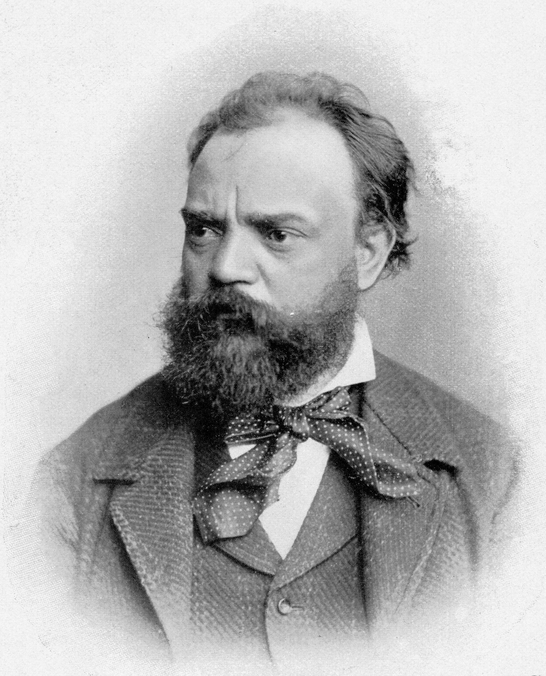
Who is Antonín Dvořák?
Antonín Dvořák was a Czech composer.
He was born in Nelahozeves, near Prague, on 8th September 1841.
Dvořák wrote chamber music, including several string quartets, piano music, songs, operas and symphonies.

Slide 3
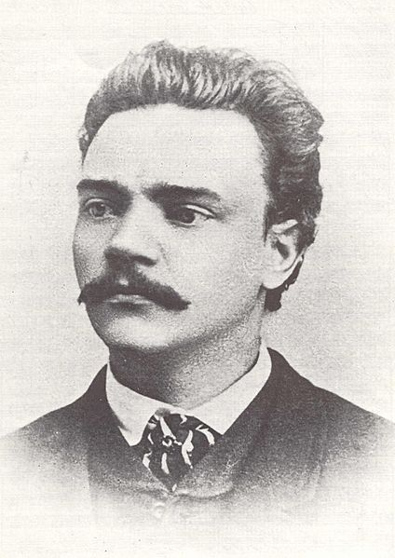
What has Antonín Dvořák composed?
Antonín Dvořák was noted for adapting traditional folk music into opera, symphony and piano pieces.
The last of Dvořák’s symphonies is known as the New World symphony, because he wrote it in the United States (the “New World”).

Slide 4
New World Symphony
Click the music note to listen to a short clip!

Slide 5
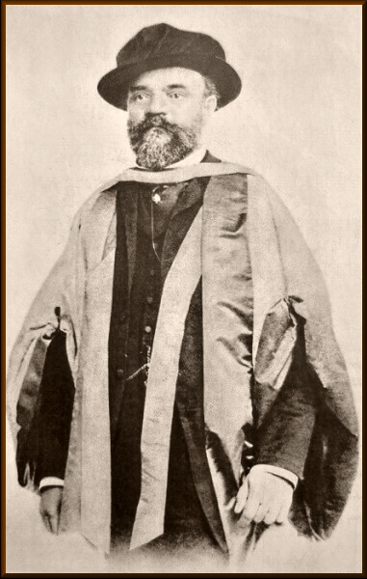
Antonín Dvořák
Dvořák wrote many kinds of music, based on classical forms but also influenced by Czech folksong.
He lived during a time when Nationalistic feelings (a strong belief and pride in one’s own nation) were felt very strongly by the Czech people.
Dvořák died after a short illness in 1904.

