Slide 1

Beethoven
6th Class
Unit 1, Lesson 4

Slide 2
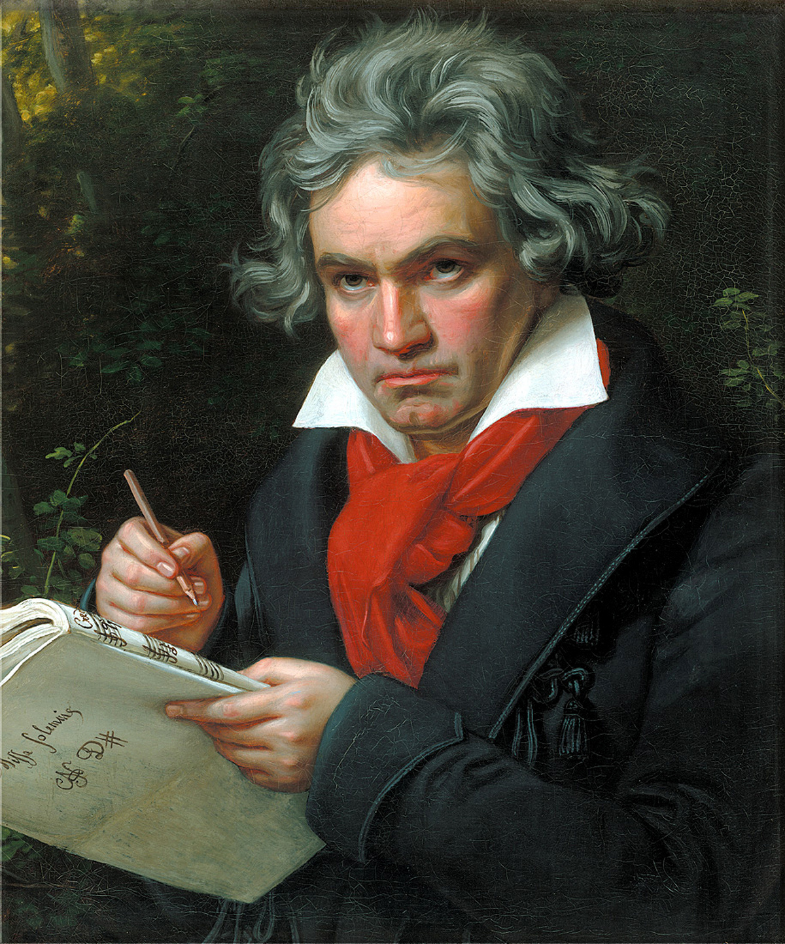
Who is Beethoven?
Ludwig van Beethoven was a German composer and pianist born on 16th December, 1770.
Born in the small town of Bonn, he began studying music at a young age.
Beethoven is considered one of the most important figures in the history of classical music.

Slide 3
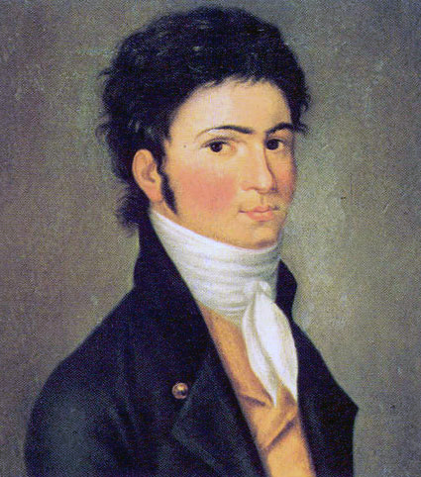
What has Beethoven composed?
Beethoven composed music in many different genres, including symphonies, operas, piano music and chamber music.
Some of his music famous works include Symphony No. 9 in D minor, Moonlight Sonata and Für Elise.
In his late twenties, Beethoven began to lose his hearing. By the middle of his forties, his hearing was almost completely gone. Yet he still continued to compose music.

Slide 4

What has Beethoven composed?
Click the music note to listen to a short clip!

Slide 5
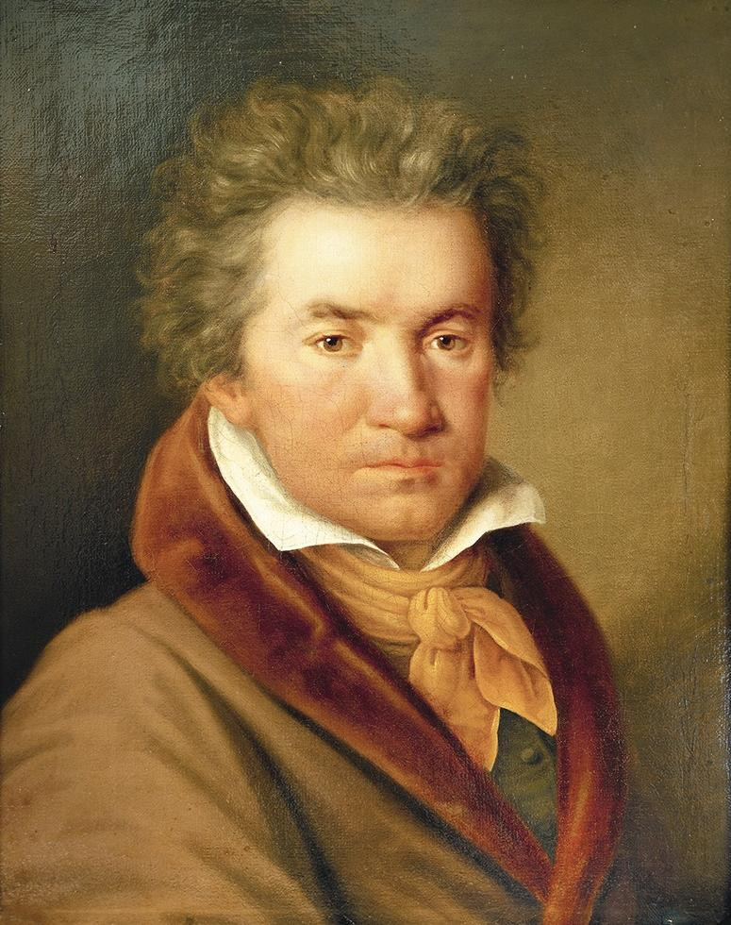
Beethoven
Beethoven was known for his powerful and emotional music.
He experimented with new forms and structures in music. His innovative approach helped to pave the way for other composers who came after him.
Today, his compositions are still listened to around the world.

