Slide 1
Amhrán na bhFiann
6th Class
Unit 1, Lesson 6

Slide 2
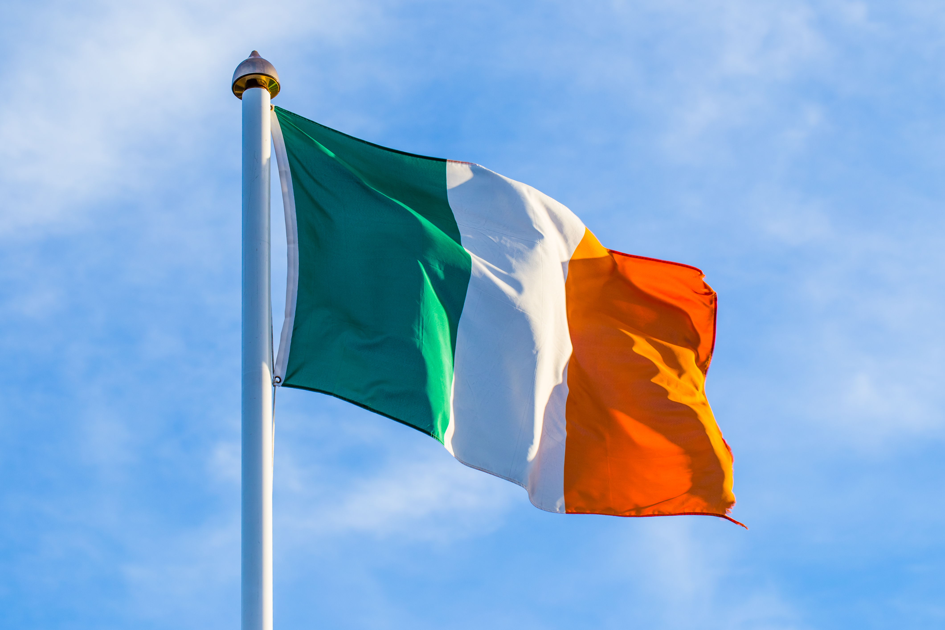
Amhrán na bhFiann
The national anthem of Ireland is called "Amhrán na bhFiann" which in English means "The Soldier's Song“.
The Irish-language lyrics were written by Liam Ó Rinn and the music was composed by Patrick Heeney and Peadar Kearney.

Slide 3
Amhrán na bhFiann
Amhrán na bhFiann was first composed in early 1910 and was adopted as the official national anthem in 1926.
The anthem is a call to arms, urging the people of Ireland to fight for their country and freedom.
It is traditionally played at Irish sporting events and other national occasions.

Slide 4
Amhrán na bhFiann
Click the Irish flag to listen to a short clip!

