Slide 1
Storm sound picture
Unit 6, Lesson 7

Slide 2
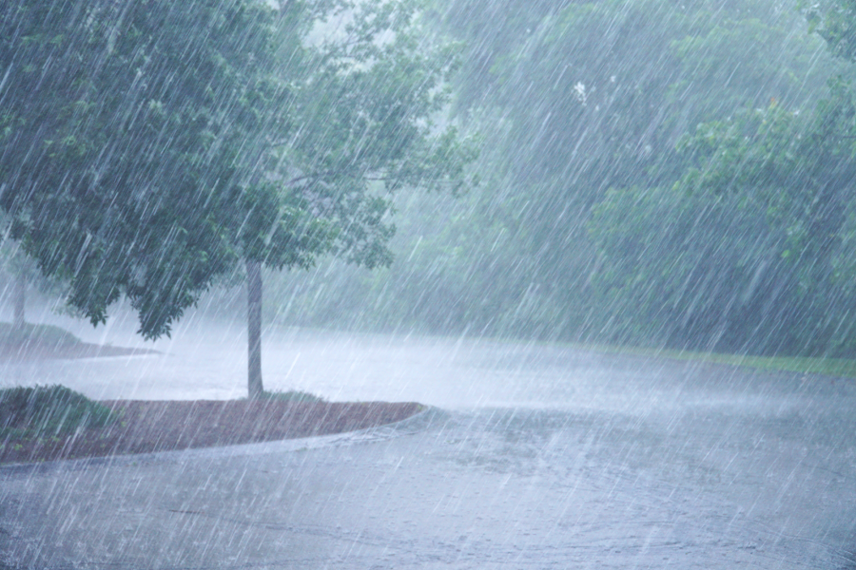
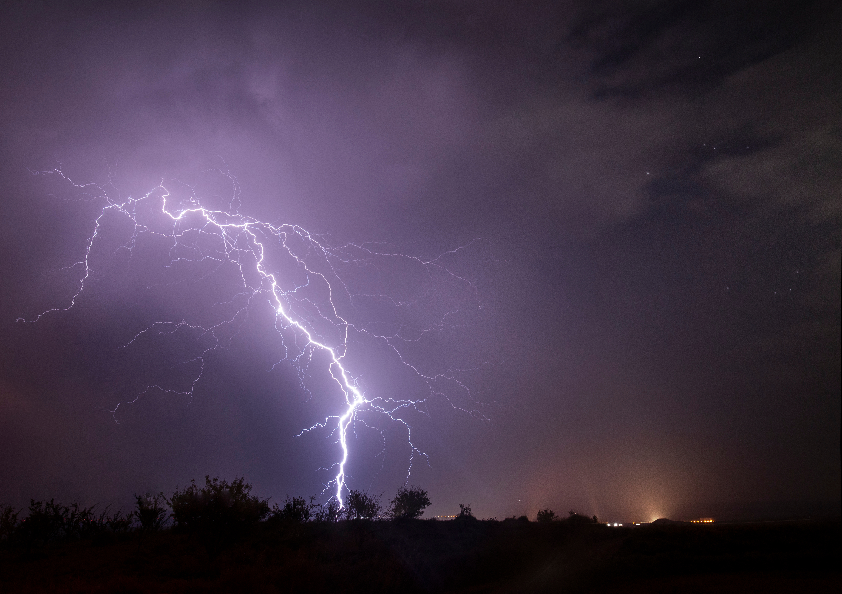
Storm sound picture
Arrange the images to compose your own storm sound picture.

