Slide 1
Module 1
Blogs

Slide 2
Learning intentions
Students will be able to understand what a blog is
and why people write blogs.
01
Students will be able to recognise the rules for
writing a blog.
02
Students will research different blogs to help them understand their purpose and write their own blogs.
03
Students will plan, draft and redraft
their own blogs.
04

Slide 3

Blogs
Blogs are found on the internet.
The word ‘blog’ is short for the term
‘web log’. Blogs are online journals.
A blog is usually written by one person and
has a series of entries about different topics.
Blogs are usually stored in chronological order
and people can comment on their entries.
Blogs are usually subject-specific – make-up, electronics, sports, animal rights, etc.
Blogs are a very popular way to express
viewpoints and are regularly updated.

Slide 4

Why do people blog?
Personal
To share information
To give a viewpoint
To publicise an issue in society
To demand action for change
Professional
To share information on a new product
News outlets blog information
Advertising

Slide 5
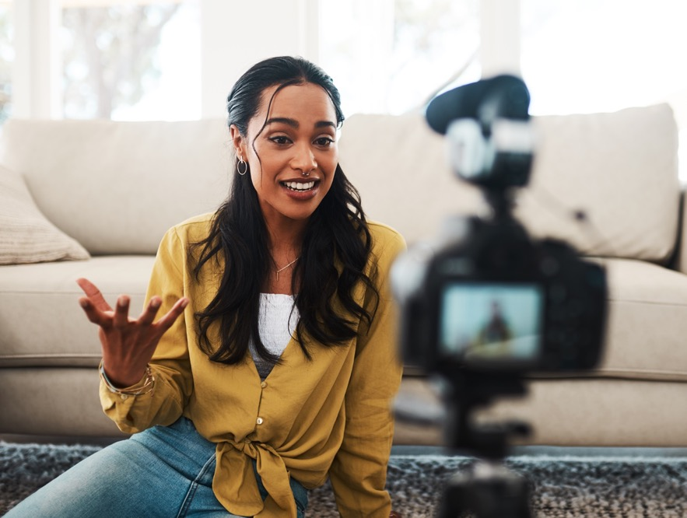
Blogs
Blogs are multimodal, which can make them more interesting than a diary or letter.
Multimodal means that there can be
more to them than just writing.
Multimodal elements can include:
Photos
Videos
Podcasts
Hyperlinks to websites/petitions
A comments section

Slide 6

Steps to consider
when writing a blog…

Slide 7

1. Brainstorming ideas
When someone wants to plan a blog,
they must consider the different ideas they would like to research and write about.
The topics of interest should be something that will grip readers’ attention as well as being of personal interest to the blogger.
If you choose a topic you are interested in,
it will mean that you are more likely to continue a blog and make multiple entries.

Slide 8
Education
Travel
Current affairs
Food
Sport
Blog Brainstorming Ideas
Health
Genre
of film
Electronics
Genre of books
Genre of TV programmes
Skincare
Celebrity gossip

Slide 9

2. Define your audience
When you have decided your topic of interest,
you must consider who you are going to write for.
It is obvious if you have a specific topic, such as baking, that you will write a blog for people who
also enjoy baking.
Do some research for your audience. Look at blogs
in your chosen topic of interest and see who they
are writing for. Is it a particular age group? Gender?
This will help you consider the language you use
in your blog.

Slide 10

3. Planning your blog entry
When you are ready to write a blog entry,
you must plan it out to ensure it is interesting,
informative and engaging for the reader.
To do this, you should try some of the following:
Use emotive language
Have interesting facts/statistics about your topic
Make it relatable to the reader
Have a clear structure and good layout
Use rhetorical questions
Give your readers the option to make a difference

Slide 11

Sample plan for a travel blog
Frog legs
Escargot
Paris
Food
Eiffel Tower
Disneyland
Language
Shopping
Moulin Rouge
Film
City views
Music
Great photos
Expensive
Train from Paris
Champs-Élysées
Magical fireworks
Romantic
Fast spoken

Slide 12

4. Layout of blog
Write the name of the blog at the top of the page.
Write the title of the blog post below it.
Write the name of the author below this.
Put in the date beside the author’s name.
Then begin your blog entry.

Slide 13

Sample blog layout
Ciara’s Cakes Blog
Blog entry #27 – How to make 12 cupcakes with three ingredients
Ciara Smith 29 December 2022

Slide 14

Main body of the blog
Language used is usually informal.
If you are asked to write a blog about a personal event(s) in your life, write it in diary-style writing.
If you are asked to write a blog about a particular topic, write it
in the style of an article.
Write the blog in the first person.

Slide 15

Authentic blog writing
Make reference to previous blog entries:
You might remember my blog entitled ‘….’ where I spoke about…
Last week, I mentioned I would be writing about…
As you are all aware, I am passionate about ‘…’ and have been getting signatures for a petition to….
Please leave a comment below with your thought on this topic.

Slide 16




Blog practice questions
Choose an area of interest of yours and follow the steps that you have gone through in this presentation. Include an image that represents your interest.
Choose an issue in society that you would like to help change. You have a strong following of your blogs and want to ask your followers to support you in making
a change.
Write a blog about a book/film you have studied as part of your LCA course that you would recommend for all young people to read/watch.

