Slide 1
Module 1
Drafting and Proofreading

Slide 2
Learning intentions
Students will be able to understand the purpose of writing drafts to written pieces and
why it should become part of their English writing practice.
01
Students will identify
the importance of proofreading pieces and changing any spellings or punctuation to improve pieces of writing.
02
Students will engage in proofreading exercises to develop this skill.
03

Slide 3
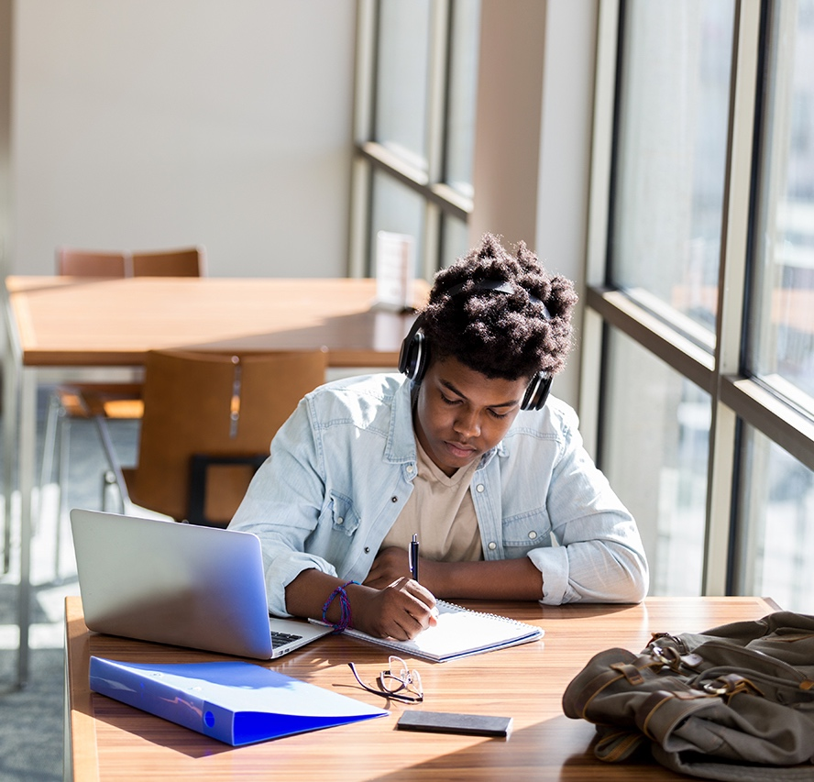
Drafting
What does drafting mean?
Drafting is a process where you write a piece, review it, get your teacher
to give you feedback, and use that feedback to write the letter again.
This process is used to make sure
you have the highest standard of writing that you are capable of.
You will be doing this for a number
of functional writing pieces.

Slide 4
Proofreading
Proofreading checklist…
Are all your spellings correct?
Have you used a capital letter at the start of every sentence?
Have you used a question mark (?) if you have asked a question?
Have you used a full stop (.) at the end of every sentence?
Have you use a capital I when speaking about yourself?
Proofreading is the process of checking for any mistakes you have made in your writing.
This can be spelling, punctuation, grammar, or inaccurate sentence structure.
By reading over your work, you can spot mistakes before your teacher sees them.

Slide 5


Proofreading practice
You are to read the following and make a note of any mistakes that are in the piece:
i went to my frends house last night and we watched a film called ‘the Notebook.’ it is my favourite movie of all time It is a love story about a boy called Noah and a girl called Allie. It goes through their whole lives together and have a very sad ending. i was wondering if you had ever seen it before.

Slide 6
Proofreading practice
You are to read the following and make a note of any mistakes that are in the piece:
I work in the local tesco. I was working at the weekend and my new friend marian came in looking for me. she wanted to knew where the special offer aisle was because she had only moved into our local area. She is very kind and i think that she will became my best friend in the futue.

Slide 7
Proofreading practice
You are to read the following and make a note of any mistakes that are in the piece:
Srah loved going to the zoo because she found animals very interesting. Her favorite animal was the lion. she thought they were brave and there roars were so loud it was incredible. her dad brought her to the zoo at least once a month so she could learn more and get to her dram of becoming a zoo keeper.

Slide 8

Proofreading practice
i went to my frends house last night and we watched a film called ‘the Notebook.’ it is my favourite movie of all time. It is a love story about a boy called Noah and
a girl called allie. It goes through their whole lives together and have a very
sad ending. i was wondering if you
had ever seen it before.

Slide 9
Proofreading practice
I work in the local tesco. I was working at the weekend and my new friend marian came in looking for me. she wanted to knew where the special offer aisle was because she had only moved into our local area.
She is very kind and i think that she will became my best friend in the future.

Slide 10
Proofreading practice
Sarah loved going to the zoo because she found animals very interesting.
Her favourite animal was the lion. she thought they were brave and their roars were so loud it was incredible. Her Dad brought her to the zoo at least once a month so she could learn more and get to her dream of becoming a zoo keeper.

