Slide 1
Module 1
Visual Literacy Skills

Slide 2
Learning intentions
Students will be able to identify the different visual literacy skills.
01
Students will be able to use these skills with sample images to develop their visual literacy skills.
02

Slide 3
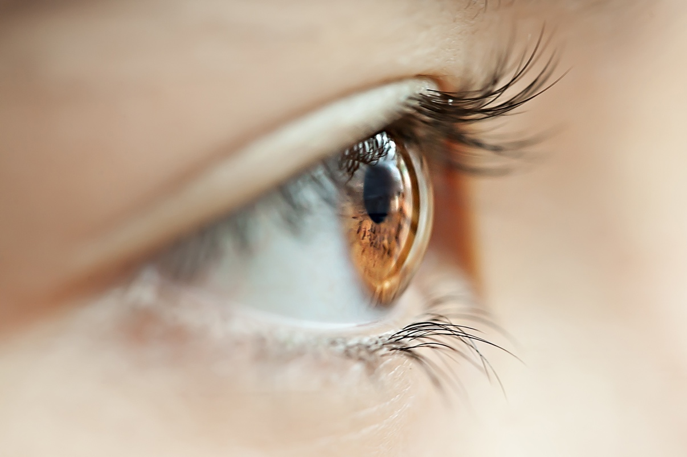
Visual literacy skills
Visual literacy is the ability to interpret, and make meaning from information presented in the form of an image.
Visual literacy is also the ability to create information presented in the form of an image.
Today’s society is highly visual, and we can be very informed by images. New digital technologies have made it possible for almost anyone to create and share visual media.
Individuals must develop these essential skills in order to understand and participate responsibly in the visual world we live in.

Slide 4
Visual world
Photos
Film
TV
Graphic novels
Memes
GIFs
Comics
Posters
Videos
Logos
Explain how each of these are part of the visual world we live in today

Slide 5
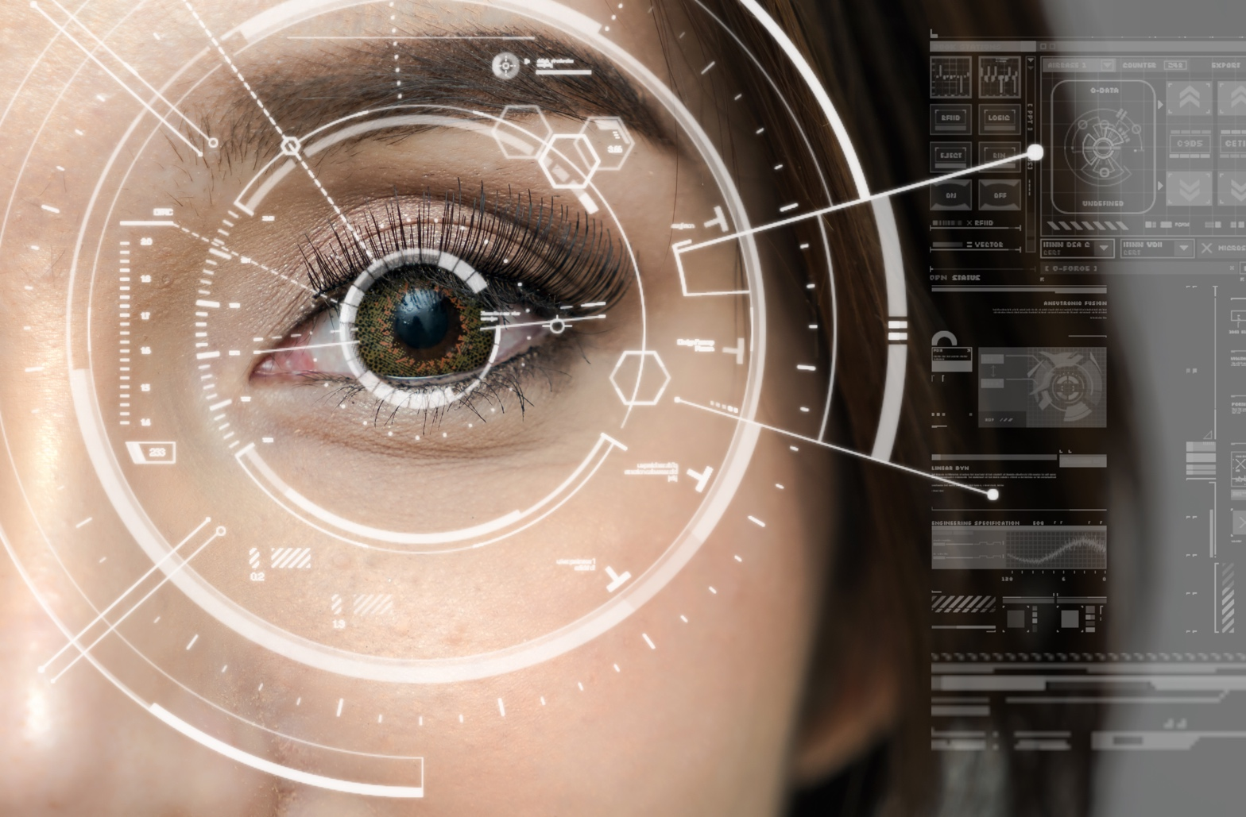
Why is visual literacy important?
Many information texts use visual elements.
Visual texts can help us understand the story more.
Visual literacy is a life skill.
Visual texts can help with planning answers.
Visual texts can communicate messages more clearly than written texts at times.

Slide 6
Analysing imagery
Things to consider | Explanation
Audience | Who is the image directed at? Why is the creator including elements to appeal to this group of people?
Purpose | Is the image being used to explain something? Is it being used to support an argument? Is it for entertainment?
Creator | Who created the image? What is their background?
Genre | What is the genre of the image? Does this influence the message? Why was this genre chosen for the image?

Slide 7
Analysing images – organisation and placement
Focal point. The viewer will be drawn toward a focal point by lines, shadows, and the way objects are arranged. What is the image’s focal point?
Background. Does the background compete with, complement, or highlight the foreground?
Balance and symmetry. Is there harmony between the elements of the image, or do they clash? What is the effect?
Perspective. Does the image suggest a point of view and, if so, is there any significance to this?

Slide 8
Analysing images – style
From the viewer’s perspective, you might ask what emotions or thoughts the image evokes. Does it appeal more to a sense of logic or to emotions?
In thinking about style from the perspective of the image’s creator, you might ask what attitude the image projects. For example, it is humorous, ironic, sarcastic, or serious?
Political cartoons often use exaggeration, caricature, and irony for humorous effect, but also to make a serious point.
Colour and typography (the type of font) may contribute to the image’s style or tone. Consider, for example, how fonts can have different effects, some seeming more serious and others more playful.
Similarly, colour can convey moods: highlighter yellow gives a much different impression than deep red.

Slide 9
Analysing images – content
What message, if any, does the image convey?
A graph can give results from a survey. | A photo can show a destination worth travelling to. | Symbols can give us a meaning – harp for Ireland. | An illustration might show the steps of a process. | A caption can explain the message of the image. | Colours can symbolise something – green for Ireland.

Slide 10
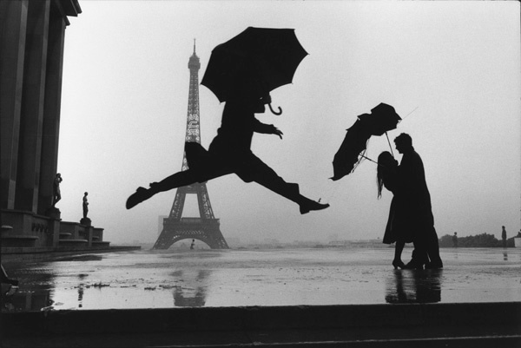
Analyse this image. Use the elements we have spoken about.

Slide 11
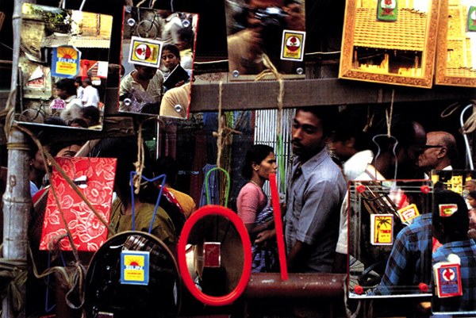
Analyse this image. Use the elements we have spoken about.

Slide 12
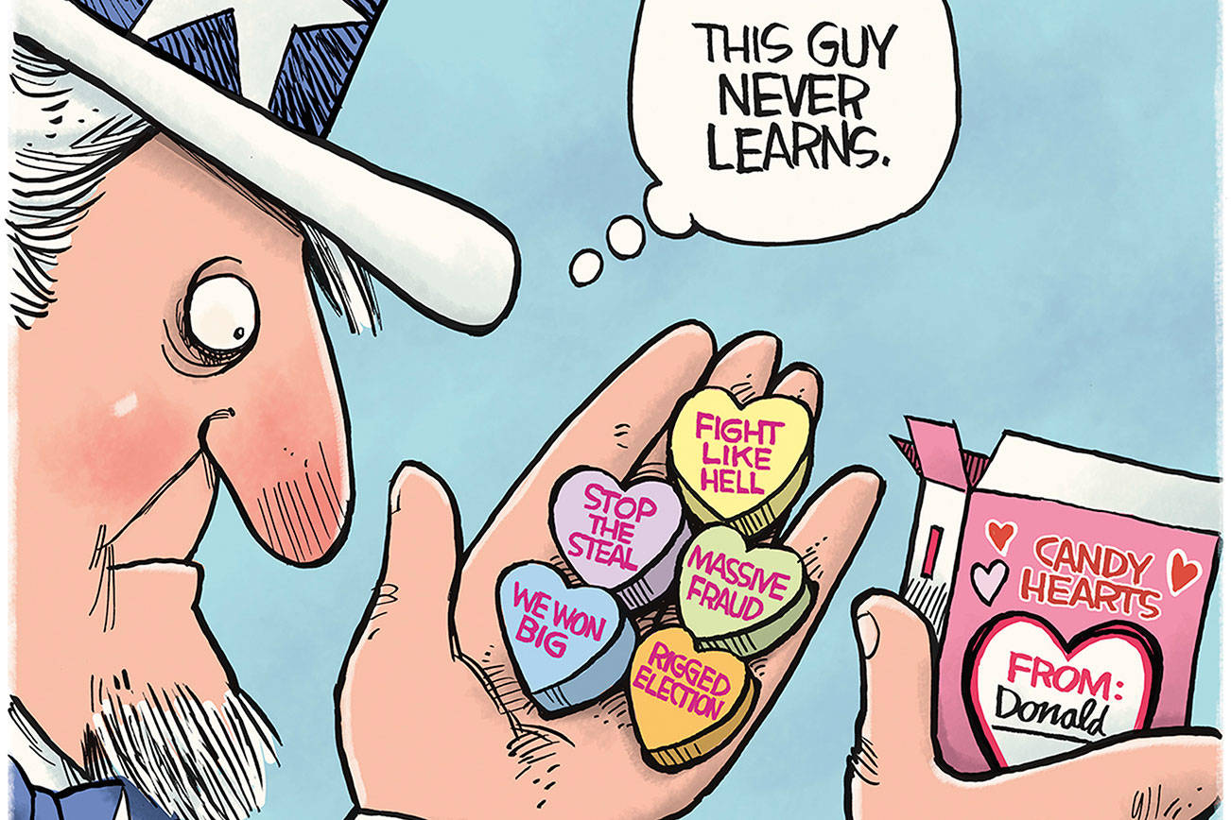
Analyse this image. Use the elements we have spoken about.

Slide 13
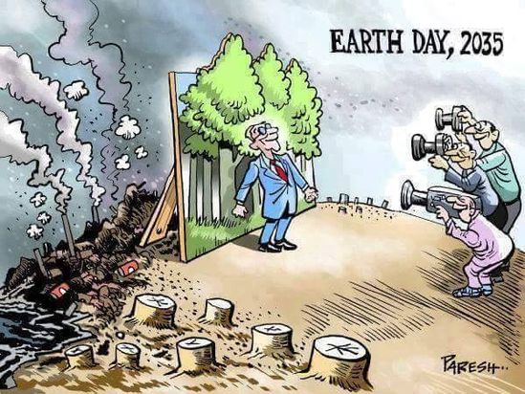
Analyse this image. Use the elements we have spoken about.

Slide 14
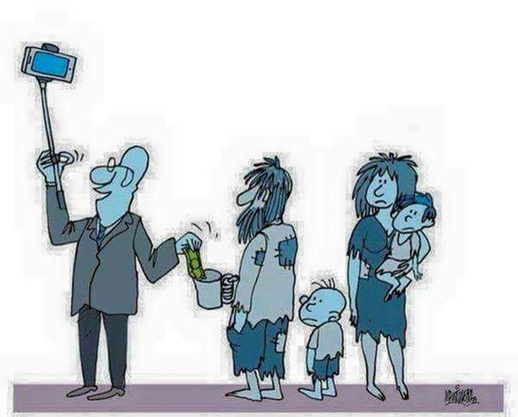
Analyse this image. Use the elements we have spoken about.

