Slide 1
Module 4: Unit 1
Dealing with Emotions

Slide 2
Learning intentions
Students will be able to express how they are feeling and understand these emotions.
1
Students will be able to understand the idea of emotional regulation.
2
Students will be
able to identify the physical reactions in the body to different feelings.
3
Students will be able to learn a variety of coping techniques and apply these in their lives.
4

Slide 3



Emotions
There is a huge number of emotions that we feel in response to everyday situations.
Our emotions are the feelings we experience.
These vary in strength and are categorised
under Sad, Happy, Angry and Nervous.

Slide 4
Emotions
Sad | Happy | Angry | Nervous
Unhappy | Content | Frustrated | Anxious
Upset | Excited | Furious | Scared
Lonely | Fulfilled | Agitated | Frightened
With your partner, think of any other ways you can say an emotion
under these headings. Write these down in your copy.

Slide 5

Reasons for emotions
There are lots of reasons we feel different ways about our own experiences.
Every day, we are faced with situations that
may cause us to be sad, happy, angry or scared. This is a normal part of being human.
Our emotions are personal to us. Everyone
reacts differently to situations. Things that
excite some people, terrify others. Some things that make people sad can make others happy.
Recognising our emotions and what influences them is very important.

Slide 6

Emotional situations
Here are some real-life examples of situations
where people’s emotions are impacted greatly.
Read each situation and decide what emotions
you believe the person is feeling.
Jane has just completed her university degree
and got the highest result in the class.
John’s best friend of 13 years has just moved
away to another country.
Sarah was minding her little brother when he dropped
her phone and cracked the screen.
Conor was walking home on his own and when he turned the corner, he saw a gang of eight boys at the end of the street.
Create your own situations and share these with the class for them to decide what emotion
you are putting forward.

Slide 7

Self-reflection
Think about what makes you feel:
Sad
Happy
Nervous
Angry
In your copies, write the reason you feel
the above.
You are to then think about what way you deal with these emotions when they happen.
Have a class discussion around this.

Slide 8
Year Head
Guidance Counsellor
Teacher
What support system do you have when you are dealing
with emotions?
Girlfriend
Boyfriend
Doctor
Family
Garda
Friends
Red – school-based support
Blue – personal life support
Black – community support
Local TD/Councillor

Slide 9
Physical dimensions
Think about the different emotions you feel and how they are felt physically by you.
Write these in your copy.
Here is an example: When someone feels angry, they can clench their fists.

Slide 10
Physical feelings
Happy | Sad | Angry | Nervous
Smiling | Frowning | Crossed eyebrows | Raised eyebrows
Laughter | Tears | Clenched jaw | Sweating
Pep in your step | Hanging shoulders | Grinding teeth | Butterflies
Cheeks raised | Avoiding eye contact | Tightness in chest | Shortness of breath
Louder voice | Head looking down | Increased heart rate | Nail biting
Eye contact |  | Raised temperature | Wringing hands

Slide 11
Role-play observations
You are to work in groups of three. Two people are to create a scenario where each person feels a different emotion. (One could be angry,
the other could be scared.)
These emotions must be acted out without any words being spoken.
This will be done through body language and physical reactions to emotions.
The third person is the observer. They must identify the physical reactions and what emotions they are.

Slide 12
Stress
Stress is a leading
factor in people’s emotions.
Stress is a part of
our everyday life –
it affects all types of people and all ages.
Stress can be detrimental to one person while for another, a good
amount of stress
can be motivating.

Slide 13
Stress in young people
Create a mind map like this in your copy.
What causes you to become stressed?

Slide 14
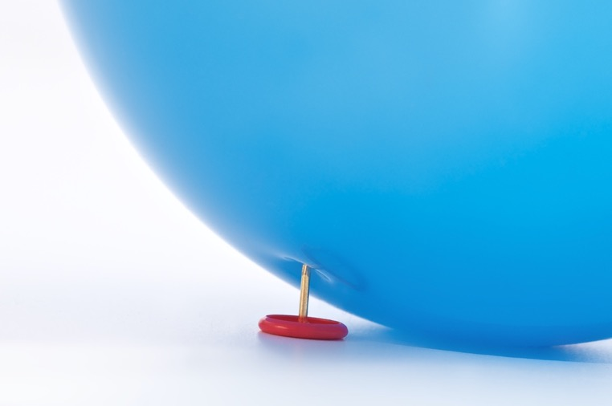
Concept – stress
Stress is a feeling we get when struggling
to cope with the pressures of life.
Most scientists agree that some stress is good
for us – it motivates us to perform at our best.
It stimulates our bodies to produce the important
hormones cortisol and adrenaline.
We need small amounts of these hormones to function
properly, but too much of them can damage our health.
A high-stress event can cause an imbalance of cortisol
and adrenaline, whether this event is real, imagined, physical or psychological.
So whether you have a fight with a friend or miss a bus, your body’s response is to release cortisol and adrenaline – heart is pounding, muscles tighten, blood pressure rises, breath quickens and senses are more alert.
Our bodies can become distressed if we continue to be stressed.

Slide 15
How do I manage my stress?
Eat
Eat a balanced diet – three meals a day, nutritious foods from a variety of food groups.
Exercise
Exercise every day.
Practise
Practise mindfulness.
Sleep
Sleep for 8-10 hours every night.

Slide 16
Resilient Zone
Being resilient is having the ability to manage the ups and downs of everyday life with
the skills and tools we have available to us.
Being resilient is not just surviving but thriving after difficult or challenging times.
Being resilient is being able
to bounce back after
tragedy and loss.
The Resilient Zone is when
our bodies and minds are in
a state of wellbeing so we
can manage our emotions
the best we can.

Slide 17
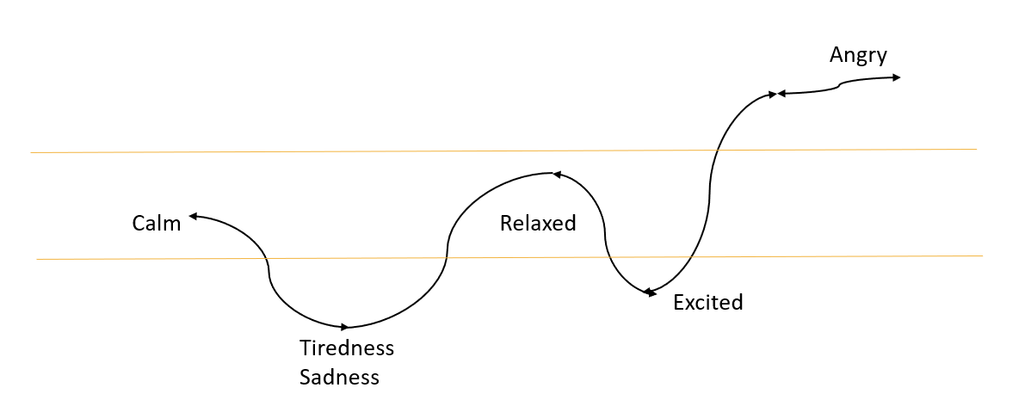
Resilient Zone
We can see within the zone, we are calm and rational.
We can see outside the zone, our emotions are heightened, which can
cause us a different reaction to situations.

Slide 18
How can we manage to stay in the Resilient Zone?
When we feel our emotions getting out of the Resilient Zone, this is normal.
However, there are some strategies that we can choose to regulate our
emotions and keep them within the zone as much as possible.
Some of these include: taking deep breaths, counting to ten, having a cup of tea, touching something close by to feel grounded, putting your feet on the floor to feel grounded, walking outside and getting some fresh air.

Slide 19
Making sense of emotion
Using our five senses can help us regulate our emotions, too. By focusing on our senses, it can bring us to a calm manner that can help us focus and make rational choices.
  Sight – Name five things you can see.
  Hear – Name four things you can hear.
  Touch – Name three things you can feel.
  Smell – Name two things you can smell.
  Taste – Name one thing you can taste in your mouth.
By focusing on these, it can distract you from your emotional distress and help you achieve a calmer state.

Slide 20
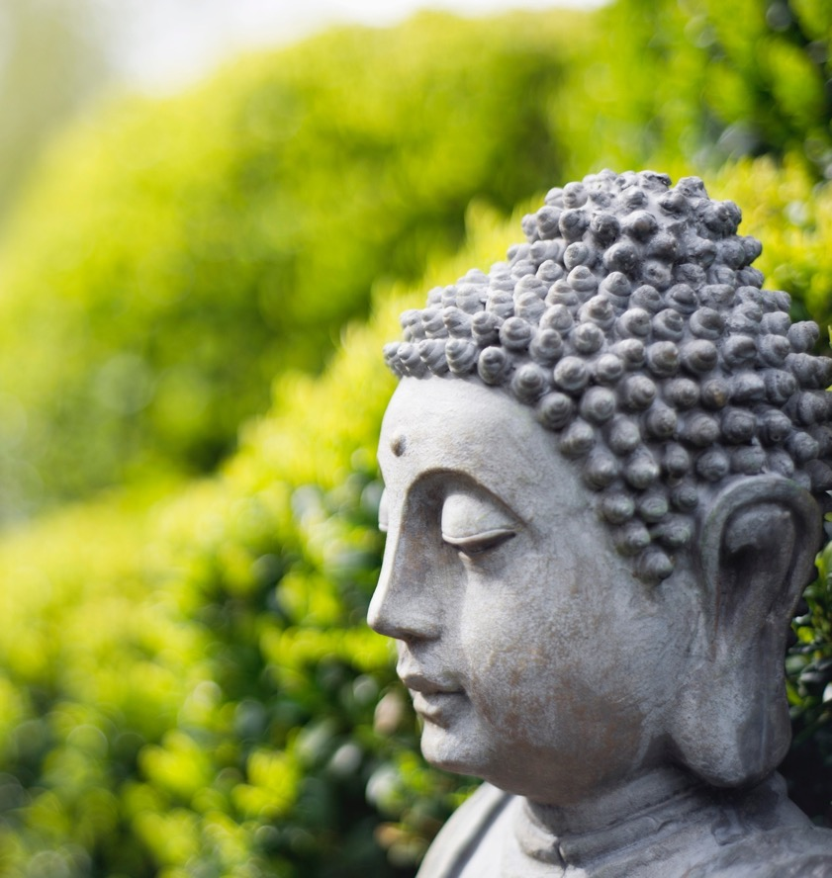
Mindfulness
This is a practice that originates from the teachings of the Buddha.
It involves being present in the moment and accepting your thoughts without judgement.
To accept our thoughts and let them rest, we can keep in a regulated emotional state, which means we are able to stay calm.
When we do not accept our thoughts,
it can cause us anxiety and worry.

Slide 21
Mindfulness meditation practice
Find a quiet place
Sit with your feet on the ground and hands on your lap.
Notice your breath and recognise
the rhythm
Close your eyes
Follow guided meditation on Headspace/
YouTube
Relax any part
of your body that has tension

Slide 22
Mindfulness colouring practice
This is a relaxing activity that can help focus the mind and help you be more present.
You should try this
when you have some
free time… even outdoors in the fresh air – nature can be
very calming.

Slide 23

Body scan – mindfulness
Completing a body scan can also help you manage your emotions.
Starting from the soles of your feet and working upward to
your head, check how each part of your body is feeling.
You can accept that ‘oh my feet feel sore from walking’,
‘my left knee feels tight’, ‘my lower back feels loose’,
‘my shoulders feel relaxed’.
Again, doing a body scan can keep us focused and help
us regulate our emotions. You can do this anywhere.

