Slide 1
Module 5: Unit 4
Active Citizenship – Voting

Slide 2
Learning intentions
Students will be able to understand the importance of elections.
1
Students will be
able to identify
the steps of proportional representation.
2
Students will be able to comment on how elections address contemporary issues at the time of
the election.
3
Students will be able to recognise the function of a politician’s clinic.
4

Slide 3

What is a vote?
Voting is a process whereby each member of a group of individuals are given the opportunity to make a choice based on their personal opinion.
It allows those with differing opinions to come together fairly and ultimately, the most popular opinion wins.
Voting is also the core fundamental concept underlying democracy.
Democracy is a system of government where the people vote who they want to represent them. It is a fair system.

Slide 4
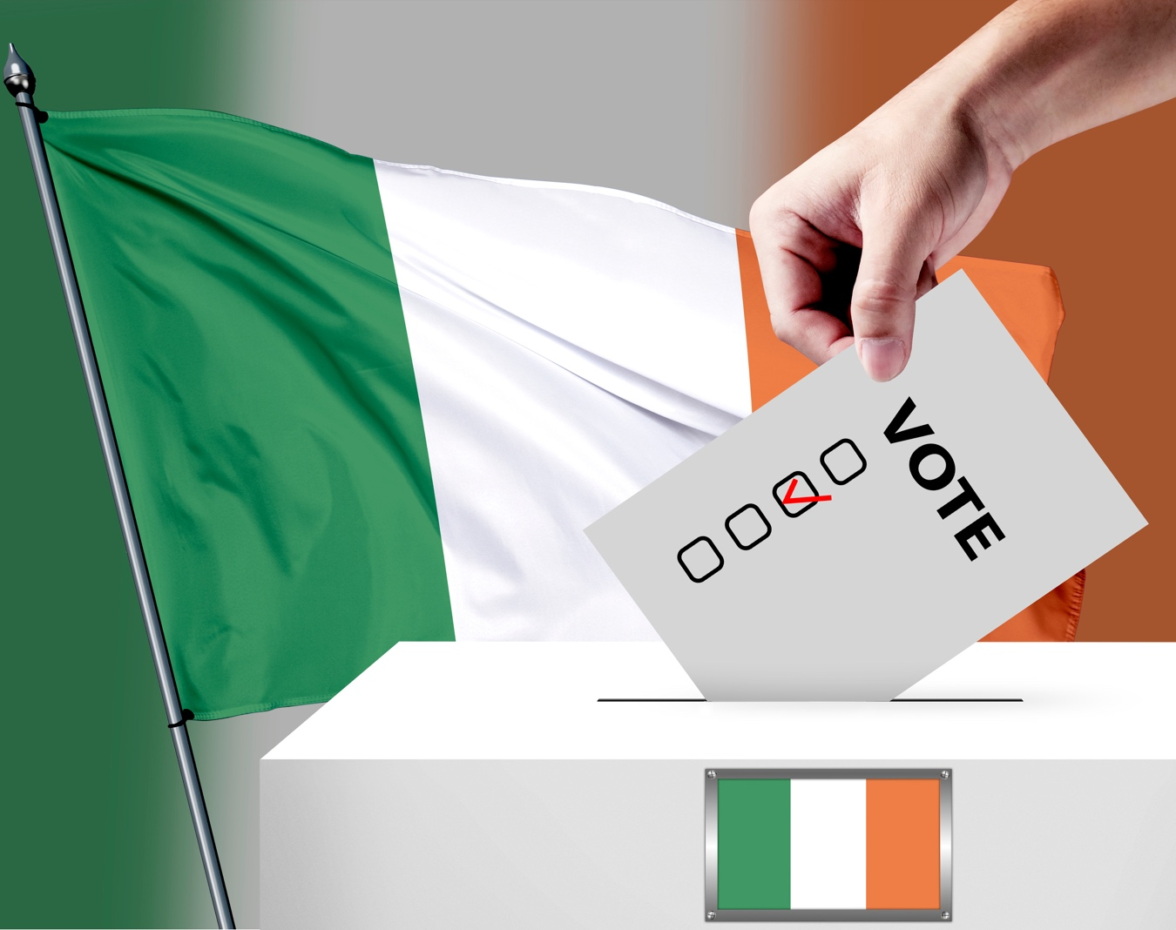
Rules for voting in Ireland
In general, there are two instances in which people would vote in Ireland:
Electoral voting
In a referendum
The three conditions for voting in Ireland:
You must be over 18 years old
You must be a resident of Ireland
You must be registered to vote

Slide 5
How to register to vote
From 1 November, ask to see the Register of Electors at your local post office, garda station, library or city or county council offices – to see if your name is on the Register.
All residents of the Republic of Ireland, regardless of nationality or citizenship, can register; you must be at least 18 years of age on 15 February, the day the Register comes into force.
Got to Vote.ie and register.
The register comes into effect from February the following year.

Slide 6
Voting in a general election
Voting is the foundation to the democratic process and despite its critics, democracy remains the most fair form of government in the world.
This typically makes the change of power between governments in democratic countries peaceful, as everyone must respect the decision which is most popular by voters.
What makes democracy so popular as a form of government is that opportunity for power change from one party to another happens every few years.
General elections are carried out typically every four to seven years, depending on the country.
For example, the general election in Ireland is carried out every five years, whereas the US general election is every four years. However, it is important to note there can be exceptions
in emergency circumstances, like the sudden collapse of a government, which could result in the calling of a general election.

Slide 7
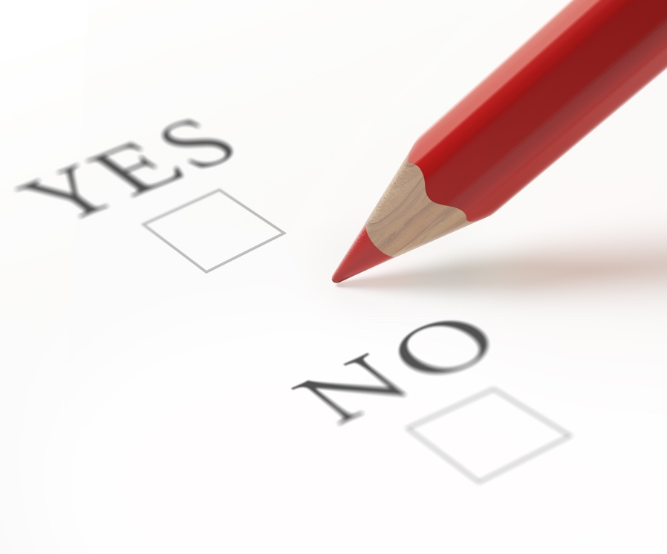
Voting in referendums
Referendums are another way in which the public vote in Ireland.
Instead of candidates on the ballot paper, the voters are asked
a choice typically either with a yes or no answer on a particular
political or social issue.
Referendums are held in order to change or keep part
of the Constitution (the laws of the country).
The Irish government cannot amend the Constitution
without the consent of the Irish public.
In order to change the Constitution, it must …
Be passed as a Bill through the Dáil and the Seanad.
Ministers decide a polling day for the public to make their decision
as to whether an article of the Constitution is to be changed or kept.
The referendum is held and the majority (yes or no) is accepted.

Slide 8
Voting in school
Write down ways you could develop a fair system of voting in your school.
How would this make your school more democratic?
Do you think having student voice in decision making is important?

Slide 9
Some examples could include
Student Council elections
Class rep elections
Changes in policies – student referendum
Head Boy/Girl elections
Class decisions (tutor based) referendum

Slide 10

Different systems of voting
The electoral voting systems take on many forms and different categories depending
on the country.
The following are examples of electoral voting systems still in use around the world:
  Plurality System (US and UK)
  Majoritarian System (Australia and Japan)
  Proportional System (Ireland and Spain)
  Mixed System (Germany and New Zealand)

Slide 11
Ireland and proportional representation by single transferable vote (PR-STV)
Ireland uses the proportional system of voting, better known as proportional representation by single transferable vote (PR-STV) .
Ireland has had this voting system since 1922 and this can only be changed by
means of referendum.
It works by order of preference. On the ballot paper, there may be many candidates. With PR-STV, the voter is asked to rank them in order of preference starting with their most desired candidate with the number 1.
The voter then may wish to number the candidates from most favourable to least favourable, 1 being the best option, 2 being your second-best option, and so on.

Slide 12
PR-STV in Ireland
If the voter does wish to only vote for one candidate, then the voter forfeits their single transferable vote.
This is because PR-STV works in a way that if the voter’s first choice gets eliminated
or gets a surplus of votes guaranteeing the candidate’s seat, then the voter’s vote
will automatically go to their second choice on the ballot paper.
PR-STV is essentially a way to ensure that the voter can guarantee that their
vote would in some way be used, not wasted, although not necessarily for their
first-choice candidate.
PR-STV is not just used in general elections, but also in local elections, European elections and Presidential elections.

Slide 13
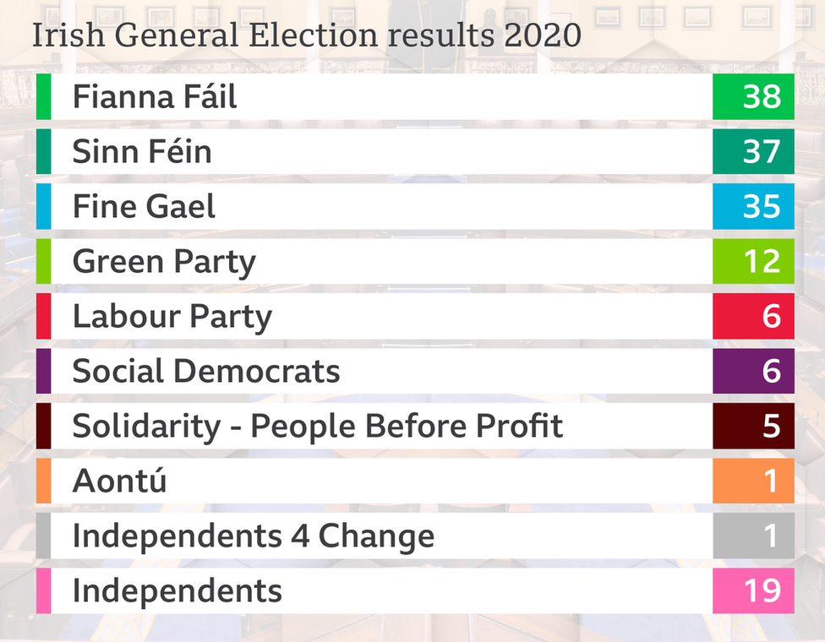
Parties of Ireland
Ireland has a multi-party system in place, with each party shifting in popularity in every election.
However, the two major parties in Ireland are traditionally Fianna Fáil and Fine Gael.
This was changed in the 2020 election, when the historically opposition party Sinn Féin gained in popularity and won the second highest number of seats.

Slide 14



Task
Why voting matters
Decisions voters make
Create a mind map about voting.
Use these questions to help you complete this.
Voting
Who can vote
When,
where, how

Slide 15

Politician’s clinic
A politician’s clinic, like a doctor’s clinic, is where the public can arrange to have consultations
with their local TDs.
The purpose of a politician’s clinic is so the TD can meet with their local constituents and talk about local issues or larger issues relating to the party or government.

Slide 16
Politician’s clinic – task
Find your local politician’s clinic and try to organise a visit.
Write down a series of questions you could ask the TD about their constituency and questions relating to their party.
Share these questions with the class.

