Slide 2
Curriculum Vitae
Module 1: Unit 2 – Job-seeking skills, page 48

Slide 3
Students should be able to:
Create a portfolio item
Know and understand a Curriculum Vitae
Create a Curriculum Vitae

Slide 4
Curriculum Vitae (CV)
Revise it
Revise skills
Follow portfolio tips on pages 208-09.
A CV is a summary of your education, skills and experience. The purpose of a CV is to help you get an interview for a job.
Although it has no specific correct layout or template, a CV will typically contain the applicant’s:
personal details
qualifications
qualities and skills
work experience
achievements and interests
referees

Slide 5
Curriculum Vitae
Personal details – name, address, email, telephone number (including area code), date of birth (day, month, year)
Skills/qualities – short statement stating skills and qualities, three of each, using more than one word, e.g. ‘excellent interpersonal skills’
Education/qualifications – names of schools and years attended, dates of exams, subjects, levels and grades (Link Modules, not LCVP)
Work experience – give the most recent first; give dates, name and address of employer/company and job description/duties undertaken
Hobbies, interests and achievements – list hobbies/interests that demonstrate skills or abilities to an employer. Achievements may be school- related/personal/sporting achievements. At least one of each is required
Referees – two are required, include title (Mr/Ms/Dr, etc.), full name, job title (exact position, not ‘owner’), addresses and telephone numbers (including area codes)

Slide 6
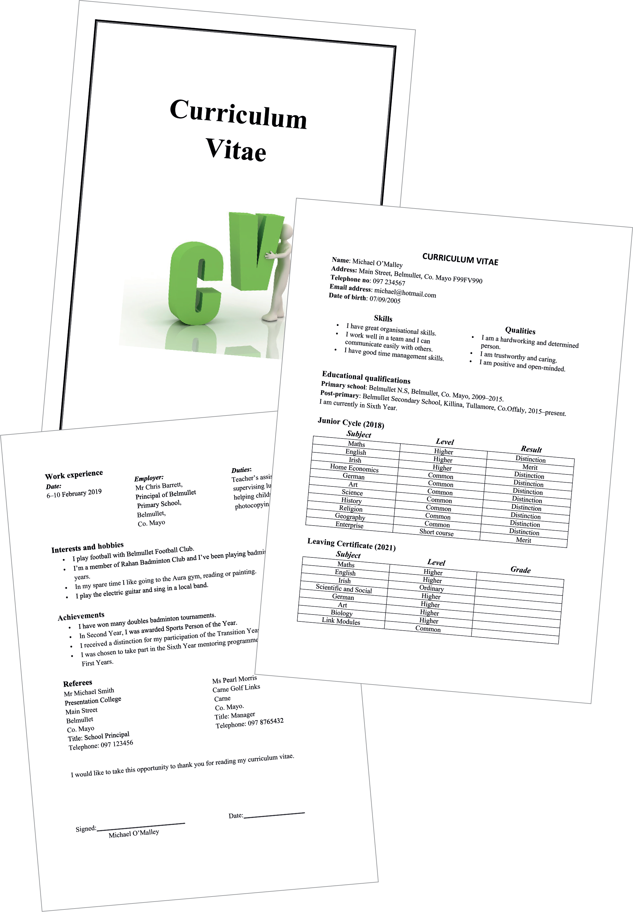
LCVP – Curriculum Vitae
Do it!
Always insert a cover page before each portfolio item.
Cover page – Curriculum Vitae

Slide 7
Curriculum Vitae – tips
Do it!
Always sign your Curriculum Vitae with a black ballpoint pen.
Two pages maximum
Must be word-processed
Correct:
Spelling
punctuation
grammar
font
tabs
headings
spacing
Signed and dated
Notes:
All portfolio items must be consistent:
Use one space after a full stop.
All headings should b. Presentation
2. Your own work
3. LCVP activities:
4. Presentation details.
5. Font:
6. Consistency
7. Contents page
8. Insert page:
9. Linking:
10. PEP
Headings set in bold and Times New Roman size 14. Use size 12 for the rest of
the text.
Use tabs to indent
Do not use any abbreviations.
Make sure your grammar is correct and there are no spelling mistakes.
Use bullet points and numbering consistently. If you use numbers (1, 2, 3) after a heading, you
must continue to use numbers after all headings. If you use bullet points, you must continue
to use them under every heading.

Slide 8
Curriculum Vitae – tips
Do it!
Work in pairs when completing the Checklist for Success Criteria.
Make sure you follow the guidelines.
Use the Curriculum Vitae template on page 62. Start with key words, then elaborate.
Follow the important guidelines on pages 60 and 61.
Word-process your CV, ensuring you use size 12 Times New Roman for main text and size 14 for headings. Check consistency, spacing, tabs, grammar and spelling.
Complete the Checklist for Success Criteria on page 63.

Slide 9
Curriculum Vitae – common errors
Presentation errors
Skills/qualities section missing
Year missing from educational qualifications
Information missing for referees
Dates/duties/full addresses missing from work experience
Email addresses – must be appropriate

Slide 10
LCVP – Curriculum Vitae
Check it!
Is your Curriculum Vitae perfect?

