Slide 2
Diary of Work Experience
Module 1: Unit 4 – Work Placement, page 94

Slide 3
Students should be able to:
Create a portfolio item
Participate in a work placement (work experience/work shadow)
Create a Diary of Work Experience

Slide 4
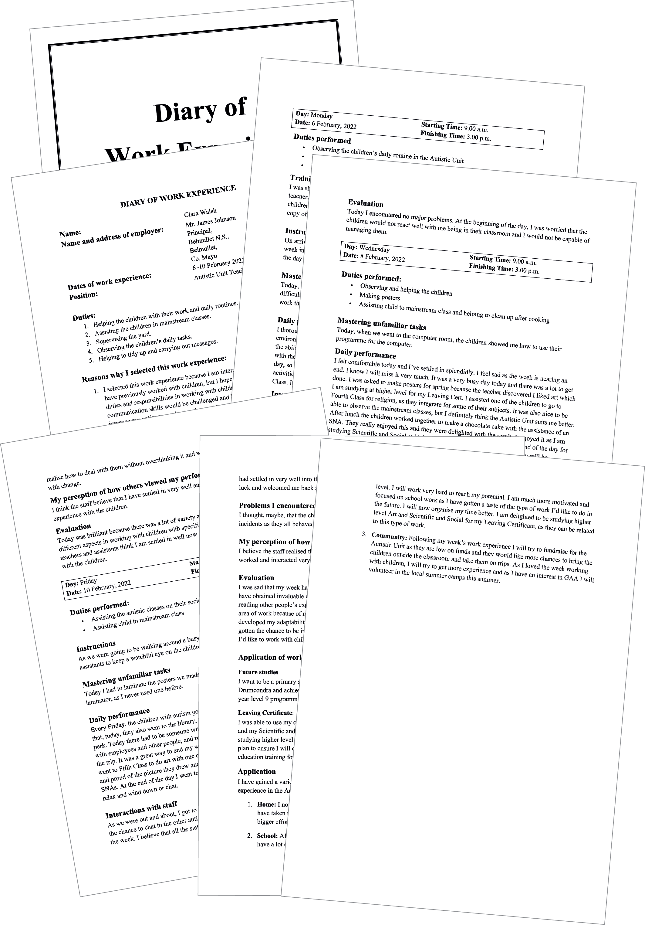
Diary of Work Experience

Slide 5
Diary of Work Experience
Know it
This will ensure you have plenty of content for your Diary of Work Experience.
Before your work placement, make sure you revise the following:
Planning
Evaluation
Communications
Teamwork
Marketing and advertising
Industrial relations
Leadership and management
Enterprise
The differences between school and work
Skills and how to apply them in the home, school and community
Legislation (Health and Safety, Equality and Employment of Young Persons Acts)

Slide 6
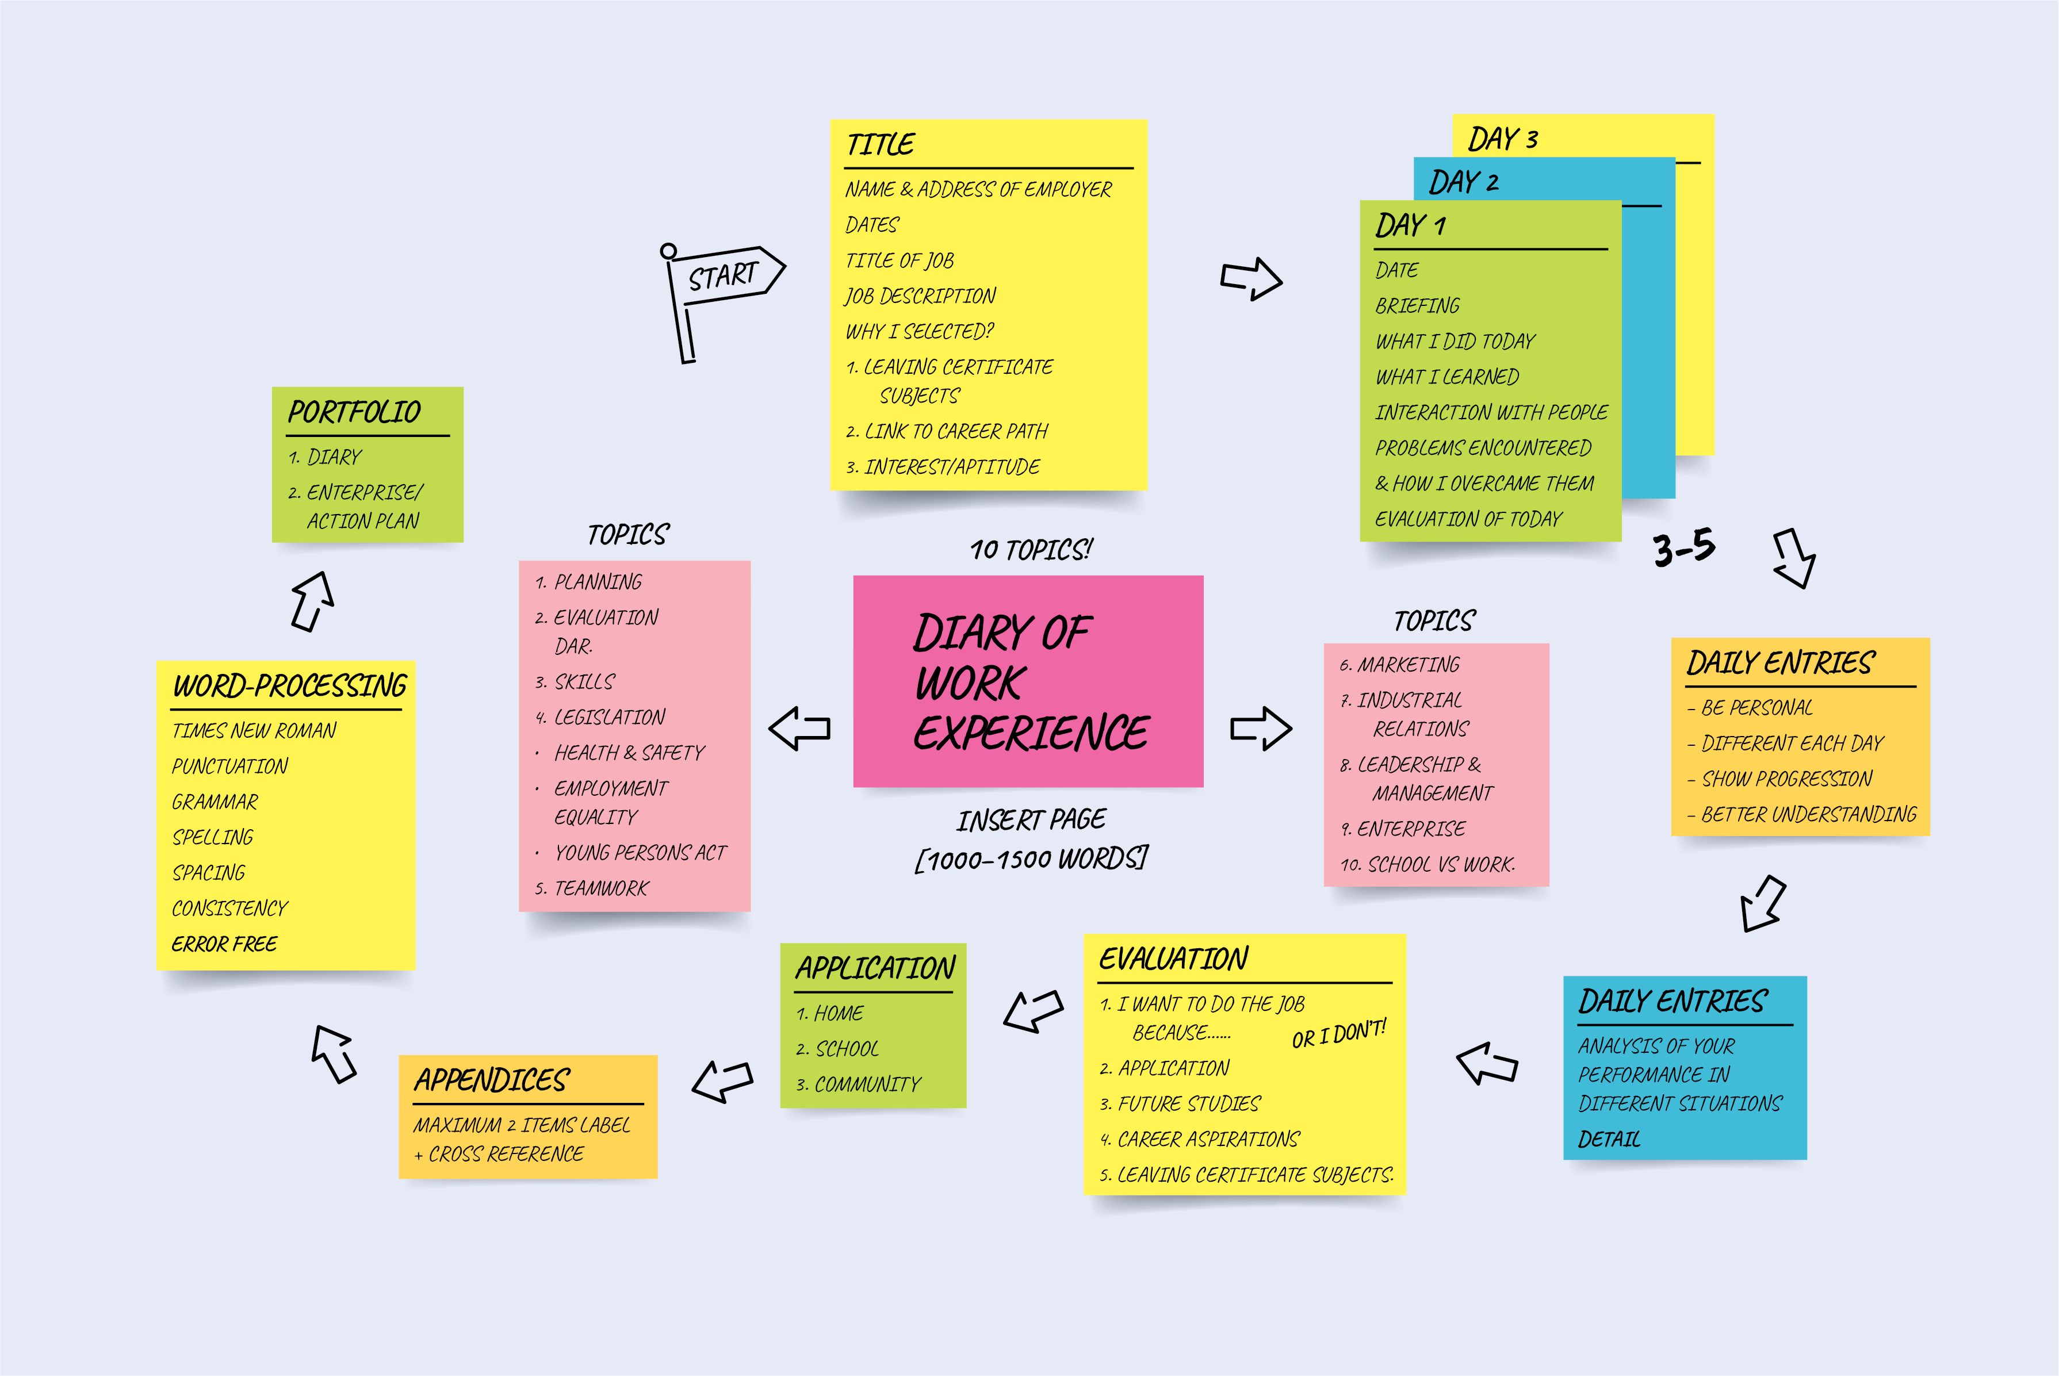
Diary of Work Experience

Slide 7
Diary of Work Experience Introductory page
Do it!
Follow the guidelines, p.105
Title
Author’s name
Dates of work placement, including year
Details of business/organisation, including full name, address and description of business
Description of duties carried out
Reasons for selection: must link with career plan, interests and aptitudes and Leaving Certificate subject(s)
Notes:
All portfolio items must be consistent:
Use one space after a full stop.
All headings should b. Presentation
2. Your own work
3. LCVP activities:
4. Presentation details.
5. Font:
6. Consistency
7. Contents page
8. Insert page:
9. Linking:
10. PEP
Headings set in bold and Times New Roman size 14. Use size 12 for the rest of
the text.
Use tabs to indent
Do not use any abbreviations.
Make sure your grammar is correct and there are no spelling mistakes.
Use bullet points and numbering consistently. If you use numbers (1, 2, 3) after a heading, you
must continue to use numbers after all headings. If you use bullet points, you must continue
to use them under every heading.

Slide 8
Diary of Work Experience Daily entries (three to five days)
One page per day, with date (including year), start and finishing time of work
Factual description of what was observed and experienced during the placement, e.g. duties, training, skills developed/gained, new knowledge acquired, legislation, SLOs
Analysis of own performance: how new tasks were mastered, how challenges were met, what was done well/not done well
If preparing a work shadowing report:
Day 1 – preparation
Day 2 – shadowing
Day 3 – debriefing/evaluation
Do it!
Follow the guidelines …

Slide 9
Diary of Work Experience Final page
Do it!
Follow the guidelines …
Evaluation of this experience in the light of future study and career aspirations
Application: how what was learned (either skill or knowledge) can be applied in the home, school and community
Appendices may be included (max. two) – employer’s report, letter of application/thank-you letter, copy of insurance, photo of workplace
Presentation/layout: spelling, grammar, spacing, punctuation, headings, font

Slide 10
Diary of Work Experience – common errors
Lack of detailed accounts of work placement
Candidates not giving enough reasons for choosing a particular work placement, e.g. links to Leaving Certificate subjects, career aspirations, interests and aptitudes
Poor analysis of own performance each day
Evaluation of work placement missing
Link to future studies (college name and course title) missing
Lack of application to home, school and community

Slide 11
Diary of Work Experience
Check it!
Is your Diary of Work Experience perfect?

