Slide 1
07 The Reformation

Slide 2
What You Will Learn
To understand the importance of the Protestant Reformation and Catholic Counter-Reformation, and why how we worship God was considered so important
Connection in Time
The early sixteenth century is known as the ‘early modern’ period. What else was happening in Europe and around the world at the same time?

Slide 3
Getting into Heaven
Consider the following ideas about getting into Heaven. Which do you find most and least attractive, and why?
Doing good things in your life
Belief in God
God has already chosen who is getting into Heaven – you have no control

Slide 4
Abuses in the Catholic Church before the Reformation
Abuse | What was it? | What was the effect?
Nepotism | Giving church offices to family members | It undermined the sanctity of church offices
Absenteeism | Parishes where there was no priest | Parishioners got no religious instruction
Pluralism | A priest holding more than one parish | Absenteeism
Simony | The sale of church offices | It allowed untrained, non-religious people to hold religious office

Slide 5
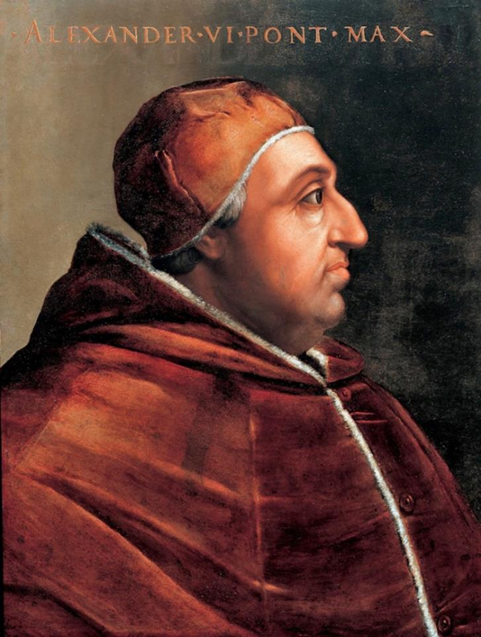
Hands on History
Go to page 99 of the textbook and examine the Hands on History task.
When you find the stories about Pope Alexander VI, divide them into what we know to be true, and what is questionable.
Pope Alexander VI

Slide 6
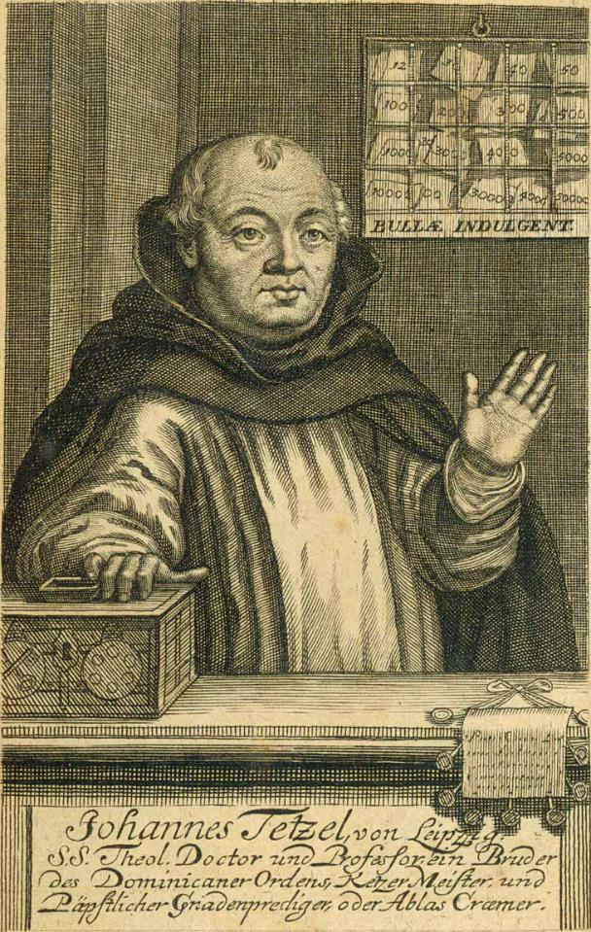
7.1 Indulgences
Read over pages 101 and 102 of the textbook.
Why did Luther find what Johann Tetzel was doing so objectionable?
List the reasons and rate them according to what you think was the most important.
The Dominican Friar Johann Tetzel is shown here selling indulgences.

Slide 7
7.2 The 95 Theses and Luther’s Argument
Why Luther was angry | What Luther’s argument was
He believed indulgences were swindling German people. | Indulgences did not save you, and the Pope should pay for Saint Peter’s.
He believed the Bible was the source of all religious authority. | The Pope did not control Purgatory.
He believed the Pope did not decide who got into Heaven. | Only faith got you into Heaven.
He believed Christians had their own relationship with God. | The Pope could not forgive sins.

Slide 8
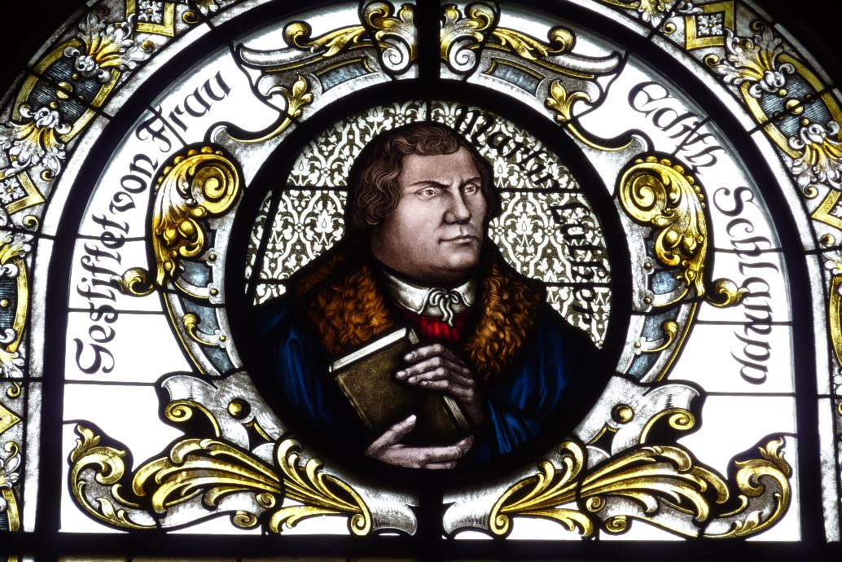
Why was Luther such an important figure in the Reformation?
Go to page 40 of the Skills Book and map out the important moments in Luther’s life.
A stained glass window depicting Martin Luther, Evangelical Church, Hockenheim, Germany

Slide 9
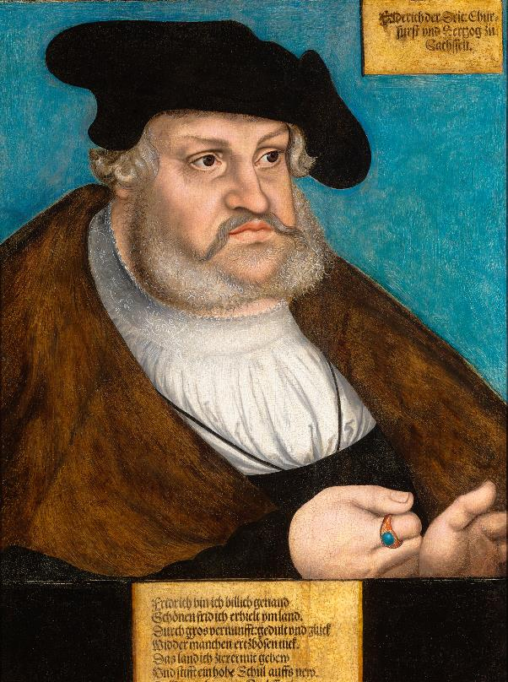
7.3 The Political Response to Luther
Martin Luther was a deeply religious man, but his protest had serious political consequences:
He was threatened with excommunication by the Pope.
He was called before the Imperial Diet of Worms to answer to the Emperor of Germany.
He was declared an outlaw.
He was protected by the Elector (Prince) Frederick of Saxony, who wanted to challenge the political power of the Pope and the Emperor.
Portrait of the Elector Frederick of Saxony by Lucas Cranach the Elder, c. 1530–1535

Slide 10
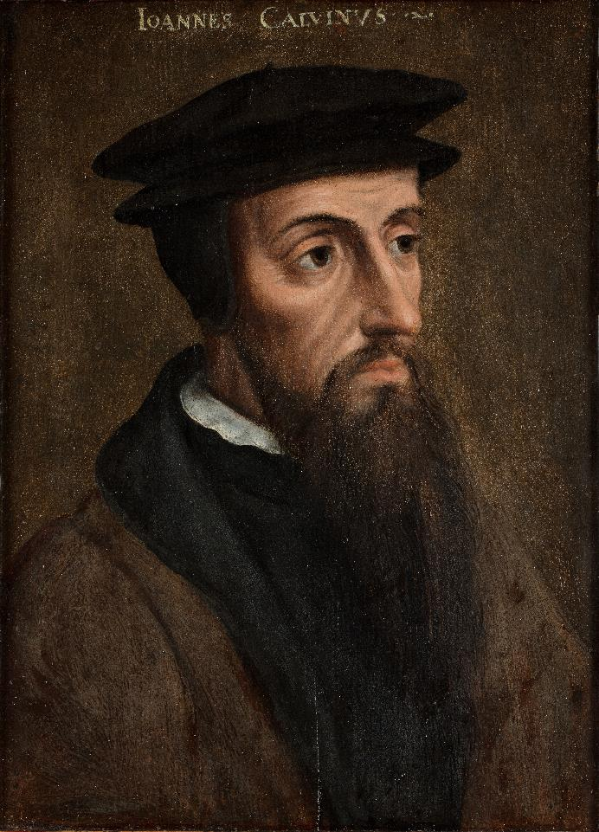
7.4 Other Reformers
The two most important reformers were Martin Luther (1483–1546) and John Calvin (1509–1564).
Examine pages 104–105 of the textbook and draft a Venn diagram showing where they agreed and where they didn’t.
French theologian and reformer John Calvin

Slide 11
Partial Reform in the Church: The Counter-Reformation
Reform
Nepotism, simony, pluralism, absenteeism banned
Bishops must stay in their diocese
Priest trained in seminaries
Indulgences remain but are no longer sold
No Reform
No change to the church liturgy
No translations of the Bible
Transubstantiation remains
Good works remain just as important as faith
No marriage for priests

Slide 12
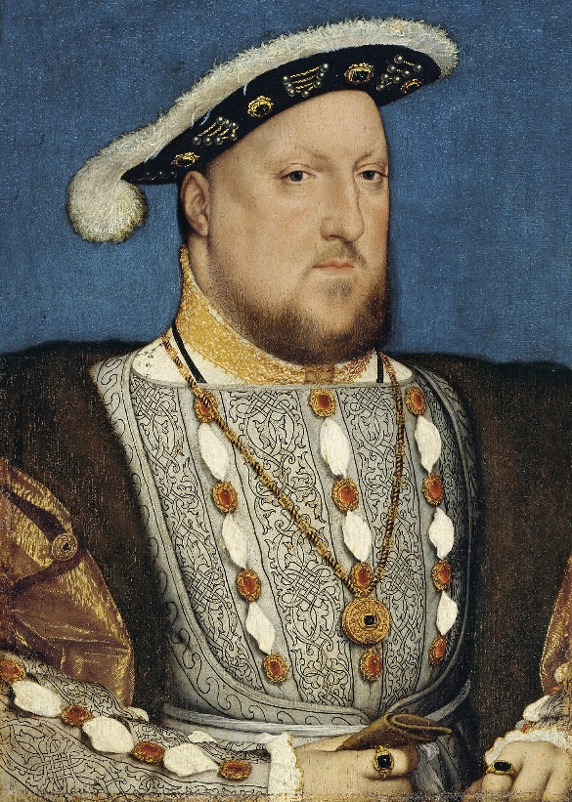
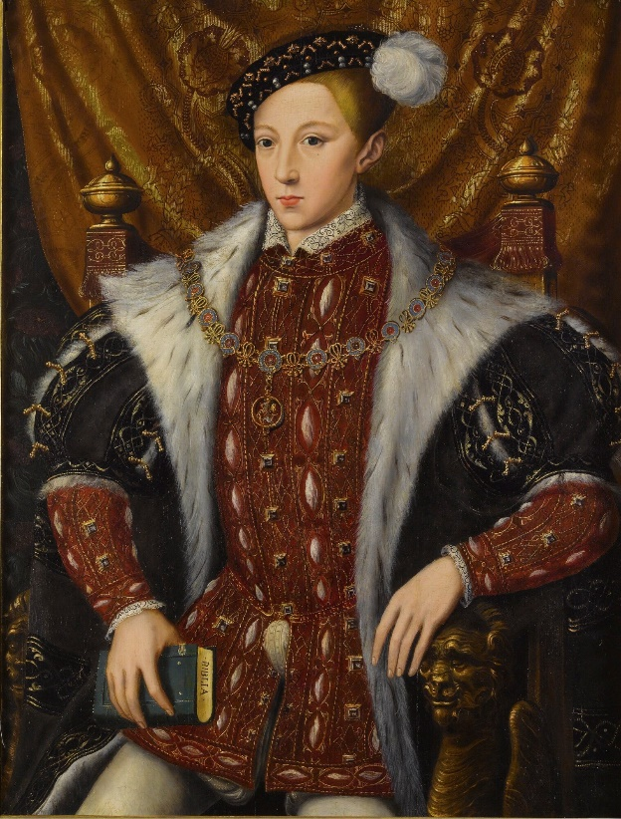
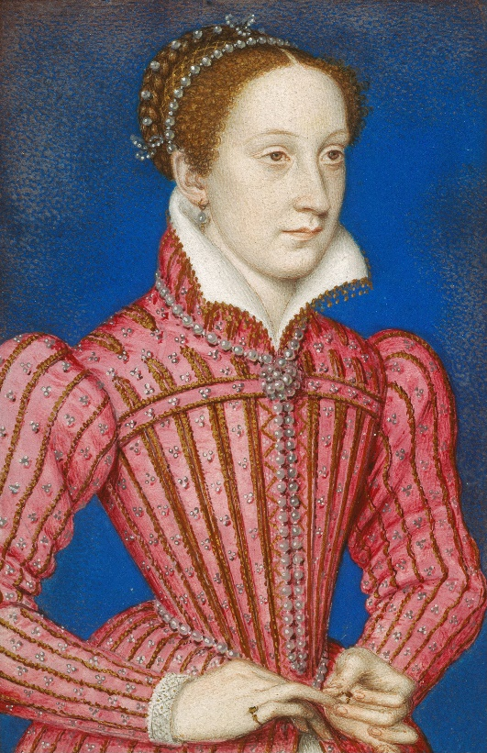
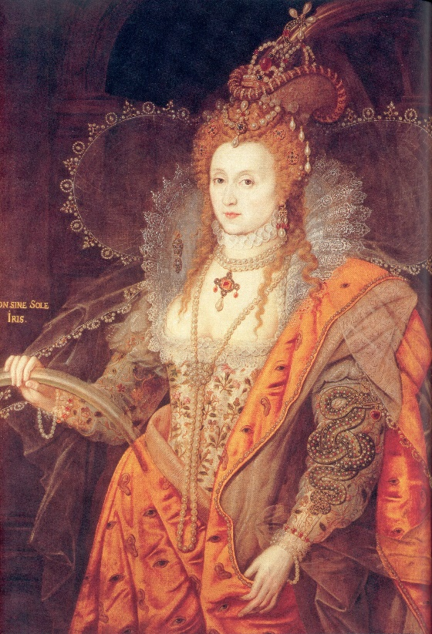
7.4 The Reformation in England
Read over page 107 of the textbook and assess how each of these English monarchs approached the Reformation.
Henry VIII
Edward VI
Mary
Elizabeth I

Slide 13
7.5 Religious Violence
The Reformation was marked by warfare and acts of violence.
People who disagreed with official religious doctrine could be burned at the stake in both Protestant and Catholic areas.
Religious wars had a devastating impact on Europe, with a third of Germany’s population dying in the Thirty Years’ War.
Read the accounts of religious violence on pages 108–110 and discuss how Christians could justify this level of violence.

Slide 14
Impact of the Reformation
Europe was divided between a mainly Protestant north and mainly Catholic south. Ireland, as a Catholic nation in north-western Europe, was isolated.
Europe was scarred by religious conflict throughout the sixteenth and seventeenth centuries.
Corrupt practices were ended in the Catholic church.
The Reformation encouraged literacy and printing throughout Europe.
Protestantism encouraged ideas of individual rights by challenging authority.

Slide 15
Reflect on Your Learning
What aspect of the Reformation do you think was most beneficial to Europe?
What Protestant idea do you find the most difficult for a modern person to understand?
What Catholic idea do you find the most difficult for a modern person to understand?
In what areas can we see the relationship between politics and the Reformation?
Do you understand and know all of the points in the Key Points for Revision for this chapter?

