Slide 1
08 Settlement and Plantation: The Ulster Plantation

Slide 2
What You Will Learn
To recognise how settlement and plantation has influenced identity on the island of Ireland by looking at the impact of the Ulster Plantation and the growth of plantation towns, such as Derry.
Connection in Time
Be aware of the ‘Bigger Picture’ of history and study the timeline for this chapter, on page 114 of your textbook. Have you heard of any of these key events? If you have, share your knowledge with your classmates!

Slide 3
Mise Éire – What does it mean to be Irish?
1 Firstly, discuss with your partner/class your own view of what ‘being Irish’ means. Then, look at this video.
2 What do you think the makers of this video believe about being Irish?
3 Which one of the figures from this video made the greatest impression on you?
4 In your opinion, is this an example of propaganda? Explain your answer.

Slide 4
8.1 Background: Settlement and Invasion Before the Ulster Plantation
Place these settlers in chronological order:
Anglo-Normans
Vikings
Early Christian monks
Hunter-Gatherers
Celts

Slide 5
Examples of Pre-Ulster Plantation Settlements
Viking towns
Norman towns
d
The Pale
Dublin
Wexford
Waterford
Carlingford
Arklow
Wicklow
Limerick
Drogheda
Carrickfergus
Athlone
Kilkenny
Mullingar
Youghal
Dundalk
Kells
Cashel
Tralee
Kinsale
Roscrea
Downpatrick
Ardee
Navan
Galway
Area around Dublin, protected by ditch and fortified settlements
Look at the map on p. 115 of your textbook. What do you notice about the location of the above settlements?

Slide 6
Previous Plantations
1 Laois–Offaly Plantation
Laois = King’s County; Offaly = Queen’s County
Begun in 1556 by Queen Mary I (Catholic)
The plantation was largely unsuccessful, as not enough planters travelled across to Ireland.
2 Munster Plantation
Begun in the 1580s by Queen Elizabeth I (Protestant)
It had mixed success in establishing English rule.

Slide 7
The Nine Years’ War (1593–1603) and the Flight of the Earls (1607)
Gaelic leaders in Ulster: Hugh O’Neill and Red Hugh O’Donnell
Begin rebellion against the Crown in 1693
Some victories for Irish: Clontibret (1595) and Yellow Ford (1598)
Battle of Kinsale (1601): Spanish force sent to support rebellion landed in Kinsale, in the winter. Ulster rebels faced long winter march to help Spanish. Defeat meant rebellion was a lost cause.
Flight of the Earls (1607) from Rathmullan, Co. Donegal, marks the end of Gaelic power in Ireland.
Why do you think the Spanish may have been willing to support the Catholic, Gaelic Irish rebellion in Ireland?

Slide 8
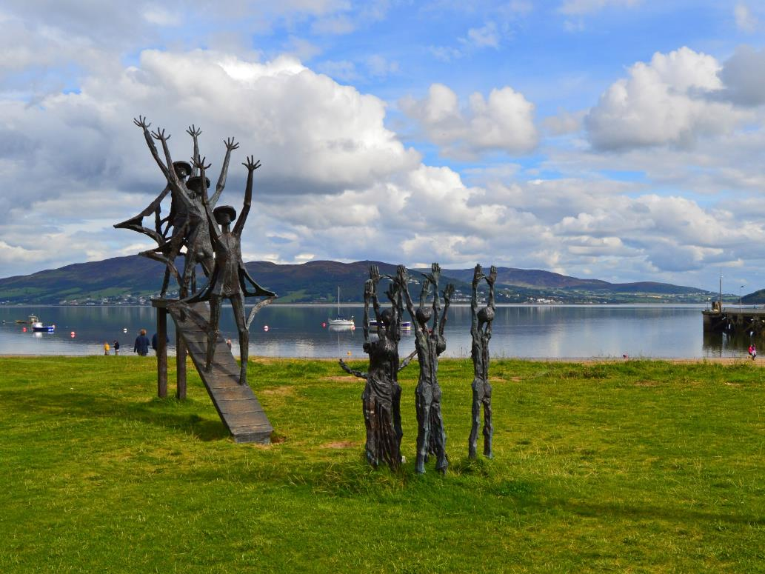
8.2 The Ulster Plantation: Why Did It Happen?
Go to page 45 of your Skills Book and complete the group-work task on the Causes of the Plantation.
Flight of the Earls commemorative sculpture by John Behan, Rathmullan, Co. Donegal. Photo © Philip McErlean (CC BY-ND 2.0)

Slide 9
Reasons for Plantation
James I wanted to create a loyal Protestant population in Ulster.
He needed to secure English rule in this rebellious part of Ireland in order to keep Britain safe from European invasions.
He needed to pay off soldiers who had fought for the crown, and granting them the lands of dispossessed Gaelic Irish allowed him to do this.
Can you think of any other reasons, having completed the group-work task on page 45 of your Skills Book?

Slide 10
Features of the Ulster Plantation
Plantation counties: Donegal, Derry, Tyrone, Armagh, Fermanagh and Cavan
Smaller, more manageable estates than previous plantations – up to 2,000 acres
Three types of planter: Undertakers, Servitors and Loyal Irish
Thousands of Scottish Presbyterians settled in Ulster
Catholic Church lands given to Anglican Church
Planters had to build bawns or bawns with fortified tower-houses, dependent on the size of their estate

Slide 11
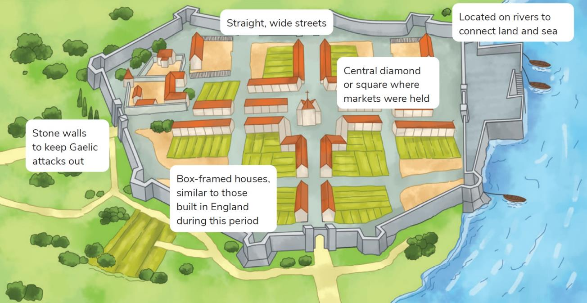
8.3 Settlements: Features of Plantation Towns
Planned towns
Located on rivers or on the coast
Straight, wide streets
Central diamond or square where markets were held
Defensive walls to repel Gaelic attacks
Box-framed, Tudor-style houses, similar to those in England

Slide 12
Maps
Cartography was very important during this time. Why do you think this is so?
Create your own map of a planned Plantation town, marking typical features.
Now go to page 48 of your Skills Book and complete the ‘Research and Reflect’ task on mapping.

Slide 13
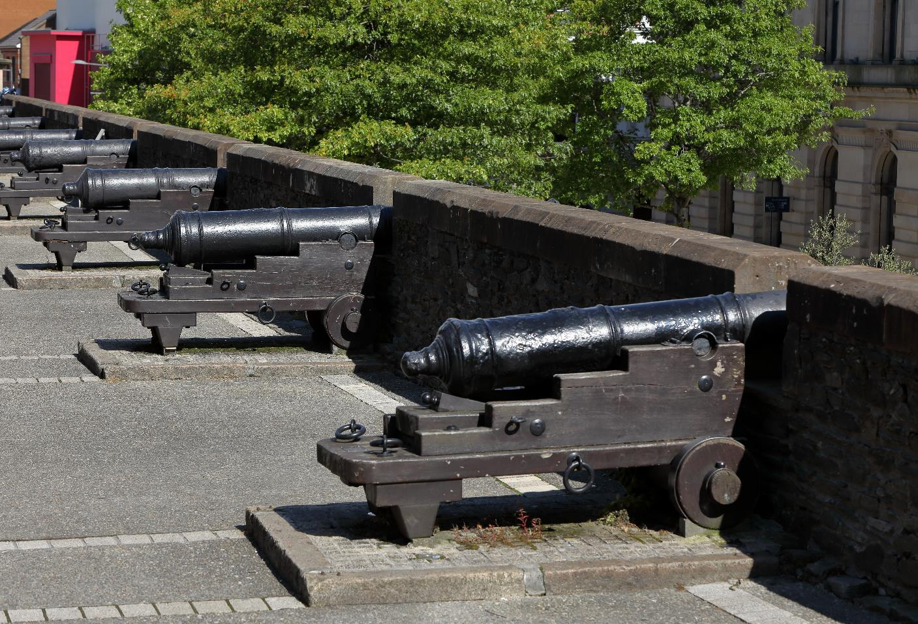
8.4 A Planned Settlement: Derry
What do you know about Derry?
Create a mind map, writing down everything you know about Derry.

Slide 14
History and Features of Derry, a Plantation Town
James I convinced 12 London guilds to invest in the city, in return for ownership of various parts of it.
As a result, Derry is now often referred to as Londonderry, particularly by Unionists.
Streets were laid out in a grid pattern.
Large defensive walls surrounded the city (and remain intact today).
The city was located on the River Foyle.
The Gaelic and Catholic population was forced outside the city walls, to the ‘Bogside’.
The city became a centre of business and economics, quickly becoming the most important urban settlement during the Plantation.

Slide 15
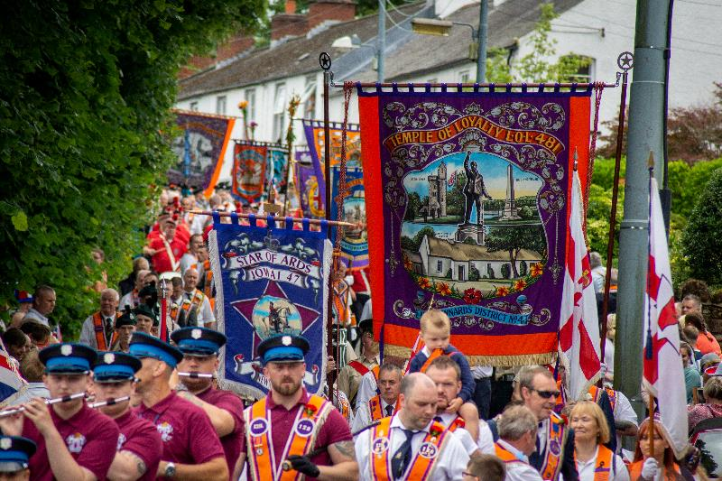
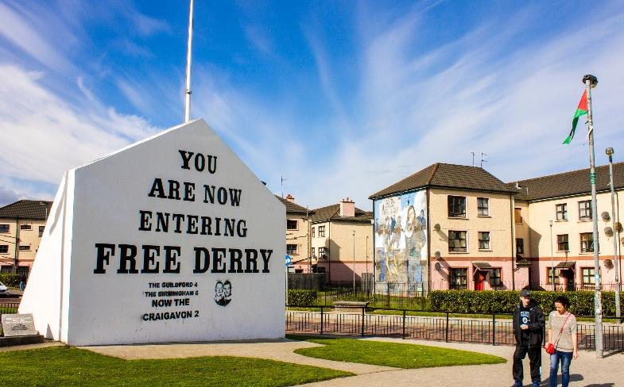
8.5 Impact of Ulster Plantation on Irish Identity
Before learning about the impact of the Ulster Plantation on identity, think historically and try to identify a number of lasting effects of the Ulster Plantation. You will have to think about the ‘bigger picture’ of history and what you know about Northern Ireland and Ireland today.
Read over the ‘Thinking Historically’ section of your textbook on page 122 and discuss your understanding of the importance of commemoration in Northern Ireland.

Slide 16
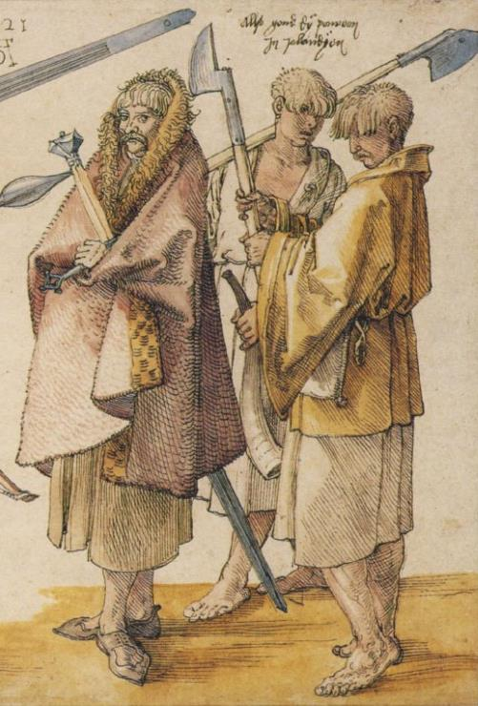
Impact of Ulster Plantation on life and identity
New methods of farming
Religion: Growth in Presbyterian and Anglican Protestantism in Ulster
Growth in urban centres as plantation towns develop and people move from countryside into towns
Brehon Law disappears, to be replaced by English Common Law
New customs develop, with Irish hairstyles disappearing and the tradition of Gaelic bardic poetry disappearing
Growth in English language and decline of Irish in Ulster
Long legacy of conflict in Ulster that continues to this day. Most recent conflict known as ‘The Troubles’ (see Chapter 22)
Gaelic customs were lost, such as the hairstyles and costumes shown in this engraving of Irish soldiers by Albrecht Dürer.

Slide 17
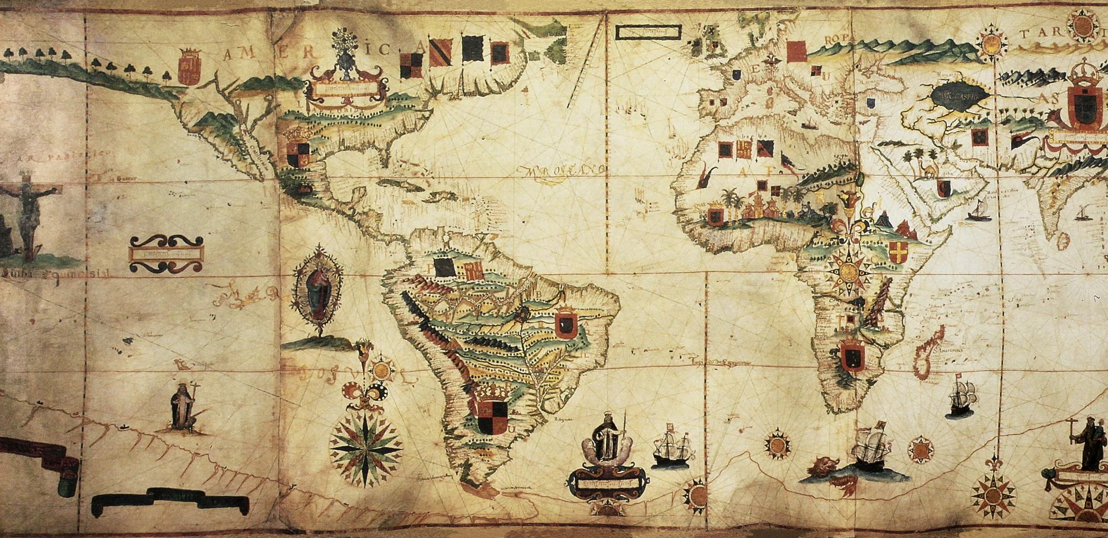
Think Historically
Go to page 122 of your textbook and complete the ‘Thinking Historically’ task by comparing the Ulster Plantation with other colonisations that occurred in the sixteenth and seventeenth centuries in other parts of the world.

Slide 18
Reflect on Your Learning
What was the most surprising thing you learned about the Ulster Plantation?
What was the most interesting thing you learned about the Ulster Plantation?
What have you learned in relation to ‘commemoration’ and the Ulster Plantation?
What area of the Ulster Plantation did you find particularly challenging, if any? Why did you find this challenging?
Do you understand and know all of the points in the Key Points for Revision for this chapter?

