Slide 2
Textiles
(Textiles in the home 2.1.6)

Slide 3
What you will learn
Use of textiles for clothing and household purposes
Selection criteria for textiles

Slide 4
Use of textiles
Textiles are fabrics or cloth used for:
Clothing purposes
Household purposes

Slide 5
Clothing
Functions of clothing:
Weather protection, e.g. _____________________________________.
Safety protection, e.g. _______________________________________.
Hygiene, e.g. _____________________________________.
Modesty, e.g. _____________________________________.
To impress, e.g. _____________________________________.
To identify, e.g. _____________________________________.
To express one’s personality, e.g. _____________________________________.

Slide 6
Household textiles
Household textiles are used for many products.
Give examples:
Carpets _____________________ _____________________
Cushions _____________________ _____________________
Blankets _____________________ _____________________
Towels _____________________ _____________________

Slide 7
Functions of household textiles
Warmth, e.g. _______________________________________
Comfort, e.g. _______________________________________
Protection, e.g. _______________________________________
Absorbency, e.g. _______________________________________
Decoration, e.g. _______________________________________

Slide 8
Selection criteria for textiles
Consider:
Suitability: _________________________________________
Cost: _____________________________________________
Aesthetic appeal/personal choice: ______________________
Ease of cleaning: ____________________________________
Safety – fire resistance: ______________________________

Slide 9
Properties of fabrics/textiles
Write a definition for property of a fabric:
____________________________________________________
____________________________________________________
List some of the properties/characteristics of textiles:
Absorbent _____________________ _____________________
Dry cleanable _____________________ _____________________
Shrinks _____________________ _____________________
Strong _____________________ _____________________

Slide 10
Recap
What are the functions of clothing?
Give four uses of textiles in household goods.
Outline the functions of household textiles.
What factors should be considered when choosing textiles?
List three properties of textiles.

Slide 11
Exam focus
See the question on page 289 of the textbook.
See the Exam and Assignment Journal, pages 136–138.

Slide 12
What you will learn
Textile care
Safety considerations in the selection of household textiles

Slide 13
Textile care
The method of caring for a fabric depends on:
The type of fibre used
The method of fabric construction
Any finishes that may be applied to the fabric

Slide 14
Types of fibres
Natural
Animal fibres, e.g. wool, silk
Plant fibres, e.g. cotton, linen
Man-made
Synthetic fibres developed in laboratories using oil, coal and chemicals, e.g. _______________, ______________
Regenerated fibres developed in laboratories using plant fibres and chemicals, e.g. ______________, _______________

Slide 15
Types of fibres
Blended fabric is made from a mixture of natural and man-made fibres, e.g. __________ and __________.
This procedure is carried out:
to _____________ and
to ______________________________________________________

Slide 16
Method of fabric construction
Woven, e.g. ________________________
Knitted, e.g. ________________________
Bonded (fibres bonded together using heat and adhesive), e.g. ________________________

Slide 17
Fabric finishes
Fill in some fabric finishes:
Crease resistant
________________________
________________________
________________________
________________________
________________________
________________________

Slide 18
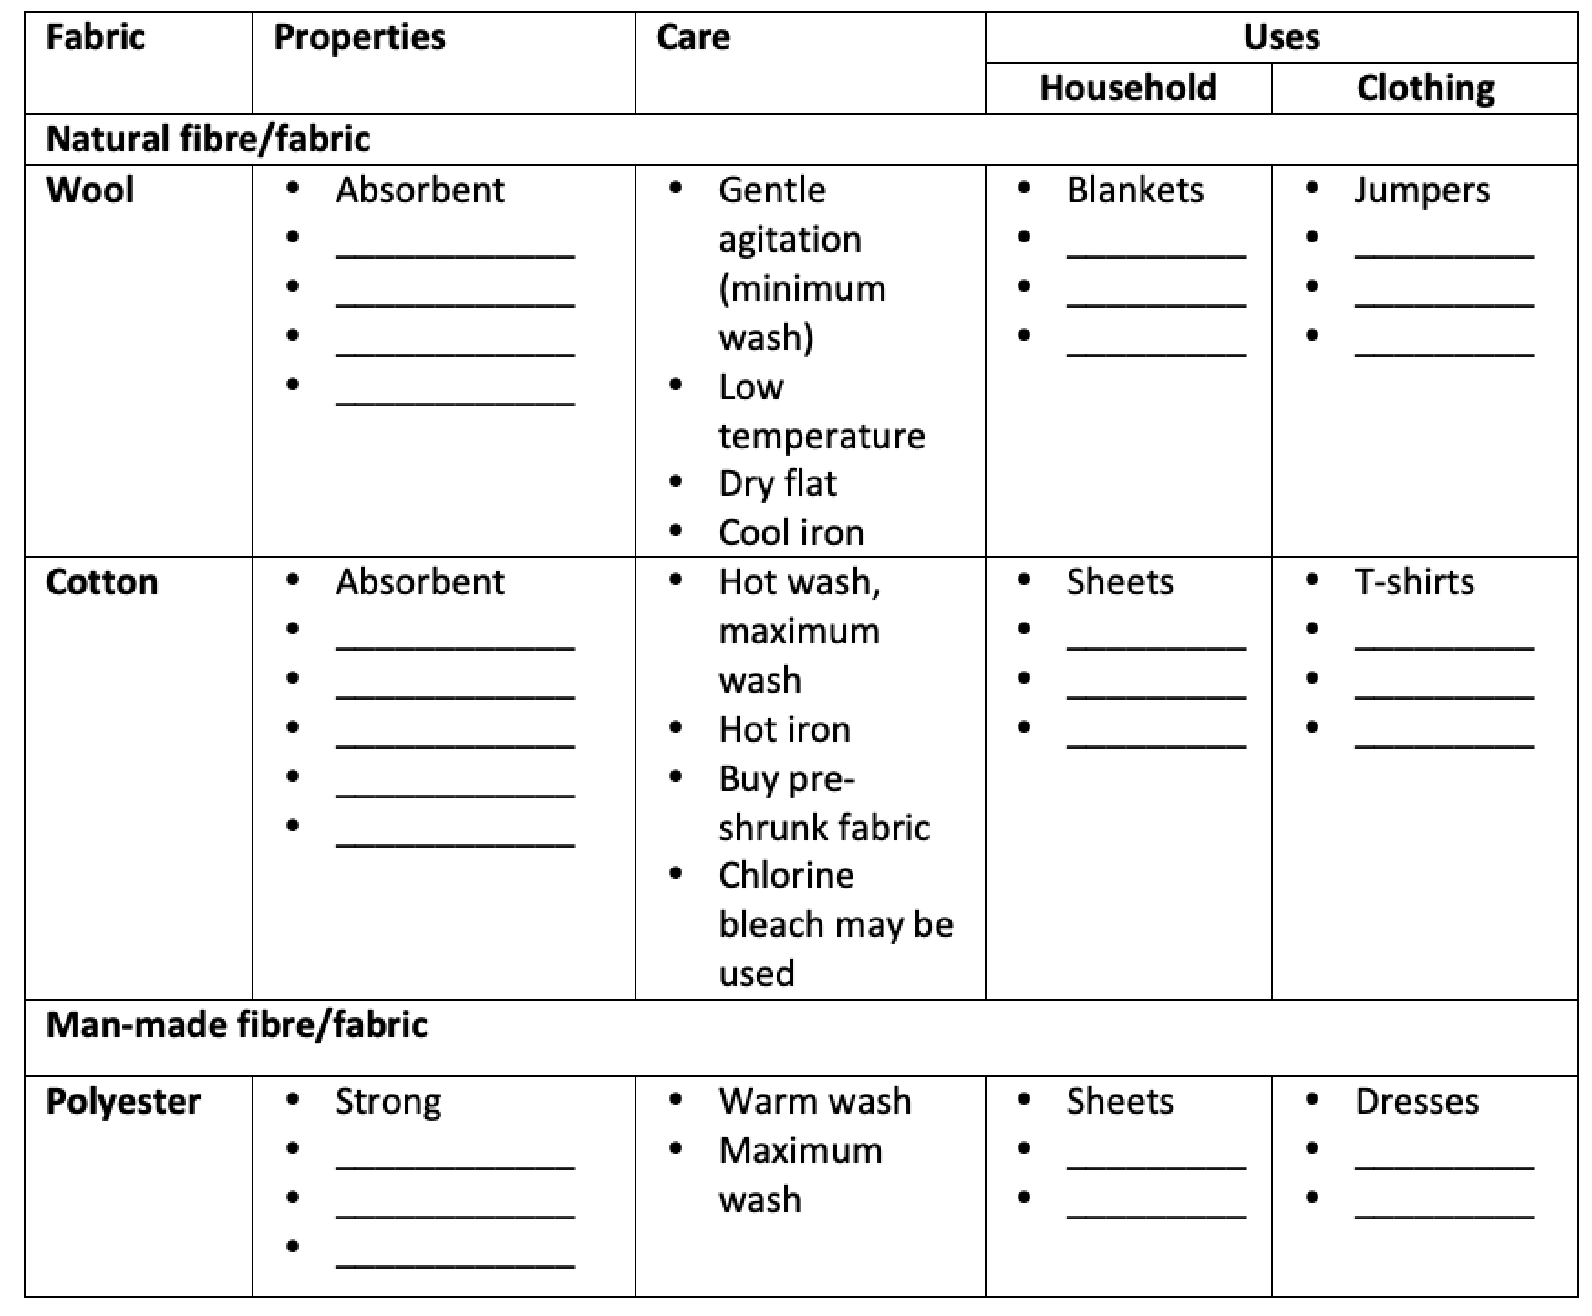
Properties, care and uses of fibre/fabric
Complete the following chart:

Slide 19
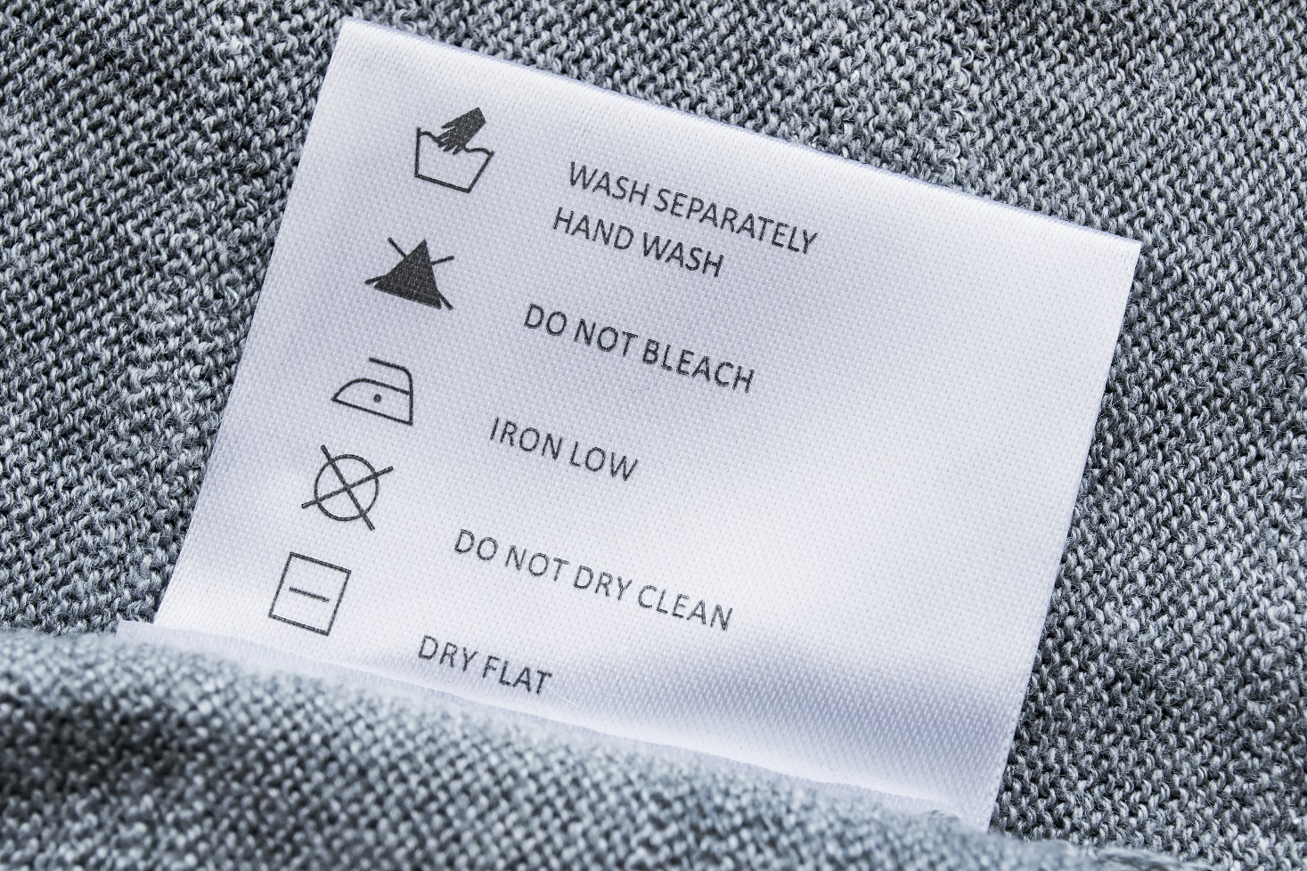
Care labelling
All textile products carry care labels regarding washing, drying, ironing, dry cleaning and bleaching.
Two types of information are given:
Written instructions
Symbols (internationally recognised)

Slide 20
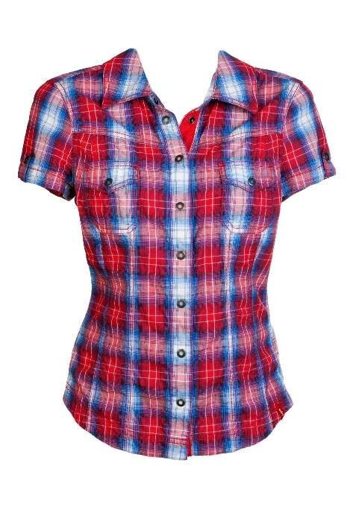
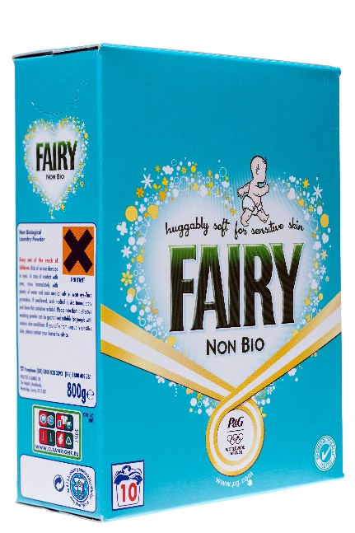
Underlying care of fabrics
Water or dry-cleaning solvent:
The temperature of the water and the type of dry-cleaning solvent is determined by the fabric.
2. Washing detergent:
Reduces surface tension of water, allowing fabric to absorb water
Dislodges dirt from fabric
Holds dirt particles in the water (away from fabric)
Softens hard water
Removes stains

Slide 21
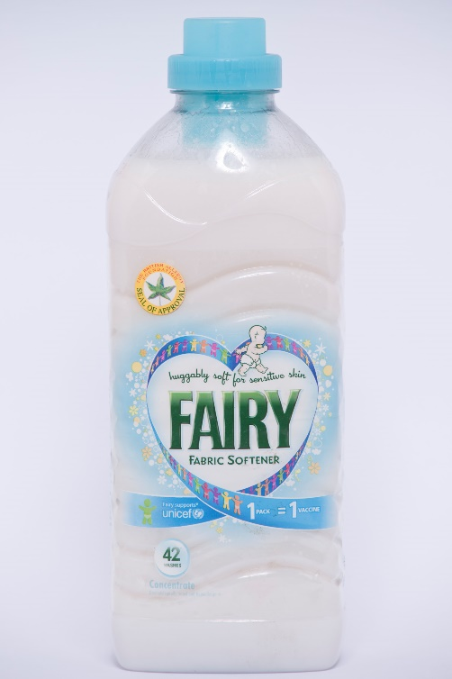
Underlying care of fabrics
3. Agitation/friction:
Removes dirt
4. Removal of water from fabric:
By squeezing or wringing
By spinning (centrifugal action)
By drip-drying, drying flat, on a clothesline or in a tumble drier
5. Fabric conditioners:
Add scent
Soften fabric
Prevent static
Aid ironing

Slide 22
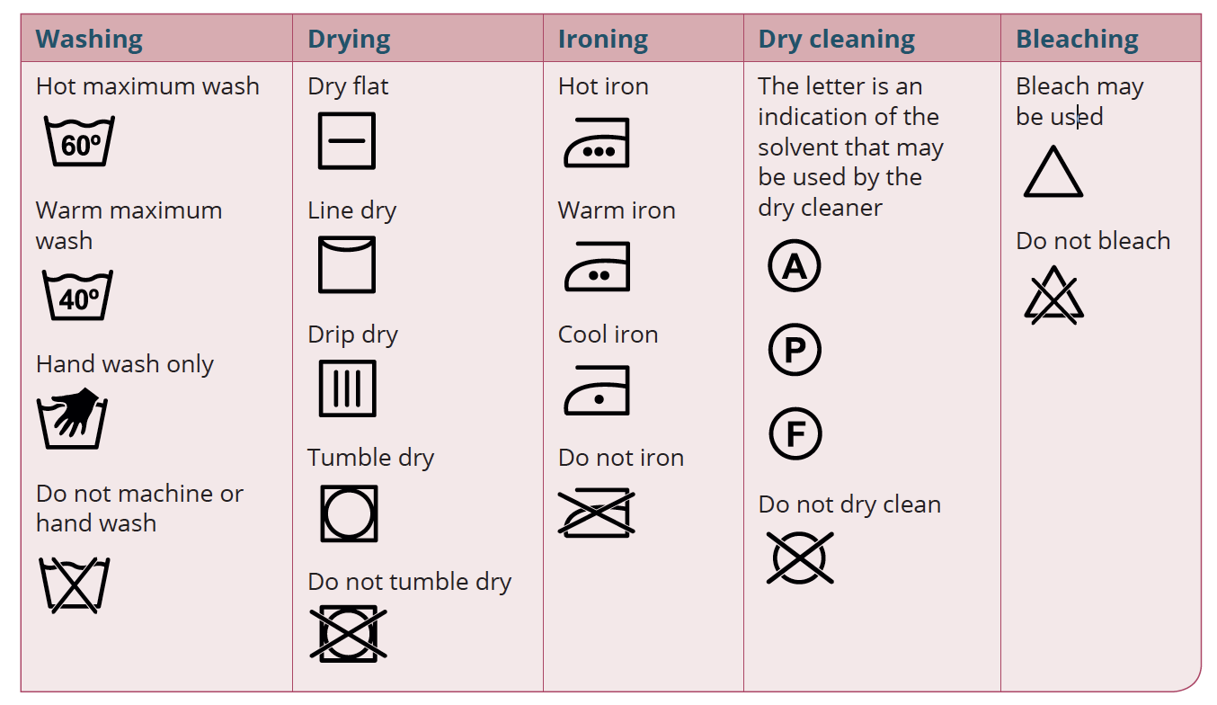
Care labelling symbols

Slide 23
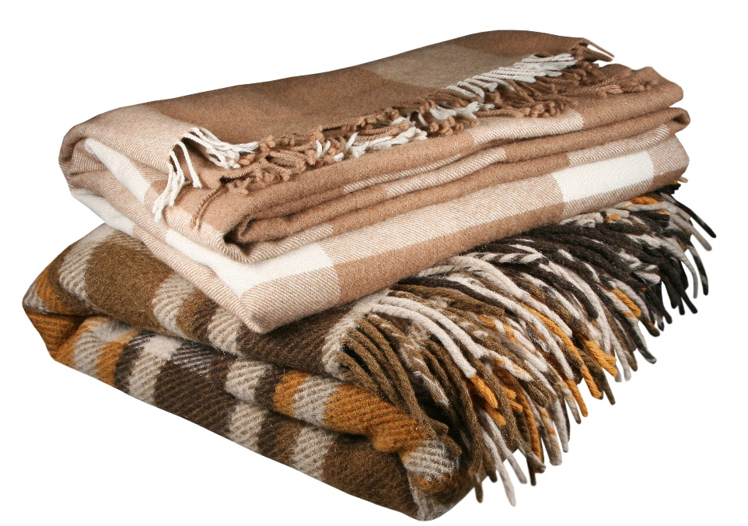
Safety considerations when choosing household textiles
Relate to:
Fire
Toxic fumes (released by synthetic foam when ignited)
Some fabrics catch fire and burn more easily:
Loosely woven fabrics
Fabrics with a pile
Blended fabrics

Slide 24
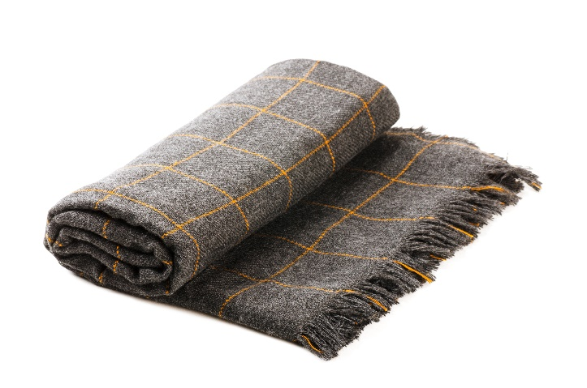
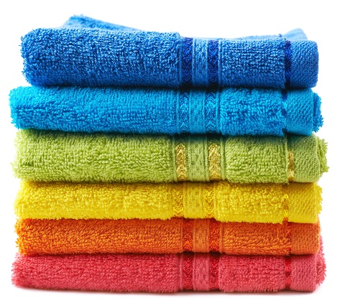
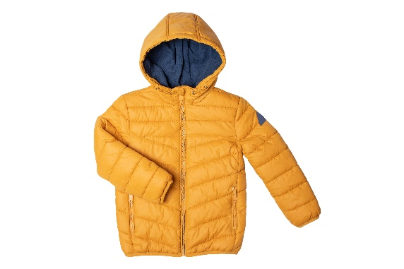
Safety considerations when choosing household textiles
Low-risk fabrics:
Wool
Polyester
High-risk fabrics:
Cotton
Silk
Acrylic

Slide 25
Safety considerations when choosing household textiles
Choose:
Low-risk fabrics
Fabrics treated with a flame-retardant finish (a finish to reduce flammability of a fabric)
Fillings that are CMHR (combustion-modified high resilience)

Slide 26
Flame-retardant finish/fabric: PROBAN
Treatment:
Phosphorus/chlorine compound is applied to a fabric.
The fabric is then treated with ammonia.
Insoluble polymers form and are embedded in the fabric.
Effects:
Reduces risk of fabric igniting
Self-extinguishing when removed from flame
More expensive fabric
May result in allergic reaction
Special care may be required during cleaning

Slide 27
Fire Safety (Domestic Furniture) Order 1988 (Updated 1995)
Aim: To reduce fire-related accidents.
Applies to: Beds, cots, pushchairs, cushions, upholstered furniture, loose covers and pillows.
Requires that:
1. Fabrics used must pass a number of tests.
2. Permanent safety labels on all items must be securely attached, clearly legible and durable.
3. A display/swing label must also be attached.
4. Foam/fillings must be CMHR.

Slide 28
Purpose of labelling
Informs the consumer about fabrics and fillings.
Warns the consumer of possible dangers.
Allows for traceability if the article proves unsafe.

Slide 29
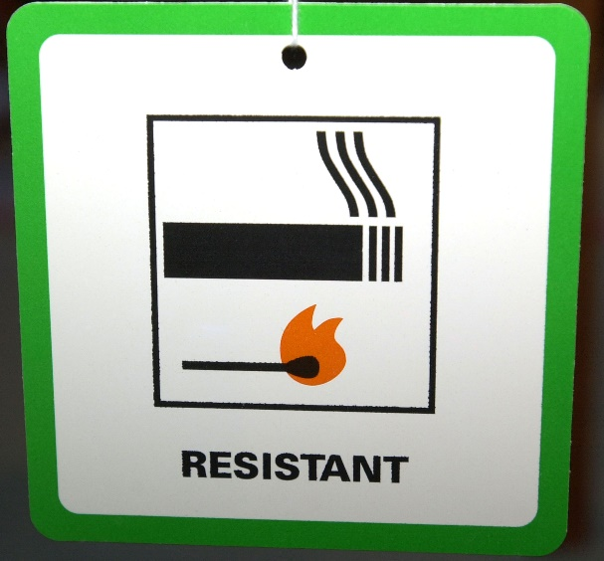
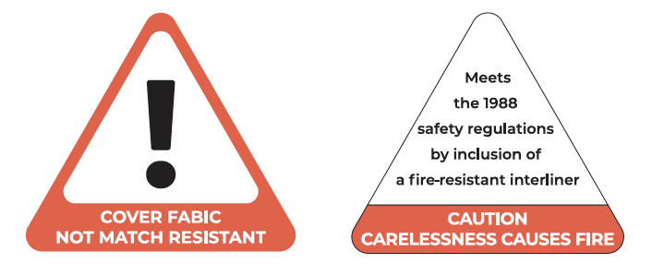
Types of labels
Display/swing labels
Square: Both the fabric and filling meet safety requirements.
Triangle: The outer fabric is not match resistant, but a fire-resistant interliner is present.

Slide 30
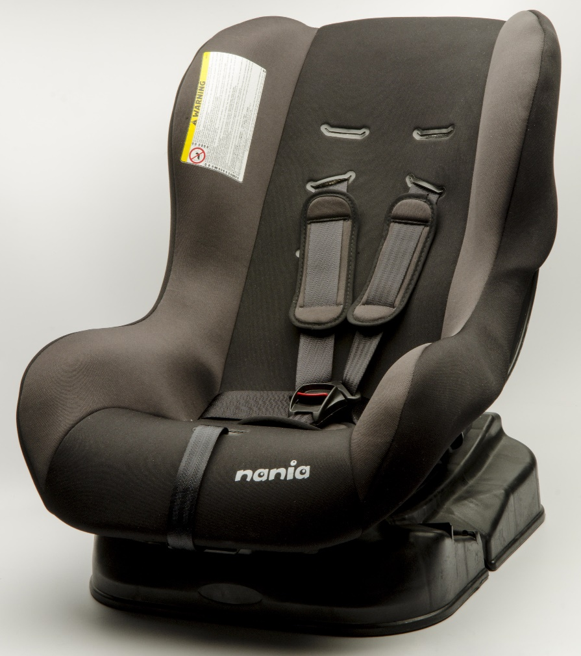
Types of labels
Permanent labels:
Stitched on
Include the warning ‘carelessness causes fire’
Include the name, address and date of manufacturing
Include the importer’s batch/identity number
Include a description of the filling and cover material
Include details of interliner, if used

Slide 31
Recap
Classify fibre types.
How are regenerated fibres produced?
What is a blended fabric?
Name two methods of fabric construction.
Explain why washing detergents are used.
Name a fire-retardant finish and describe how this treatment is applied.
What is required under the Fire Safety (Domestic Furniture) Order?
Outline the function of fire safety labelling.

Slide 32
Exam focus
See the questions on page 292 and page 294 of the textbook.
See the Exam and Assignment Journal, pages 136–138.

