Slide 2
Marriage
(Marriage and society 3.1.5)

Slide 3
What you will learn
Definition of marriage
Cultural variations in marital arrangements
Legal obligations, rights and responsibilities within marriage

Slide 4
Definition of marriage
Marriage is a socially and legally binding union between two people who will live together and remain faithful to each other to the exclusion of all others.
Some form of marriage exists in most societies throughout the world.

Slide 5
Cultural variations
Minimum age
Choice of partners
Number of spouses

Slide 6
Minimum age
The minimum legal age for marriage in Ireland is 18 years.
This is not a restriction in every society.

Slide 7
Choice of partners
All societies place some form of restriction on the choice of marriage partner.
Restrictions may be based on religion, class or close family relationship between the couple.
In Ireland, restrictions are based on either consanguinity (blood relationship) or affinity (relationship by marriage).

Slide 8
Number of spouses
Monogamy
Being married to one person at a time
Most common form of marriage
In Ireland, most marriages are based on monogamy.
Bigamy is a crime committed when an individual marries again while still legally married to someone else.
Polygamy
More than one partner is allowed
Polygyny = a marriage between one male and several females
Practised in many parts of Africa and in Islamic societies
Symbol of a man’s wealth and success
Polyandry = marriage between one female and several males
Rare – limited to Tibet in China and parts of northern India
Occurs in very poor cultures – a number of working males are needed to support one wife and children.

Slide 9
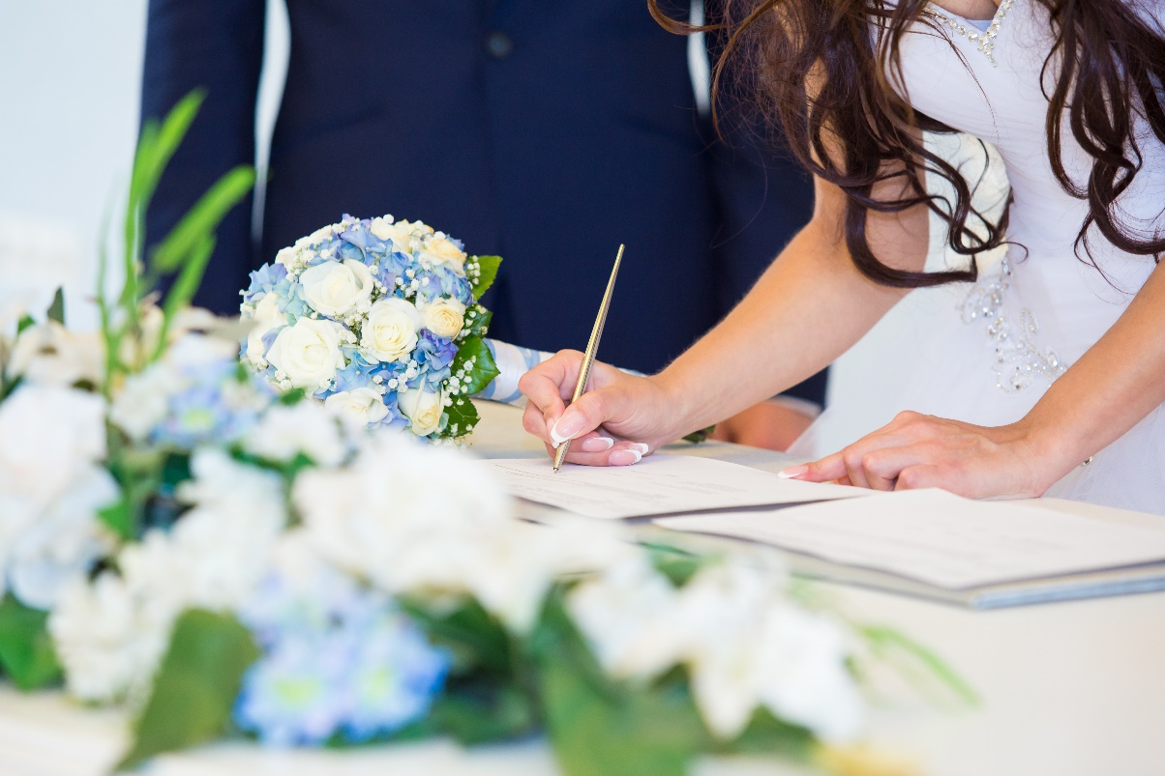
Legal obligations for marriage in Ireland
Entered into voluntarily by both partners
Both people must be over 18 years of age
Neither person can be in an existing marriage
Not closely related through blood or marriage
Three months’ notice must be given to the registrar
For a religious ceremony, the church also requires three months’ notice.
Ceremony must take place in an approved location
Marriage must be registered after the ceremony

Slide 10
Rights and responsibilities
To co-habit and to share each other’s company.
Sexual intimacy should be a feature of the marriage.
The couple must remain faithful to each other.
Spouses are the joint guardians of children born within the marriage and must provide for their needs and look after their welfare.
A dependent spouse has a legal right to maintenance.
Spouses have a legal right to inherit from each other.

Slide 11
Recap
Define marriage.
What is the minimum legal age for marriage in Ireland?
Distinguish between monogamy and polygamy.
Outline some of the legal requirements for marriage.
Describe some of the rights and responsibilities of marriage partners.

Slide 12
Exam focus
See the questions on page 329 of the textbook.
See the Exam and Assignment Journal, pages 150–152.

Slide 13
What you will learn
Preparation for marriage: facilities and services available
Marriage stability

Slide 14
Preparation for marriage
Preparation for marriage occurs:
At home
At school
At pre-marriage courses

Slide 15
Pre-marriage courses
Run by:
Accord Catholic Marriage Care Service
Other non-denominational organisations, e.g.____________________________.

Slide 16
Topics covered at pre-marriage courses
Communication
Family planning
Parenthood
Role expectations
Finance
Potential problem issues, e.g. alcohol, gambling

Slide 17
Advantages of pre-marriage courses
Couples communicate and share their feelings.
Couples are forced to face reality on issues such as finances and housing.
Couples become more aware of potential problem areas they may have been ignoring, e.g. a drink problem or violence.
Couples discuss each other’s personal qualities with emphasis on the positive areas and discuss how to deal with negative qualities.

Slide 18
Marital stability
The strength of a relationship is influenced by:
Expectations of marriage: Must be realistic or can become disillusioned.
Family background: Influences role expectations and whether one has positive or negative views of marriage.
Age: Need to be mature enough to take on responsibilities.
Similar culture and interests: For example, couples from a similar background may share beliefs and expectations, resulting in less friction.
Social factors: For example, financial problems and alcohol abuse put a strain on marriage.

Slide 19
Marriage counselling
Provided by:
Accord
MyMind Centre for Mental Wellbeing
Functions:
Helps couples resolve marital problems before they become grounds for separation or divorce
Refers them to experts, e.g. Money Advice and Budgeting Service (MABS), Alcoholics Anonymous (AA)

Slide 20
Marriage counselling
Marriage counselling may not be successful if:
Only one partner seeks counselling
Problems are too far advanced
The problem is so serious that separation is the only solution, e.g. child abuse

Slide 21
Recap
What topics are discussed at pre-marriage courses?
Outline the benefits of completing a pre-marriage course.
Describe some factors that influence the stability of a marriage.
How might counselling help couples who are experiencing marital difficulties?

Slide 22
Exam focus
See the question on page 330 of your textbook.
See the Exam and Assignment Journal, pages 150–152.

Slide 23
What you will learn
Marriage breakdown
The choices available when a marriage has broken down
The effects of marital breakdown

Slide 24
Marital breakdown
Marital breakdown is increasing in Irish society due to the following:
Separation and divorce are more socially acceptable.
Acquiring a divorce has become easier and less expensive.
Women are more likely to be financially independent.
State assistance is available for lone parents.

Slide 25
Family Mediation Service
A free, state-run service through the Legal Aid Board.
Helps couples to negotiate a separation agreement.
Couples meets in the presence of an impartial mediator.
They make decisions on children, finances and property.

Slide 26
Family mediation
Advantages:
Helps to reduce conflict between partners
Enables couples to make their own decisions
Helps the people involved to come to terms with the reality of separation
Encourages a spirit of co-operation and responsibility between partners, especially in relation to children

Slide 27
Legal separation
Separation agreement
Decisions agreed by the couple in mediation are drawn up in a deed of separation by a solicitor.
Judicial separation
A judicial separation is a separation granted by the court as a decree of separation (under the Judicial Separation and Family Law Reform Act, 1989) if a couple cannot reach a separation agreement or if only one spouse wishes to separate.

Slide 28
Deed of separation
A deed of separation includes:
An agreement to live apart and not to interfere with each other
Arrangements regarding the care of children
Amount of maintenance to be paid
Arrangements regarding ownership and occupation of the family home
Arrangements regarding rights of spouses to inherit from each other

Slide 29
Grounds for judicial separation
Adultery
Desertion
Unreasonable behaviour, such as _________________
No normal marriage relationship for a least one year
Spouses living apart for one year before application (where both consent to separation) or living apart for three years where one spouse does not give consent

Slide 30
Nullity of a marriage
Legal annulment
A decree of nullity issued by the court means that in the eyes of the state, the marriage never existed.
Partners are free to marry.
Church annulment
This type of annulment has no legal standing but is needed in order to remarry in a church.
When a person remarries within a church, the state will not recognise the marriage unless a decree of divorce or a decree of nullity was granted in respect of the first marriage.

Slide 31
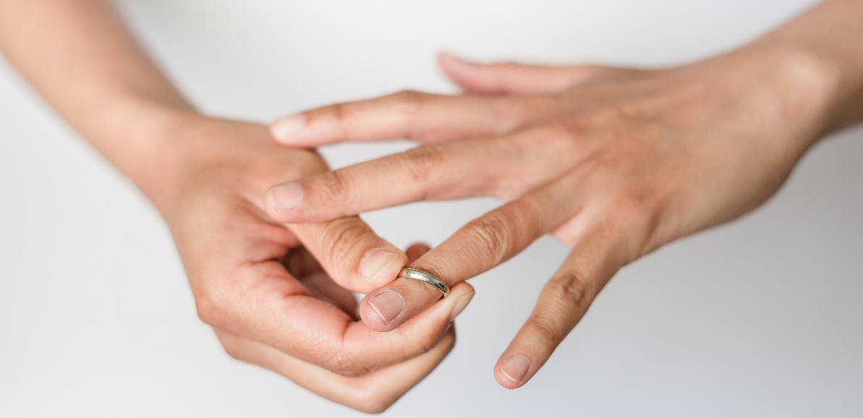
Grounds for nullity
Lack of capacity, e.g. _________________
Non-observance of certain formalities, e.g. ___________________
Absence of consent, e.g. _________________
Inability to form and sustain a marital relationship, e.g. _________________

Slide 32
Divorce
Under the Family Law (Divorce) Act, 1996, a spouse who wishes to end an existing legal marriage can make an application to the court for a decree of divorce.
A solicitor must inform the applicant about available counselling and mediation services.

Slide 33
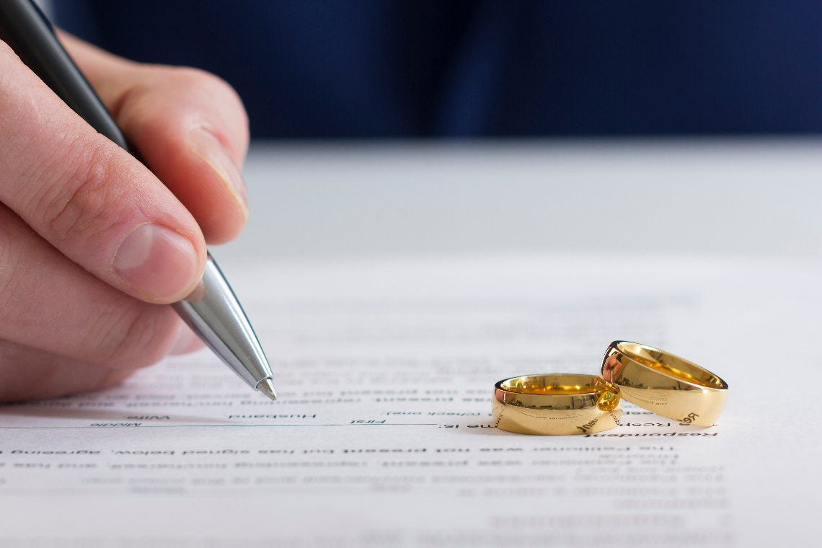
Grounds for divorce
Spouses have lived apart for at least two of the previous three years.
There is no prospect of reconciliation.
The court may make orders to cover maintenance, child custody and access, property, maintenance and, if necessary, safety or barring orders.
A decree of divorce gives spouses a right to remarry.

Slide 34
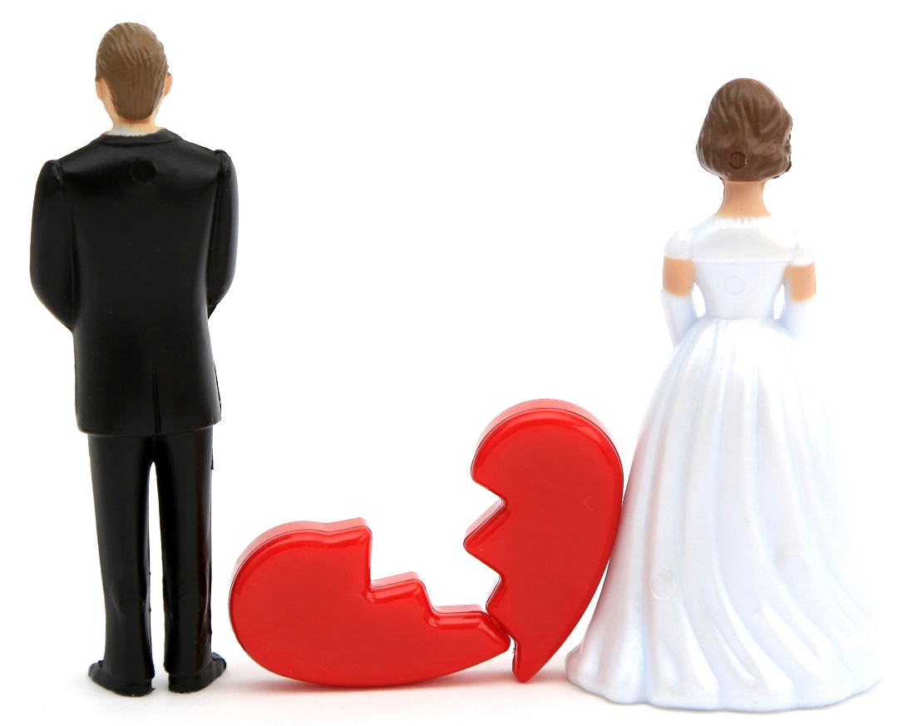
Effects of marital breakdown on spouses
A sense of failure, rejection or guilt.
May feel lonely, isolated and depressed and may resort to drink or drugs.
May suffer financial loss and a fall in living standards.
One spouse gains custody of the children and may assume full responsibility for their upbringing.
Future relationships may be difficult because they often do not have legal recognition.

Slide 35
Effects of marital breakdown on children
May experience emotional or physical violence during the breakdown period.
May feel responsible for the break-up and a sense of guilt and insecurity.
Can be used for emotional blackmail during the breakdown.
The loss of a parent results in the lack of a mother or father figure.
May be left with negative views of marriage and may have difficulties forming stable relationships in later life.
May be upset by a drop in living standards or a change of home.

Slide 36
Effects of marital breakdown on society
Undermines the family, which is the basic unit of Irish society, leading to more one-parent families and blended families.
The family may become dependent on the state for financial support.
Results in a greater need for accommodation/housing.
Traumatised children of a broken marriage may resort to aggression, vandalism and violence.
Future relationships involving children can be legally complicated.

Slide 37
Recap
Explain why marriage breakdown is increasing.
Outline the function of the Family Mediation Service.
What factors are covered in a deed of separation?
Distinguish between a church annulment and a state annulment.
How does divorce differ from separation?
Describe the effects of marital breakdown on (a) spouses (b) children (c) society.

Slide 38
Exam focus
See the questions on page 333, page 334 and page 335 in the textbook.
See the Exam and Assignment Journal, pages 150–152.

