Slide 1
PowerPoint
Exemplar

Slide 2
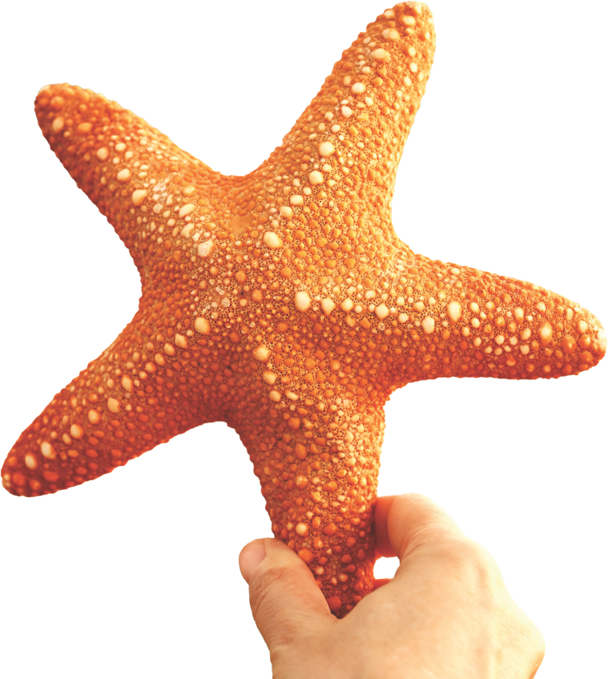
Power
& Decision-making

Slide 3
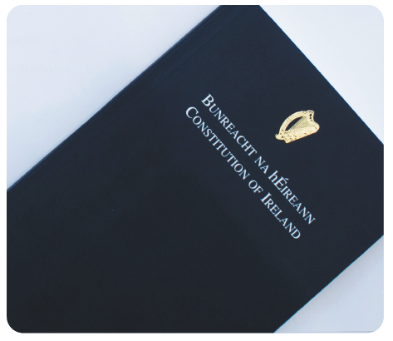
Chapter
09
Abraham Lincoln
‘Government of the people,
by the people,
for the people’
Bunreacht na hÉireann
‘We the people of Éire’

Slide 4
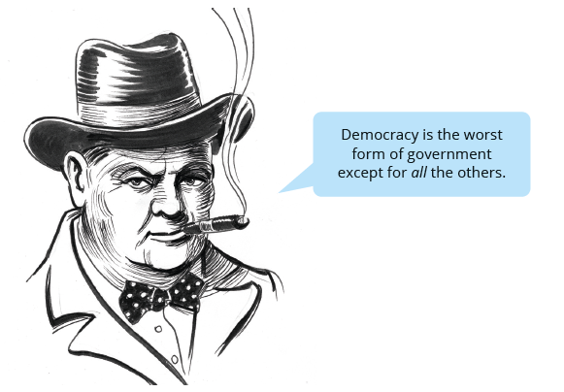
Chapter
09

Slide 5
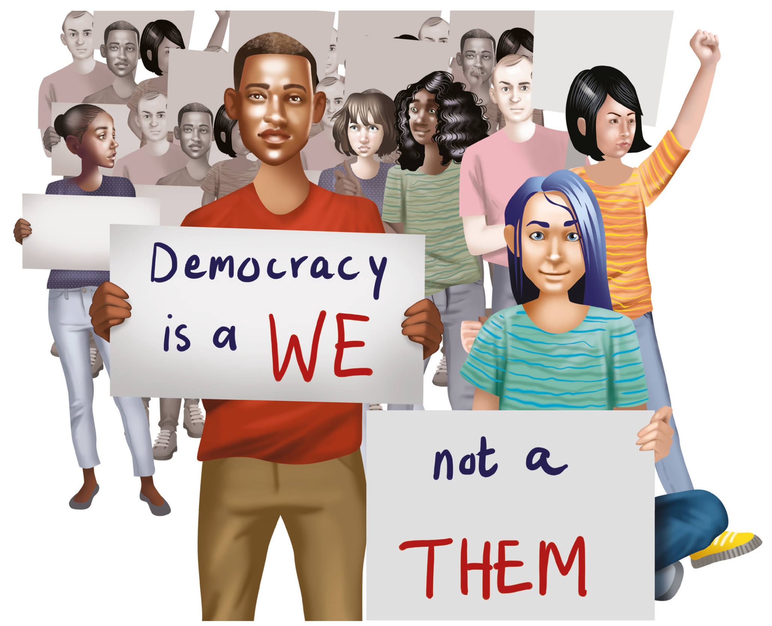
Chapter
09

Slide 6
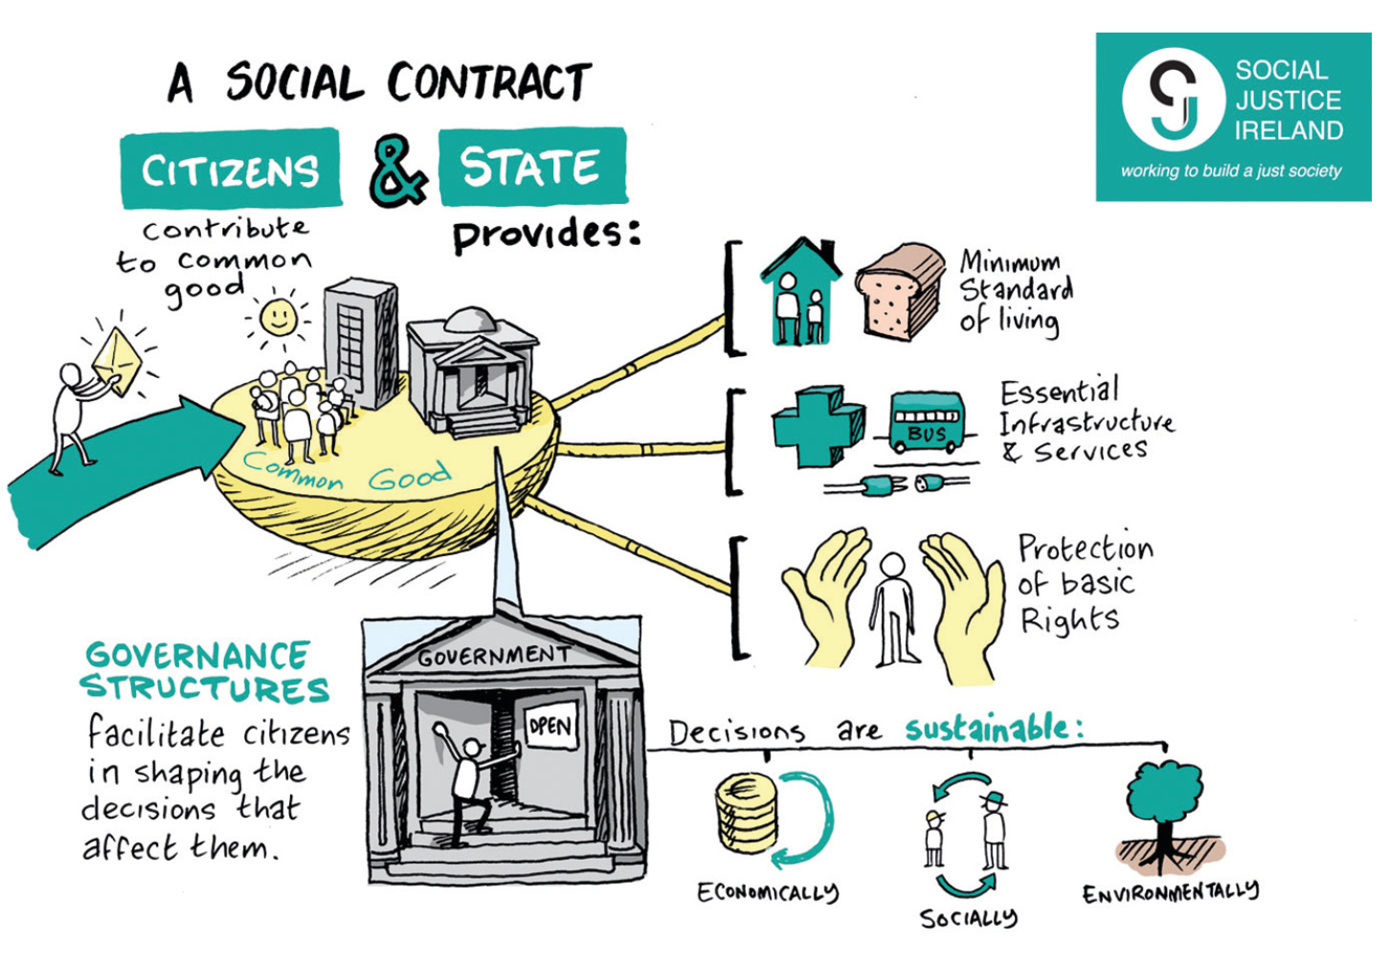
Chapter
09

Slide 7
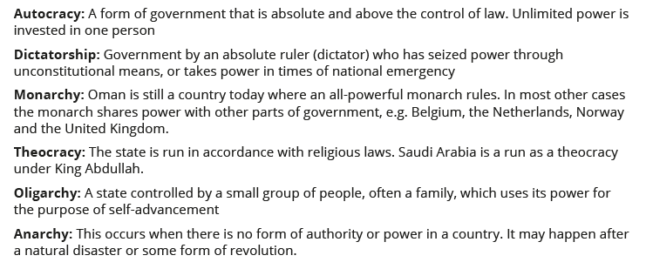
Different types of government
Chapter
09
Now write your own definition for Democracy

Slide 8
Government in Ireland
Chapter
09
The Irish Constitution, Bunreacht na hÉireann, sets out the type of government that we have here.

Slide 9
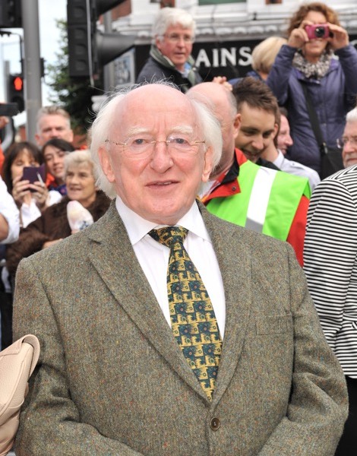
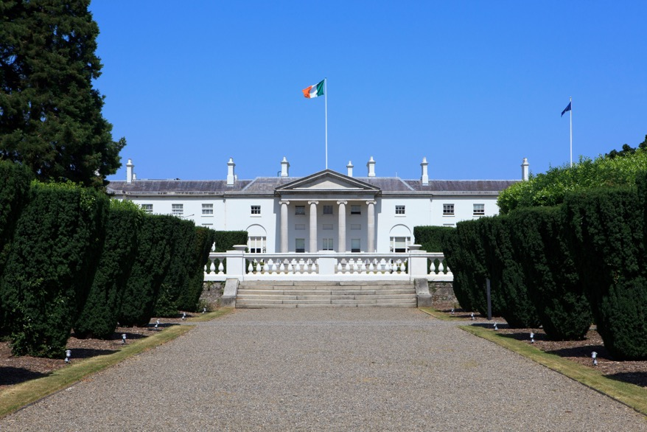
The President of Ireland
Chapter
09
The President of Ireland is the first citizen in the State.
Michael D. Higgins, President of Ireland
Áras and Uachtaráin,
Phoenix Park, Dublin
The Presidential Crockery!
The President of Ireland serves a 7-year term and may serve no more than two terms.

Slide 10
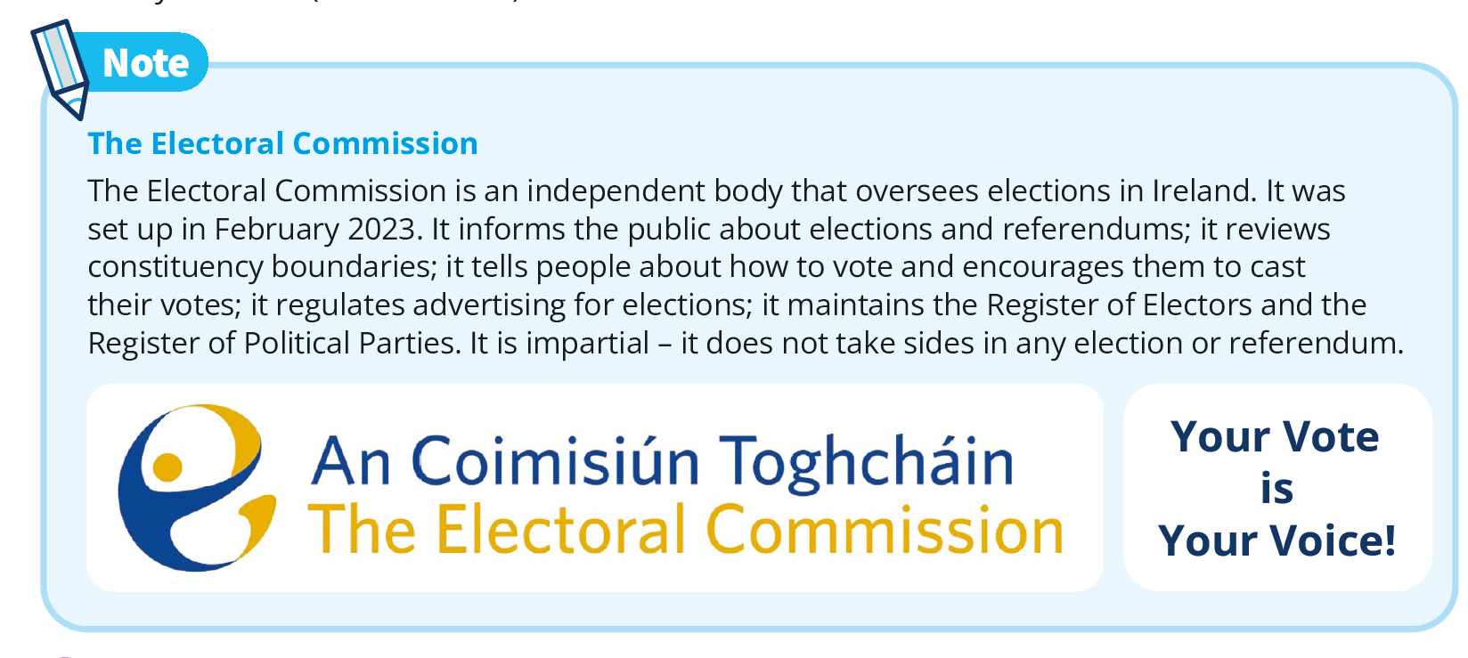
The Electoral Commission
Chapter
09

Slide 11
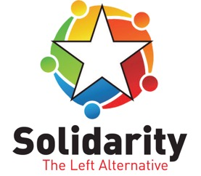




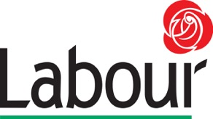



Political parties & elections in Ireland
Chapter
09
Types of elections in Ireland
General election
By-election
Presidential election
Seanad election
Local election
European election
Referendum
What other smaller parties are there?

Slide 12
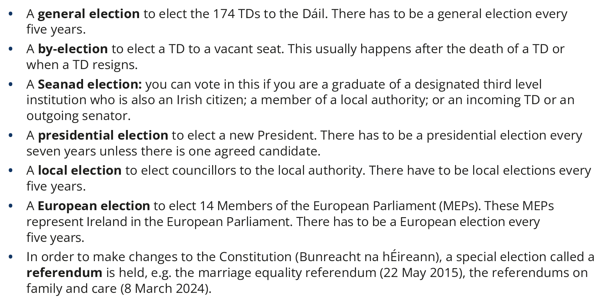
Elections in Ireland explained
Chapter
09

Slide 13
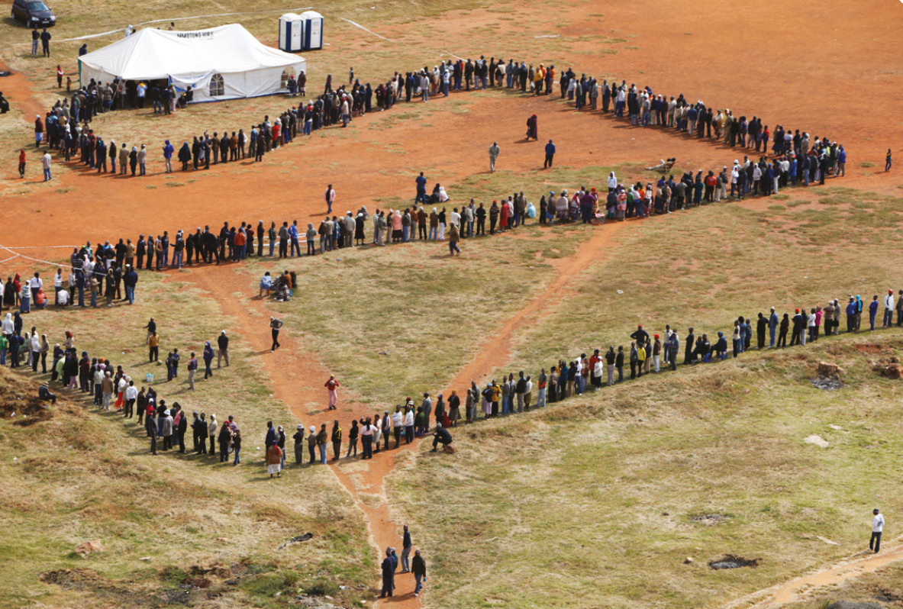
What’s happening here?
Chapter
09

Slide 14
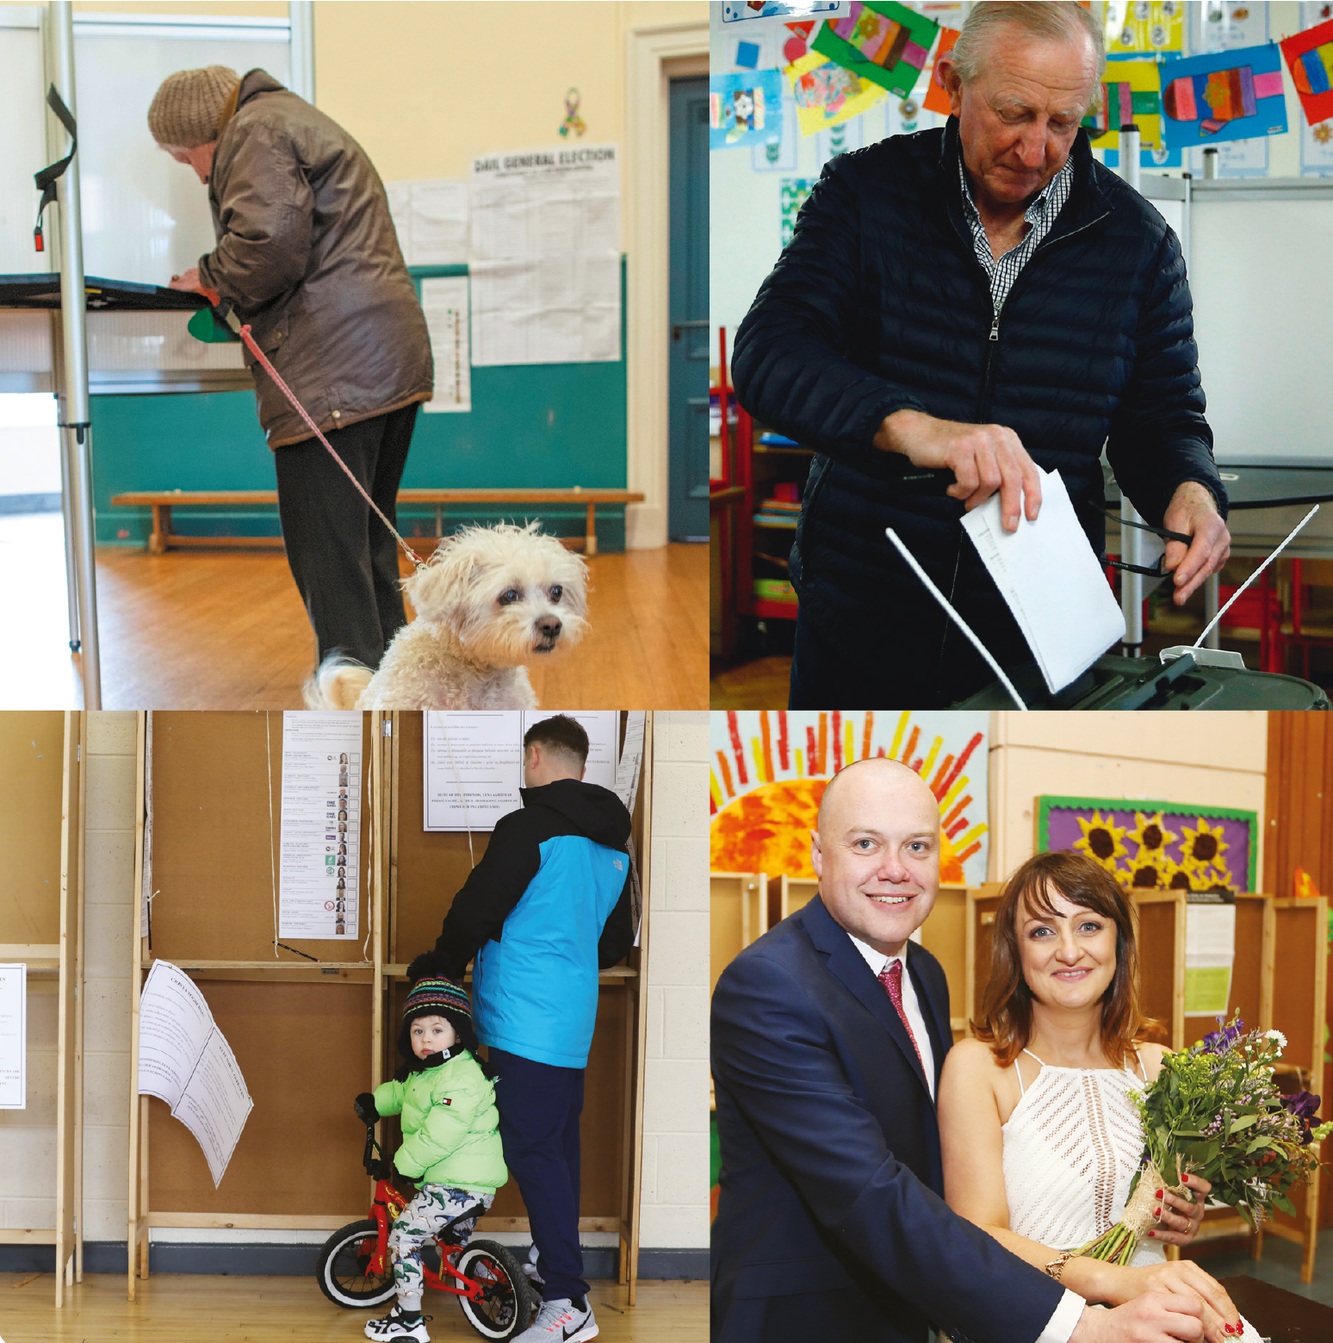
Voting around the world
Chapter
09
South Africa
Ireland
Kuwait
UAE

Slide 15
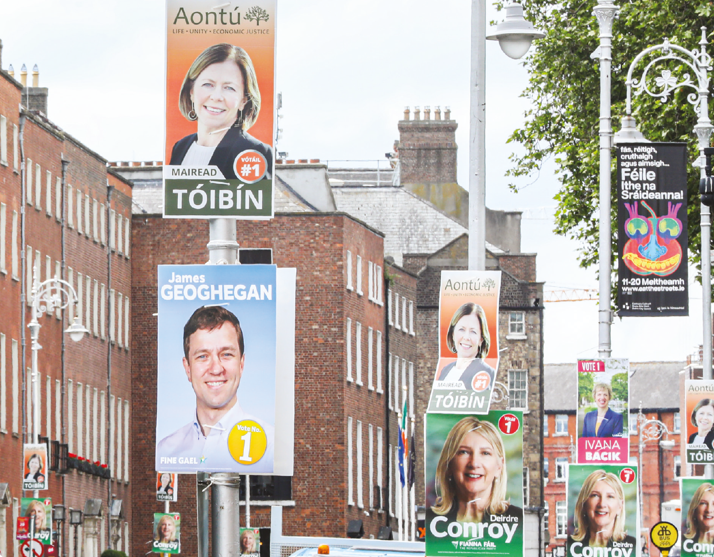
Chapter
09
Why do we have election posters?

Slide 16
Why do you think people put up these kinds of posters at election time?
Have you seen any other funny ones?
Chapter
09

Slide 17
Take a close look at the ‘Which Party?’ activity in your Action Record Portfolio and decide which party you would vote for.
Chapter
09

Slide 18
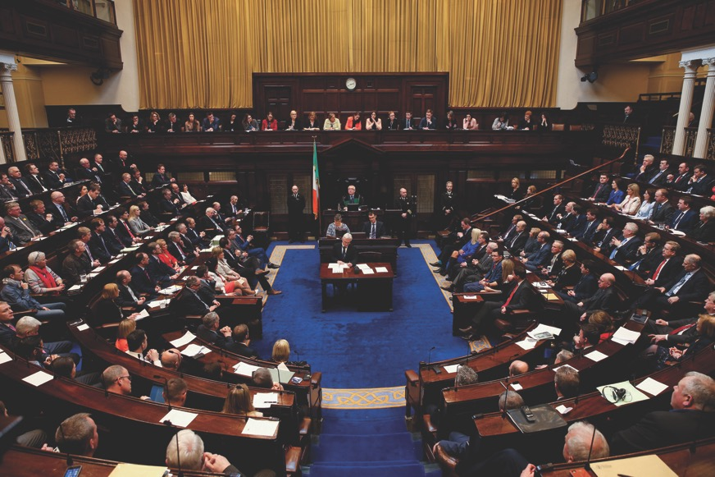
Dáil Éireann & Seanad Éireann
Chapter
09
174
Tánaiste
The Cabinet
The Taoiseach is the leader of the government.
The Tánaiste is Deputy Leader.
The Cabinet is made up of the Taoiseach, Tánaiste and all the Ministers.
There are 174 Teachta Dála (TDs) in the Dáil representing 43 constituencies.
Taoiseach
The Dáil Chamber, Leinster House

Slide 19
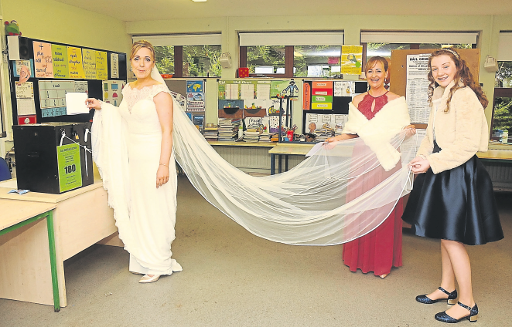
Citizens in a democracy have …
Chapter
09
Rights …
To vote
To lobby
To protest peacefully
To free speech
Responsibilities …
To obey the law
To keep the peace
To treat people equally
To respect the rights of others

Slide 20
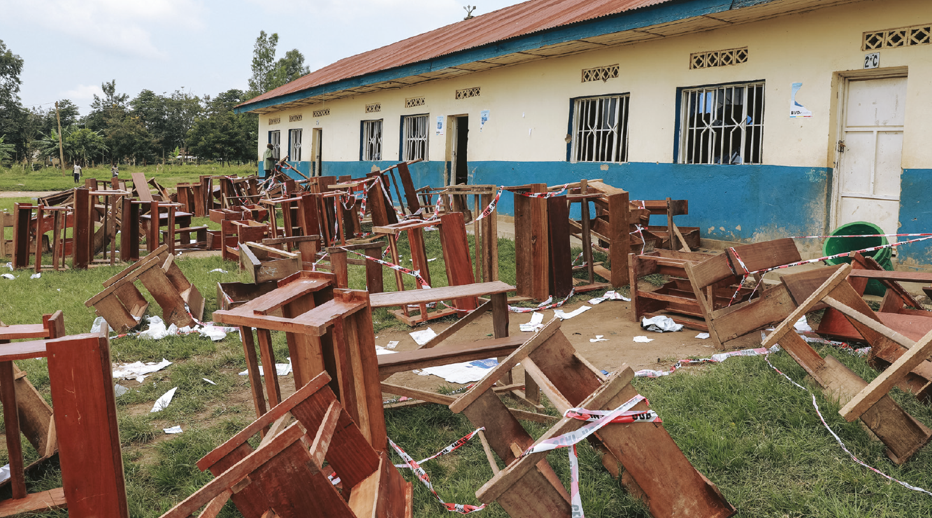
Election controversy in DRC
Chapter
09
Five opposition presidential candidates in the Democratic Republic of Congo have jointly called for a re-run of the country’s general election after a day of administrative chaos, delays and closed polling stations.
How might these kinds of controversy be resolved?

Slide 21
Important election data
Chapter
09

Slide 22
Students having their voices heard!
Chapter
09
Student Council Meeting
Associate Board Members Election

Slide 23
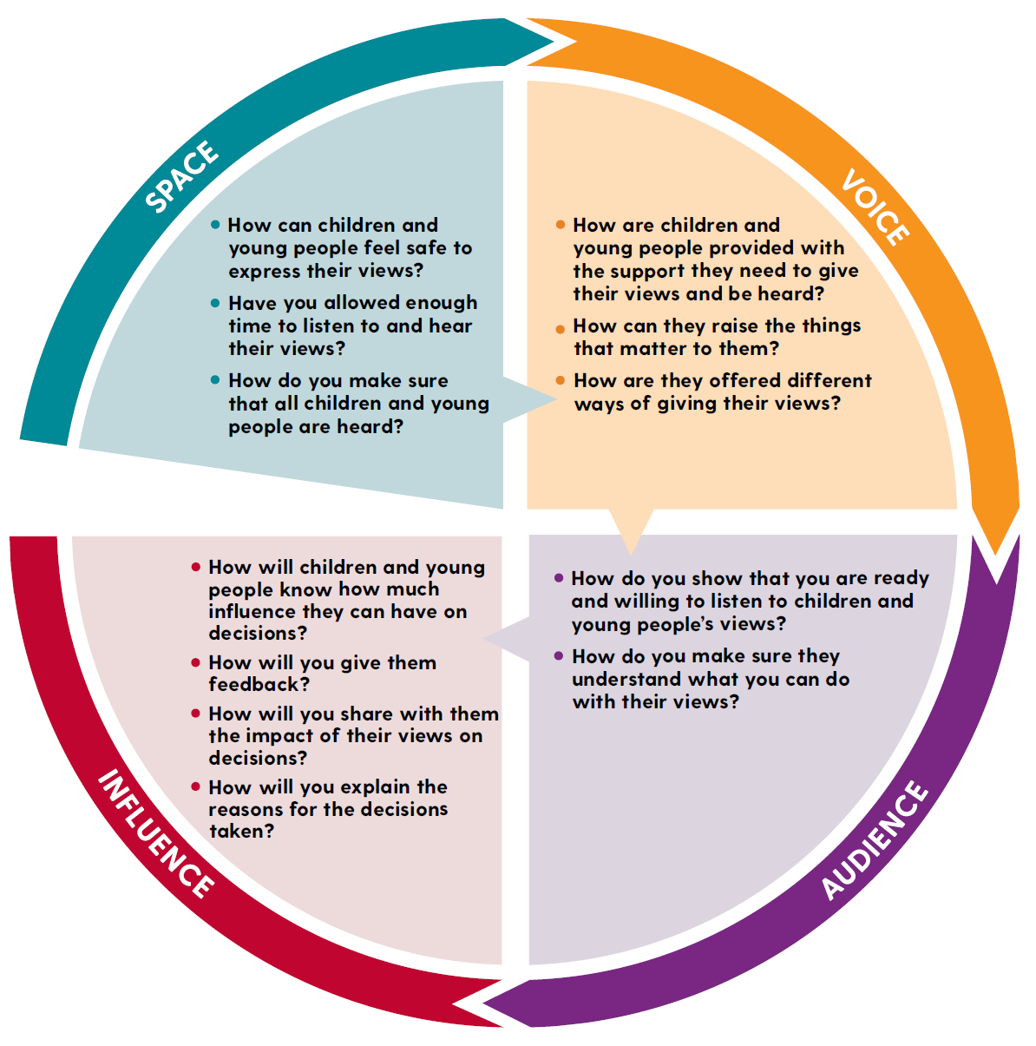
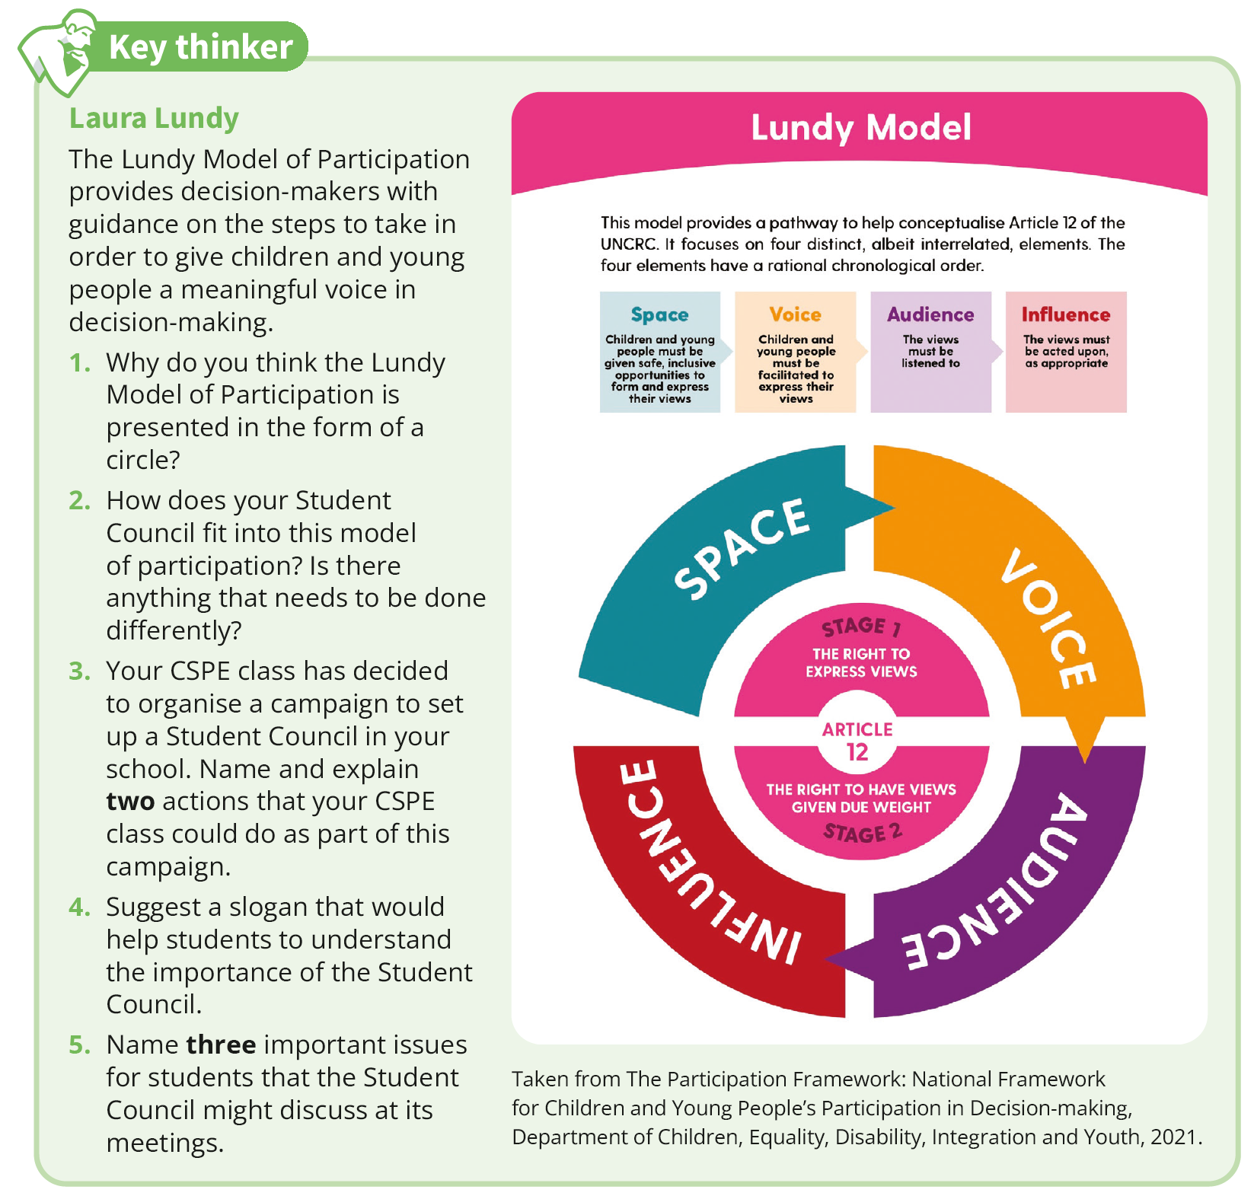
The Lundy Model of Participation
Chapter
09

Slide 24
What role does the media play in our democracy?
Chapter
09

Slide 25
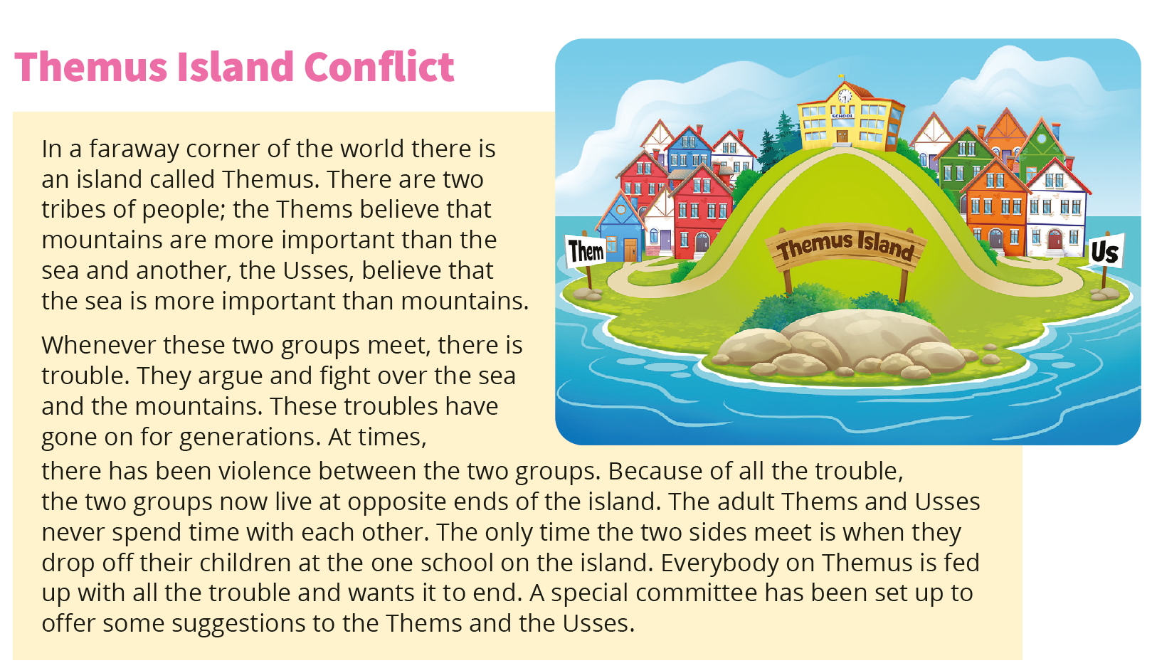
Northern Ireland
Chapter
09

Slide 26
Do you recognise these European buildings?
Chapter
09

Slide 27
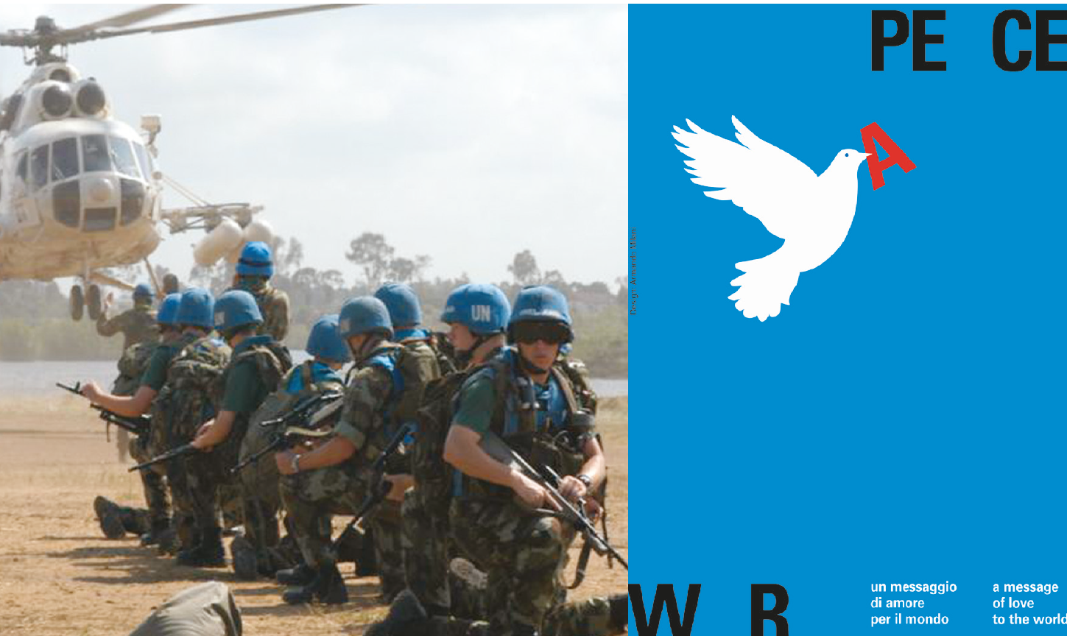
The United Nations
Chapter
09

Slide 28
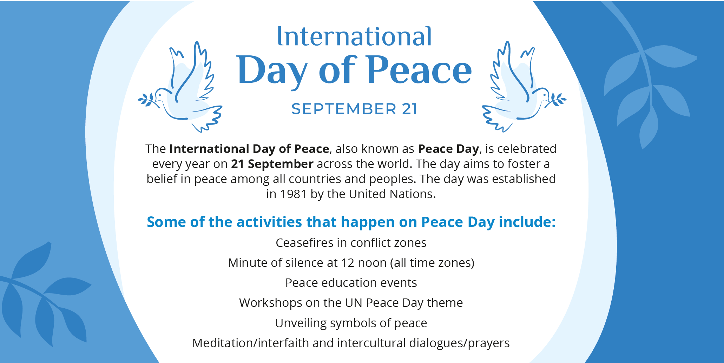
How could we as a CSPE class celebrate International Day of Peace in our school?
Chapter
09

