Slide 1
Unit 1 Personal Development
1.1 The Concept of Personal Development

Slide 2
1.1 The Concept of Personal Development
p. 3
Learning Intentions
At the end of this unit, you will be able to:
Explain what personal development is
Use a SWOT analysis to consider
current situation
Key Concepts
Personal development
Self-awareness
SWOT analysis

Slide 3
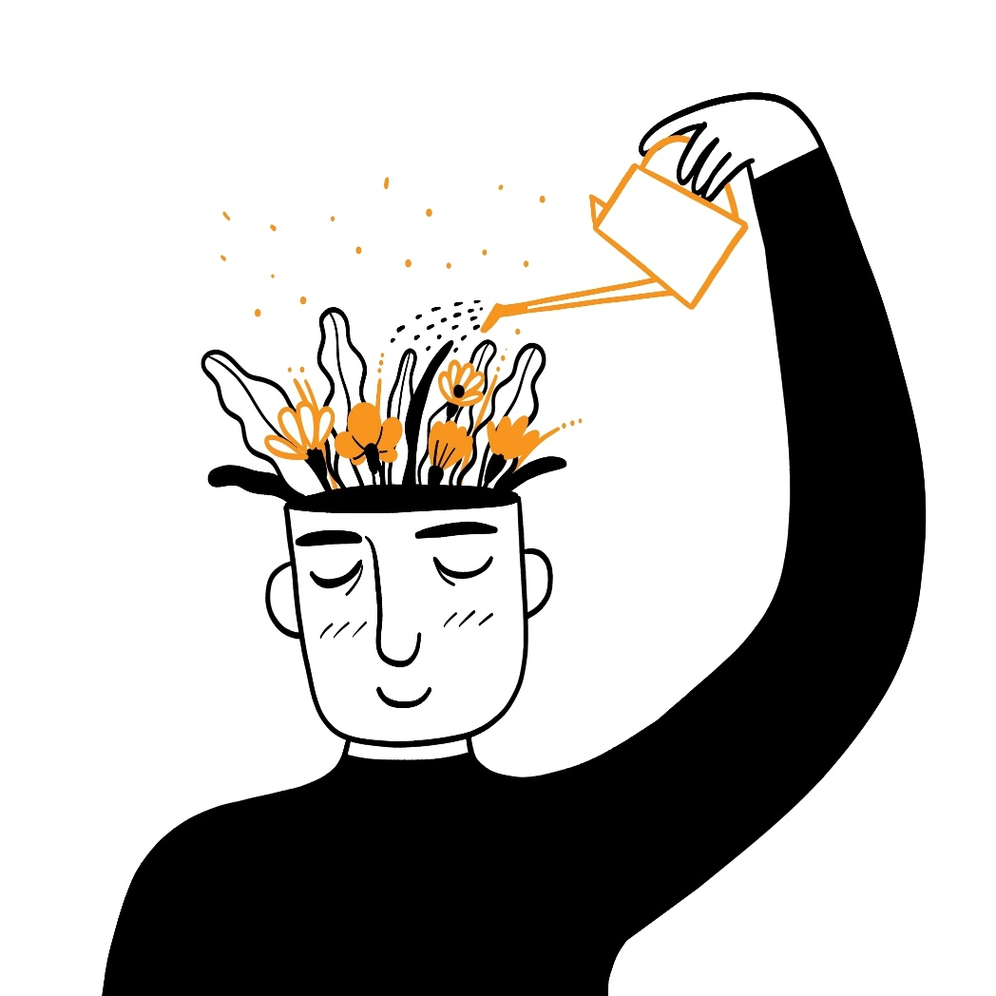
What Is Personal Development?
pp 3–4
Personal development is the process of improving yourself in different areas, to lead a more meaningful and successful life.
It involves building:
Values
Strengths
Aptitudes
Skills
This helps you:
Become more confident
Make choices that help you reach your full potential

Slide 4

Personal Development in School
p. 4
Personal development takes place inside and outside school.
In school, it includes:
Learning how to stay healthy and maintain wellbeing
Building positive relationships
Exploring career interests and progression
Developing values
Strengthening skills

Slide 5
Personal Development in School
p. 4
Participate
Divide into four groups. Label four large sheets of paper with the headings School, Home, Social and Community. In your groups, take turns writing ideas for how a person might develop in each area.
For example:
School: improving time management or teamwork
Home: helping more with responsibilities
Social: listening better to friends or managing conflict
Community: volunteering or learning about local issues
Once each group has contributed to all four areas, take turns reading out the ideas and note one or two that are most relevant to you.

Slide 6

Getting Started: Self-Awareness
p. 5
Self-awareness means being honest about your strengths, interests and the areas you want to improve.
Ask yourself:
What activities am I good at?
What subjects do I enjoy most?
What do I find challenging?
What do I enjoy in my free time?
What matters most to me?

Slide 7
Thinking About Your Future
p. 6
Look at:
Your strengths
Areas you want to improve
This helps you:
Prepare for opportunities
Make better decisions
Plan next steps

Slide 8
Thinking About Your Future
p. 6
A SWOT analysis helps you reflect on your current situation by looking at:
Strengths – what you do well
Weaknesses – what you find challenging
Opportunities – what could help you
Threats – what might make things difficult

Slide 9

Thinking About Your Future
p. 6
Read Amina’s example.
1. What advice would you give her for managing her time and building confidence?
2. How could she use her strengths and opportunities to overcome her challenges?
3. What small steps could she take inside and outside school to continue her personal development?

