Slide 1
Unit 1 Personal Development
1.2 Creating and Reflecting on Personal Development Goals

Slide 2
1.2 Creating and Reflecting on Personal Development Goals
p. 8
Learning Intentions
At the end of this unit, you will be able to:
Use the SMARTER model to plan and set achievable goals
Discover the benefits of reflecting on your progress
Key Concepts
Personal development goal
SMARTER model
Reflection

Slide 3
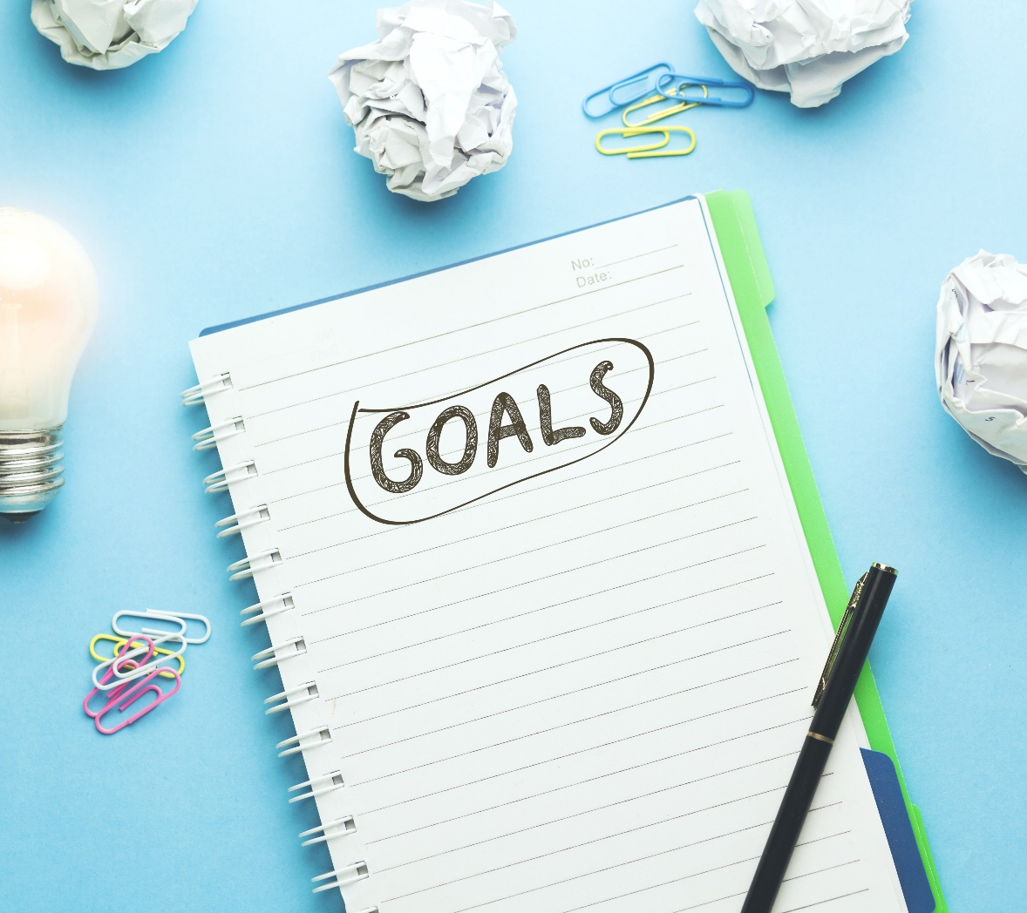
What Are Personal Development Goals?
p. 8
A personal development goal is something you want to achieve or improve.
Goals give you:
Direction
Focus
Motivation

Slide 4
What Are Personal Development Goals?
p. 8
Goals can be:
Short-term – achieved soon
Long-term – take more time
You can set goals in:
School
Hobbies
Community
Work

Slide 5
Using the SMARTER Model
p. 9
The SMARTER model is a tool that can help you plan and set clear and achievable goals.
Specific
Measurable
Achievable
Relevant
Time-bound
Evaluated
Revised

Slide 6
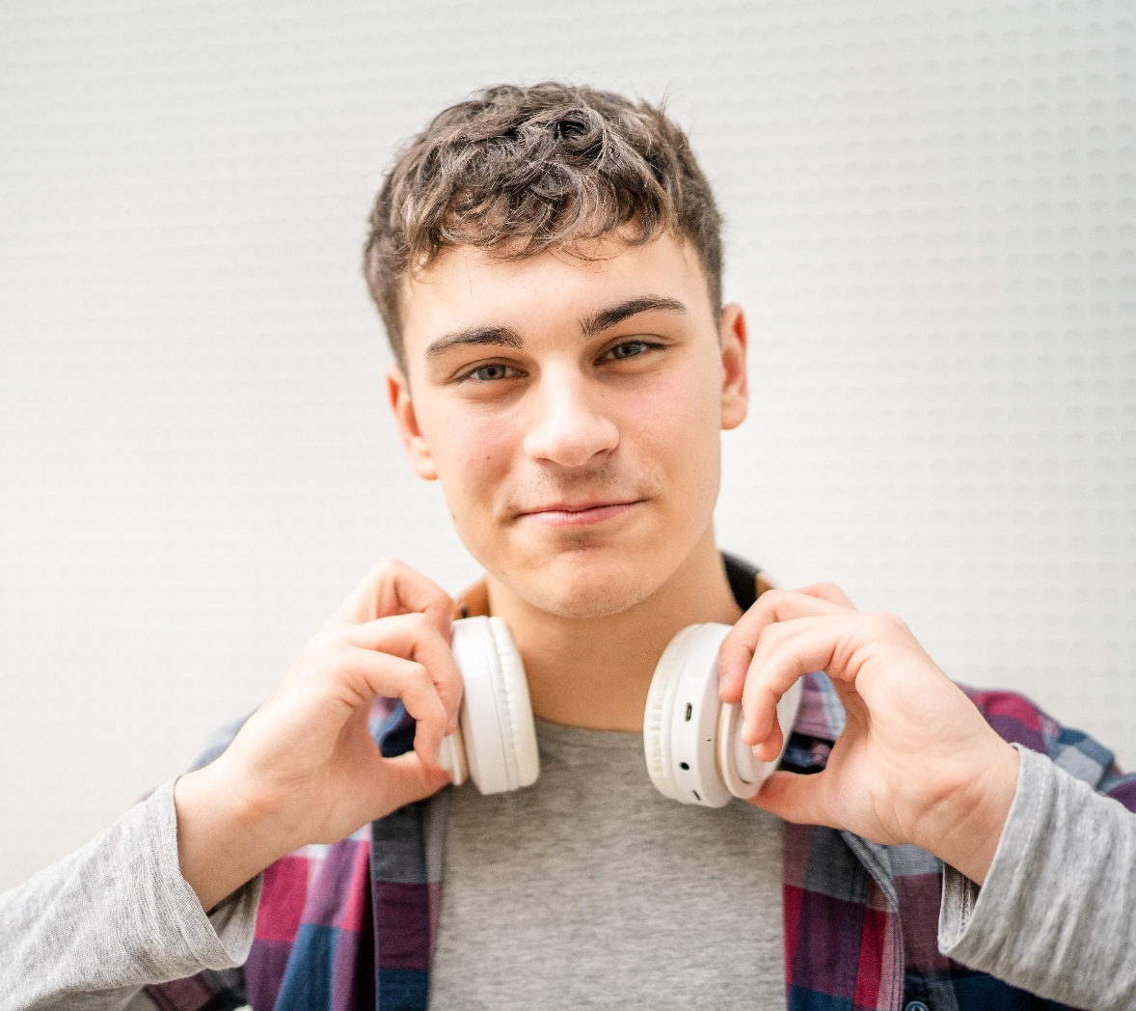
Using the SMARTER Model
pp 9–10
Read Cian’s example.
Which parts of the plan do
you think are (a) strongest and
(b) most challenging?
Are there any small changes Cian could make to his plan
to make it more achievable?

Slide 7

Reflecting
p. 11
Reflection means:
Thinking about experiences
Recognising what you learned
Using learning in the future
Reflection helps you understand:
What worked
What was challenging
What to do differently next time

Slide 8
Reflecting
p. 11
Discuss a recent experience with a partner.
What happened?
What went well?
What was difficult?
What did you learn?
How could you use this learning again?

