Slide 1
Unit 2 My Values
2.2 Personal Development

Slide 2
2.2 Personal Development
p. 19
Learning Intentions
At the end of this unit, you will be able to:
Explain how your values might change as you grow and experience new things

Slide 3
How Values Change
p. 19
Your values are not fixed.
They can change as you:
Gain new experiences
Meet new people
Take part in school, work, volunteering or community life

Slide 4
Values in Different Contexts
pp 19–20
The same value can appear differently depending on:
Where you are
What you are doing
Who you are with
Sometimes, different values take priority in different situations.

Slide 5
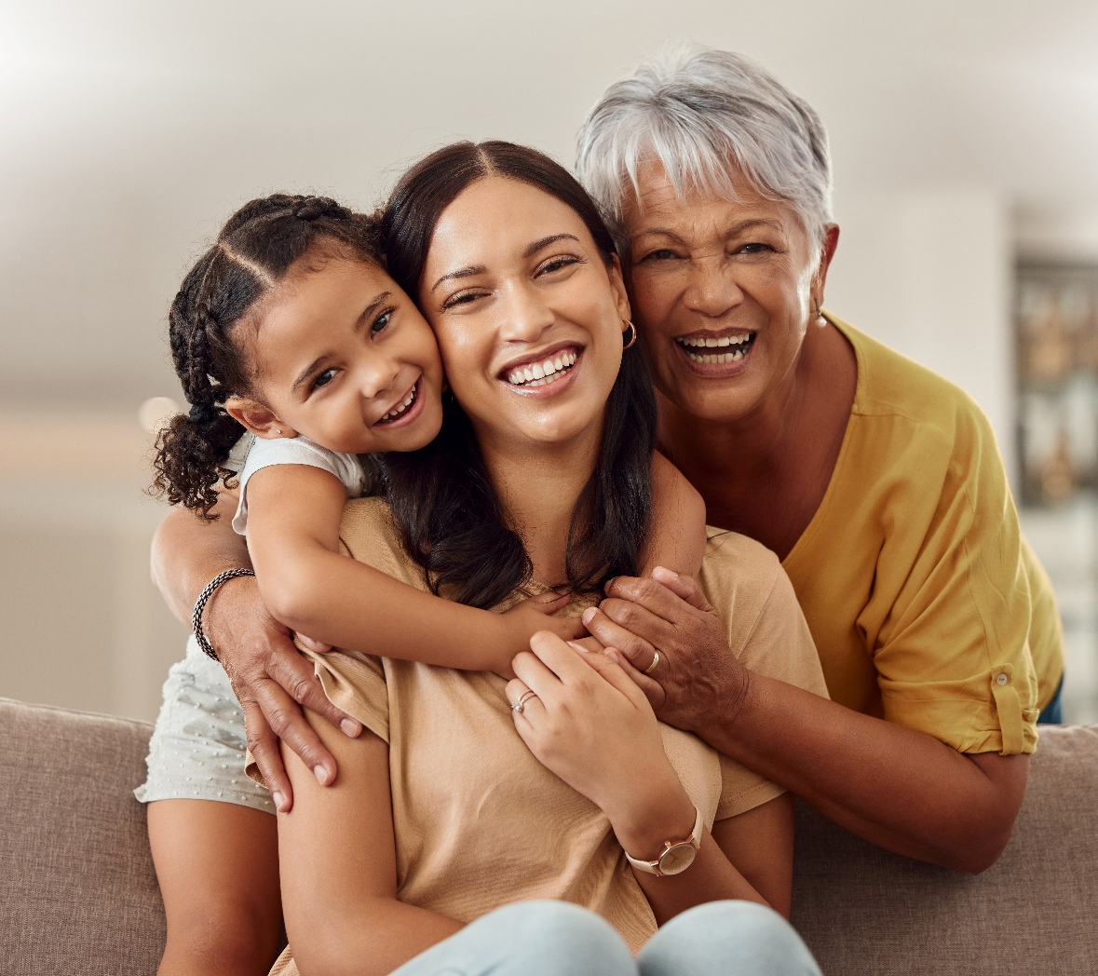
Values Over Time
p. 21
As you grow older:
Your responsibilities change
Your priorities change
Your values may change
It’s important to:
Check in with your values
Reflect on what matters most now

Slide 6
Applying Your Values
p. 22
Applying your values means:
Using them to make choices
Solving problems
Building relationships

