Slide 1

Chapter 9
Recovery and Periodisation

Slide 2
p.142
In this chapter you will learn about:
Recovery Strategies and Overtraining
Discuss multiple recovery strategies
Understand the symptoms of overtraining
Role and Application of Periodisation
The role that periodisation plays in preparing an athlete for peak performance
How to apply the principles of periodisation to a training plan.
The three cycles of periodisation: macro-, meso- and micro- cycles
Incorporating Recovery and Periodisation
How to plan for recovery in programme design
How to plan for periodisation
LO 2.3a
LO 2.3b
LO 2.3c

Slide 3

Recovery Strategies
LO 2.3a
p.143
Definition: Recovery strategies are methods athletes use to help the body rest, repair and prepare for future training. They reduce tiredness, prevent injury and improve performance
Key Points:
Recovery strategies reduce tiredness
Lowers chance of injury
Improves overall results
Examples:
Active recovery
Cold water immersion
Compression tools

Slide 4
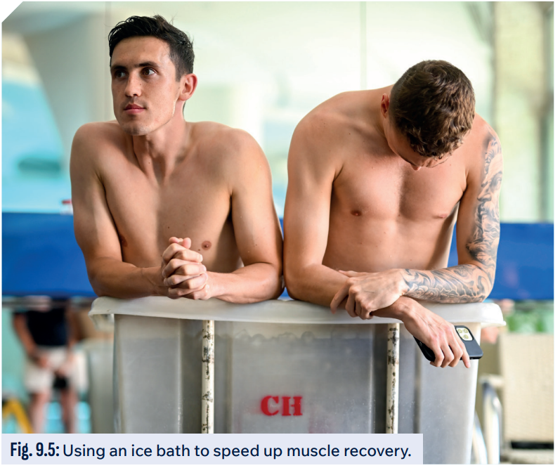
Types of Recovery Strategies
p.144
1. Active Recovery
Lower intensity movement
Helps blood flow and clearing waste from muscle
2. Cold Water Immersion
Reduces inflammation and muscle soreness
Improves circulation and removal of waste
3. Contrast Bathing
Alternating between hot and cold water
Helps stimulate blood flow and removal of waste products
Helps reduce soreness

Slide 5

Types of Recovery Strategies….
p.144
4. Compression Tools
Apply pressure to the muscles
Reduces swelling and improves blood flow
Eases DOMS
5. Sleep and Napping
Good quality sleep aids muscle repair and energy restoration
Napping for 20-30 minutes can boost recovery
6. Static Stretching
Improves flexibility and reduces muscle stiffness
Lowers risk of injury

Slide 6

Types of Recovery Strategies….
p.145
7. Massage
Reduces muscle tightness
Improves circulation
Faster recovery
8. Foam Rolling
Self-myofascial release
Using pressure to release tension and reduce soreness
9. Nutrition
Protein helps muscle repair
Carbohydrates aid glycogen replenishment
Adequate hydration is vital to replace fluids lost through sweat

Slide 7

p.145

Slide 8


Recovery Strategies
Watch this video of an NFL player recovering after a game.
What strategies does he implement to ensure faster recovery?
Does he do anything different that we haven’t already discussed?
https://www.youtube.com/watch?v=nVUcRz-45qw

Slide 9
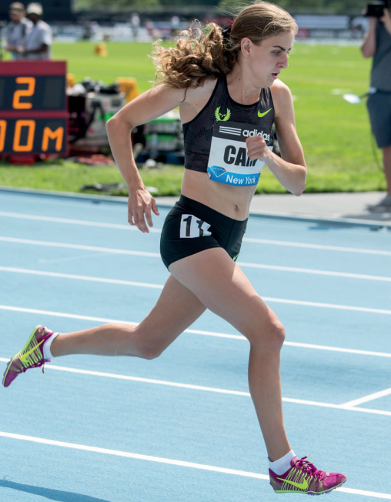
What is Overtraining?
p.147
Definition: Overtraining is when an athlete exercises too much without enough rest, leading to fatigue, decreased performance and higher risk of injury or illness.
Physical Symptoms of Overtraining:
Constant fatigue
Slower recovery
Increased injuries
Decline in performance
Mental Symptoms of Overtraining:
Lack of motivation
Mood swings
Sleep disturbances
Irritability or anxiety
Mary Cain – Case Study p.147

Slide 10

The Role and Application of Periodisation
LO 2.3b
p.148
Definition: Periodisation is a planned structure of training cycles designed to build performance and ensure athletes peak for key events while avoiding burnout.
Coaches need to be able to implement successful periodisation to avoid overtraining, support recovery, ensure steady progression and help athletes peak at the correct time.
To do this they must consider the following five roles:
Timing peak performance
Providing structure and clarity to training
Supporting long-term athlete development
Managing training load
Preventing overtraining and injuries

Slide 11
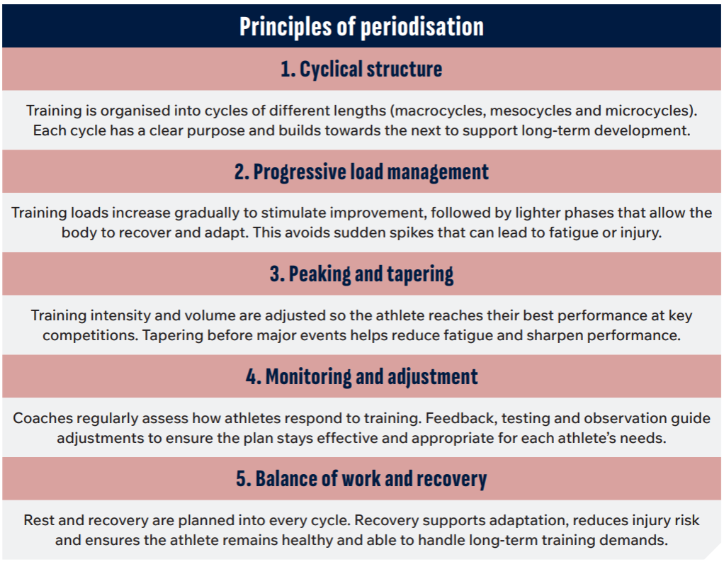
Applying the Principles of Periodisation
p.149

Slide 12
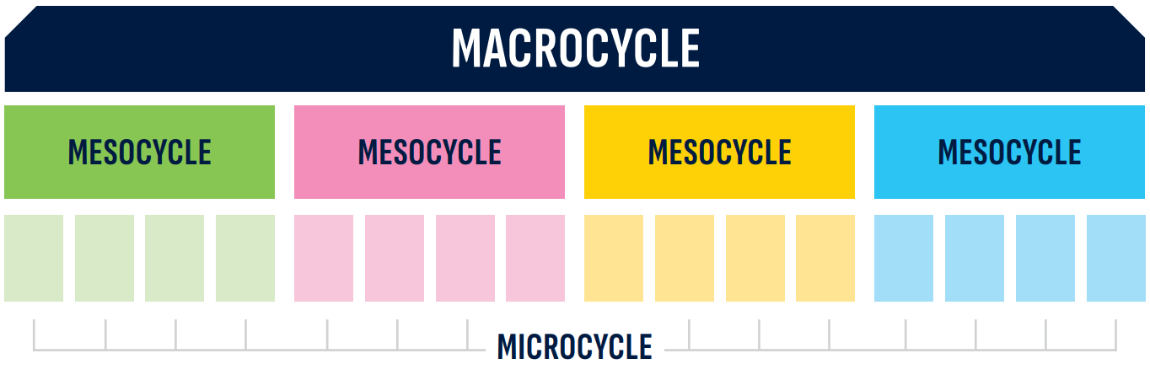
Cycles of Periodisation
p.149

Slide 13
Macrocycle
p.150
Macrocycle = the ‘Big Picture’
A macrocycle typically spans an entire season or year and focuses on preparing the athlete for major goals or competitions.
It usually includes different phases, such as a pre-season, competition season and transition (rest) period.

Slide 14
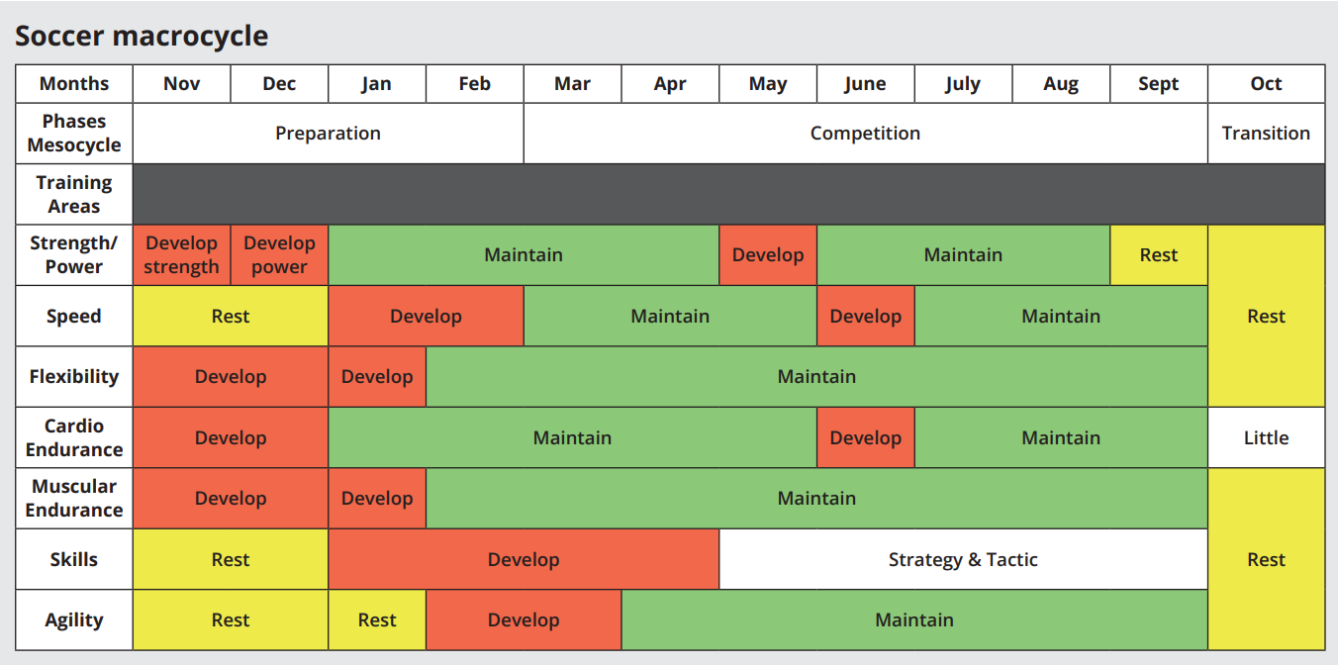
Macrocycle Example
p.150

Slide 15
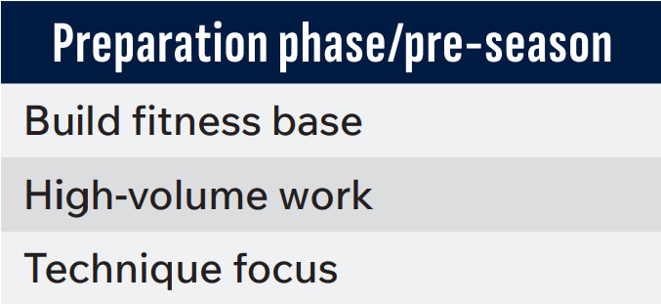
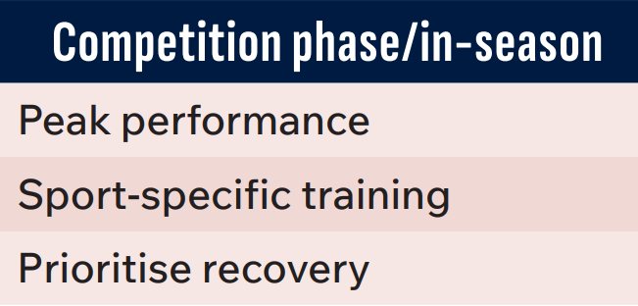
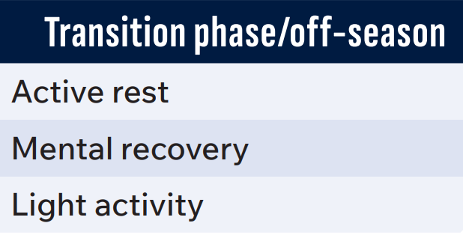
Mesocycle
p.150
Macrocycle = Medium term training block
Each mesocycle has a specific training goal.
Example: A football team might have a six-week mesocycle focused on strength and conditioning during pre-season.

Slide 16

Microcycle
p.150
Microcycle = Shortest training block
Microcycles include day-to-day training sessions and rest periods.
Example: A microcyle might include three intense training days, two lighter days, one skill-focused day and recovery to support the overall goals of the mesocycle.
https://www.youtube.com/watch?v=Kwq-R0NNvBc

Slide 17
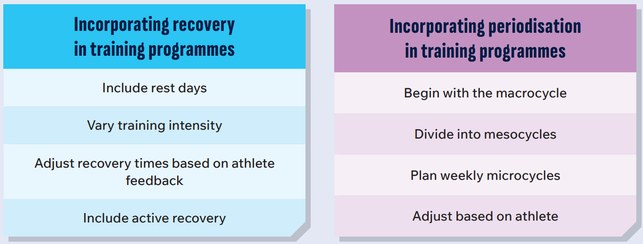
Incorporating Recovery and Periodisation into Programme Design
LO 2.3c
p.151

Slide 18
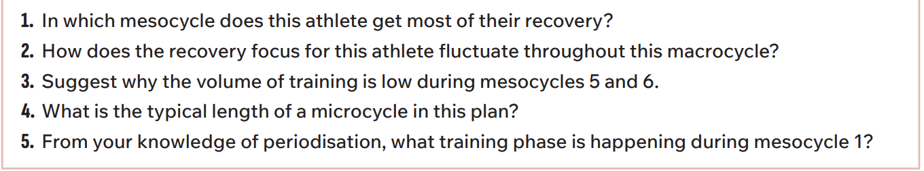
p.152
Examine the periodisation plan on page 152 of the textbook and answer the questions that follow:

Slide 19
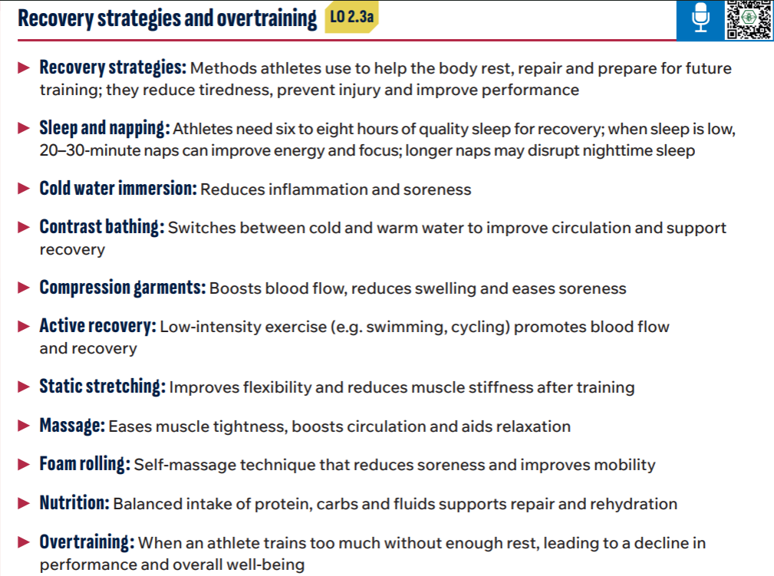
p.154

Slide 20
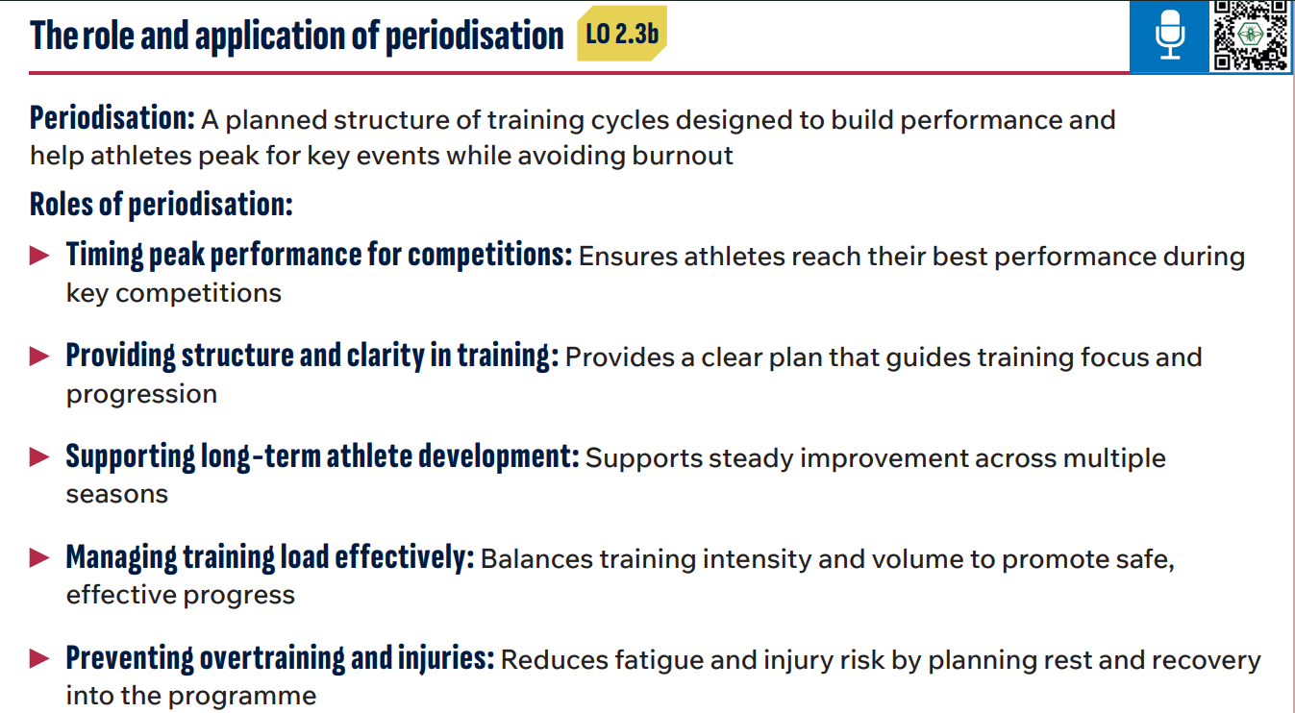
p.154

Slide 21
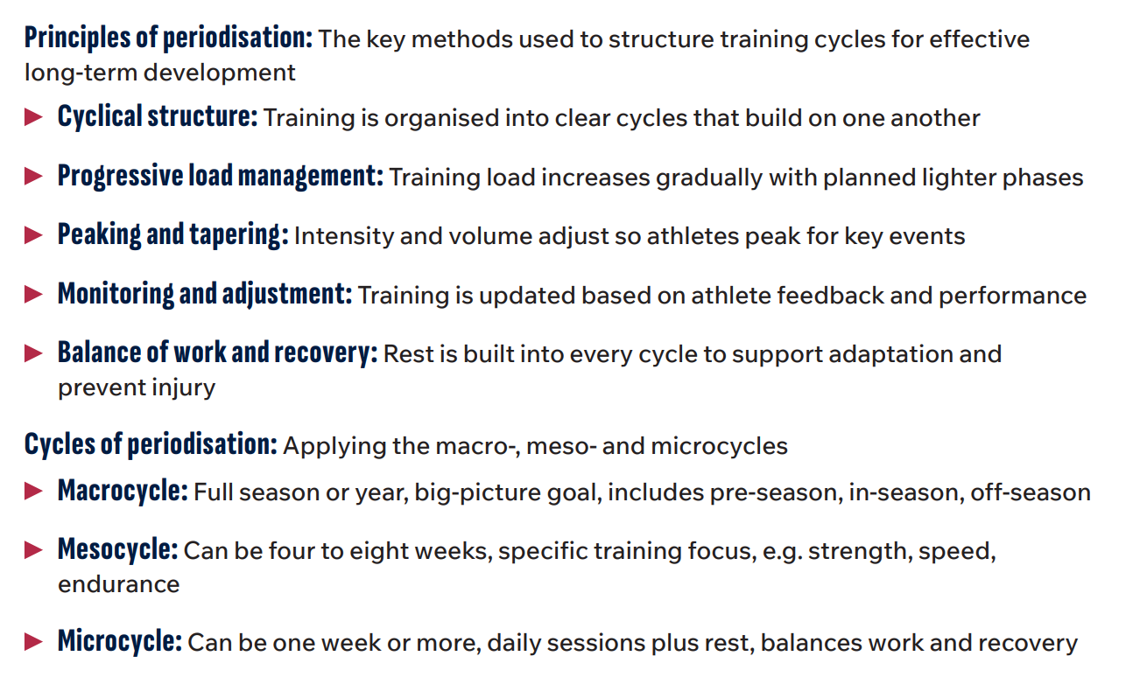
p.155

Slide 22
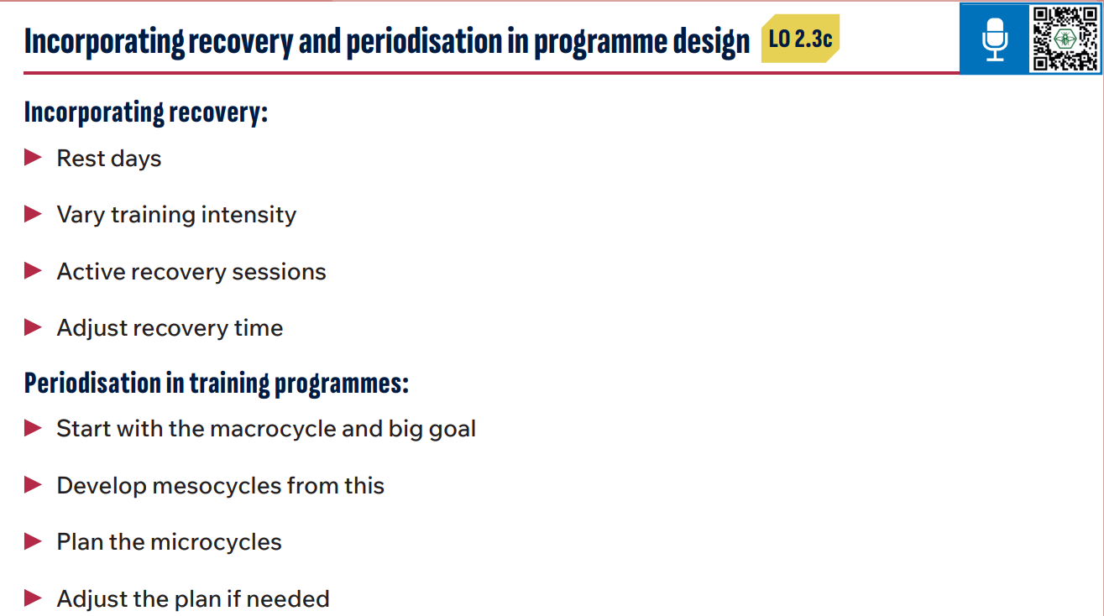
p.155

