Slide 1
My Life 3
Lesson 14
Improving your body image

Slide 2
Improving your body image
Wear clothes you feel comfortable in.
Don't wear clothes that feel too tight or restrict movement.
Don't wear something just because it is in fashion. Find something that suits your body shape.
Dress to express yourself, not to impress others. You should feel good in the clothes you wear.

Slide 3
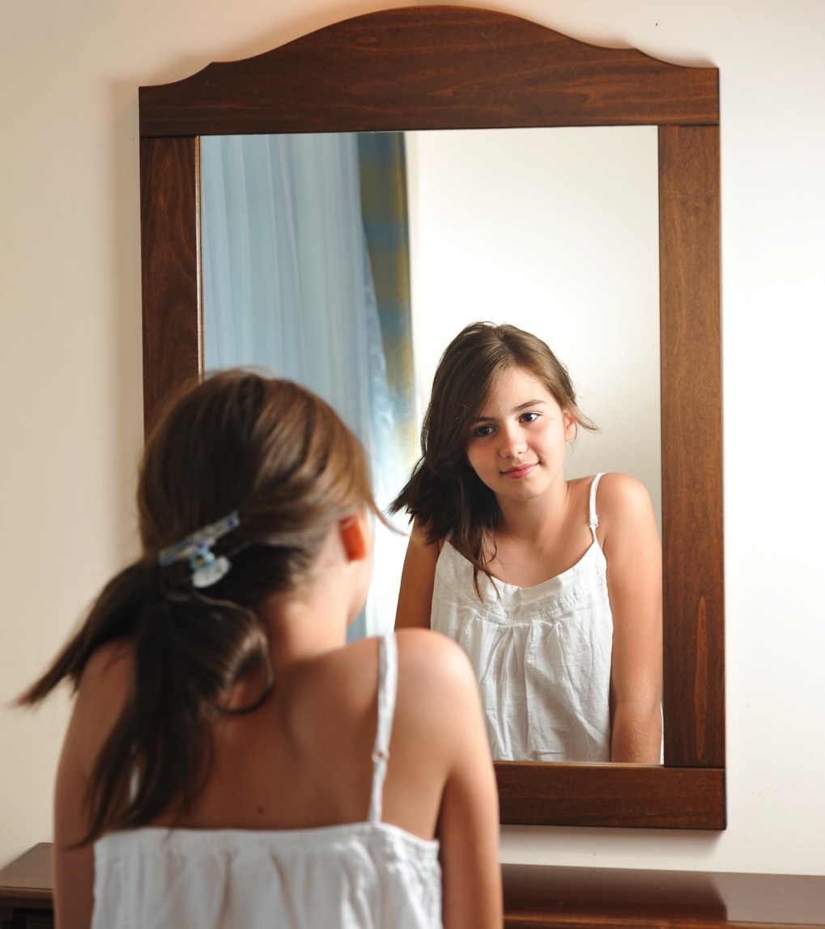
Improving your body image
Talk positively to yourself at the mirror.
Focus on what you like.
Remind yourself that it's okay to like what you see – you don’t always have to find fault.

Slide 4
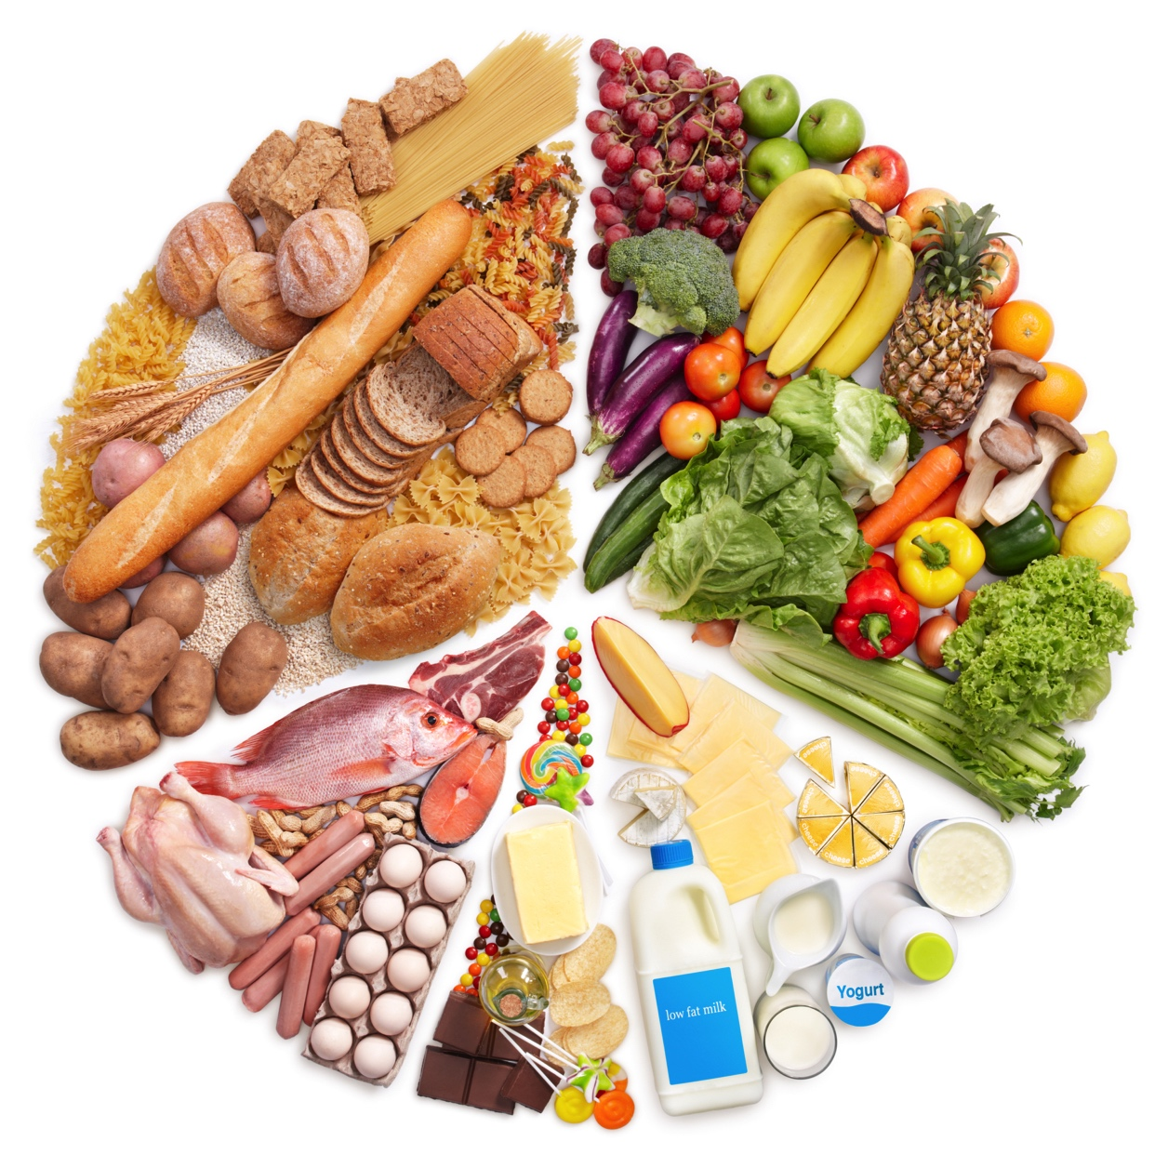
Improving your body image
Be healthy.
Being well rested, eating right and exercising make you look and feel better.

Slide 5
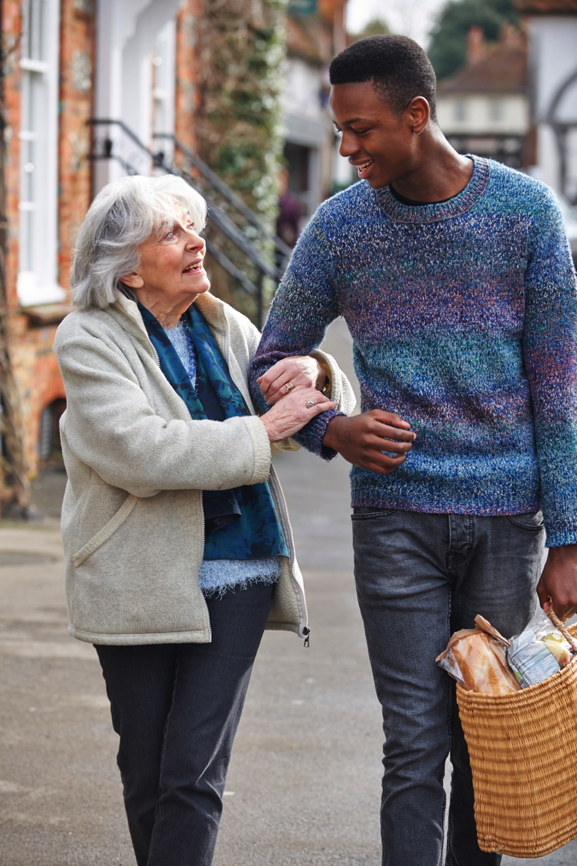
Improving your body image
Have a purpose.
People who have a purpose are too busy getting things done to obsess about how they look.
Being a good friend, helping out in your community, making your school a better place, working hard, studying well and being a great brother or sister will all make you a better person and make you feel more positive about yourself.

